Slide 1

Applied Microprocessor Lab VS Code Env Setting
전력전자연구실

Slide 2
Index
CubeSTM32 into VS Code
Make a Project with CubeMX
Build and Download into MCU

Slide 3
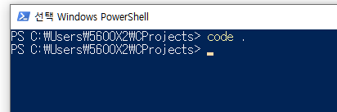
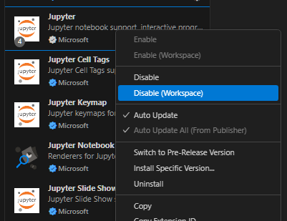
CubeSTM32 into VS Code
Launch VS Code
Do not use Onedrive / Gdrive / 한글 in Project Path to avoid permission issues.
Turn off extensions you will not use

Slide 4
CubeSTM32 into VS Code
Pros and Cons
Pros
Can use VS Code
Works on all OS (Windows / Mac / Linux)
Free to use / Opensource
Cons
No official technical support or warranty
Many companies prefer paid tools with professional support

Slide 5
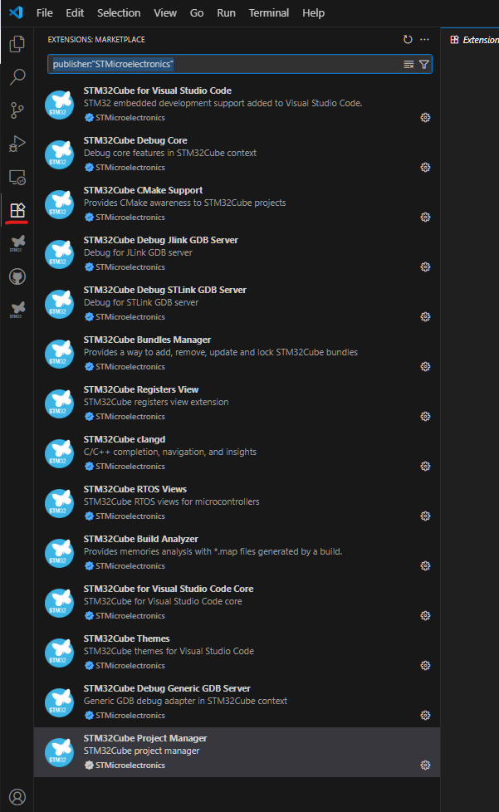
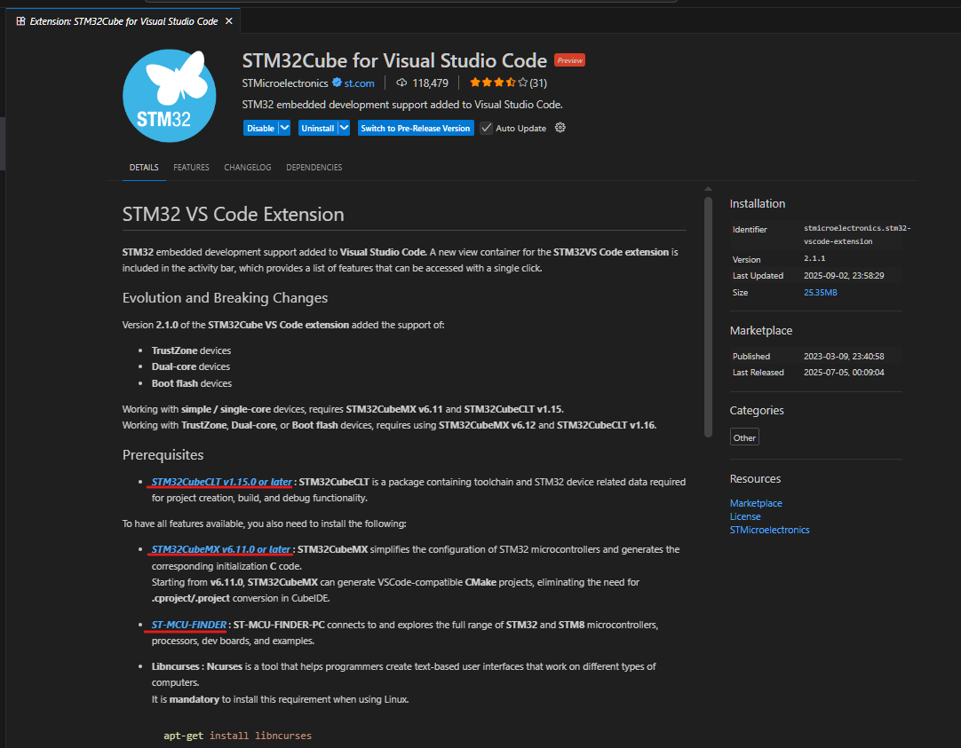
CubeSTM32 into VS Code
Install extensions
Search ‘stm’ in extension menu in VS Code
Install Prerequisites

Slide 6
CubeSTM32 into VS Code
Install extensions
STM32CubeCLT : ARM C Compler, Debugger, Library
STM32CubeMX : Help you make STM Projects
STMCUFinder : Find and Download into mcu board

Slide 7
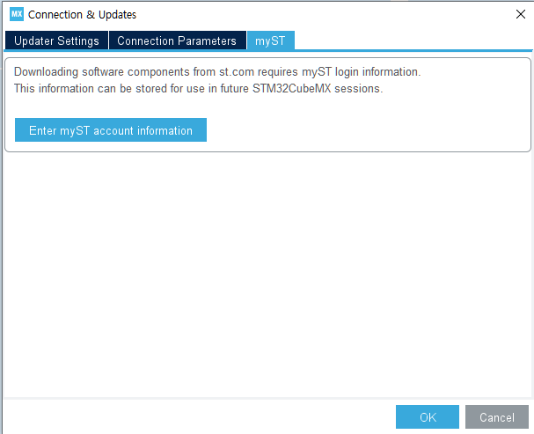
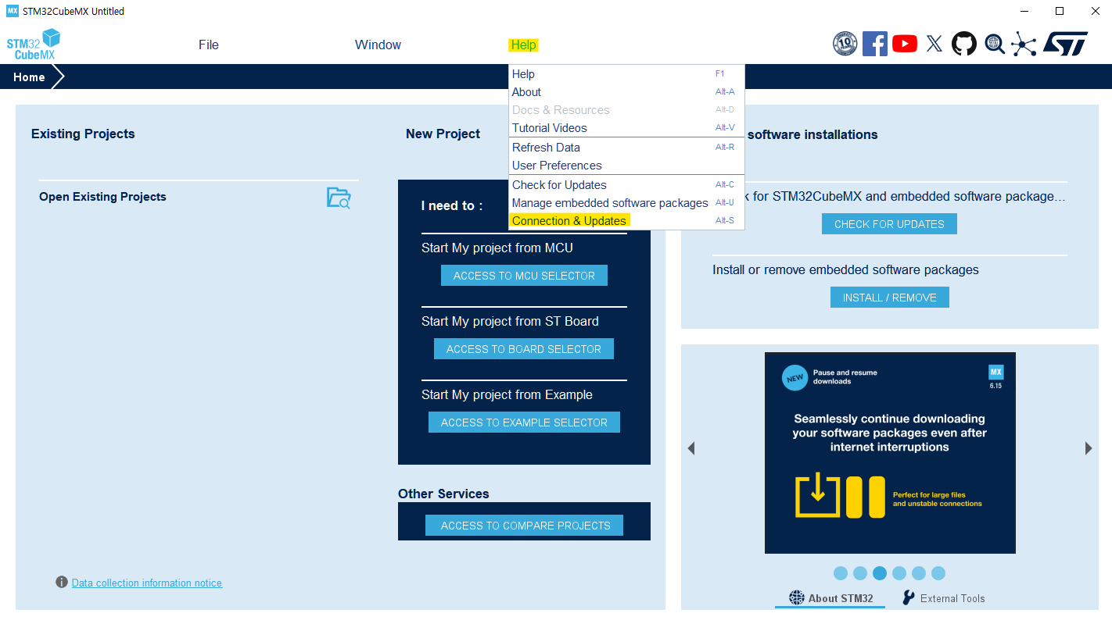

Make a Project with CubeMX
Make a new C Project with CubeMX
Login first myST

Slide 8
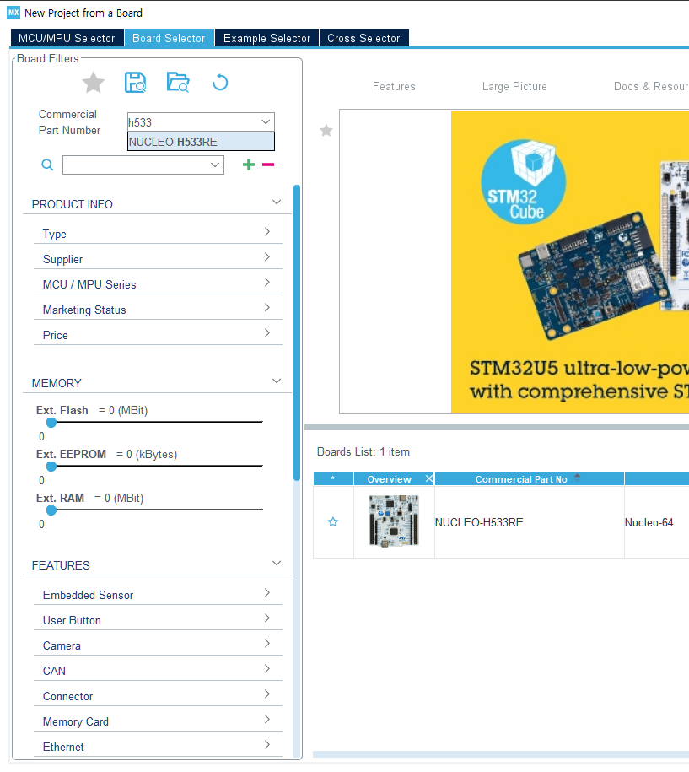
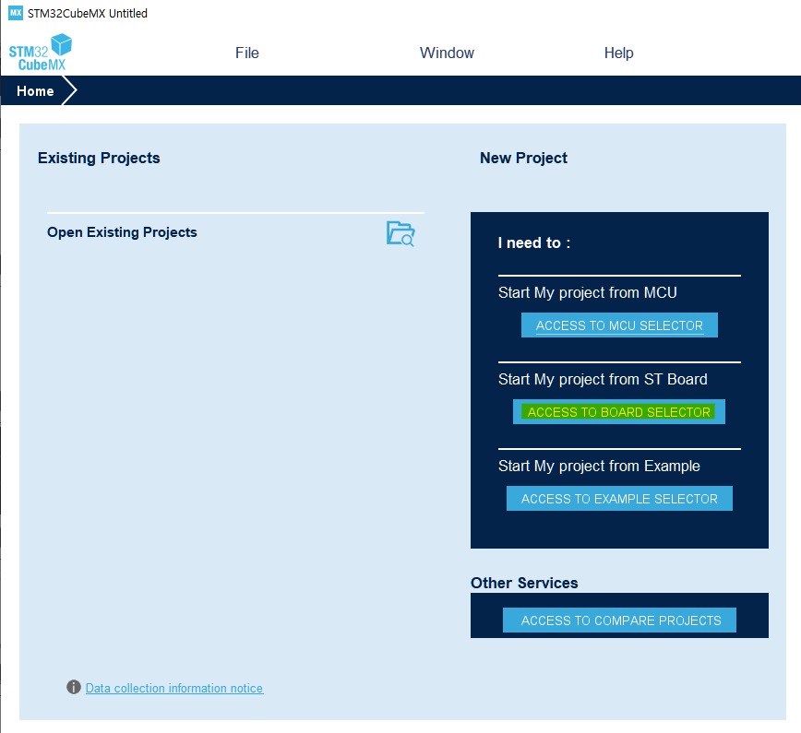
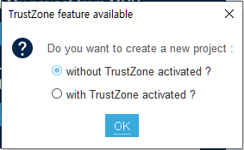
Make a Project with CubeMX
Make a new C Project with CubeMX
Select the right board (check model number of your board)
Double click here

Slide 9
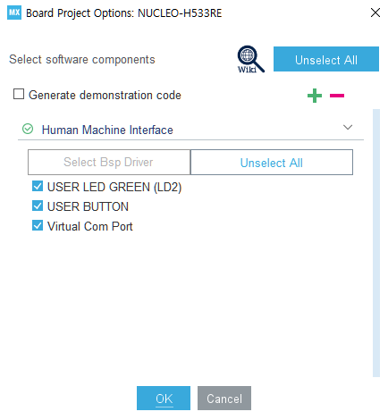
Make a Project with CubeMX
Make a new C Project with CubeMX
TrustZone is not covered in this class (need for product-level security) (It may not appear depending on the board)
Press OK if no error occurs
LED and Button, useful for build testing

Slide 10
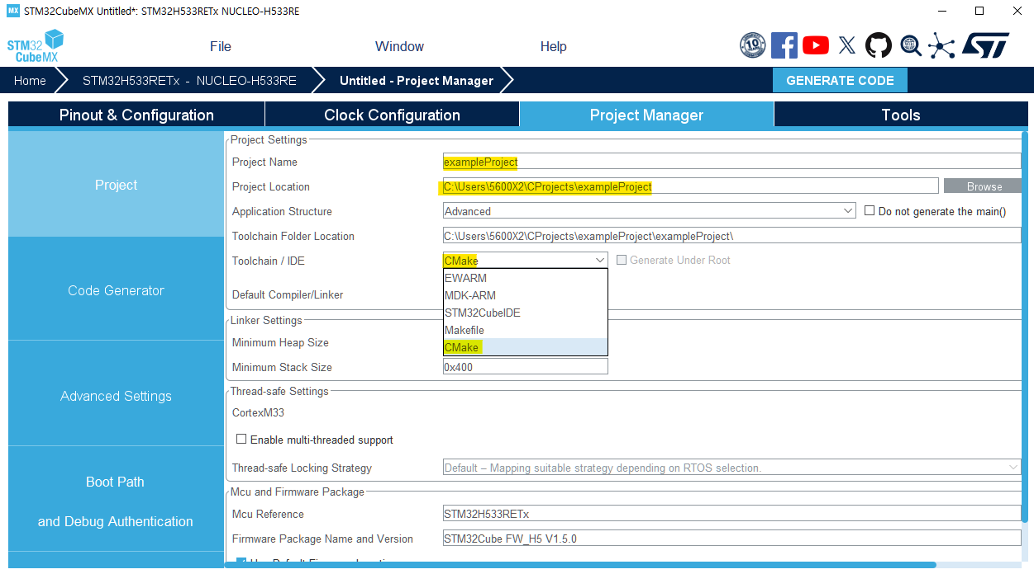
Make a Project with CubeMX
Make a new C Project with CubeMX
Use the exact path and select Cmake toolchain
Pinout and clock configuration will be covered later

Slide 11
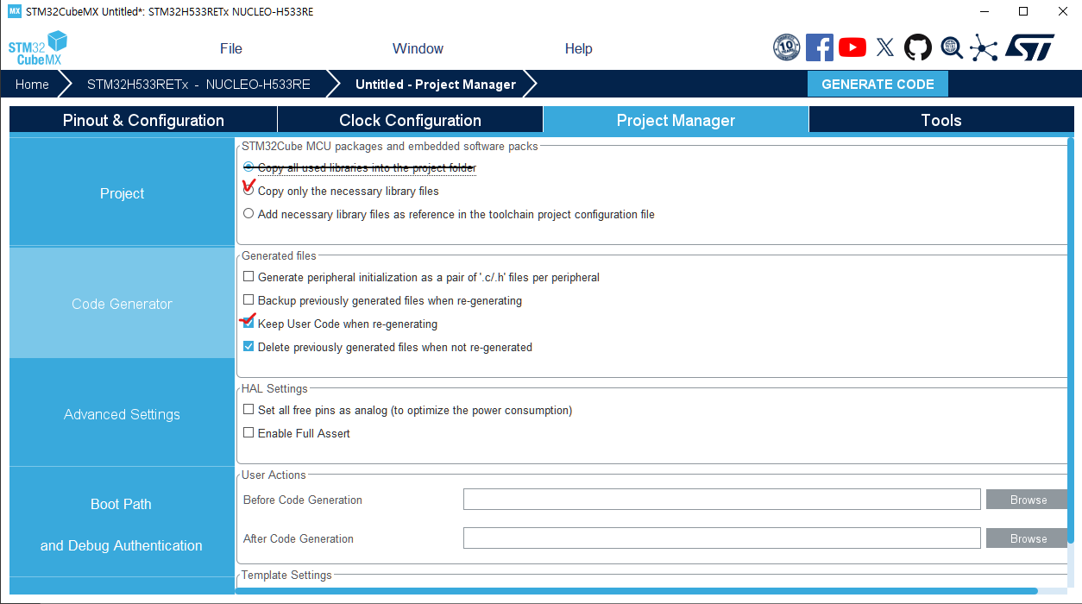
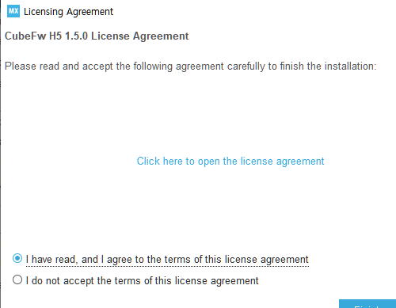
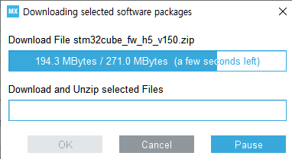
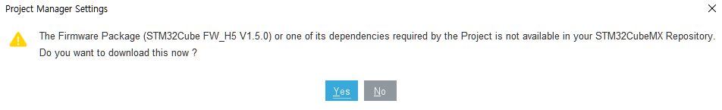

Make a Project with CubeMX
Make a new C Project with CubeMX
This option increases the size of project (but ok)
CubeMX generates useful C code automatically Enabling this option keep your codes (Enabled by default)
Click this button to generate code

Slide 12
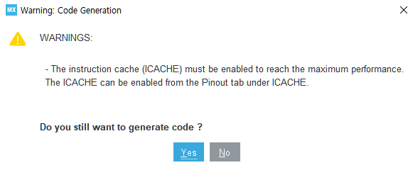
Make a Project with CubeMX
Make a new C Project with CubeMX
Press OK if no error occurs

Slide 13
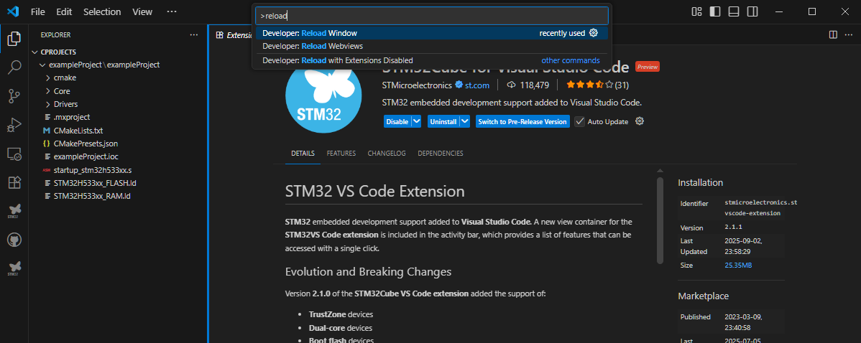
Make a Project with CubeMX
Return to VS Code
Always reload VS Code when something new is installed
Type >reload or press Ctrl + Shift + P and search for “reload

Slide 14
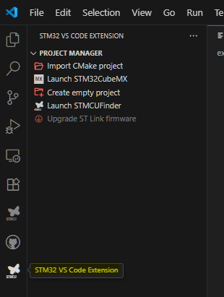
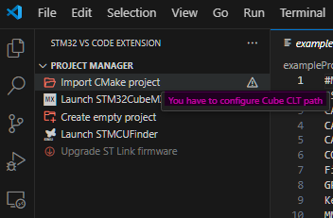
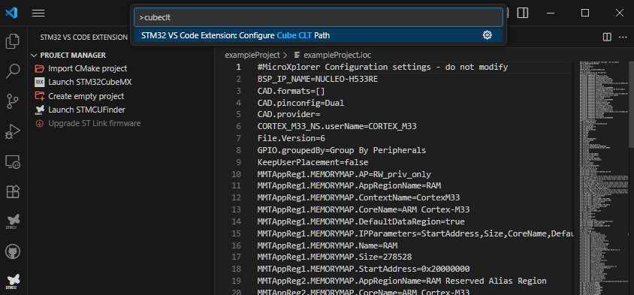
Make a Project with CubeMX
In VS Code
In menu “STM32 VS Code Extension” Extension, we have to import CMake project but sometimes it does not work at first
Similar to reload, search for >cubeclt and configure the path

Slide 15
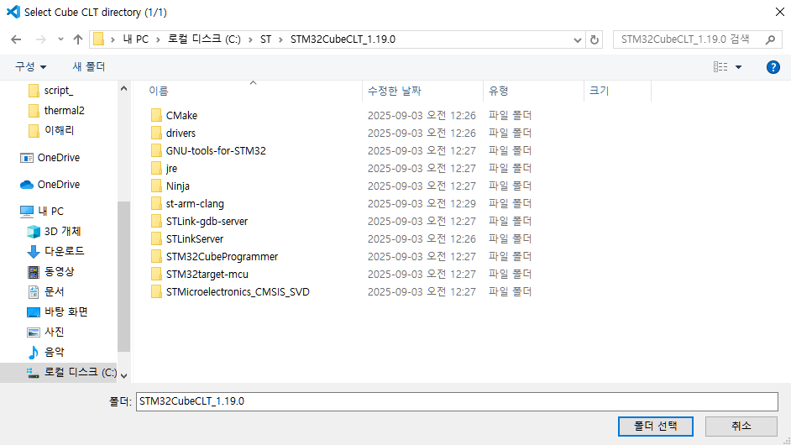
Make a Project with CubeMX
In VS Code
If you installed CubeCLT successfully, you can select C:/ST/STM32CubeCLT_X.XX.X (Linux/MacOS : auto-detected)

Slide 16
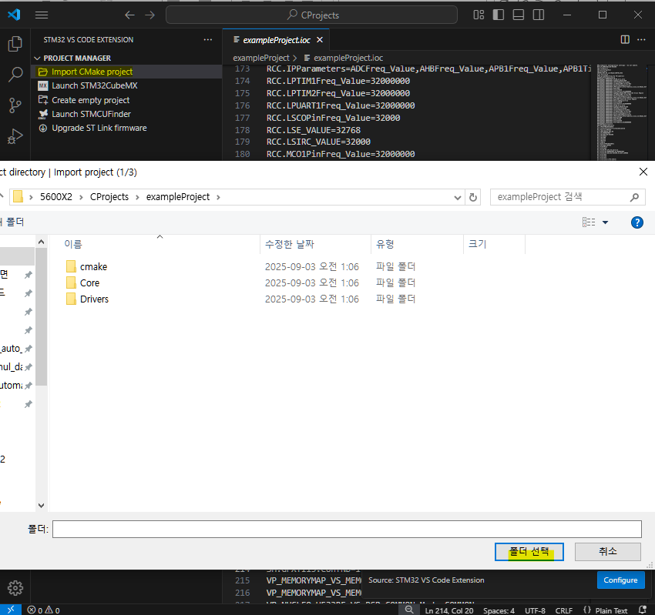
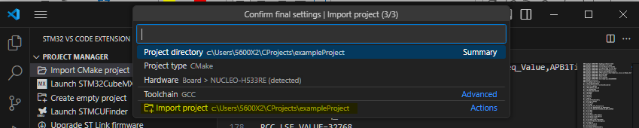
Make a Project with CubeMX
CubeCLT Configured
Now you can import your project and VS Code will complete the remaining setup that CubeMX did not

Slide 17
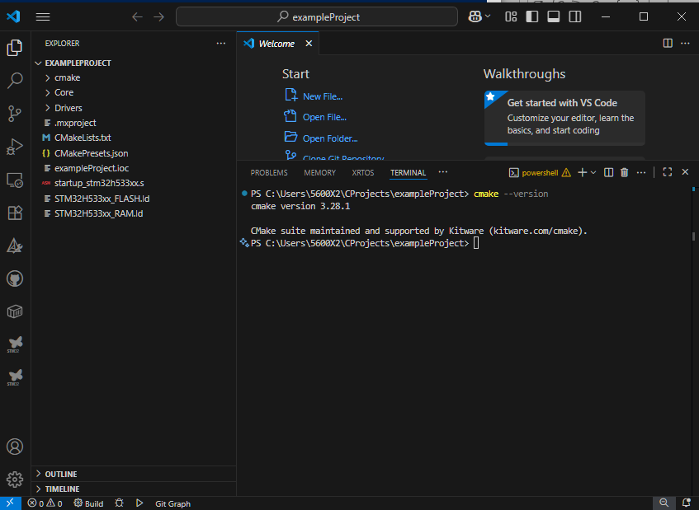
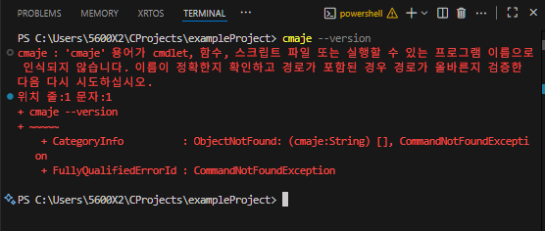
Make a Project with CubeMX
Import CMake Project
If “cmake --version” command not works, quit and re-open vscode

Slide 18
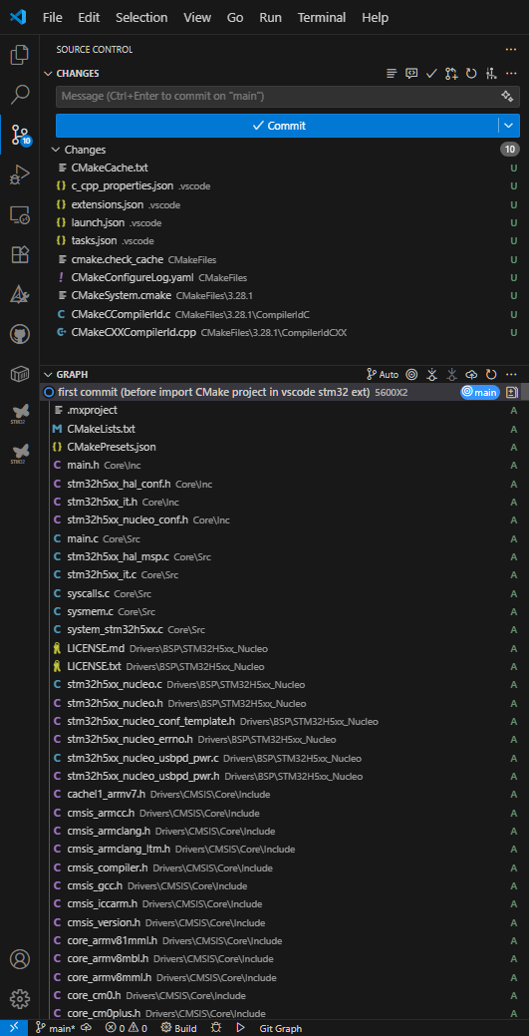
Build and Download into MCU
CMake Project Imported
This is made by VS Code Ext
- This is made by CubeMX

Slide 19
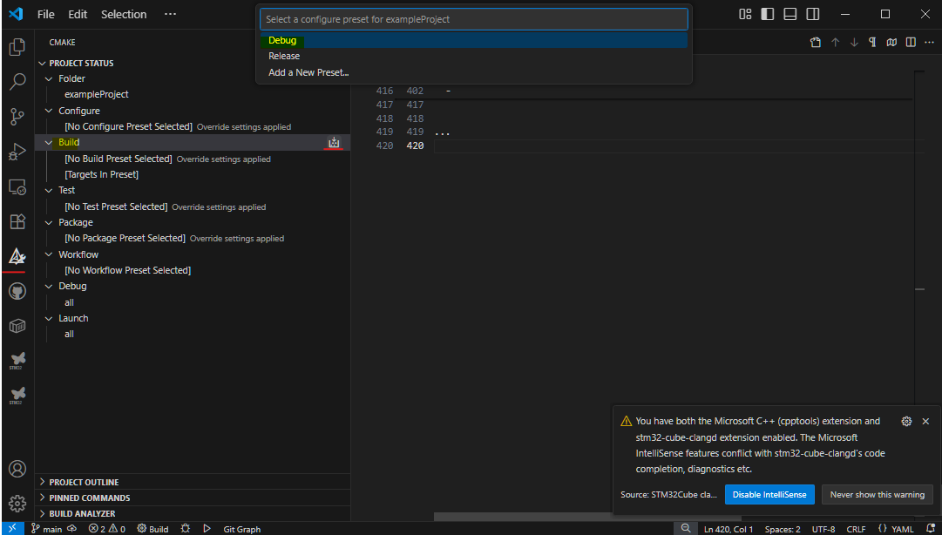
Build and Download into MCU
Build Test
Now you can compile whole .c source codes and get .elf binary

Slide 20
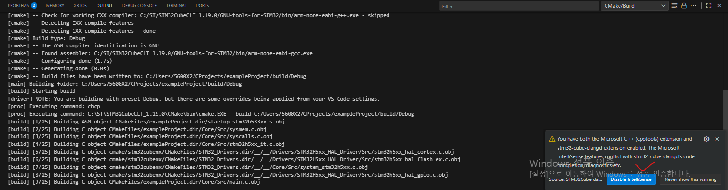
Build and Download into MCU
Build Test
(Compiling messages)
They want to disable something, let them do it

Slide 21
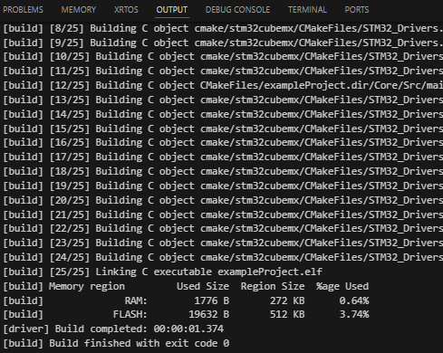
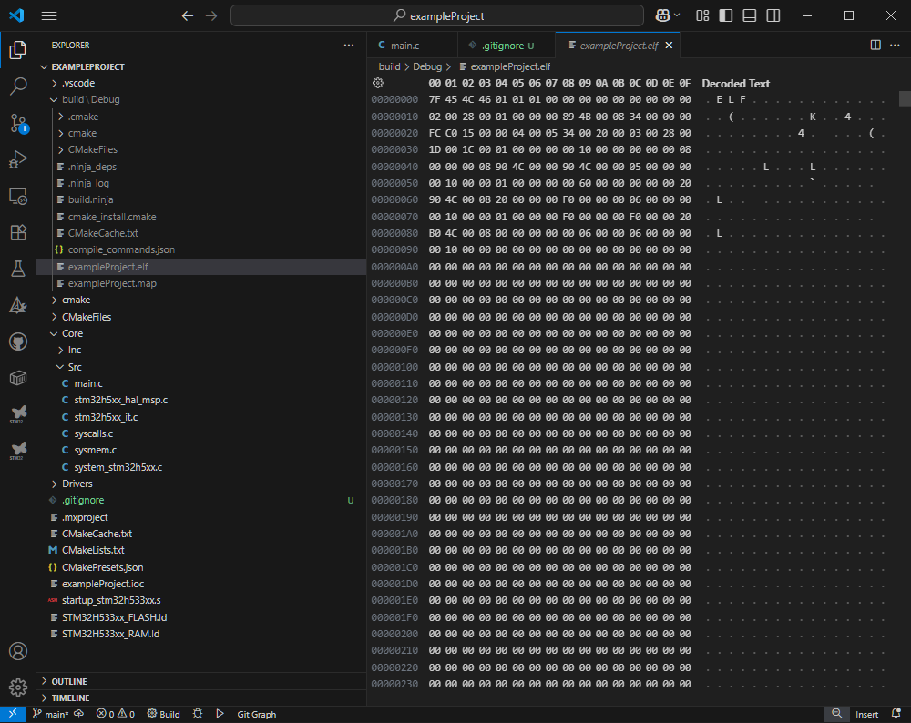
Build and Download into MCU
Build completed messages
[build] Build finished with exit code 0
- You can also check the compiled binary (.elf)

Slide 22
Build and Download into MCU
Download .elf binary into your board
(사진추가예정)

Slide 23
Finish
You can find my source code and installation video on his Github

