Slide 1
DATA STORY / 2021 RETAIL
RETAIL BUSINESS
EDA REPORT
Customer profile · Orders · Product catalogue · Sales performance
Exploratory data analysis from four connected retail tables
ANALYSIS WINDOW
01 JAN 2021 — 24 OCT 2021
Prepared from the supplied report.ipynb notebook

Slide 2
EXECUTIVE SUMMARY
A 4-table view of the retail operation
The notebook connects customer, order, product and sales records into one transaction-level view.
CUSTOMERS
ORDERS
PRODUCT VARIANTS
1,000
1,000
1,260
8 state / territory labels
Jan 1 – Oct 24, 2021
420 per product type
SALES LINES
UNITS SOLD
SALES-LINE VALUE
5,000
9,962
1.032M
Unique sales IDs
Across recorded line items
Currency not specified
01 Customer value
02 Strongest month
03 Product mix
The 18–30 age band contributes the highest recorded sales-line value: 195,768 (19.0% of sales-line total).
March has the highest order count (118) and the highest sales-line value (131,364).
Jackets lead category sales-line value at 357,026 (34.6%); the three product types are closely balanced.
Interpretation note: “payment” in orders and “total_price” in sales are separate measures and do not reconcile in this notebook.
SOURCE report.ipynb · Retail dataset · Jan–Oct 2021
02

Slide 3
DATA LANDSCAPE
Four tables, one retail story
The relationship path follows customer → order → sales line, with each sales line pointing to a product variant.
CUSTOMERS
ORDERS
SALES
PRODUCTS
1,000 rows · 9 columns
1,000 rows · 5 columns
5,000 rows · 6 columns
1,260 rows · 8 columns
PK customer_id
PK order_id · FK customer_id
PK sales_id · FK order_id / product_id
PK product_ID → product_id
product_id
Analysis grain
Join keys
One row in sales represents one product line within an order. A single order can therefore appear in multiple sales rows.
customers.customer_id = orders.customer_id
orders.order_id = sales.order_id
sales.product_id = products.product_ID (standardised to product_id)
Notebook date coverage: 2021-01-01 to 2021-10-24 · Customer country values: Australia only
SOURCE report.ipynb · Retail dataset · Jan–Oct 2021
03

Slide 4
DATA QUALITY
The files are structurally clean — but not fully reconciled
Primary keys and row-level completeness look strong; several cross-table exceptions need business validation.
NULL CELLS
EXACT DUPLICATE ROWS
CROSS-TABLE EXCEPTIONS TO INVESTIGATE
0
0
383
customers have no matching order in the orders table
Across all four tables
Across all four tables
PRIMARY KEYS
NEGATIVE NUMERIC VALUES
7
orders have no matching sales lines
4 / 4
0
27
catalogue product IDs do not appear in sales
Unique in each source table
No negative values found
5,000 / 5,000
sales line prices differ from the matched catalogue price
Join coverage
32.9×
orders.payment total is 33.97M vs sales.total_price of 1.032M
All order customer IDs and sales order / product IDs resolve to the corresponding dimension records; exceptions are missing activity, not orphaned sales keys.
Do not silently reconcile
The notebook does not identify the currency or explain the payment-to-sales difference. Keep the two measures separate until their definitions are confirmed.
SOURCE report.ipynb · Retail dataset · Jan–Oct 2021
04

Slide 5
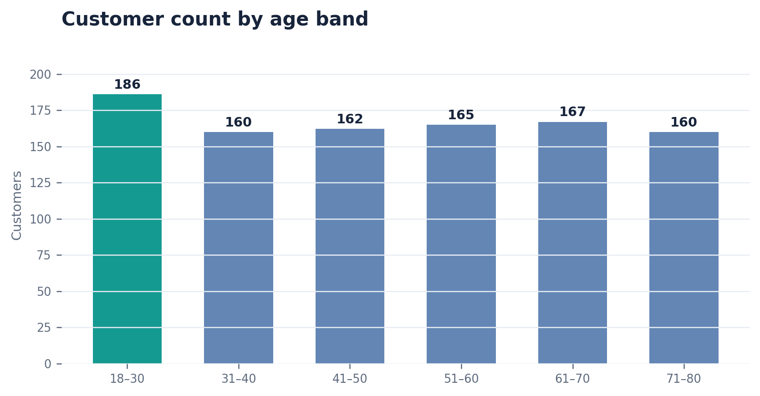
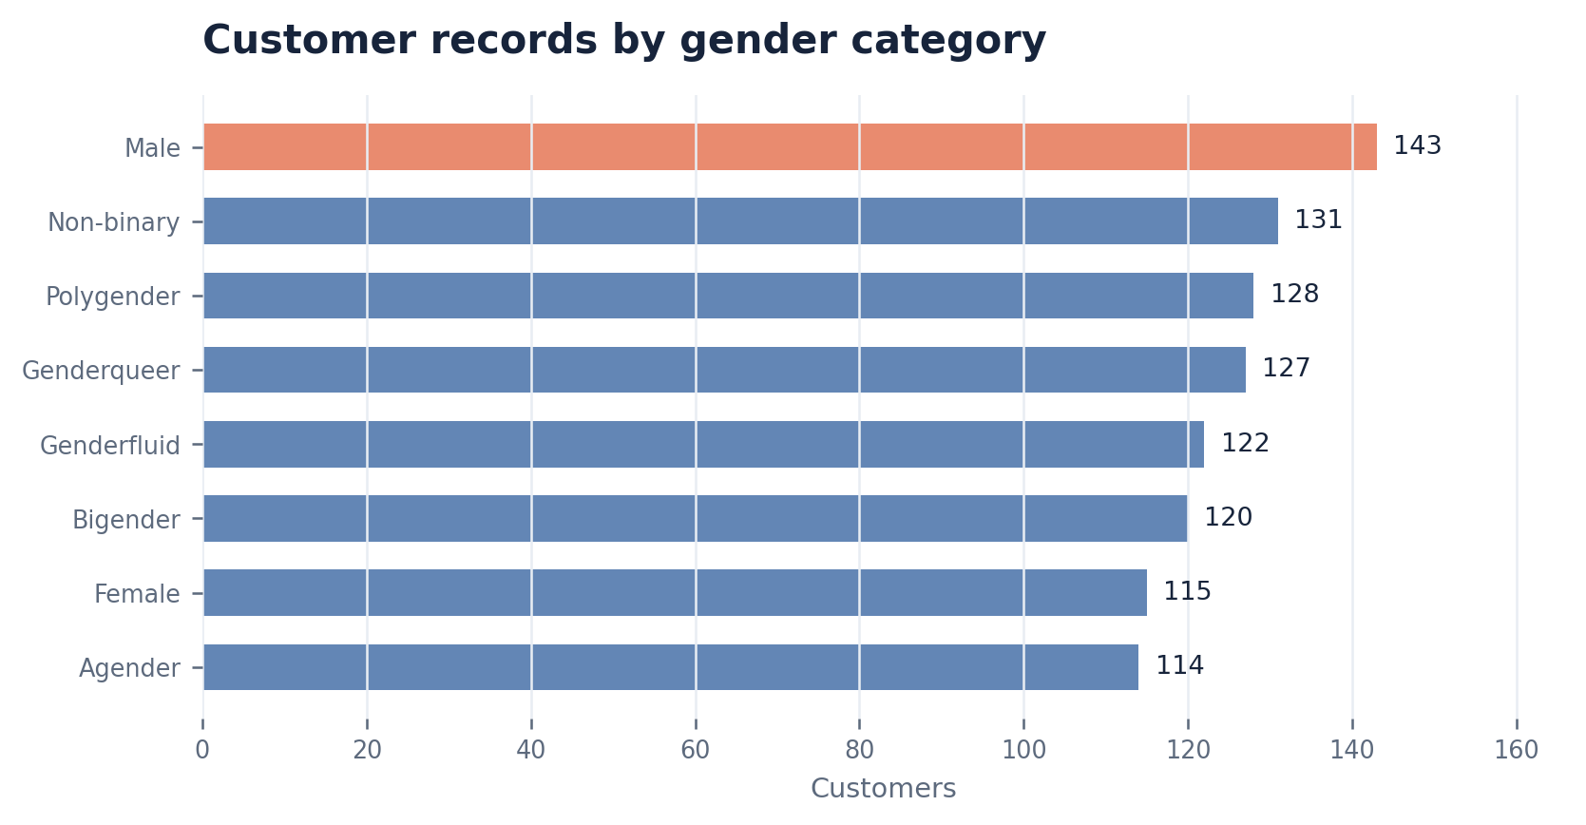
CUSTOMER PROFILE
A broad age mix and a diverse set of gender categories
Customer ages span 20–80; no single gender category dominates the 1,000-record customer file.
MEAN AGE
LARGEST BAND
Gender counts range from 114 (Agender) to 143 (Male); categories are relatively close in size.
49.9
18–30
Median age 50
186 customers
SOURCE report.ipynb · Retail dataset · Jan–Oct 2021
05

Slide 6
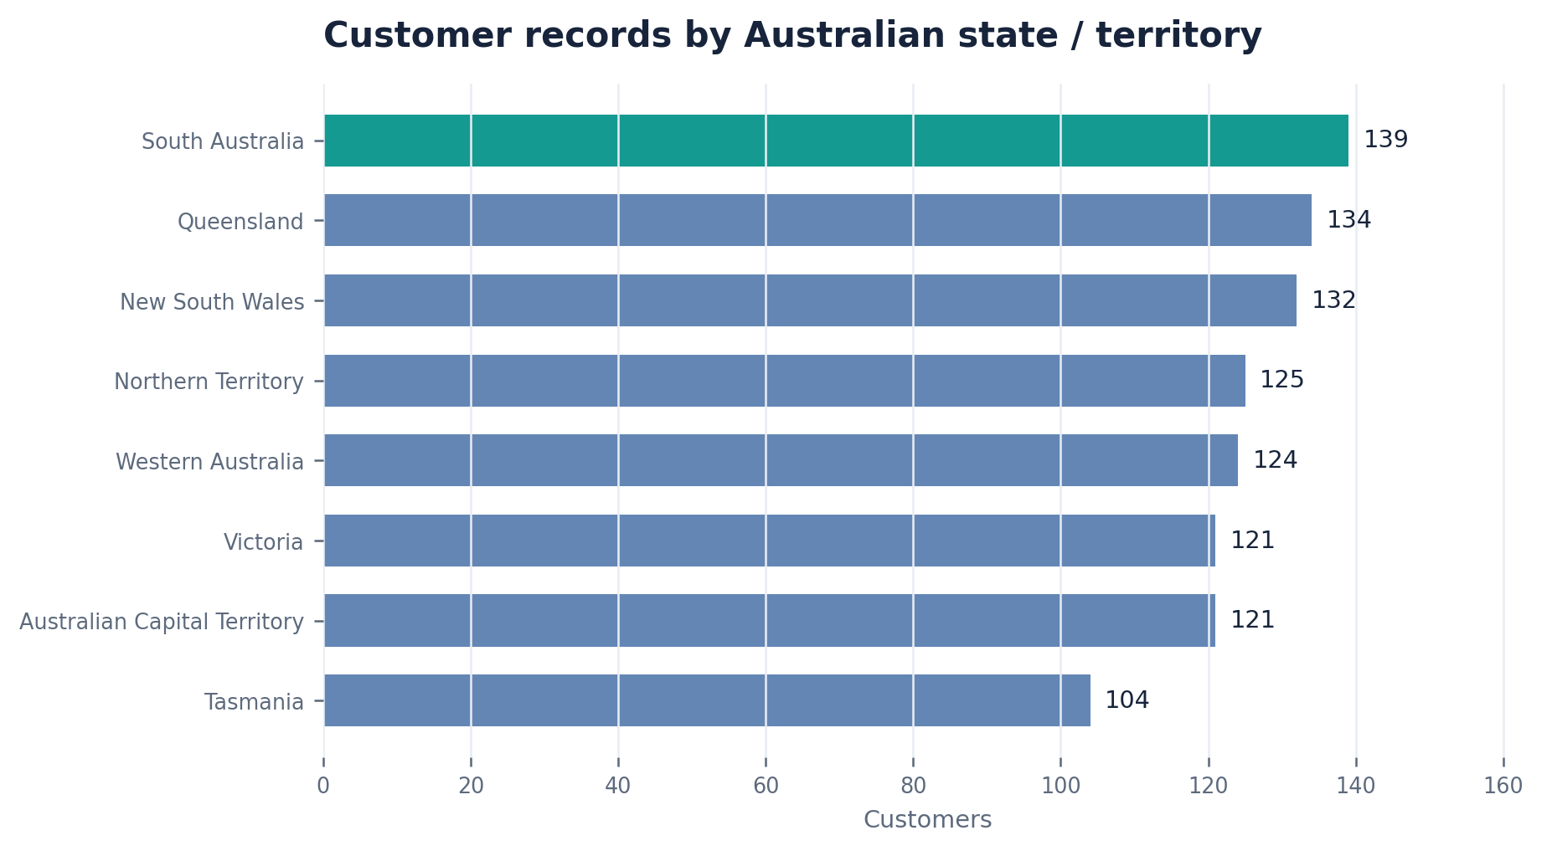
CUSTOMER GEOGRAPHY
Customers are distributed across eight Australian states and territories
South Australia has the largest customer count; Tasmania has the smallest.
TOP STATE
139
South Australia
LOWEST STATE
104
Tasmania
UNIQUE CITIES
961
Across 1,000 customers
All 1,000 customer records are labelled Australia.
SOURCE report.ipynb · Retail dataset · Jan–Oct 2021
06

Slide 7
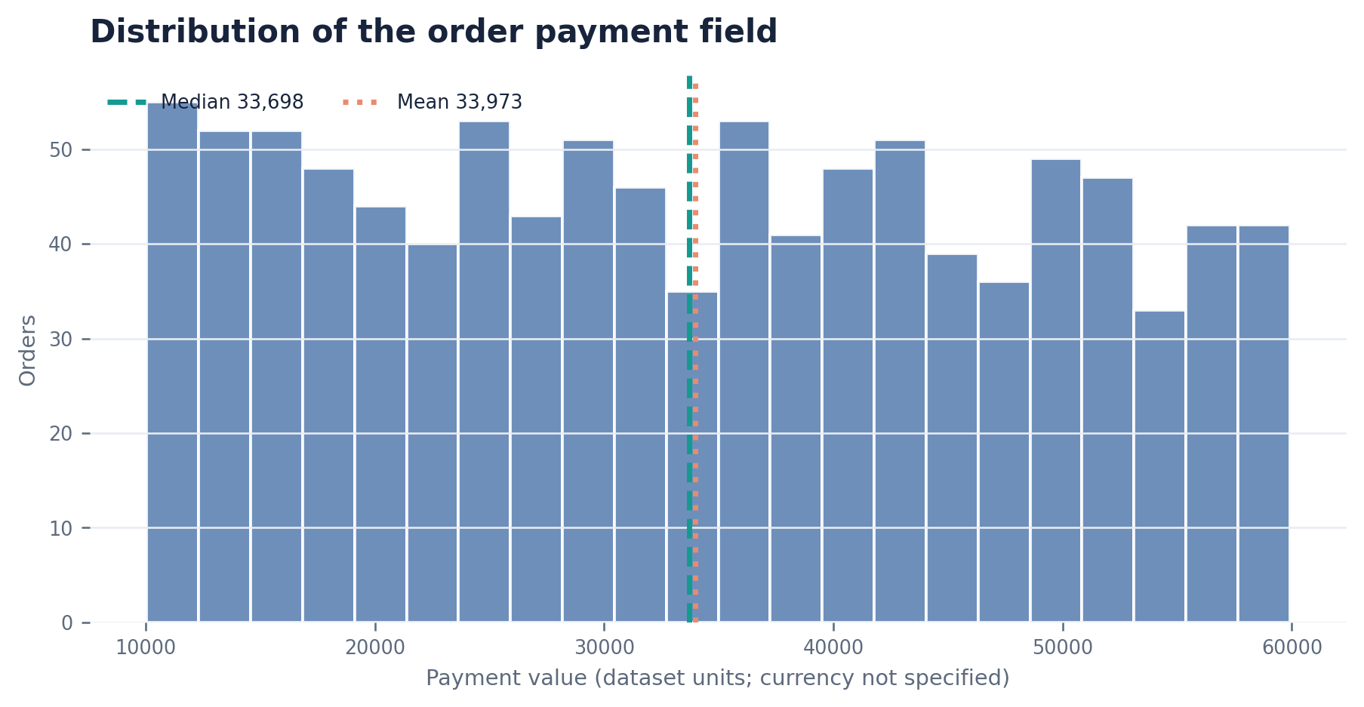
ORDER ECONOMICS
Order payment values are widely spread across the dataset
The payment field contains 1,000 order-level values; its currency and relationship to sales-line values are not defined.
MEAN PAYMENT
33,973
Dataset units
MEDIAN PAYMENT
33,698
Dataset units
TOTAL PAYMENT
33.97M
Orders table
Reconciliation alert
Orders payment total is 32.9× the sales-line total. Do not label either value as revenue until reconciled.
SOURCE report.ipynb · Retail dataset · Jan–Oct 2021
07

Slide 8
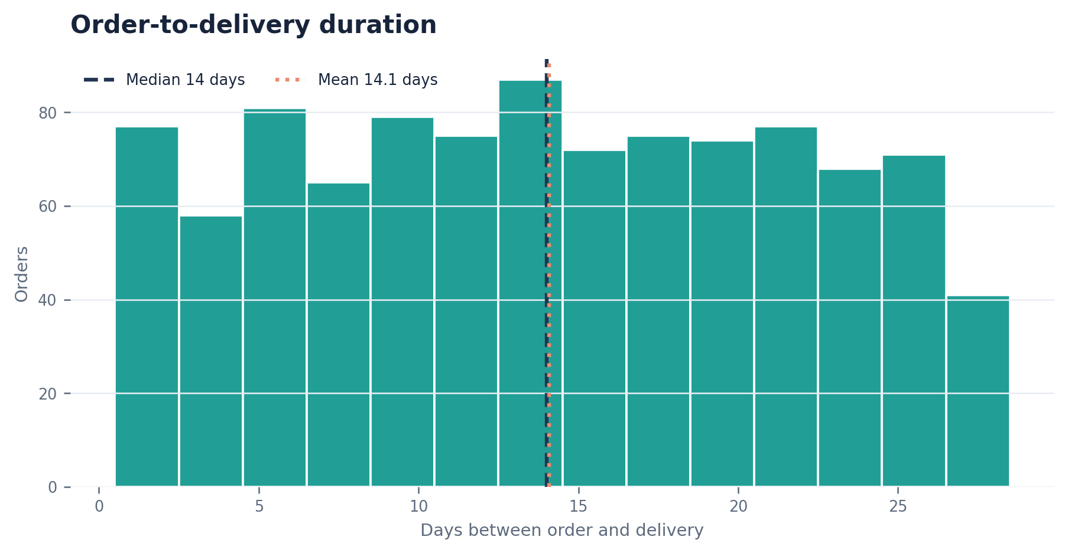
DELIVERY PERFORMANCE
A typical order took about two weeks to arrive
Delivery duration is derived as delivery_date minus order_date for each order.
AVERAGE
14.08 days
Mean delivery duration
MEDIAN
14 days
Midpoint order
MIDDLE 50%
8–21 days
25th to 75th percentile
Observed range: 1–27 days. Investigate the long end of the distribution before setting a service-level target.
SOURCE report.ipynb · Retail dataset · Jan–Oct 2021
08

Slide 9
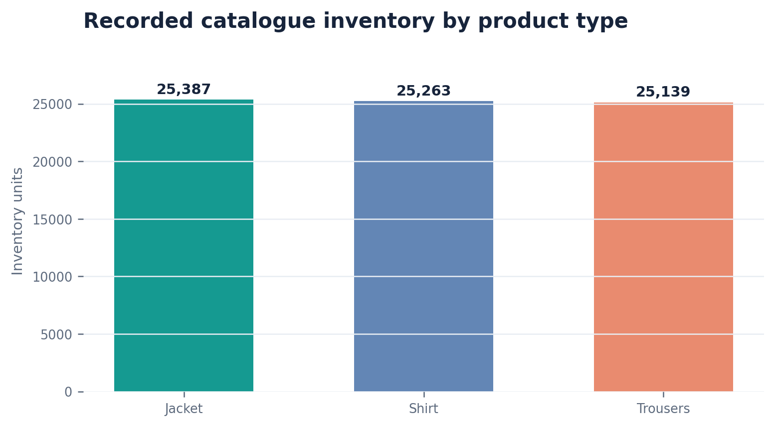
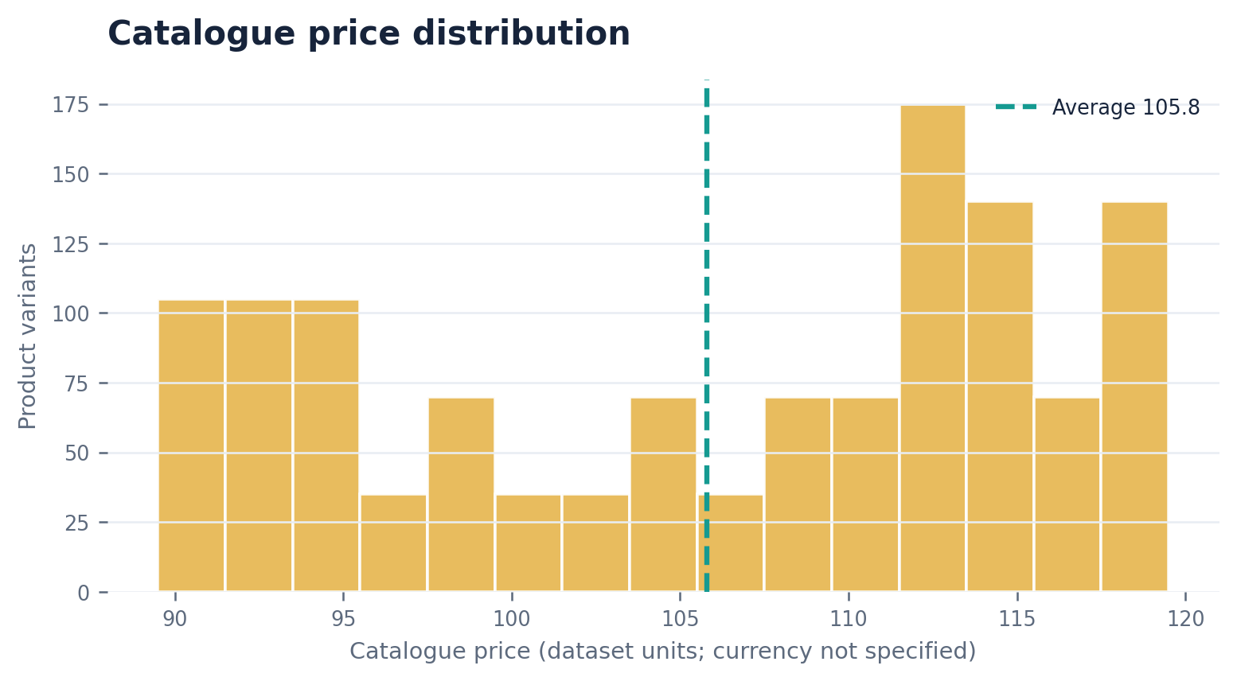
PRODUCT CATALOGUE
The catalogue is balanced across types, with a compact price range
The 1,260 product rows represent product variants; category counts and inventory are almost evenly split.
TOTAL INVENTORY
VARIANTS / TYPE
AVG. CATALOGUE PRICE
PRICE RANGE
75,789
420
105.8
90–119
Recorded catalogue units
Jackets, shirts, trousers
Dataset units
Dataset units
SOURCE report.ipynb · Retail dataset · Jan–Oct 2021
09

Slide 10
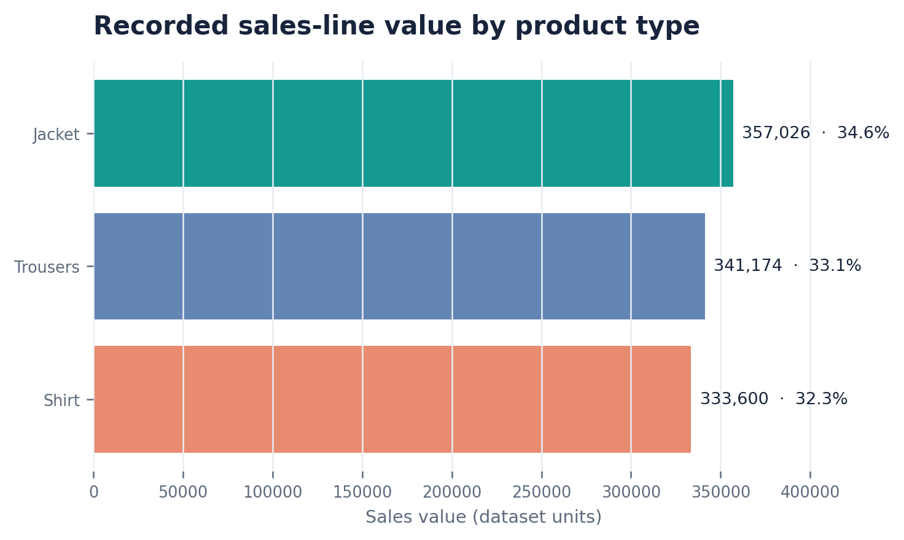
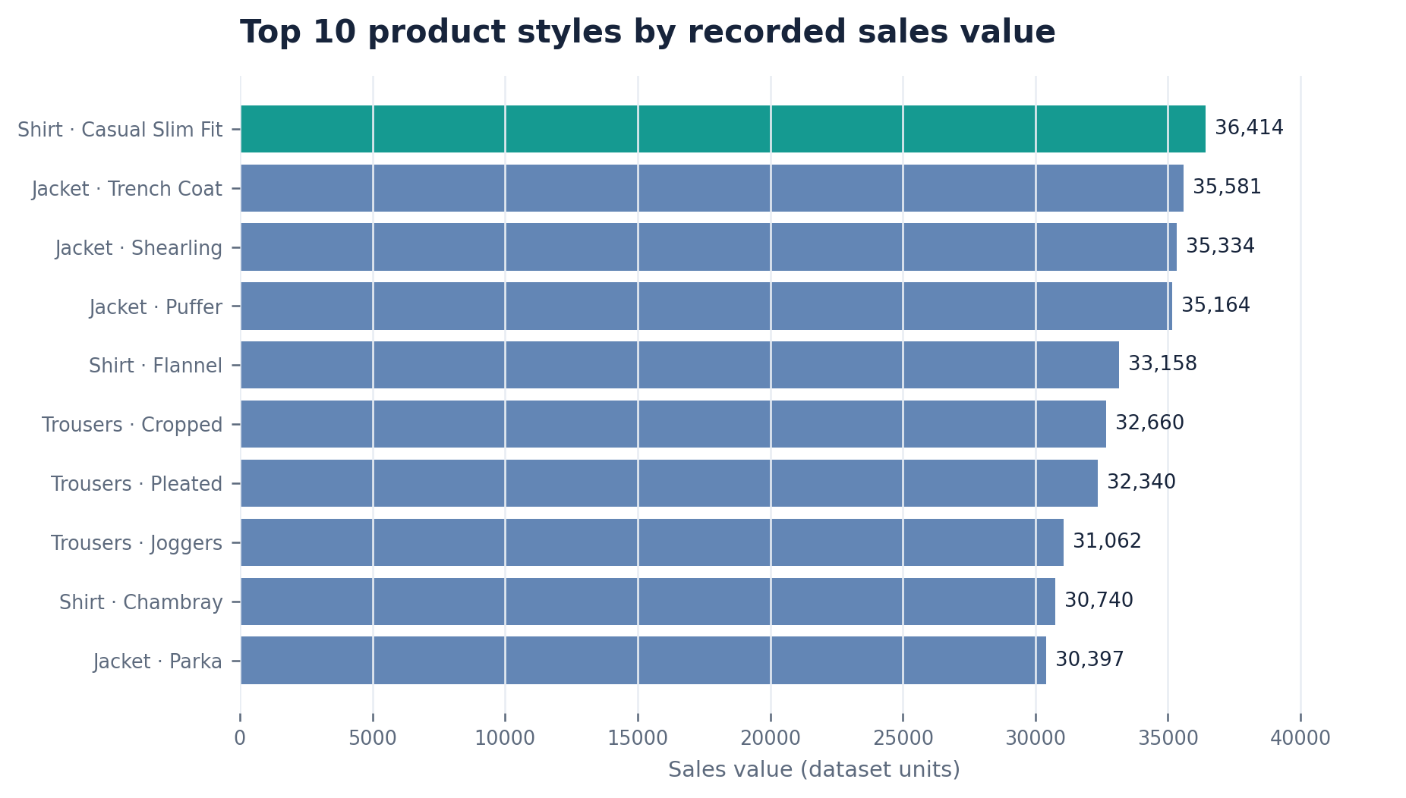
SALES PERFORMANCE
Jackets lead recorded sales-line value; top styles are closely grouped
The sales table contains 5,000 transaction lines, 9,962 units and 1,031,800 in summed line value.
Top style: Shirt · Casual Slim Fit — 36,414 value across 306 units.
Category split: Jackets 34.6% · Trousers 33.1% · Shirts 32.3%.
SOURCE report.ipynb · Retail dataset · Jan–Oct 2021
10

Slide 11
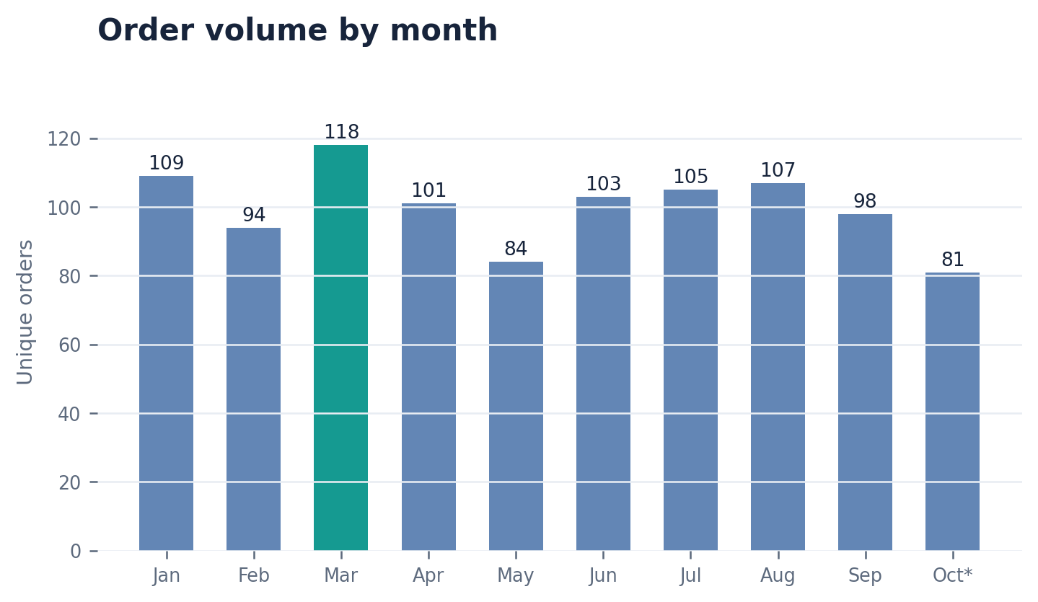
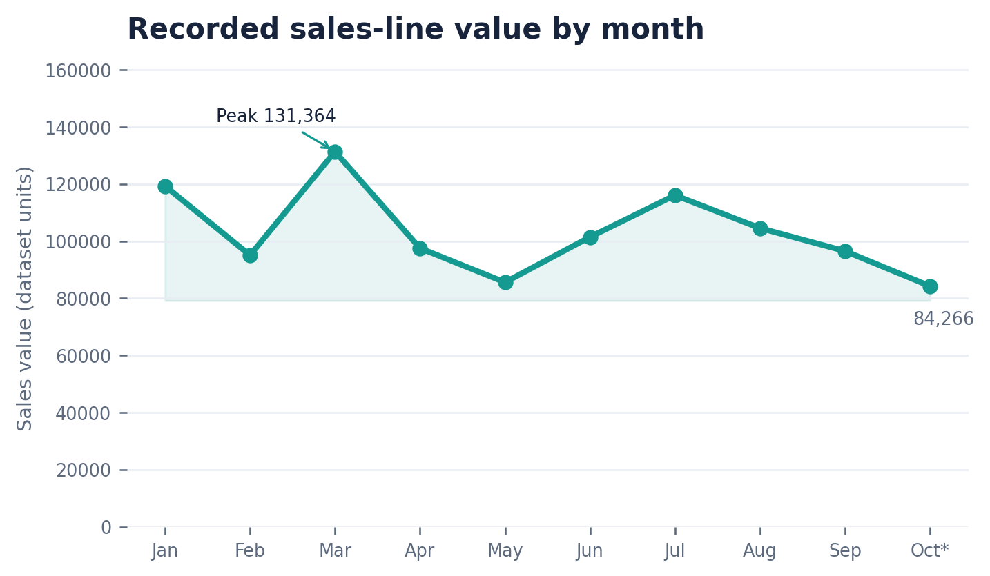
MONTHLY TRENDS
March leads in monthly orders and sales-line value
Order counts are grouped from the orders table; sales value is summed from sales lines joined to order month.
Order peak
March: 118 orders. May: 84 orders (lowest complete month).
Sales-line peak
March: 131,364. October is partial (through Oct 24).
SOURCE report.ipynb · Retail dataset · Jan–Oct 2021
11

Slide 12
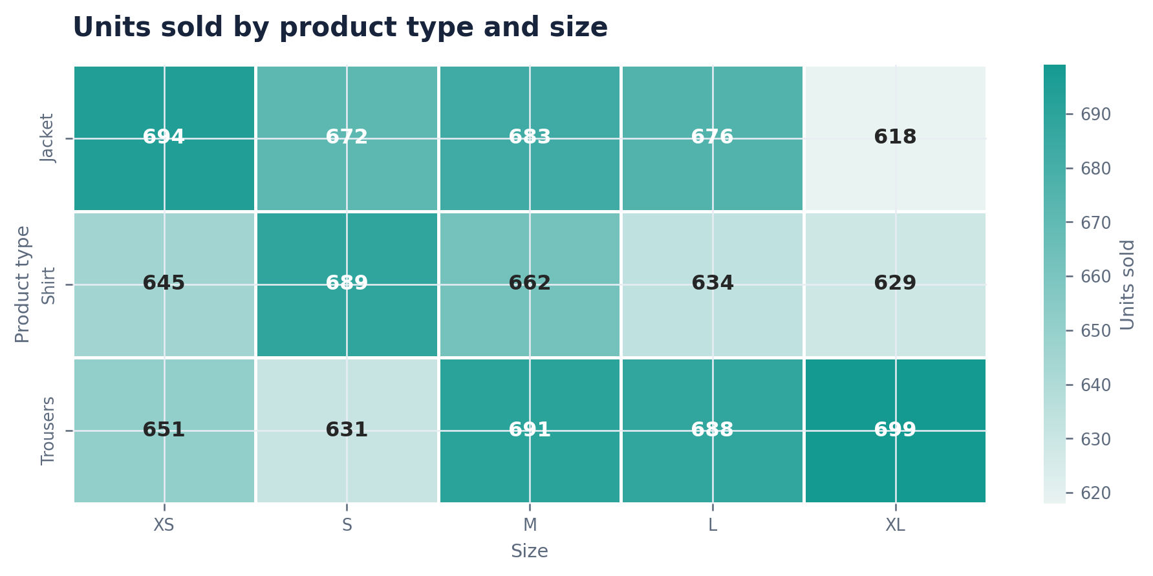
PRODUCT DEMAND
Size demand is broadly balanced across product types
The heatmap uses units sold at the product-type × size level; differences are modest rather than strongly concentrated.
TOP SIZE
M · 2,036
Units sold across types
LOWEST SIZE
XL · 1,946
Units sold across types
TOP COLOUR
Blue · 1,528
Orange lowest at 1,359
Size range from highest to lowest = 90 units (about 4.5% of the top size).
SOURCE report.ipynb · Retail dataset · Jan–Oct 2021
12

Slide 13
CUSTOMER VALUE
Younger customers and South Australia lead recorded sales value
These figures use sales-line totals after joining each transaction to its customer; they are not order.payment totals.
SALES BY CUSTOMER AGE BAND
TOP STATES BY SALES-LINE VALUE
AGE BAND
BUYERS
ORDERS
SALES VALUE
SHARE
South Australia
147,816
18–30
116
186
195,768
19.0%
Queensland
142,062
31–40
98
175
183,601
17.8%
41–50
102
157
158,940
15.4%
New South Wales
131,744
51–60
108
177
181,943
17.6%
Australian Capital Territory
130,442
61–70
101
153
159,407
15.4%
Western Australia
125,430
71–80
91
145
152,141
14.7%
Tasmania
122,095
18–30 contributes 195,768 (19.0%) in recorded sales-line value.
South Australia: 147,816 · Queensland: 142,062
SOURCE report.ipynb · Retail dataset · Jan–Oct 2021
13

Slide 14
WHAT TO DO NEXT
Turn the exploratory findings into a reliable operating view
Recommended follow-ups are prioritised by the risks and opportunities surfaced in the notebook.
01
Reconcile monetary measures
Confirm what orders.payment represents, validate currency and taxes/fees, and reconcile it to sales.total_price before publishing revenue KPIs.
02
Audit price differences
All 5,000 sales lines differ from matched catalogue prices. Test for discounts, promotions, price history or product-key mapping issues.
03
Close transaction gaps
Review 7 orders without sales lines and 27 product variants with no sales activity; classify as valid inactivity or missing records.
04
Make customer cohorts actionable
Track repeat buyers (263 of 617 ordering customers placed 2+ orders) and investigate the 18–30 cohort’s higher sales contribution.
05
Use inventory at SKU grain
Compare each product variant’s catalogue quantity once per product_id with cumulative units sold; obtain dated stock snapshots for sell-through.
SOURCE report.ipynb · Retail dataset · Jan–Oct 2021
14

Slide 15
APPENDIX
Definitions and interpretation guardrails
These points make the report reproducible and prevent unsupported business conclusions.
METRIC DEFINITIONS
LIMITATIONS
Order volume: Distinct order_id values grouped by order_date month.
• Currency is not specified; monetary values are shown in dataset units.
• Order payments and sales-line totals differ materially and must not be combined.
• The latest order date is October 24, 2021; October is a partial month.
• A catalogue quantity field is not a dated stock ledger; historical sell-through cannot be established.
• A price mismatch does not prove a discount; pricing history and rules are absent.
• Customer and state sales are based on recorded sales lines, not the order payment field.
Sales-line value: Sum of sales.total_price; total_price equals price_per_unit × quantity in the source rows.
Delivery days: delivery_date minus order_date, in calendar days.
Age bands: 18–30, 31–40, 41–50, 51–60, 61–70 and 71–80, using the notebook’s cut points.
Customer repeat: 263 of 617 customers with orders have more than one distinct order (42.6%).
Inventory: Summed once from products.quantity at product_id grain; no dated inventory history is provided.
Prepared from the supplied report.ipynb analysis and its four input tables.
SOURCE report.ipynb · Retail dataset · Jan–Oct 2021
15

