Slide 1
GridPACK™: Framework and Library for Accelerating HPC in Grid Applications
IEEE PES hpcGrid WG Webinar
July 16, 2018
Bruce Palmer, William Perkins, Yousu Chen, Renke Huang, Zhenyu (Henry) Huang

Slide 2
Acknowledgement
Webinar Sponsor:
IEEE Power and Energy Society Working Group on High Performance computing for Grid Applications (hpcGrid WG)
Funding Sponsors:
US Department of Energy (DOE) Office of Electricity (OE) Advanced Grid Modeling (AGM) Program
US Department of Energy (DOE) Grid Modernization Laboratory Consortium (GMLC)
US Department of Energy (DOE) Office of Advanced computing Scientific Research (ASCR)
US Department of Energy (DOE) Advanced Research Program Agency – Energy (ARPA-E)
Bonneville Power Administration (BPA) Technology Innovation Program

Slide 3
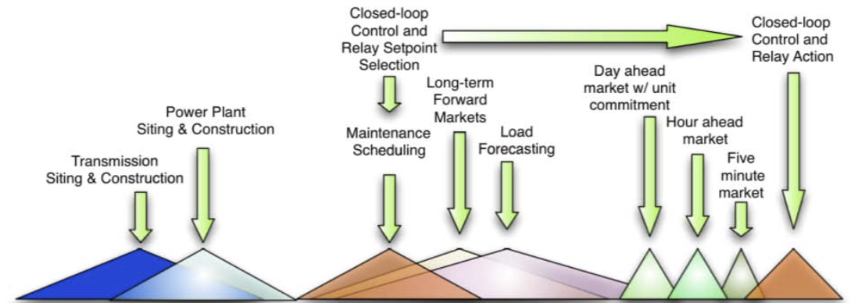
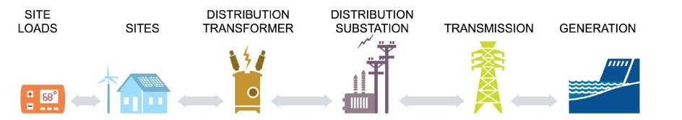
Math and computing challenges in modeling and simulation of the future grid
Multi-scale spatio-temporal modeling and simulation with stochasticity
From micro-second to decades
From 10³ generators nodes to 10⁹ end-use devices
Large-scale data assimilation for state and parameter calibration
Petabyte data/year from high-speed sensors and smart meters.
Modeling of multi-system dynamics and dependency
Grid, buildings, communication, gas pipelines, weather/wind/solar, water
Spatial Temporal
15 years 10 years 5 years 1 year 1 month 1 week 1 day 5 minutes μ-seconds
10³ 10⁴ 10⁵ 10⁶ 10⁸ 10⁹
Generation Transmission Substation Transformer Site Load
Notes:
Interaction among systems. Multiscale problem

Slide 4
Why use High Performance Computing (HPC) for the Power Grid?
The power grid is growing more complex
More renewables
Smart grid technology
Serial codes are no longer enough
Simulation of larger and more complex models
Reduced time to solution for operations
Evaluation of thousands (N-1) or millions (N-2) of contingencies
Large scale optimization

Slide 5
Does Parallel Computing Help?
Computation Bound
Communication Bound
Small Problem
Big Problem
Time to Solution
Number of Processors

Slide 6
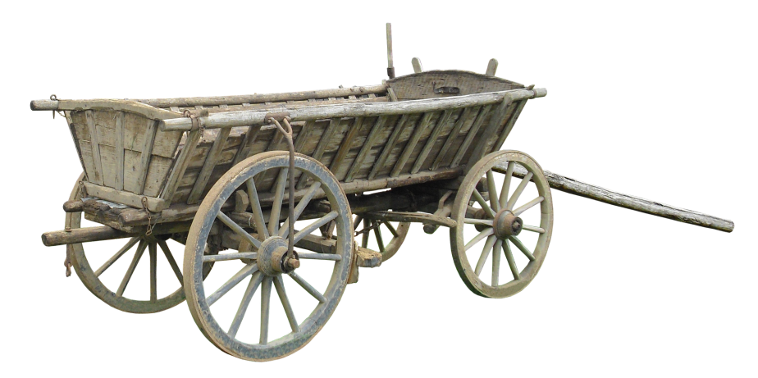
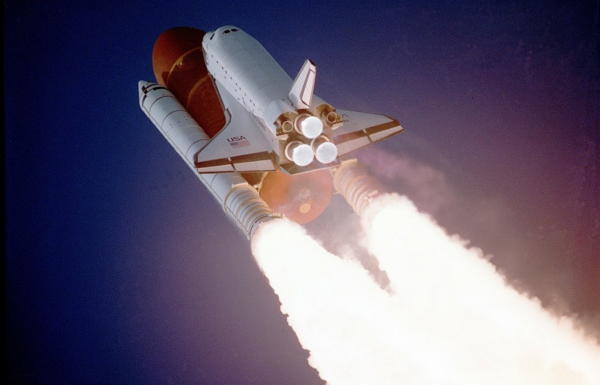
Power Grid Computing Challenges
Faster time to solution for operations
Large number of scenarios to account for uncertainties and increasing variability
More complicated algorithms and more detailed models
Optimization problems are increasing in size and complexity
Significant gap in program complexity in going from serial to parallel code

Slide 7
Example Success: Fast State Estimation captures the changes and offers an opportunity to stop cascading
For the first time, the core function in control rooms – State Estimation – can run at a unprecedented 0.5s speed (>40x faster).
When the event interval is less than the ability to respond, there is a cascading effect. This means that the region of impact from the disturbance is expanding.
Traditional view, >20 sec
Need for speed
improvement
SCADA interval, ~5 sec
New, 0.5 sec view

Slide 8
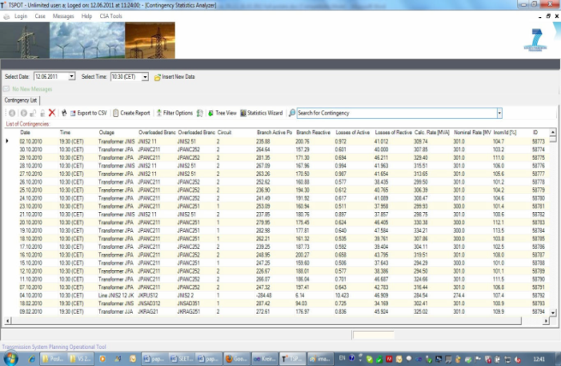
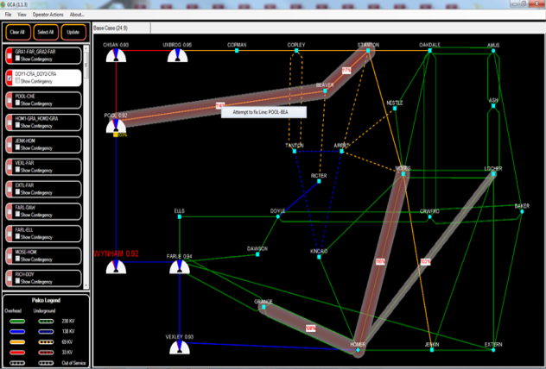
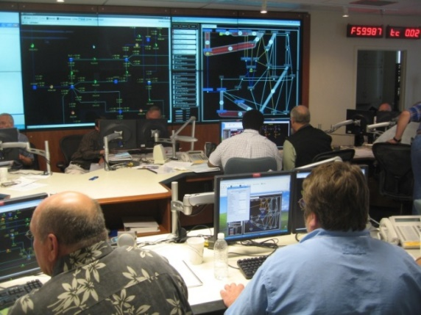




Example Success: Visual analytics of massive contingency analyses for real-time decision support
Contingency | # of scenarios | Serial on 1 core | Parallel on 512 cores | Parallel on 10,240 cores
WECC N-1 (full) | 20,000 | 39 minutes | 4.8 seconds
WECC N-2 (partial) | 1,000,000 | 68.5 hours | 8 minutes (511x speedup) | 25 seconds (9871x speedup)
ERCOT | 1,000,000 | ~4 hours (estimated) | ~0.5 minute (estimated) | <2 seconds (estimated)
Eastern Interconnect | 1,000,000 | ~1100 hours (estimated) | ~128 minutes (estimated) | ~400 seconds (estimated)
Current tabular format presents data, not information
New visualization tool converts data to actionable info
Easy-to-interpret visualization with prioritized concerns & recommendations
Operators reported 30% improvement in emergency response

Slide 9
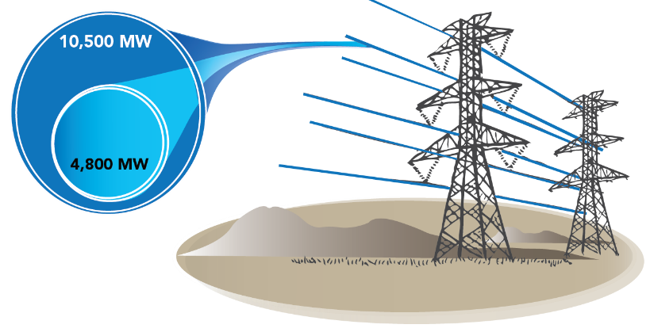
Example Success: Real-time path rating through fast computation to manage transmission congestion
Look-Ahead Dynamic Simulation
16,000-bus w/ simplification
9 sec for 30-sec simulation
13X faster than today’s commercial tools
Real-Time Path Rating in 10 min
Significant congestion cost: NYISO $1.1B/2010; PJM $1.4B/2012
Transmission expansion?
Realistic ratings: +1000 MW = +$240M/year
Avoid renewable curtailment
26X
1 2 4 8 16 32 64
tap into unused capacities

Slide 10

GridPACK Approach
Lower the threshold for development of HPC codes
Create high level abstractions for common programming motifs
Encapsulate high performance math libraries
Compartmentalize functionality and promote reuse of software components
Hide communication and indexing

Slide 11
GridPACK Framework
GridPACK is written in C++ and is highly customizable
Inheritance
Software templates
Runs on Linux-based clusters and workstations.
Wide variety of solvers and parallel linear algebra available through PETSc suite of software.
Prebuilt modules
Power flow
State estimation
Dynamic simulation
Dynamic state estimation (Kalman filter)
Robust support for task-based execution.

Slide 12
GridPACK Core Framework
Base Factory
Network-wide Operations
Base Network Components
Neighbor Lists
Matrix Elements
GridPACK™ Applications
Application Driver
Application Factory
Application Components
GridPACK™ Framework
Import Module
PTI Formats
Dictionary
Network Module
Exchanges
Partitioning
Configure Module
XML
Export Module
Serial IO
Task Manager
Math and Solver Module
PETSc
Mapper
Utilities
Errors
Profiling
Core Data Objects
Matrices and Vectors
Power Grid Network

Slide 13
Major GridPACK Modules
Network: manages the topology, neighbor lists, parallel distribution and indexing
Components: define the behavior and properties of bus and branch
Mapper: Creates distributed matrices and vectors from network components
Factory: manages interactions between network and the components
Math: generic wrapper on top of parallel math libraries
Math
Mappers
Network
Components
Factory

Slide 14
GridPACK Functionality
What you supply
Bus and branch classes that define your power system application
High level application driver describing solution procedure
What you get
Parallel network distribution and setup
Data exchanges between processors
Parallel matrix builds and projections
I/O of distributed data
Parallel solvers and linear algebra operations
Distributed task management
Application modules for use in more complex workflows

Slide 15
GridPACK Application
Power Grid Application
GridPACK
Algebraic Equations
Bus Class
Algorithms
Branch Class
Matrix Operations and Solvers
MPI
Global Arrays
ParMetis
PETSc HPC Math Library

Slide 16
Software Reuse
Rename and modify existing GridPACK component or module to create a new application
Use GridPACK components and/or modules as is
Inherit from GridPACK component or module to create a new application
User Component or Module
User Component or Module
GridPACK Component or Module

Slide 17
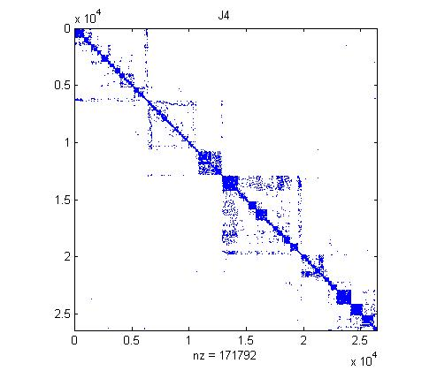
Distributed Power Flow Jacobian from Mapper
16351 bus WECC system

Slide 18
Power Flow Code
1 typdef BaseNetwork<PFBus,PFBranch> PFNetwork;
2 Communicator world;
3 shared_ptr<PFNetwork>
4 network(new PFNetwork(world));
5
6 PTI23_parser<PFNetwork> parser(network);
7 parser.parse("network.raw");
8 network->partition();
9 typedef BaseFactory<PFNetwork> PFFactory;
10 PFFactory factory(network);
11 factory.load();
12 factory.setComponents();
13 factory.setExchange();
14
15 network->initBusUpdate();
16 factory.setYBus();
17
18 factory.setSBus();
19 factory.setMode(RHS);
20 BusVectorMap<PFNetwork> vMap(network);
21 shared_ptr<Vector> PQ = vMap.mapToVector();
22 factory.setMode(Jacobian);
23 FullMatrixMap<PFNetwork> jMap(network);
24 shared_ptr<Matrix> J = jMap.mapToMatrix();
25 shared_ptr<Vector> X(PQ->clone());
26
27 double tolerance = 1.0e-6;
28 int max_iteration = 100;
29 ComplexType tol = 2.0*tolerance;
30 LinearSolver solver(*J);
31
32 int iter = 0;
33
34 // Solve matrix equation J*X = PQ
35 solver.solve(*PQ, *X);
36 tol = X->normInfinity();
37
38 while (real(tol) > tolerance &&
39 iter < max_iteration) {
40 factory.setMode(RHS);
41 vMap.mapToBus(X);
42 network->updateBuses();
43 vMap.mapToVector(PQ);
44 factory.setMode(Jacobian);
45 jMap.mapToMatrix(J);
46 solver.solve(*PQ, *X);
47 tol = X->normInfinity();
48 iter++;
49 }

Slide 19
GridPACK Task Manager Support
World Group
Parallel tasks running on subgroups

Slide 20
Multiple Levels of Parallelism
8 tasks, 4 processors
8 processors
16 processors (2 levels of parallelism)

Slide 21
Dynamic Contingency Analysis
Two-level parallelism starts here
Simulation of 16 contingencies on 16351 bus WECC network

Slide 22
GridPACK Examples

Slide 23
Dynamic Simulation Mini-Framework
Dynamic Simulation Application
DS Bus Component
DS Branch Component
Base Generator
Base Exciter
Base Relay
Base Governor
Base Relay
Base Relay
Base Generator
Base Exciter
Base Relay
Base Relay
Base Governor
:
Base Relay
:
:
:
GENCLS
EXDC1
WSIEG1
LVSHBL
GENROU
ESST1A
WSHYGP
FRQTPAT
GENSAL
ESST4B
GGOV1
DISTR1

Slide 24
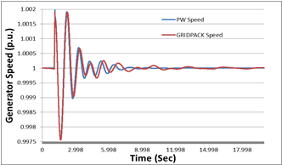
Dynamic simulation of WECC system
WECC system of 17,000 buses with detailed dynamic models, 20 seconds simulation, results compared with PowerWorld.
Achieve Faster-than-real-time simulation with 16 cores.
No. of Cores | Total Solution Time (seconds)
1 | 72.92
2 | 45.04
4 | 30.96
8 | 22.95
16 | 19.57

Slide 25
Module-Based Simulations
Dynamic Security Assessment under Uncertainty
Real-Time Path Rating
Contingency Analysis
PF-Module
DS-Module
SE-Module
PF-Matrix
DS-Matrix
SE-Matrix
User Applications
Y-Matrix Components
GridPACK™ Framework

Slide 26
Many Task Simulations
Time
Program Setup and Task Initialization
Task Manager
T1
T2
T3
T4
T5
T6
T7
T8
T9
T10
T11
T11
Result Collection and Second Stage Task Initialization
Task Manager
T1
T2
T3
T4
T5
T6
T7
T8
T9
T10
T11
T12
T13
T14
T15
Processors

Slide 27
Application (1): Contingency Analysis
Contingency Analysis
Static Contingency Analysis of WECC system using 1 processor per contingency for 3638 contingencies
PF-Module
Task Manager
PF-Matrix
Y-Matrix Components
GridPACK™ Framework

Slide 28
Example (2): Dynamic Contingency Analysis
Simulation of 16 contingencies on 16351 bus WECC network
Dynamic Contingency Analysis
PF-Module
DS-Module
2 levels of parallelism
Task Manager
PF-Matrix
DS-Matrix
Y-Matrix Components
GridPACK™ Framework

Slide 29
Application (3): Dynamic Security Assessment (DSA) under Uncertainty
Dynamic Security Assessment under Uncertainty
PF-Module
DS-Module
SE-Module
PF-Matrix
DS-Matrix
SE-Matrix
User Applications
Updated bus components based on realizations that covers forecast errors
Y-Matrix Components
GridPACK™ Framework

Slide 30
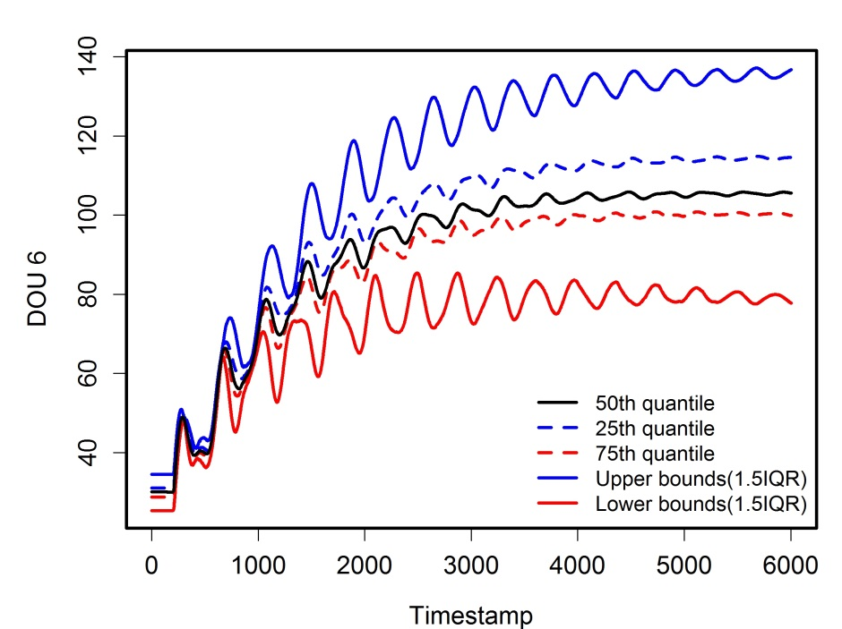
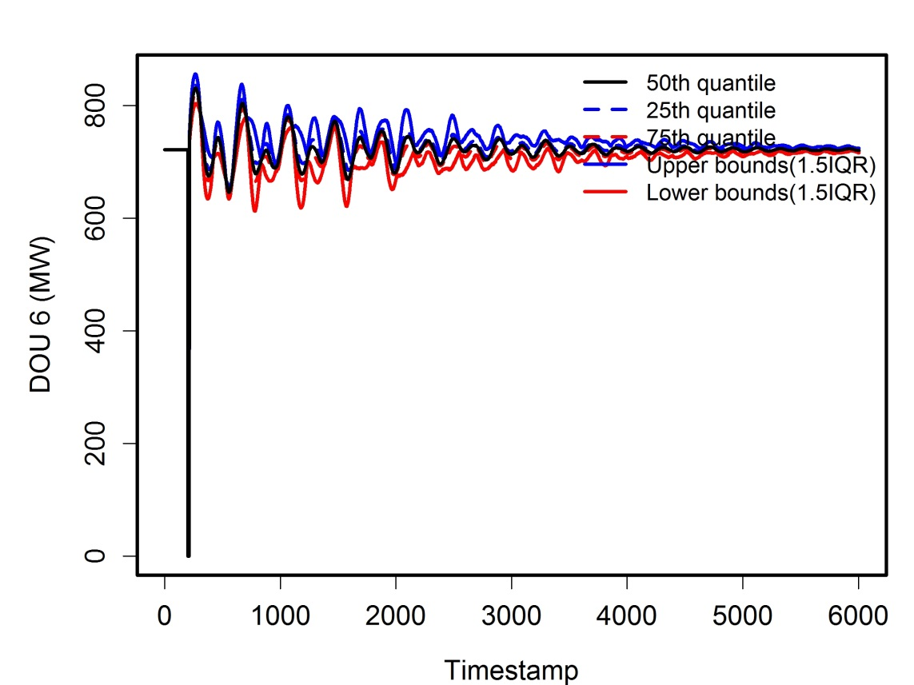
Application (3) DSA under Uncertainty
Rotor speed under different contingencies with different quantiles and IQR
Line flow under different contingencies with different quantiles and IQR
The quantiles of all the contingencies for each generator are used to represent the statistical characteristics at each time stamp.
The lower/upper bounds use 1.5 interquartile range (IQR).

Slide 31
GridPACK Summary
Open source software for running HPC power grid simulations
Written in C++ and designed to run on Linux platforms with MPI
Many applications already available
Power flow
Dynamic simulation
State estimation
Kalman Filters
Can be reused to develop own applications
Download and documentation at www.gridpack.org
Contact us at gridpack.account@pnnl.gov

Slide 32
Accessing GridPACK
Download from www.gridpack.org
Extensive documentation in GridPACK user manual
Documentation on building GridPACK on numerous different platforms. If you run into problems, we can help
Contact us at gridpack.account@pnnl.gov

Slide 33
Extra Slides

Slide 34
Customizing Networks using the BaseNetwork Class
Template class that can be created with arbitrary user-defined types for the buses and branches
BaseNetwork<MyBus, MyBranch>(const Communicator &comm)
Implements partitioning of network between processors
Create highly connected sub-networks on each processor with minimal connections between processors
Implements data exchanges between buses and branches on different processors
Manages indexing of network components

Slide 35
Customization Through Templates
User Code
Buses
Branches
GridPACK Framework

Slide 36
Network Topology
Bus
Branch

Slide 37
Partitioning the Network
Process 0
Process 1

Slide 38
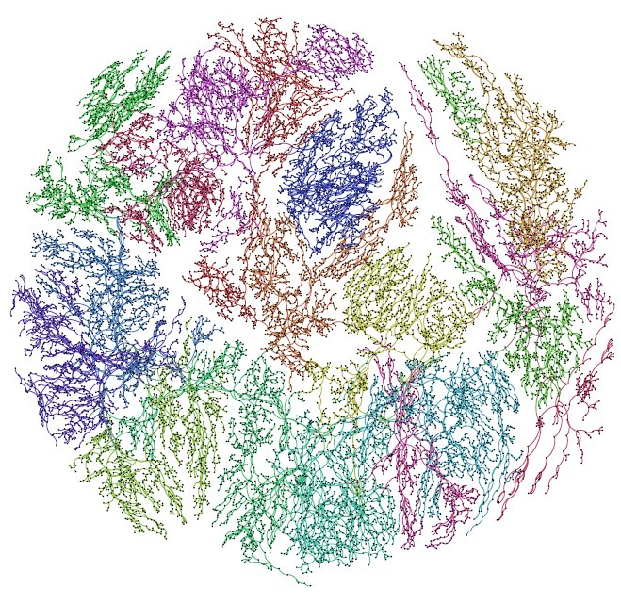
Partitioning of Network
WECC (Western Electricity Coordinating Council) network partitioned between 16 processors

Slide 39
Multiple Networks
Process 0
Process 1

Slide 40
Multiple Distributed Networks
Process 0
Process 1
Process 2
Process 3

Slide 41
Component Classes
Each bus and branch in the network has an associated bus or branch object. They also have an associated DataCollection object
The bus and branch classes are written by the user. Access to other functionality in GridPACK is through functions defined in the bus and branch interfaces
Creation of matrices and vectors
IO
Data exchange between processors
Creation of optimization equations

Slide 42
Traditional Programming to Evaluate Y_{ii}
integer nbus
integer attached_branch_start(nbus+1)
integer attached_branch_nghbrs(n_neighbors)
for ibus = 1, nbus
ibeg = attached_branch_start(ibus)
iend = attached_branch_start(ibus+1)-1
ydiag(ibus) = 0.0
for j = ibeg, iend
ibranch = attached_branch_nghbrs(j)
x = reactance(ibranch)
r = resistance(ibranch)
c = cmplx(r,x)
ydiag(ibus) = ydiag(ibus)+1.0/c
end do
end do
Properties are in large lists with auxiliary data structures maintaining relationships between different pieces of data

Slide 43
C++ Programming to Evaluate Y_{ii}
int nbus = network->numBuses()
for (int ibus=0; ibus<nbus; ibus++) {
Bus *bus = network->getBus(i);
std::vector<Branch> branches = bus->getNeighborBranches();
DoubleComplex y(0.0,0.0);
for (j=0; j<branches.size(); j++) {
Branch *branch = branches[j];
double r = branch->getResistance();
double x = branch->getReactance();
DoubleComplex c(r,x);
y += 1.0/c;
}
bus->setYdiag(y);
}
Data is tied to individual objects instead of being associated with large. global lists

Slide 44
Component Class Hierarchy
MatVecInterface
GenMatVecInterface
BaseComponent
BaseBusComponent
BaseBranchComponent
AppBusComponent
AppBranchComponent

Slide 45
Component Reuse
BaseBusComponent
BaseBranchComponent
Y-Matrix Bus Component
Y-Matrix Branch Component
Powerflow Bus Component
Powerflow Branch Component

Slide 46
Mapper
Provides a flexible framework for constructing matrices and vectors representing power grid equations
Hide the index transformations and partitioning required to create distributed matrices and vectors from application developers
Developers can focus on the contributions to matrices and vectors coming from individual network elements

Slide 47
Mapper
1
2
3
4
5
8
9
10
7
6
12
11

Slide 48
Matrix Contributions from Components
1
2
3
No matrix contribution
4
5
No matrix contribution
No matrix contribution
8
9
10
7
6
12
11

Slide 49
MatVecInterface
// Implemented on buses
virtual bool matrixDiagSize(int *isize,
int *jsize) const
virtual bool matrixDiagValues(ComplexType *values)
// Implemented on branches
virtual bool matrixForwardSize(int *isize,
int *jsize) const
virtual bool matrixReverseSize(int *isize,
int *jsize) const
virtual bool matrixForwardValues(ComplexType *values)
virtual bool matrixReverseValues(ComplexType *values)

Slide 50
Distribute Component Contributions and Eliminate Gaps

