Slide 2
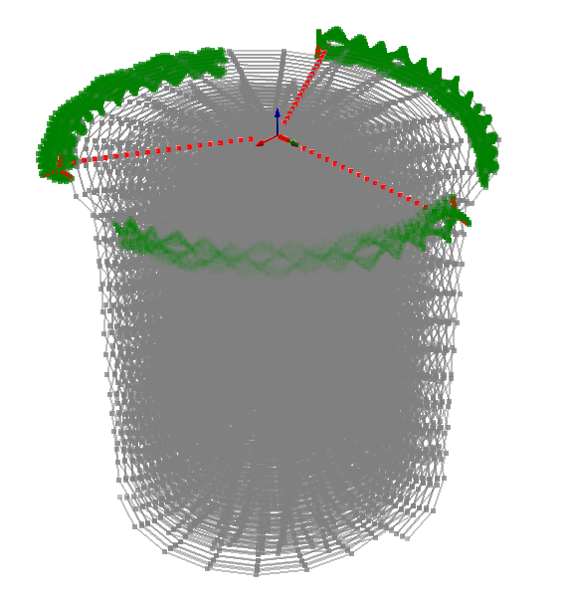
LLM setup: the number of points and wake
lengths are reduced for image clarity

Slide 3
