Slide 1
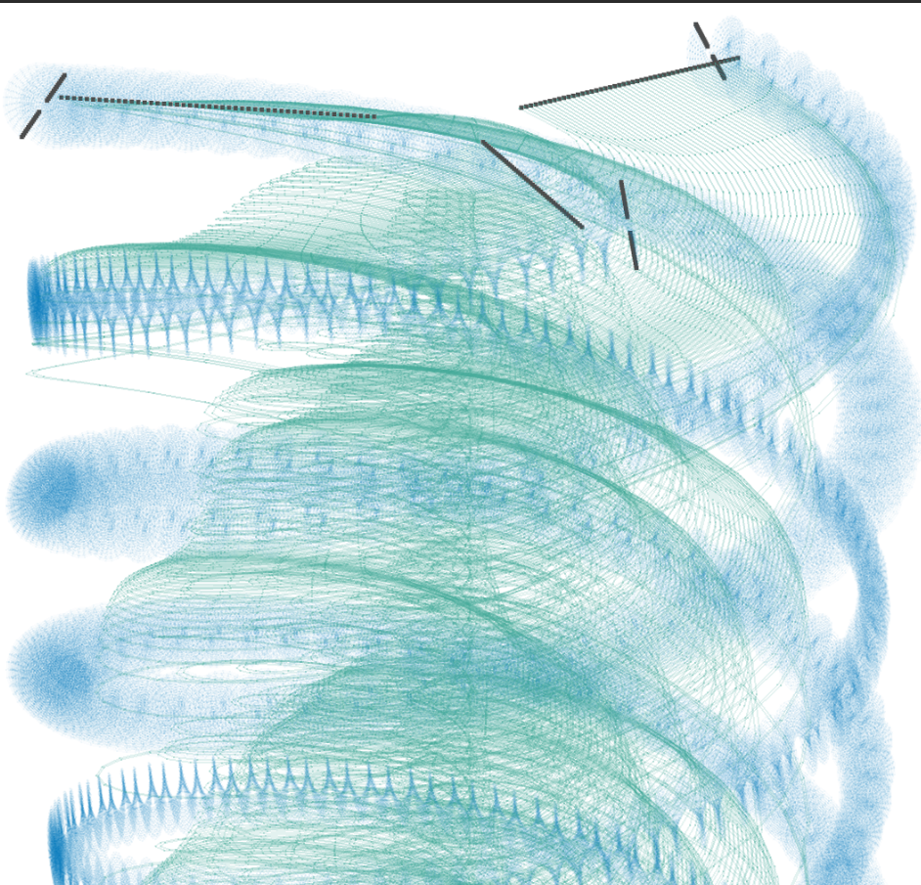
Title slide + image
Aerodynamic Performance
Analysis of a
Tip-Propelled
Rotorcraft UAV
Green Light Presentation

Slide 2
Agenda
Midterm state review
LL Model
  LL model sensitivity analysis
  CFD comparison (update)
Baseline configurations
Factorial design
Results
  Performance Comparison
  Tip propellers efficiency
Conclusions

Slide 3


Midterm results summary (1)
Main Objective
Develop and validate a low-fidelity aerodynamic framework for analyzing tip-propelled spinning drones in hover, and use it to evaluate and improve their aerodynamic efficiency compared with conventional configurations.
Research questions
What modeling approach can effectively represent the coupled aerodynamic behavior of the tip-propelled rotorcraft under low-Reynolds-number conditions within a modular low-fidelity framework?
How does the developed low-fidelity model compare with higher-fidelity methods in terms of accuracy and computational efficiency?
How does the aerodynamic performance of the tip-propelled rotorcraft UAV compare to conventional platforms used for hovering?
What are the aerodynamic limitations of the tip-propelled rotorcraft UAV, and how can these insights inform design improvements to enhance efficiency?

Slide 4
Lifting Line (LL) model sensitivity analysis
Free variables (5):
Rotor wake length, propeller wake length, wake refinement, rotor blade refinement, propeller blade refinement
Control variables:
Thrust and Torque residuals (for either rotor or propeller)
Resultant values:
Model is more sensitive to geometry refinement, rather than wake refinement

Slide 5
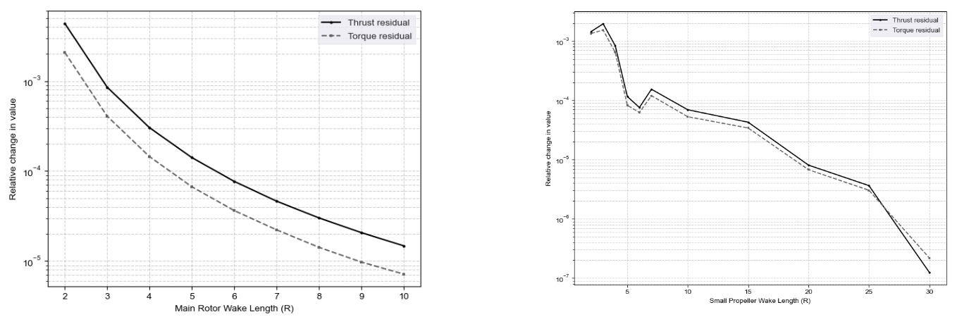
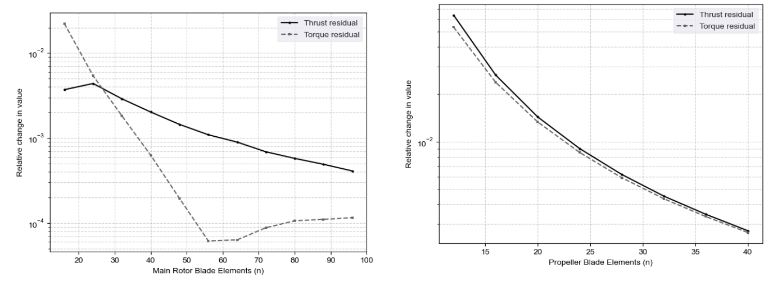
Lifting Line (LL) model sensitivity analysis(2)
Variable | Final value | Max residual
L_wr | 6 | <1e-4
L_wp | 10 | <1e-4
PPR | 60 | <1e-4
n_r | 50 | <1e-3
n_p | 25 | <1e-2

Slide 6
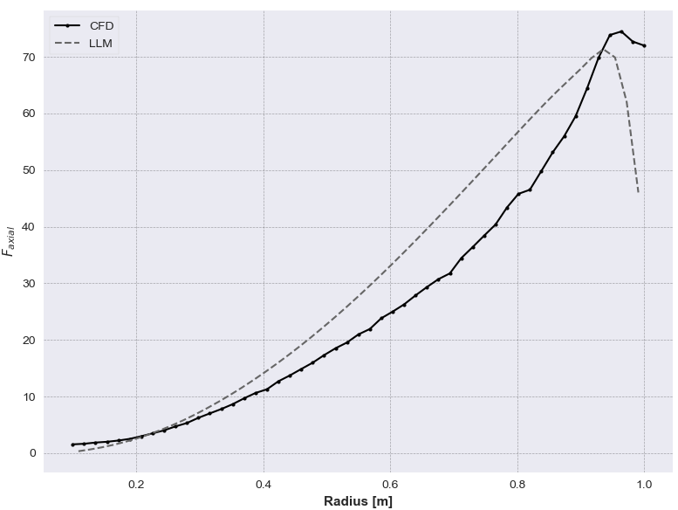
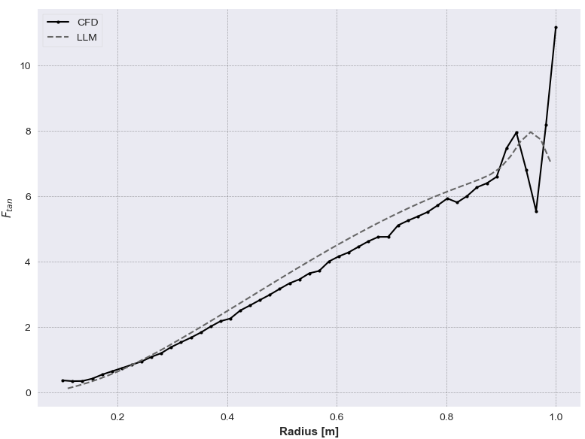
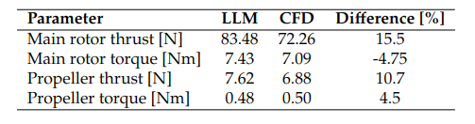
Lifting Line (LL) CFD comparison (update)
Good global match, but poor correlation in distribution patterns

Slide 7
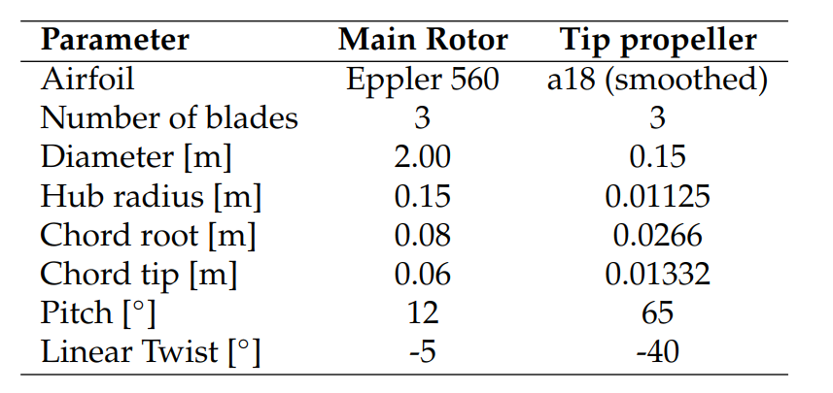
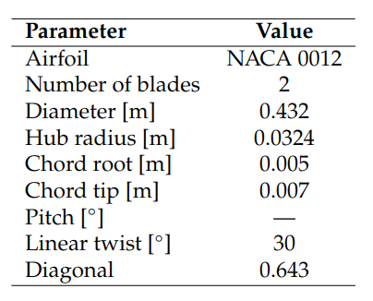
Baseline configurations
Drone and Helicopter
Quadcopter (DJI inspired)

Slide 8
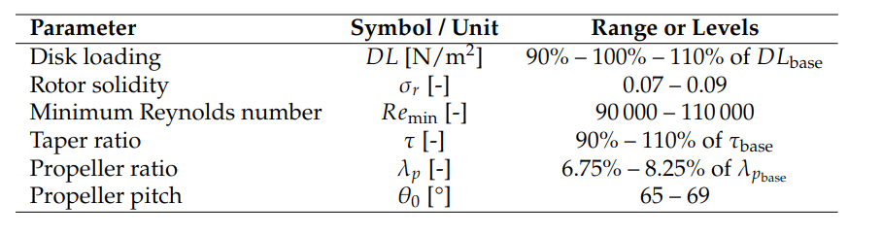
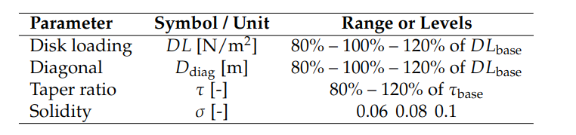
Factorial Design Setup
Drone and helicopter variables:
Quadcopter design variables:

Slide 9
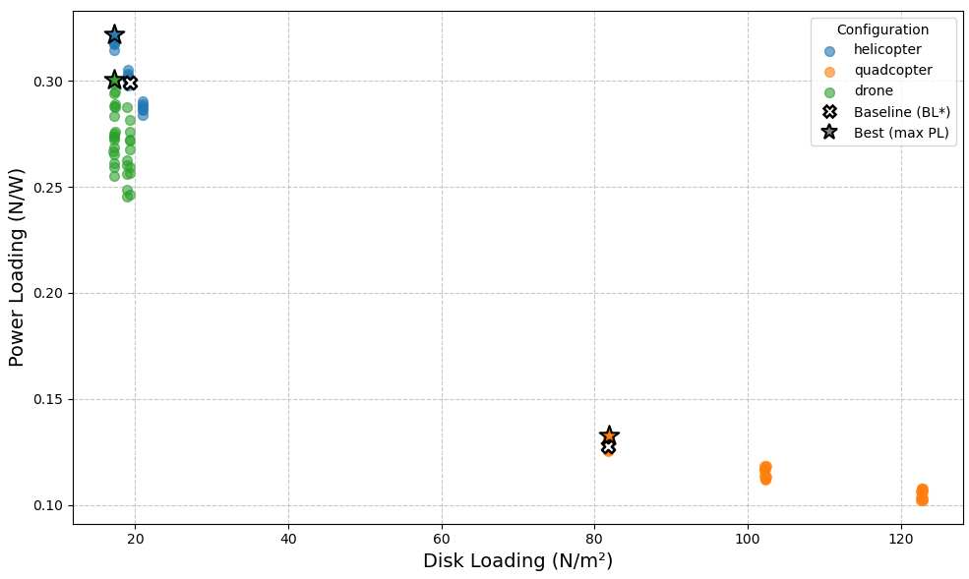
Factorial design results

Slide 10
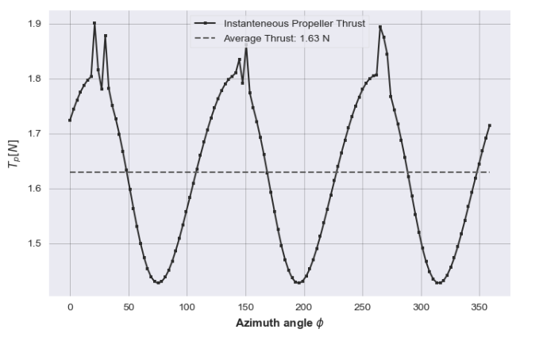
Tip propeller thrust distribution
Pulsating thrust generation (source of vibrations)
Propeller blade-rotor airframe interactions (limitation of the model, causes instabilities)

Slide 11
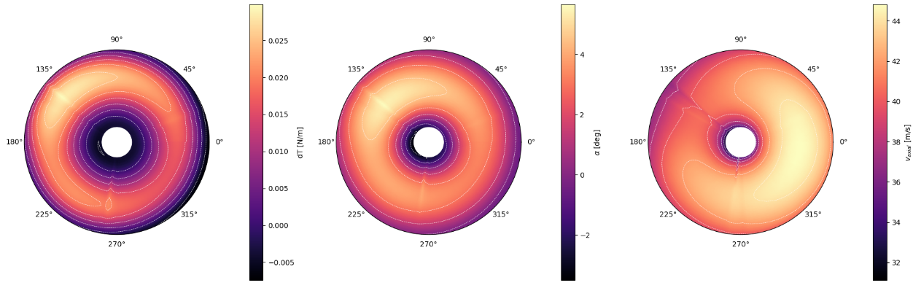
Tip propeller thrust distribution (2)
Thrust
Angle of attack
Axial velocity

Slide 12
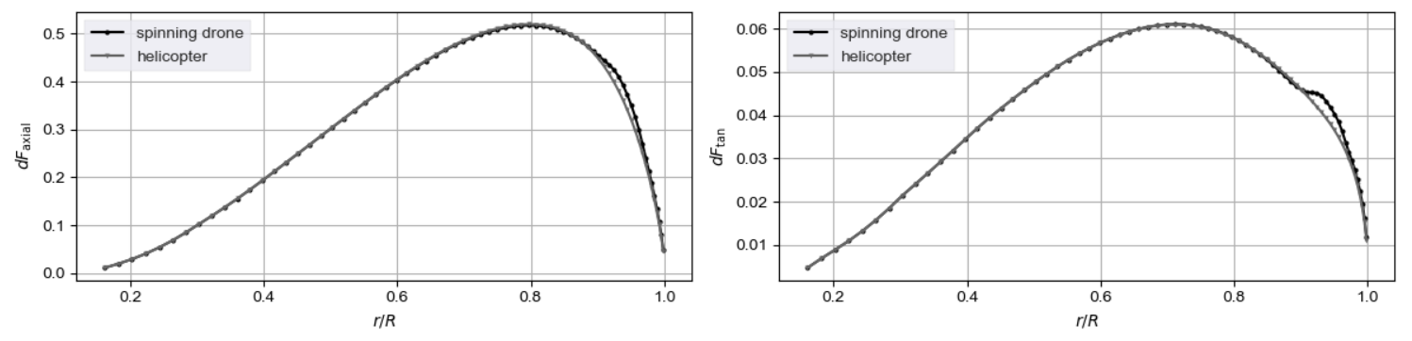
Tip propeller effect on the main balde
The positive aerodynamic effects of tip-mounted propellers described by T. Sinnige et al. are also observed in the rotorcraft configuration. However, due to the significantly lower local flow acceleration, these effects remain minor.

Slide 13

Looking back at the RQs
Main Objective
Develop and validate a low-fidelity aerodynamic framework for analyzing tip-propelled spinning drones in hover, and use it to evaluate and improve their aerodynamic efficiency compared with conventional configurations.
Research questions
What modelling approach can effectively represent the coupled aerodynamic behaviour of the tip-propelled rotorcraft under low-Reynolds-number conditions within a modular low-fidelity framework?
How does the developed low-fidelity model compare with higher-fidelity methods in terms of accuracy and computational efficiency?
How does the aerodynamic performance of the tip-propelled rotorcraft UAV compare to conventional platforms used for hovering?
What are the aerodynamic limitations of the tip-propelled rotorcraft UAV, and how can these insights inform design improvements to enhance efficiency?

Slide 14
Conclusions
Model
A low-fidelity aerodynamic model has been successfully developed and implemented. Sensitivity analysis identified optimal precision–computation cost trade-offs for the model’s free parameters.
The model demonstrates acceptable accuracy when compared with high-fidelity simulations.
Design and insights
The proposed design shows competitive hover performance – slightly inferior to a conventional helicopter, but significantly superior to a classical quadcopter
Design suffers due to uneven inflow distribution for the tip propellers that decreases their efficiency.
Positive aerodynamic side effects from tip-mounted propellers are minor and do not significantly influence overall performance.

