Slide 1
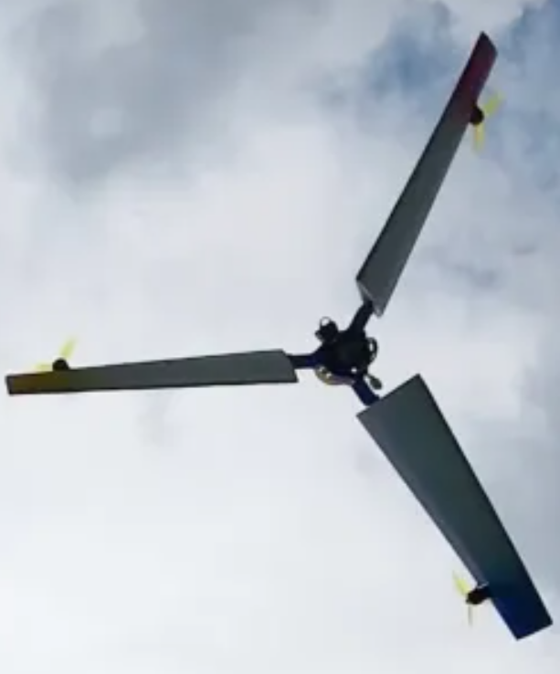

Title slide + image
Rotating Drone Aerodynamic Analysis and Design
Gleb Martjanovs | Midterm presentation

Slide 2
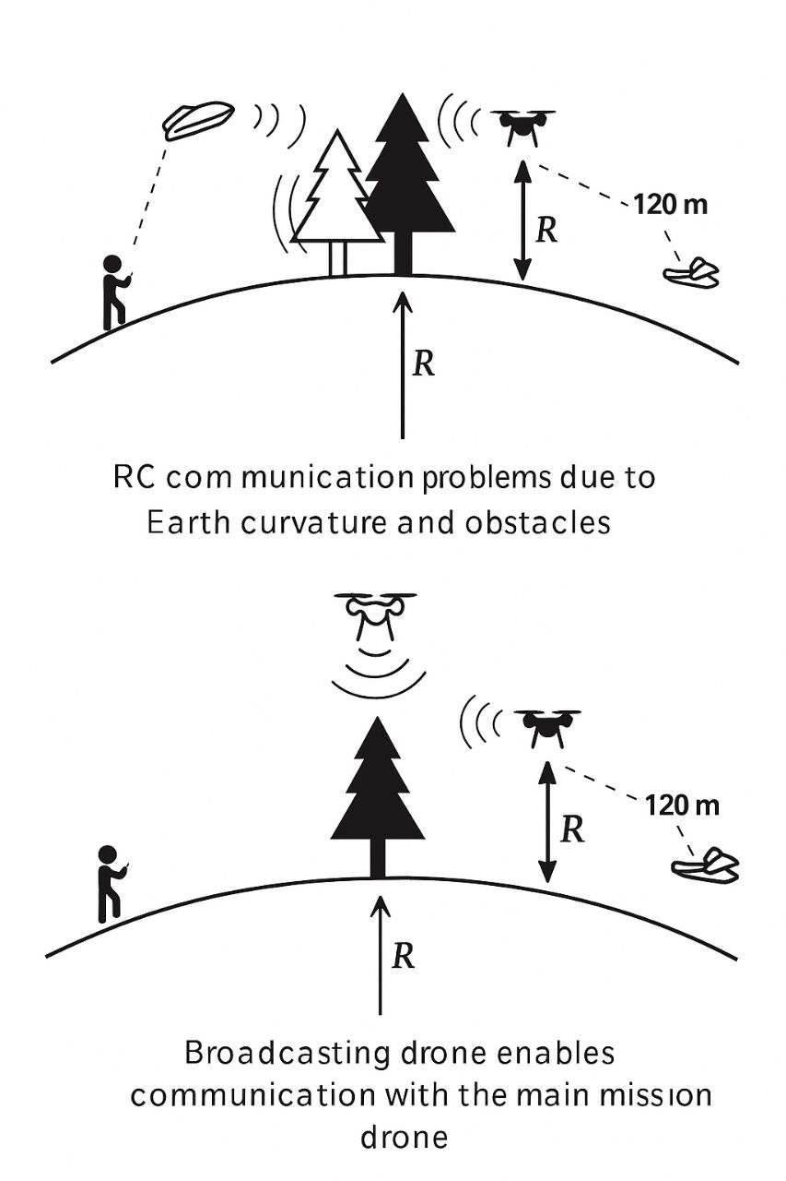
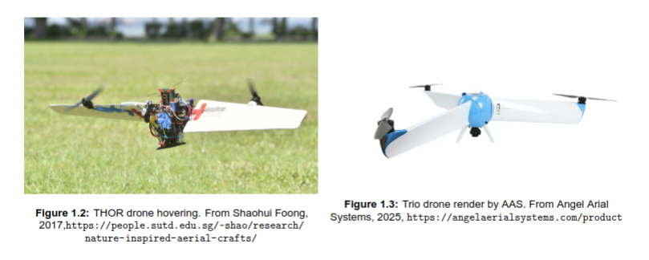
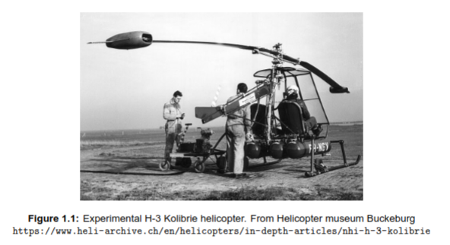
Motivation and background
        Efficient hover solution for broadcasting applications
  Long range mission communication
  Broadcasting point (speaker, Wi-Fi)
        Previous attempts:

Slide 3
Research objective
        Main Objective
Explore rotating drone aerodynamic performance and optimize its configuration for extended hover time.
        Sub-Objectives
Develop a low-fidelity aerodynamic model suitable for rotating-wing configurations.
Validate the model against established methods such as Blade Element Momentum (BEM) theory and Computational Fluid Dynamics (CFD).
Optimize the rotor design to minimize the power required for hovering.
Compare the performance of the optimized configuration against conventional quad-copters and helicopter-like drones.

Slide 4
Methodology
Choosing text levels
Home
Text level down
Text level up
Under the tab ‘Home’, use the list level-buttons to choose a text level.
Choose from:
Low-fidelity Model
  Assumptions
  Model description
  Wake modeling
CFD analysis
  Setup
  Mesh convergence
  Results comparison
1
Bullet
2
Sub-bullet
3
Default text
4
Title/Quote
5
Subtitle
6
Default text
7
Numerical bullet
8
Alphabetical bullet
9
Source
Want to know more?
Go to the tab 'SLIDEBUILDER’ and click
on the button ‘Inspiration'
Inspiration

Slide 5
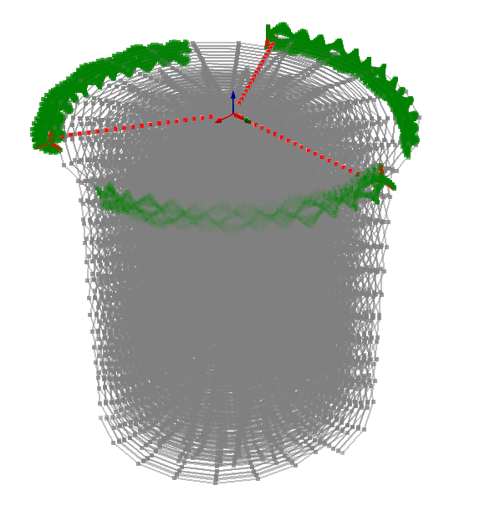
Choosing a Low-Fidelity Model
Choosing text levels
Home
Text level down
Text level up
Under the tab ‘Home’, use the list level-buttons to choose a text level.
Choose from:
  Blade Element Model
  Dynamically Prescribed Wake Lifting Line Model
  Free Wake Lifting Line Model
1
Bullet
2
Sub-bullet
3
Default text
4
Title/Quote
5
Subtitle
6
Default text
7
Numerical bullet
8
Alphabetical bullet
9
Source
Want to know more?
Go to the tab 'SLIDEBUILDER’ and click
on the button ‘Inspiration'
Inspiration
Prescribed Wake LLM setup: the number of points and wake
lengths are reduced for image clarity

Slide 6
Assumptions
Choosing text levels
Home
Text level down
Text level up
Under the tab ‘Home’, use the list level-buttons to choose a text level.
Choose from:
Steady
Incompressible
Inviscid
Tip-rotor wakes are unperturbed
Small angles of attack
1
Bullet
2
Sub-bullet
3
Default text
4
Title/Quote
5
Subtitle
6
Default text
7
Numerical bullet
8
Alphabetical bullet
9
Source
Want to know more?
Go to the tab 'SLIDEBUILDER’ and click
on the button ‘Inspiration'
Inspiration

Slide 7
Initial geometry
Choosing text levels
Home
Text level down
Text level up
Under the tab ‘Home’, use the list level-buttons to choose a text level.
Choose from:
Initial sizing was done based on historical data of existing helicopter-like drones. The objective was to keep it simple for model validation purposes
1
Bullet
2
Sub-bullet
 | Main rotor | Comments | Tip rotor | Comments
Main rotor diameter | 2 [m] |  | 0.15 [m]
NB | 3 |  | 3
Hub radius | 0.1 [m] |  | 0.01 [m]
Chord | 0.1 [m] | Uniform chord distribution | 0.02 - 0.01 | Linear taper
Root pitch | 15 deg |  | 80 deg
Twist | -8 deg | Linear negative twist | -40 deg | Linear negative twist
Airfoil | A18sm |  | A18sm
RPM | 400 |  | 7445
3
Default text
4
Title/Quote
5
Subtitle
6
Default text
7
Numerical bullet
8
Alphabetical bullet
9
Source
Want to know more?
Go to the tab 'SLIDEBUILDER’ and click
on the button ‘Inspiration'
Inspiration

Slide 8
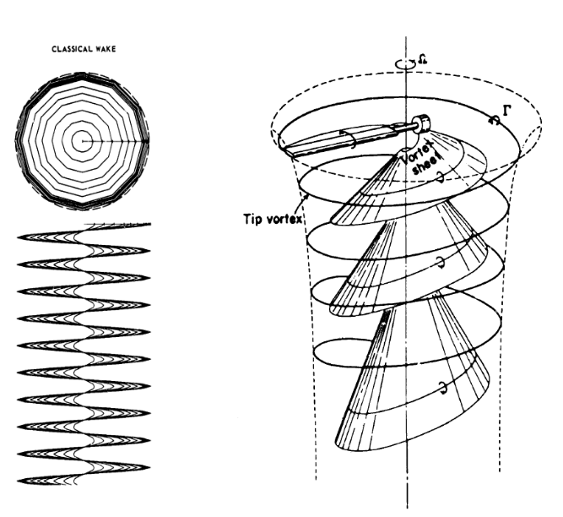
Wake modeling
Choosing text levels
Home
Text level down
Text level up
Under the tab ‘Home’, use the list level-buttons to choose a text level.
Choose from:
Dynamically defined wake
Wake contraction
Donwash of the tip-rotor wakes
1
Bullet
2
Sub-bullet
3
Default text
4
Title/Quote
5
Subtitle
6
Default text
7
Numerical bullet
8
Alphabetical bullet
9
Source
Want to know more?
Go to the tab 'SLIDEBUILDER’ and click
on the button ‘Inspiration'
Inspiration

Slide 9
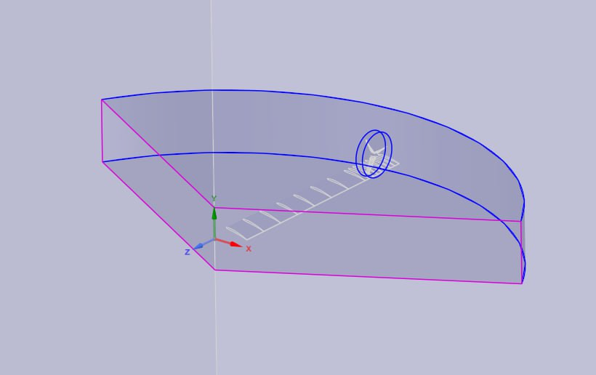
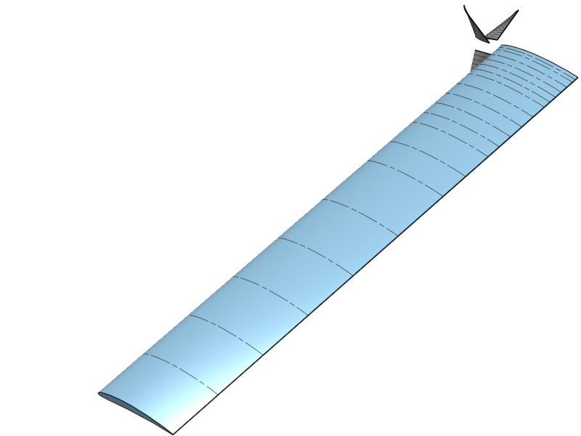
CFD
Choosing text levels
Home
Text level down
Text level up
Under the tab ‘Home’, use the list level-buttons to choose a text level.
Choose from:
CFD setup relies on 2 Multiple-Reference-Frame (MRF) regions that define rotating regions for the main and tip rotor. Periodic boundary conditions are used to reduce the domain size.
1
Bullet
2
Sub-bullet
3
Default text
4
Title/Quote
5
Subtitle
6
Default text
7
Numerical bullet
8
Alphabetical bullet
9
Source
Want to know more?
Go to the tab 'SLIDEBUILDER’ and click
on the button ‘Inspiration'
Inspiration
CAD 3D model generated in Onshape
Geometry preparation for CFD simulation

Slide 10
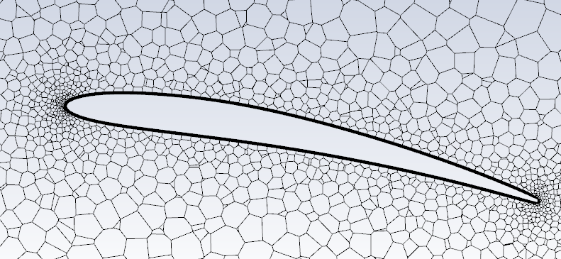
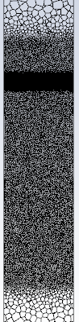
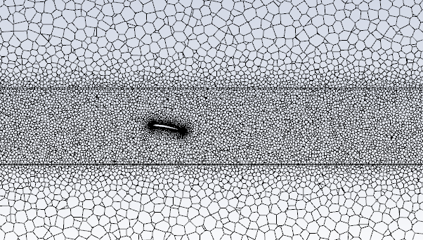
CFD meshing
Choosing text levels
Home
Text level down
Text level up
Under the tab ‘Home’, use the list level-buttons to choose a text level.
Choose from:
Unstructured meshing was performed in Ansys Fluent, utilizing influence bodies and face sizing. The inflation layers around the walls aim to reach y+ < 1 to adequately capture boundary layer phenomena
1
Bullet
a
a
2
Sub-bullet
3
Default text
4
Title/Quote
5
Subtitle
6
Default text
7
Numerical bullet
8
Alphabetical bullet
9
Source
Want to know more?
Go to the tab 'SLIDEBUILDER’ and click
on the button ‘Inspiration'
Inspiration
b
b
c
Some snapshots of the coarse mesh are demonstrated highlighting boundary layer refinement (a), MRF interface region (b) and the influence body effect on the main wake refinement (c).

Slide 11
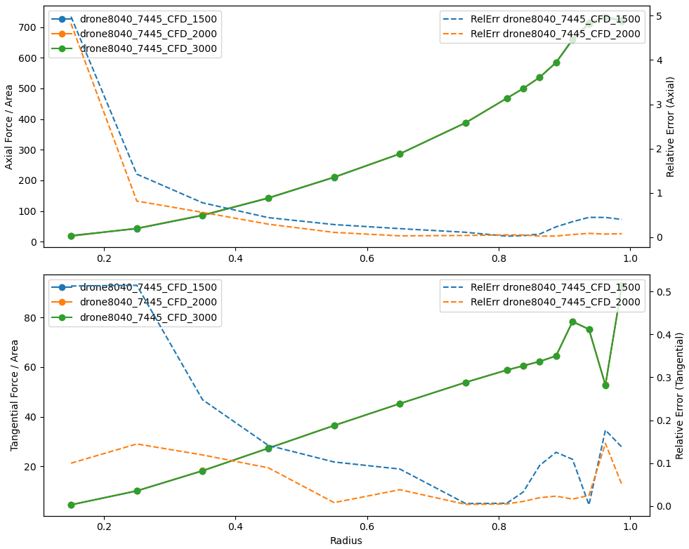
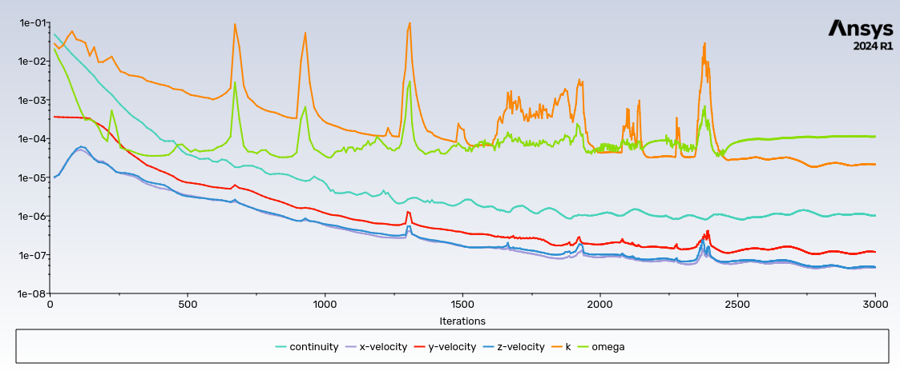
CFD simulation convergence
Choosing text levels
Home
Text level down
Text level up
Under the tab ‘Home’, use the list level-buttons to choose a text level.
Choose from:
1
Bullet
2
Sub-bullet
3
Default text
4
Title/Quote
5
Subtitle
6
Default text
7
Numerical bullet
8
Alphabetical bullet
9
Source
Want to know more?
Go to the tab 'SLIDEBUILDER’ and click
on the button ‘Inspiration'
Inspiration
Continuity and momentum equations gradually converge, whereas turbulence model parameters keep spiking up to 2500 iterations
For the integral part of the blade span relative error stays below 1%, fluctuating in the blade root region

Slide 12
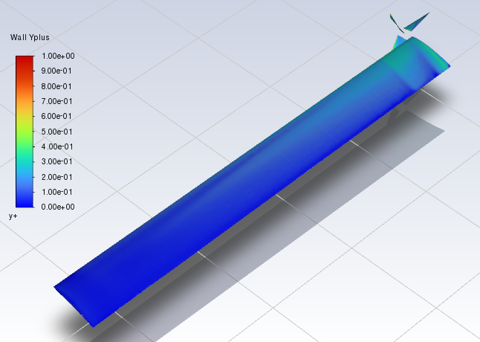
CFD y+
Choosing text levels
Home
Text level down
Text level up
Under the tab ‘Home’, use the list level-buttons to choose a text level.
Choose from:
The y+ value stays below 1 for the integral portion of the wall surfaces getting slightly higher around the leading edge of the blades and closer to the tip where the flow velocity is higher, yet remaining below 1.
1
Bullet
2
Sub-bullet
3
Default text
4
Title/Quote
5
Subtitle
6
Default text
7
Numerical bullet
8
Alphabetical bullet
9
Source
Want to know more?
Go to the tab 'SLIDEBUILDER’ and click
on the button ‘Inspiration'
Inspiration

Slide 13
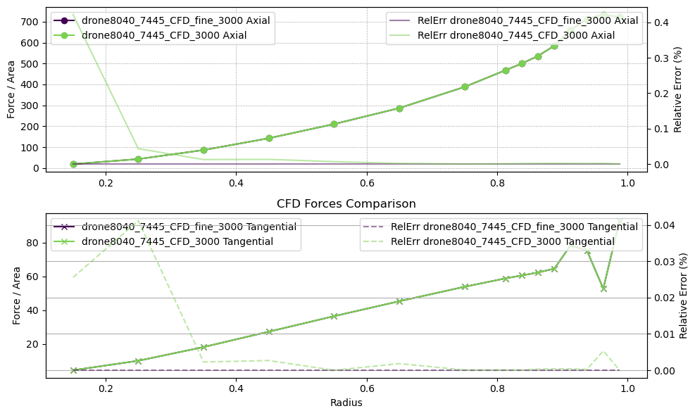
CFD: mesh convergence study
Choosing text levels
Home
Text level down
Text level up
Under the tab ‘Home’, use the list level-buttons to choose a text level.
Choose from:
To estimate mesh effect on the simulation results mesh convergence study was carried out using the refinement factor of 2 . The mesh information is presented in the table. below.
1
Bullet
2
Sub-bullet
3
Default text
4
Title/Quote
5
Subtitle
6
Default text
7
Numerical bullet
8
Alphabetical bullet
The study reveled that the mesh sensitivity is low and does not effect the results significantly with relative error for cumulative thrust and torque being 0.002% and 0.001% respectively.
9
Source
Want to know more?
Go to the tab 'SLIDEBUILDER’ and click
on the button ‘Inspiration'
Inspiration
 | Number of cells [millions] | Thrust [N] | Torque [Nm]
Coarse mesh | 6.59 | 72.1827 | 10.0017
Fine mesh | 13.02 | 72.1809 | 10.0019

Slide 14
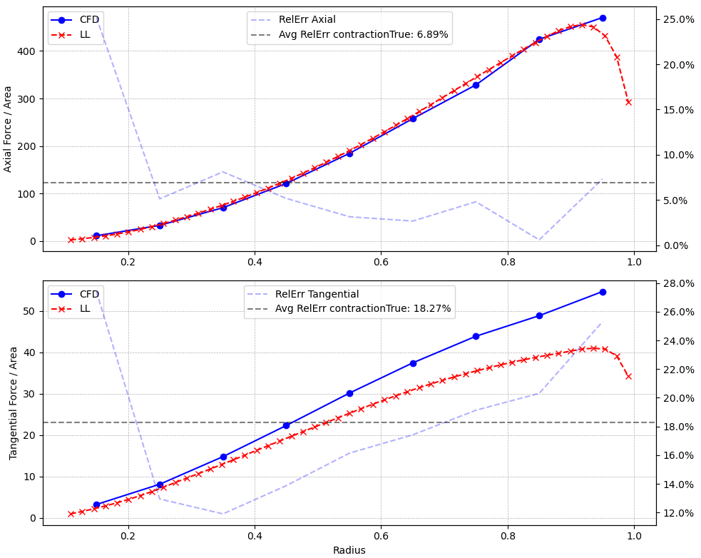
LLM and CFD results comparison (helicopter)
Choosing text levels
Home
Text level down
Text level up
Under the tab ‘Home’, use the list level-buttons to choose a text level.
Choose from:
Axial forces (thrust) are in good agreement between CFD and LLM results
Tangential forces (torque) are significantly underpredicted by the LLM. This was expected, as the viscous forces are not taken into account.
1
Bullet
2
Sub-bullet
3
Default text
4
Title/Quote
5
Subtitle
6
Default text
7
Numerical bullet
8
Alphabetical bullet
9
Source
Want to know more?
Go to the tab 'SLIDEBUILDER’ and click
on the button ‘Inspiration'
 | Thrust [N] | Torque [Nm]
LLM | 56.2865 | 4.39966
CFD | 57.021 | 5.554
Rel error | 1.288 % | 20 %
Inspiration

Slide 15
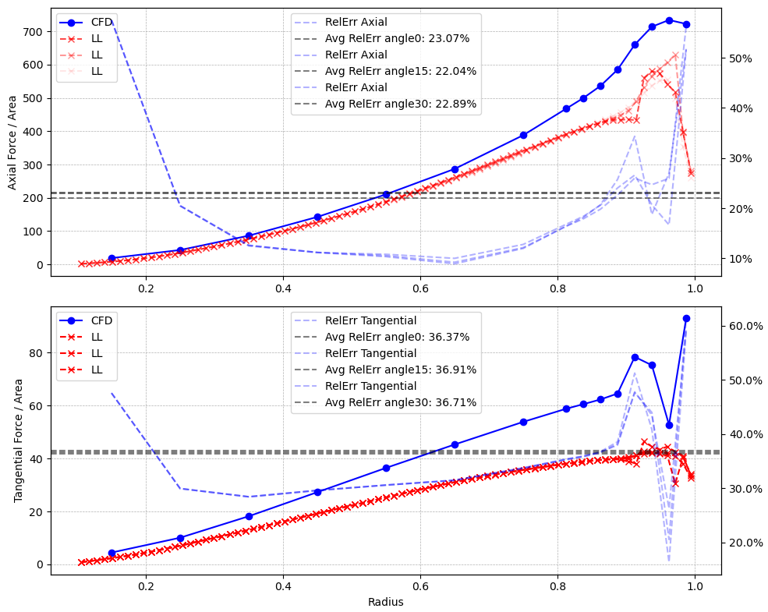
LLM and CFD results comparison (main blade)
Choosing text levels
Home
Text level down
Text level up
Under the tab ‘Home’, use the list level-buttons to choose a text level.
Choose from:
LLM heavily underpredicts both thrust and torque compared to the CFD results, yet it remains uncertain whether the CFD results are plausible.
1
Bullet
2
Sub-bullet
3
Default text
4
Title/Quote
5
Subtitle
6
Default text
7
Numerical bullet
8
Alphabetical bullet
9
Source
Want to know more?
Go to the tab 'SLIDEBUILDER’ and click
on the button ‘Inspiration'
 | Thrust | Torque
LLM | 57.8953 | 4.4704
CFD | 72.1827 | 7.0519
Rel error | 19.79 % | 36.3 %
Inspiration

Slide 16
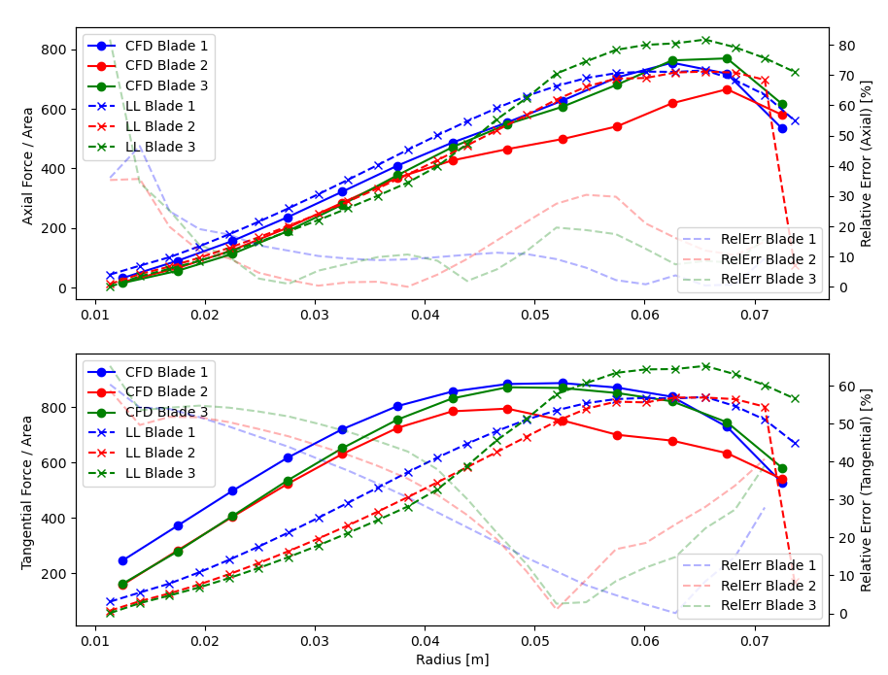
LLM and CFD results comparison (tip rotor)
Choosing text levels
Home
Text level down
Text level up
Under the tab ‘Home’, use the list level-buttons to choose a text level.
Choose from:
Tip rotor forces are in a better agreement between LLM and CFD. Yet this time torque is significantly overpredicted by the LLM.
1
Bullet
2
Sub-bullet
3
Default text
4
Title/Quote
5
Subtitle
6
Default text
7
Numerical bullet
8
Alphabetical bullet
9
Source
Want to know more?
Go to the tab 'SLIDEBUILDER’ and click
on the button ‘Inspiration'
 | Thrust | Torque
LLM | 6.8767 | 0.2147
CFD | 6.9092 | 0.1681
Rel error | 0.42 % | 27%
Inspiration

Slide 17
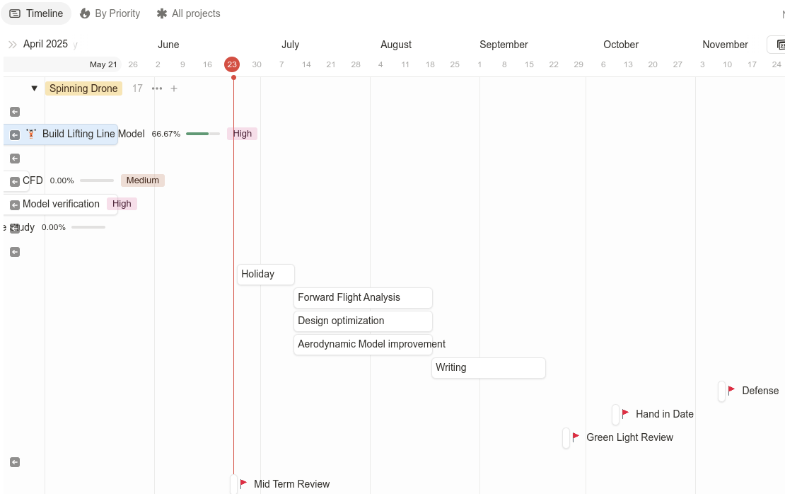
Future steps
Choosing text levels
Home
Text level down
Text level up
Under the tab ‘Home’, use the list level-buttons to choose a text level.
Choose from:
Design/model optimization
Forward flight investigation
1
Bullet
2
Sub-bullet
3
Default text
4
Title/Quote
5
Subtitle
6
Default text
7
Numerical bullet
8
Alphabetical bullet
9
Source
Want to know more?
Go to the tab 'SLIDEBUILDER’ and click
on the button ‘Inspiration'
Inspiration

