Slide 1


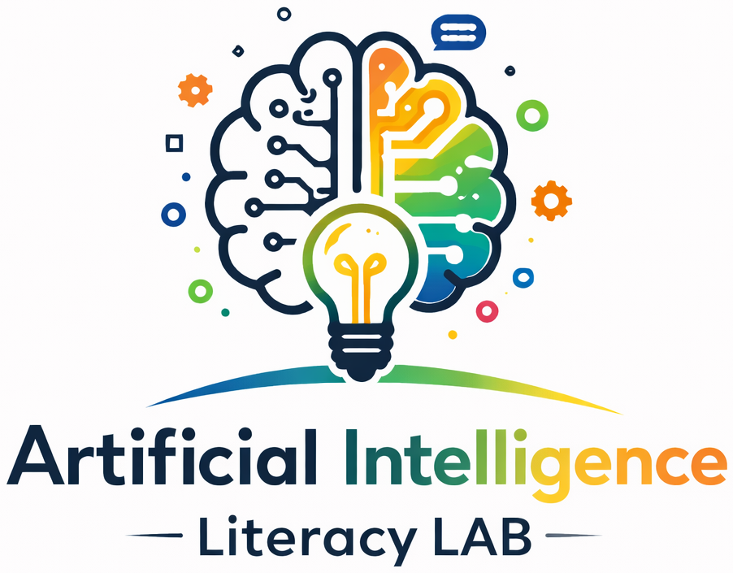
PCC AI LITERACY LAB • ROBOTICS WORKSHOP
AI & Robotics
Exploring the NVIDIA JetBot — Hardware, Software, and Live Autonomous Navigation Demos
PCC AI Lab Team

Slide 2




WORKSHOP ROADMAP
What We'll Cover Today
What Is AI?
A quick, practical grounding in artificial intelligence and where you already encounter it.
Meet the JetBot
Hardware architecture, software stack, autonomous navigation, and real-world applications.
Road Following
(today’s workshop)
Track setup, model training, and a live run — watch JetBot steer on its own.
Collision Avoidance
(next workshop)
Data collection, model training, and a live run — watch JetBot sense and stop.
Summary & Discussion
Key takeaways and open Q&A.

Slide 3




PART 1 — FOUNDATIONS
What Is Artificial Intelligence?
Artificial Intelligence is the field of computer science focused on building systems that can sense, learn from data, and make decisions — tasks that normally require human intelligence.
Voice Assistants
Computer Vision
Recommendation Engines
Generative AI & Chatbots
Siri, Alexa, and Google Assistant interpret speech and respond to spoken requests.
Face unlock, photo tagging, and quality inspection systems that recognize objects in images.
Netflix, Spotify, and online stores predicting what you'll want to watch, hear, or buy next.
Tools like ChatGPT and Claude that generate text, answer questions, and write code.

Slide 4
PART 2 — CASE STUDY
AI/ML on the JetBot
How one small robot puts hardware, software, and machine learning (ML) to work together.

Slide 5




2A — MEET THE PLATFORM
What Is JetBot?
JetBot is NVIDIA's open-source, AI-powered robot platform built around the Jetson Nano single-board computer. It pairs a camera, motors, and a compact GPU-equipped computer so students can build and run real deep-learning models — vision, navigation, and control — directly on the robot.
Jetson Nano Compute
Built for the Classroom
Onboard CSI Camera
A widely-used teaching robot for AI, robotics, and edge-computing courses — small enough for a desk, capable enough for real autonomy.
Open-Source Python & PyTorch
Designed for Hands-On Learning

Slide 6


2A-1 — JETBOT HARDWARE
Hardware Architecture
Compute
Memory & Power
Vision
I/O & Motor Control
128-core Maxwell GPU + quad-core ARM Cortex-A57 CPU — enough parallel power for real-time neural network inference.
4GB LPDDR4 RAM at 25.6 GB/s bandwidth; runs on 5–10W, small enough for battery-powered mobility.
MIPI CSI camera streams live video directly into GPU memory for low-latency perception.
GPIO, I2C, and PWM pins drive the motor controller, plus USB and Wi-Fi for setup and telemetry.
The Jetson Nano bridges low-cost microcontrollers and full desktop GPUs — enabling local, real-time inference without cloud reliance.

Slide 7


2A-2 — JETBOT SOFTWARE
Software Stack
Customized Linux kernel, board-support package, and GPU/graphics drivers for the Jetson hardware.
OS & Drivers
Linux for Tegra (L4T)
GPU-accelerated libraries that optimize trained models for low-latency, real-time inference.
AI Acceleration
CUDA • TensorRT • cuDNN
The tools used to collect data, train models, and control the robot — all run interactively on-device.
Application Layer
Python • PyTorch • Jupyter • OpenCV

Slide 8

2A-3 — HOW JETBOT SEES & MOVES
Autonomous Navigation
JetBot relies on two lightweight neural networks, both trained by students and run live on the robot's own GPU.
Collision Avoidance
Road Following
Binary Classifier
Regression Model
Classifies each camera frame as “Free” or “Blocked.” If the blocked probability crosses a safety threshold, the motors stop instantly.
Predicts an (X, Y) target point on the path ahead. A PD controller converts that point into steering commands.
Camera Frame → GPU Inference (TensorRT) → Steering & Motor Commands — all in real time.

Slide 9



2A-4 — BEYOND THE CLASSROOM
Potential AI Applications
Warehouse & Logistics
Smart City Analytics
Industrial Automation
Autonomous mobile robots (AMRs) that navigate aisles, avoid obstacles, and move inventory.
Traffic monitoring, crowd safety analysis, and edge cameras that process video without sending it to the cloud.
Quality inspection, defect detection, and robotic guidance on the factory floor.
The same perception → decision → action loop that runs on JetBot scales up to these real-world edge-AI deployments.

Slide 10

PART 3 — HANDS-ON
Live Demo: Seeing AI in Action
From Jupyter notebook to trained model to a JetBot driving itself.

Slide 11

3A — OUR DEVELOPMENT ENVIRONMENT
Working with Jupyter Notebooks
Every demo today runs inside a Jupyter notebook — a browser-based, interactive environment where we write and run Python code one cell at a time, right on the JetBot itself.
Cell-by-Cell Python
Run one step at a time and immediately see the result — ideal for teaching and debugging.
Live Camera Widgets
View the robot's live video feed directly in the notebook while collecting data or testing.
JupyterLab
Maintained by Project Jupyter, part of the Linux Foundation — an open, community-driven toolchain.
Data, Training & Control in One Place
The same notebook collects images, trains the model, and drives the motors.

Slide 12
ROAD FOLLOWING
Road Setup & Image Data Collection
Next, JetBot learns to steer along a path by watching where a human driver aims it.
Lay Out the Track
Mark a simple road or path on the floor for JetBot to follow.
1
Teleoperate & Capture
Drive JetBot along the track, capturing frames as it moves.
2
Annotate the Target Point
Click the desired path center in each image to label the (X, Y) steering target.
3

Slide 13
ROAD FOLLOWING
Model Training
This time the model doesn't classify — it predicts continuous coordinates, framing steering as a regression problem.
ResNet-18 Regression
Train the model to predict the (X, Y) target point for the path ahead.
1
Minimize MSE Loss
Optimize so predicted points land as close as possible to the human-labeled targets.
2
Compile with TensorRT
Convert the trained model for fast, low-latency inference on JetBot's GPU.
3

Slide 14

ROAD FOLLOWING
LIVE DEMO
Watch JetBot Steer Itself
Allow 10–15 minutes for this demo
A PD controller converts each predicted point into steering and throttle commands.
JetBot follows the track center in real time, using only its onboard camera.
We'll set JetBot loose on the track for a live run.

Slide 15

COLLISION AVOIDANCE
Image Data Collection
We teach JetBot to recognize safe vs. unsafe paths by showing it labeled examples — the first step in any supervised learning workflow.
Drive & Capture
Manually drive JetBot around the space, capturing camera snapshots as it goes.
1
Label “Free”
Save images where the path ahead is clear and safe to continue.
2
Label “Blocked”
Save images where an obstacle blocks the path, building a balanced two-class dataset.
3

Slide 16
COLLISION AVOIDANCE
Model Training
With a labeled dataset in hand, we fine-tune a pretrained vision model to classify new frames in real time.
Transfer Learning
Start from a pretrained ResNet-18 model rather than training from scratch.
1
Fine-Tune in PyTorch
Retrain the final layers on our “Free” / “Blocked” dataset, right in the notebook.
2
Export for the Robot
Save the trained weights so JetBot can run live inference on-device.
3

Slide 17
COLLISION AVOIDANCE
LIVE DEMO
Watch JetBot Sense & Stop
Allow 10–15 minutes for this demo
JetBot streams live camera frames through the trained classifier.
When obstacle probability crosses the safety threshold, motors halt immediately.
We'll test it with obstacles placed in JetBot's path.

Slide 18
PART 4 — WRAP-UP
Summary
AI Is Already Everywhere
JetBot Puts It in Your Hands
From voice assistants to recommendation engines, AI powers tools we use daily.
Real hardware, a real software stack, and real neural networks running at the edge.
Collision Avoidance
Road Following
A binary classifier taught JetBot to recognize obstacles and stop safely.
A regression model taught JetBot to steer along a path using only its camera.
The perception → decision → action loop you saw today is the same pattern behind real-world edge AI.

Slide 19

Questions & Discussion
Thank you for joining AI & Robotics: Exploring the NVIDIA JetBot
PCC AI Lab Team

