Slide 1
Effective FP Data Structures
Glen Peterson 2015
@GlenKPeterson
https://github.com/GlenKPeterson/UncleJim
This work is licensed under a Creative Commons Attribution-ShareAlike 4.0 International License.

Slide 2
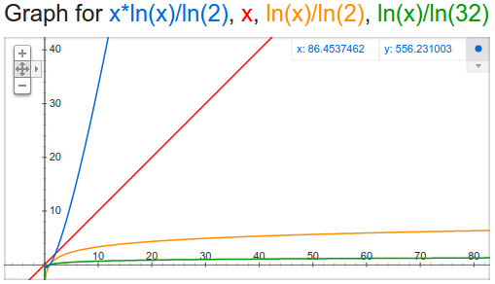
Asymptotic Growth (re: Collection Speed)
y = x * ((ln x) / (ln 2)) O(n × log₂ n)
y = x O(n)
y = (ln x) / (ln 2) O(log₂ n)
y = (ln x) / (ln 32) O(log₃₂ n)

Slide 3
Choosing a Collection
 | Ordered | Unordered
Duplicates | Vector setItemAt(int n, E e) T getItemAt(int n) O(3) O(log₃₂ n)
No Duplicates | TreeSet put(E e) contains(E e) first() rest() O(log₂ n) | HashSet put(E e) contains(E e) O(3) O(log₃₂ n)
No Duplicates | TreeMap put(K k, V v) V get(K k) first() rest() O(log₂ n) | HashMap put(K k, V v) V get(K k) Set<Entry<K,V>> entrySet() O(3) O(log₃₂ n)

