Slide 1
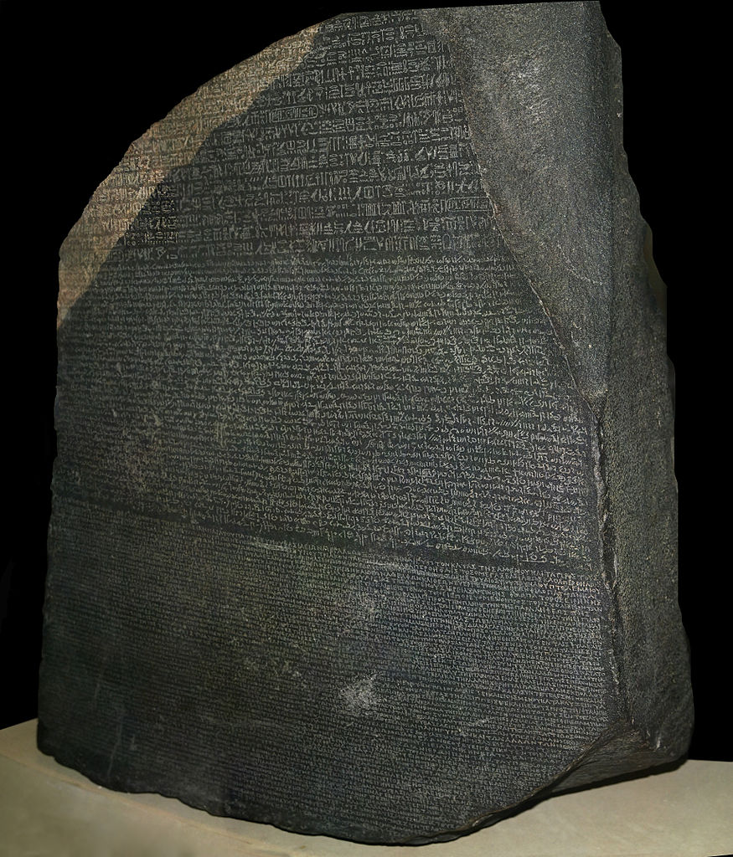
A Common Refactoring Problem vs. Three Languages
Java, Scala, and Clojure
Talk © Glen K. Peterson / CC-BY-SA-3.0
Image © Hans Hillewaert / CC-BY-SA-3.0

Slide 2
Outline
Motivations
Initial design
  Java
  Scala
  Clojure
Problem
Second design with refactoring
  Java
  Scala
  Clojure
Conclusions

Slide 3
Motivations
The earlier in the development cycle you catch an error, the cheaper it is to fix.
Type-safety catches errors at compile time, before code is checked into source control, tested, or shipped, meaning just one programmer and their compiler are involved = cost savings!
Assessing the value of type-safety in the abstract proved too difficult.
Assessing the relative strengths and weaknesses of type safety by comparing specific languages is a much easier problem.
But type safety is not free! It has a cost measured in code complexity and initial productivity.

Slide 4
Problem Description: Original Design
Represent a specific month of a specific year
This problem has come up at both places I've worked in the last 13 years.
Ideas?

Slide 5
Problem Description: Original Design
Represent a specific month of a specific year
A “Fiscal Month”, not a date! Doesn't necessarily correspond exactly to a calendar month
Two Fields:
  Year
  Month
Simple
No packing/unpacking
Fast modification
Easy to read

Slide 6
Java Interface
public interface YearMonthInterface {
public int getYear();
public int getMonth();
}
A Java interface defines methods.

Slide 7
Problem Description: Queries
-- Querying a single YearMonth is Simple,
-- safe, and fast!
select * from monthly_thing mr
where mr.year = :year and
mr.month = :month

Slide 8
Format for upcoming code
Present typical solutions
  Java
  Scala
  Clojure
Each solution:
  Includes addMonths function
  Meaningful toString
  Immutable
  Hopefully idiomatic for that language

Slide 9
Show Code
Show Original Code

Slide 10
Query Problems
-- Querying a single YearMonth is Simple,
-- safe, and fast!
select * from monthly_thing mr
where mr.year = :year and
mr.month = :month
-- But querying a range is Confusing,
-- error-prone, and slow.
select * from monthly_thing mr
where (mr.year > :startYear and
mr.year < :endYear) or
(mr.year = :startYear and
mr.month >= :startMonth) or
(mr.year = :endYear and
mr.month <= :endMonth)
order by mr.year, mr.month

Slide 11
Problem Description: Changed Design
One Field:
  Year * 100 + Month = YyyyMm
Sorting alphabetically = sorting numerically = sorting by date
Still easy to read
Easy/fast to query either singly or as a range.

Slide 12
Better Queries
-- Simpler, still safe, and faster!
select * from monthly_thing mr
where mr.yyyy_mm = :yyyyMm
-- Simpler, safer, and faster!
select * from monthly_thing mr where
mr.yyyy_mm >= :startYyyyMm and
mr.yyyy_mm <= :endYyyyMm
order by mr.yyyy_mm

Slide 13
Problem Description: Java Thoughts
Would I write an adapter, then wrap each implementing class in the adapter everywhere it is used?
No. That's just as much or more work than updating all the implementing class.
Problems like this happen all the time. Sometimes it is a change of data representation, sometimes a change of function signature or functionality.

Slide 14
Show Code
Show Changed Code Now

Slide 15
Scala and Clojure
The big wins associated with these languages have to do with an assumption of immutability and functional programming.
 | Scala | Clojure
Types | Strongly type-safe | Dynamic
Syntax | C/Java (with a little Haskell) | Lisp
Style | Object-Oriented and Functional | Functional
Attitude | Trying to please | We Provide the Right Way
The biggest differences between them are their views of type safety and general community attitude

Slide 16
Additional Solutions
Java: OOP:Interpreters, Functional:Visitors
  Any good typing course can improve your speed and accuracy.
Scala: Traits are the official solution (as shown)
  “Independently Extensible Solutions to the Expression Problem” paper by Zenger/Odersky
Clojure: simplicity. defrecord/defprotocol or multimethods.
  “Clojure's Solutions to the Expression Problem” talk by Chris Houser on InfoQ

