Slide 1
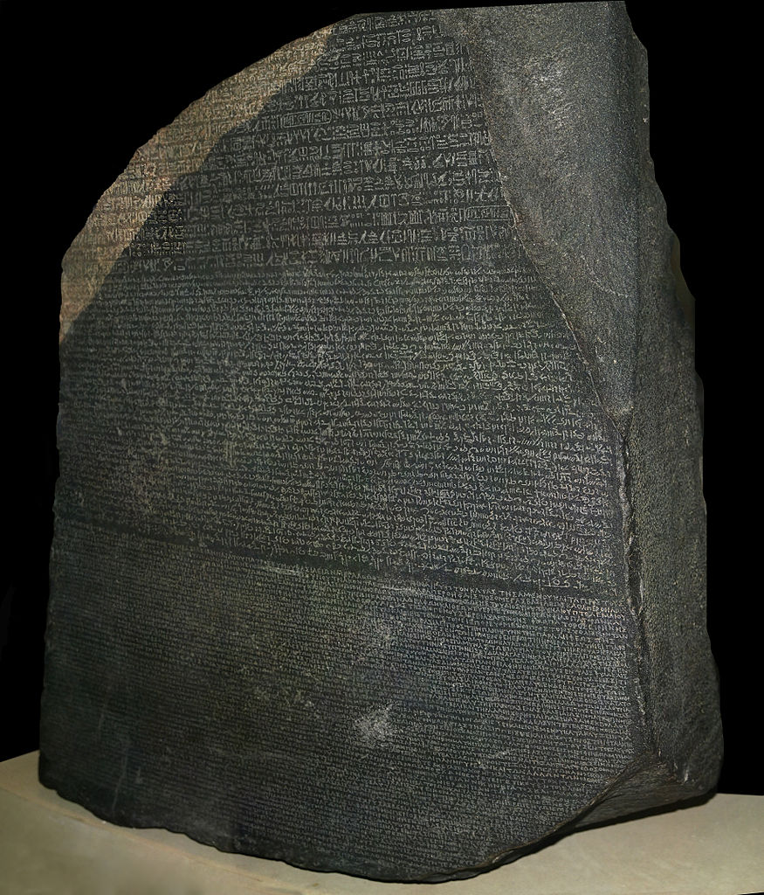
Type Safety and Refactoring in
Java, Scala, and Clojure
Glen Peterson
@GlenKPeterson
Talk © 2014 Glen K. Peterson / CC-BY-SA-3.0
Image © Hans Hillewaert / CC-BY-SA-3.0

Slide 2
Outline
Motivations
Initial design
  Java
  Scala
  Clojure
Problem
Second design with refactoring
  Java
  Scala
  Clojure
Conclusions

Slide 3

What is Type Safety?
Image: http://en.wikipedia.org/wiki/File:Kobushi-mini-dvi.jpg

Slide 4
Benefits of Type Safety:
“The earlier in the development cycle you can find a bug, the cheaper it is to fix.” Catching bugs in the compiler or IDE is many times cheaper than a bug a client discovers in production.
Easier to maintain a large code base with type safety than without – especially refactoring.
Run-time performance on JVM languages is better with type safety.
Documenting Expectations/Limits (compiler verified documentation)
If fixing one thing breaks anything else, type safety forces you to fix all of those things before your code will compile, hence “safe.”

Slide 5
Benefits of Dynamic Languages:
“I'm more productive without worrying about types.”
Try out half-baked ideas quickly to see how well they work - don't have to “make all the types work out” before you can compile something just to try it.
Solve the core problem first, then sweat out the details.
Can be less code
Can be simpler code
Design as you go.

Slide 6
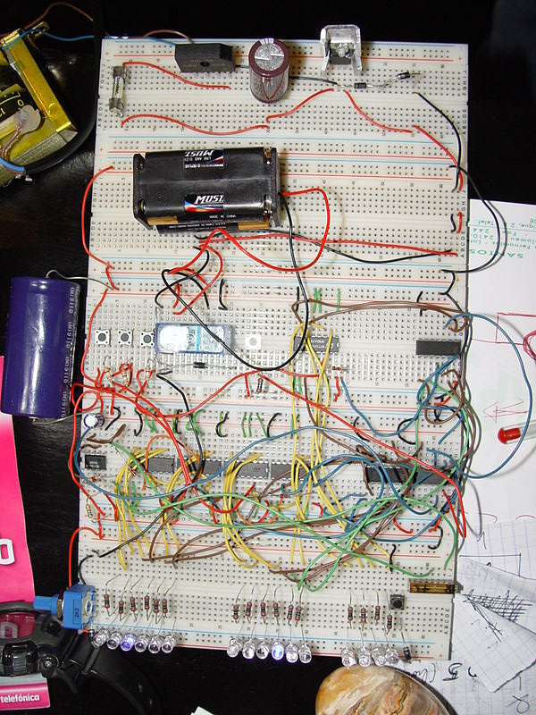

Type Safety: Good or Bad?
Image: http://en.wikipedia.org/wiki/File:Computer-connector-sockets.jpg
Image: http://commons.wikimedia.org/wiki/File:Relogio_binario.JPG

Slide 7
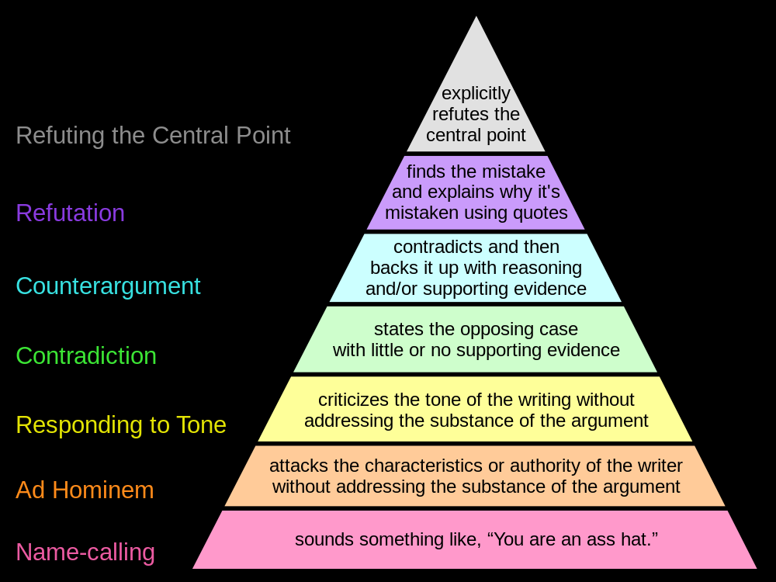
Paul Graham's Disagreement Hierarchy
http://commons.wikimedia.org/wiki/File:Graham's_Hierarchy_of_Disagreement.svg

Slide 8
Problem Description: Original Design
Work with dates as a year and month combination, ignoring days
A “Fiscal Month”, not a date! Doesn't necessarily correspond exactly to a calendar month
Two Fields:
  Year
  Month
Simple
No packing/unpacking
Fast modification
Easy to read

Slide 9
Java Interface
public interface YearMonthInterface {
public int getYear();
public int getMonth();
}
A Java interface defines methods.

Slide 10
Problem Description: Queries
-- Querying a single YearMonth is Simple,
-- safe, and fast!
select * from monthly_thing mt
where mt.year = :year and
mt.month = :month

Slide 11
Format for upcoming code
Present typical solutions
  Java
  Scala
  Clojure
Each solution:
  Includes addMonths function
  Meaningful toString
  Immutable
  Hopefully idiomatic for that language

Slide 12
Show Code
Show Original Code

Slide 13
Query Problems
-- Querying a single YearMonth is Simple,
-- safe, and fast!
select * from monthly_thing mt
where mt.year = :year and
mt.month = :month
-- But querying a range (start-ym to end-ym)
-- is Confusing, error-prone, and slow.
select * from monthly_thing mt
where (mt.year > :startYear and
mt.year < :endYear) or
(mt.year = :startYear and
mt.month >= :startMonth) or
(mt.year = :endYear and
mt.month <= :endMonth)
order by mt.year, mt.month

Slide 14
Problem Description: Changed Design
One Field:
  Year * 100 + Month = YyyyMm
Sorting alphabetically = sorting numerically = sorting by date
Still easy to read
Easy/fast to query either singly or as a range.

Slide 15
Better Queries
-- Simpler, still safe, and faster!
select * from monthly_thing mt
where mt.yyyy_mm = :yyyyMm
-- Simpler, safer, and faster!
select * from monthly_thing mt where
mt.yyyy_mm >= :startYyyyMm and
mt.yyyy_mm <= :endYyyyMm
order by mt.yyyy_mm

Slide 16
Problem Description: Java Thoughts
Would I write an adapter, then wrap each implementing class in the adapter everywhere it is used?
No. That's just as much or more work than updating all the implementing class.
Problems like this happen all the time. Sometimes it is a change of data representation, sometimes a change of function signature or functionality.

Slide 17
Show Code
Show Changed Code Now

Slide 18
Other Considerations
Compiling Scala is slow, taking 2-3x as long as Java. Sbt, on the other hand, is extremely clever, maximizing processor usage and deciding not to compile everything unless it needs to, so compiling Scala with SBT may effectively be faster than compiling Java with Ant.
Compiled Clojure code executes about 50% slower than comparable Scala/Java code
Both Scala and Clojure require a few small jar files to compile which hold their specific APIs.

Slide 19
Recap: All Three Languages:
Accomplished the work
Required specifying logic/functions

Slide 20
Clojure vs. Java
Rich Hickey says, “Clojure is a replacement for Java”
Jason Wolfe's* team started missing type-safety-ish guarantees in Clojure after 3 Person Years (Jason authored Prismatic/schema).
REPL == easier testing as you go. Ends bad ideas quickly.
Less code == simplicity
Lisp == simplicity
Strongly functional == safety
Assumes immutability == safety

Slide 21
Scala and Clojure
The big wins associated with these languages have to do with an assumption of immutability and functional programming.
 | Scala | Clojure
Types | Strongly type-safe | Dynamic
Syntax | C/Java (with a little Haskell) | Lisp
Style | Object-Oriented and Functional | Functional
Attitude | Keep adding features | One way, but simple

Slide 22
Poor Java...
Java solved virtually every major issue with C++
Popularized fast, reliable garbage collection
Created the JVM which these other two languages are built on.
Huge API and existing tool set is accessible from both Scala and Clojure
Good if memory is so critical that you couldn't add 2-4MB of Jar files for the other languages?
Maybe best used to write the core of Scala and Clojure?

Slide 23
Type-safe Scala
Has ???, Nothing, and Anything types so that you can compile to try things out without dotting every I and crossing every T
Type safety is an iron-clad guarantee vs. certain kinds of bugs. Testing can only ever catch what you test for. Fewer tests means simpler code.
Types are documentation that the compiler verifies. This can make code easier to READ.
Ideal for large projects, multiple developers

Slide 24
Dynamic Clojure
Define functions / data-transformations first
Data structures almost disappear altogether
Less to think about when coding – simpler and faster to WRITE
The cost is run-time safety and compiler-enforced documentation
Comprehensive unit test coverage can mitigate this risk, but that is another kind of effort, which introduces complexity and keeping tests updated has a high maintenance cost.
Ideal for < 3 person-year projects
Prismatic/schema apply safety after-the-fact

Slide 25
Additional Solutions
Java: OOP:Interpreters, Functional:Visitors
  Any good typing course can improve your speed and accuracy.
Scala: Traits are the official solution (as shown)
  “Independently Extensible Solutions to the Expression Problem” paper by Zenger/Odersky
Clojure: simplicity. defrecord/defprotocol or multimethods.
  “Clojure's Solutions to the Expression Problem” talk by Chris Houser on InfoQ

