Slide 1
Recovery Techniques
Recovery concepts
Recovery techniques based on Deferred Update
  No-UNDO/REDO
Recovery techniques based on Immediate Update
  UNDO/REDO
Shadow paging (No-undo/No-redo)
Recovery in multidatabase transactions

Slide 2
Database Recovery
1.1 INTRODUCTION
  Nothing can work perfectly 100% of the time.
  In system R, approximately 10% of the code is devoted to recovery; moreover, that 10% was quite difficult to write. In IMS, the figure is even larger.
  Recovery: Restoring a database to a correct state from an incorrect state caused by some system failure.
  Possible failures:
    programming errors in an application , OS, or DBMS,
    H/W errors on a device, channel, or CPU.
    operator errors
    fluctuations in a power supply,
    fire in the machine room,
    etc.

Slide 3
Solution for recovery: redundancy
  any piece of information in a DB can be reconstructed from some other information stored redundantly somewhere else in the system.
What are the disadvantages of duplicating a DB for recovery?
  need twice as much storage
  have to operate two DBs simultaneously
  two DBs should have independent failure modes?
  . . .

Slide 4
Roughly speaking, a recovery procedure can be outlined as follows:
  periodically, the entire DB is copied to archive storage (tape),
  every change to a DB is written to the log, which contains the old and new values of the changed item,
  if a failure occurs, there are two possibilities:
    The DB is damaged:
      restore DB by copying it from the most recent archive copy
      redo all changes, using the log, to the DB copy.
    The DB is not damaged but its contents are unreliable (e.g. incorrect S/W:
      restore DB to a correct state by using the log to undo all “unreliable” changes. The archive copy is not needed in this case.

Slide 5
Types of failure:
  Transaction-level failures 【§1.3】
    detectable by the application code (e.g., INSUFFICIENT FUNDS in TRANSFER)
    undetectable by the application code (e.g., arithmetic overflow)
  System-wide failures: cause no damage to DB【§1.4】
  Media failures: cause damage to DB 【§1.5 (skip)】

Slide 6
1.2 TRANSACTIONS
A unit of work; it consists of the execution of an application-specified sequence of operations.
application program:
...................
BEGIN TRANSACTION
....................
COMMIT or ROLLBACK (one of them)
An application program can have several transactions.
A transaction cannot be partially successful. It is atomic.

Slide 7
Reliability:
  If a transaction succeeds, good;
  If it fails, then nothing should be done (the effect should be as if it had never started).
  If a transaction is executed, it is in effect executed exactly once.
  Reliability of a DB is provided by the recovery manager.
Messages:
  Transaction termination is planned (commit or rollback) ==> message displayed
  Transaction termination is unplanned (e.g., overflow) ==> system-generated error messages should be automatically displayed (==> output messages should not be transmitted until the end of transaction.

Slide 8
To implement this:
  use a queue to pend the output message
  on planned termination ==> transmit the message
  on unplanned termination ==> discard the message
Data communication (DC) manager handles messages and the queue.
Tasks of DC manager:
  on receipt of an input message (e.g., transfer ... from ... to ...)
    writes a log record containing the input message
    places a message on the input queue
  on planned termination:
    write a record on the log (commit or rollback)
    arrange for transmission of output message (or cancel the output message on unplanned termination)
    remove input message from the input message queue

Slide 9
1.3 Transaction failures (unplanned)
For example, arithmetic overflow, memory overflow, bugs in system software, ....
A rollback for a transaction failure is to
  cancel output messages the transaction has produced
  undo changes made by the transaction to DB
    by working backward through the log until the BEGIN TRANSACTION record is reached
On-Line Log:
Multi-Mbytes (or even Gbytes) of log data may be generated per day
Impossible to keep the entire log on-line. But from performance point of view, to keep log data on direct access device is necessary.

Slide 10
BFIM(Before image): the old value of a data item before update.
AFIM (After image): the new value after update.
Write-ahead log:
The log entry must be flushed to disk before the BFIM is overwritten with the AFIM.
Rollback:
Undo changes made by the transaction to DB by working backward through the log.
REDO/UNDO Logic:
  A rollback is subject to failure too. Therefore, the recovery manager may need to redo/undo an update for multiple times. REDO(REDO(…(X))) = REDO(X) UNDO(UNDO(....(X))) = UNDO(X)
  That is
  Rollback(Rollback(…..(Transaction)))
  = Rollback(Transaction)

Slide 11
Long Transactions:
  A transaction should be short to reduce the amount of undoing and redoing work.
  It is good to subdivide a long transaction in an application into multiple transactions with explicit COMMITs.

Slide 12
Log Compression:
For the sake of reducing storage requirements and speeding up later use of log data for recovery.
  For transactions that failed to COMMIT, their log records are unnecessary since those transactions have already been rolled back.
  For transactions that did COMMIT, the old data values are of no use since undo will never be needed. (But REDO may be required in case of system failure in which new data is still needed.)
  Changes can be consolidated: +2+3+4 => +9

Slide 13
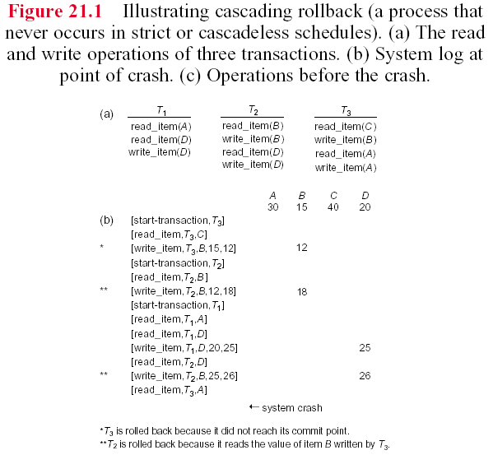

Slide 14
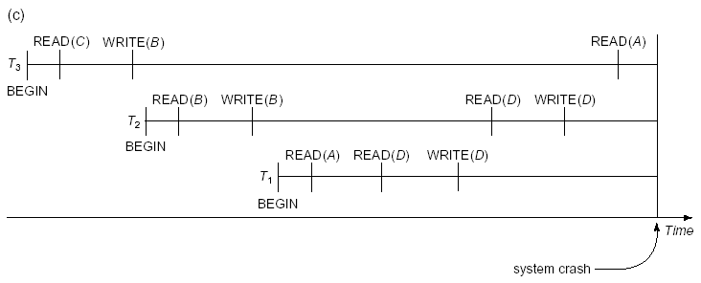

Slide 15
1.4 System Failures
  System failure: A failure causes system to stop and requires a subsequent system restart. Main storage contents are lost, but DB is not damaged.
  Action:
    Transactions that were in progress at the time of failure must be rolled back (undone).
    Transactions that were complete but not written to secondary storage need to be redone.
  Problem: How do we know which transaction to rollback and which to redo?
    It is too costly to search the BEGIN TRANSACTION and COMMIT (or ROLLBACK) from the very beginning of the log.

Slide 16
Checkpoint
A checkpoint record has
All transactions active at the time of checkpoint
The address of each transaction’s most recent log record.
Checkpoint actions:
Suspend execution of transactions temporarily.
Force-write all main memory buffers that have been modified to disk. 【不同的recovery protocol，在1~2二步有不同作法】
Write a [checkpoint] record to the log, and force-write the log to disk.
Resume the executing transactions.
New technique: “fuzzy checkpoint” allows the system to resume transaction processing after the checkpoint record is written to the log without having to wait for Step 2 to finish.

Slide 17
2. Recovery based on Deferred Update
Idea:
To defer updates to the DB until the transaction completes its execution successfully and reaches its commit point.
During transaction execution , the updates are recorded only in the log and in the cache buffers.
After the transaction reaches its commit point and the log is force-written to disk, the updates are then recorded in the DB.
The protocol
  A transaction cannot change the database until it reaches its commit point.
  A transaction does not reach its commit point until all its update operations are recorded in the log and the log is force-written to disk.
➔ Because the DB is never updated until after the transaction commits, there is never a need to UNDO any operations. Hence, it is known as a No-UNDO/REDO algorithm.
No-Undo: if transaction fails before commits.
Redo: if transaction fails after commits but not force-written to disk yet (controlled by OS).

Slide 18
2.1 Single-user environment
Algorithm
REDO all the write_item operations of the committed transactions since the last checkpoint from the log in the order in which they were written to the log.
Resubmit the active transactions.
REDO(Write_OP)
Access the operation’s log entry [write_item,T,X, new_value] for data item X of transaction T.
Set the new_value to X.

Slide 19
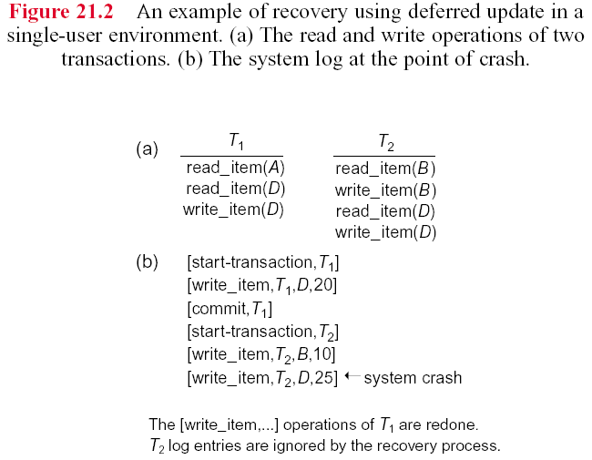
Deferred Update – Single user environment

Slide 20
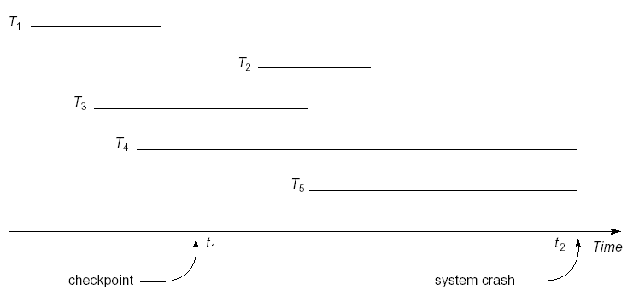
2.2 Multiuser environment
Algorithm
Same as that in the single-user environment.
Do nothing
redo
redo
Do nothing
Do nothing

Slide 21
2.3 Transaction actions that do not affect the DB
Transaction actions include generating and printing messages or reports from information retrieved from the database. These actions should not be done if a transaction fails.
Hence, these actions are done after the transaction reaches its commit point.

Slide 22
3. Recovery techniques based on Immediate Update
When a transaction issues an update, the DB can be updated immediately without waiting for transaction commit. (Certainly, an update operation still must be recorded in the log (write-ahead log protocol) before the update is applied to DB.)
Types:
All updates of a transaction are recorded in the DB on disk before the transaction commits ➔ Undo/No-Redo.
A transaction is allowed to commit before updates are written to DB in disk (i.e., updates of a transaction may or may not be recorded in the DB on disk before the transaction commits). ➔ Undo/Redo (the most complex technique – we only present this one)

Slide 23
3.1 Undo/Redo recovery based on Immediate Update in a single-user environment
Algorithm
Active transactions: UNDO all the write operations since the last checkpoint from the log in the reverse order.
Committed transactions: REDO all the write operations since the last checkpoint from the log (because some write op may not have been written to disk).

Slide 24
3.2 UNDO/REDO Immediate update with concurrent execution
Algorithm: same as that in the single-user environment.
Do nothing
redo
redo
undo
undo

Slide 25
4. Shadow paging
(No-Undo/No-Redo)
When updating database, the AFIMs are written to a new location different from that of the BFIMs.
Two tables are used:
Current page table: pointing to the most recent DB pages on disk
Shadow page table: pointing to the DB pages before transaction execution.
While crash occurs: discard current pages; back to the state before transaction executes (using the data referenced by the shadow page table); hence, No-Undo.
While transaction commits: discard shadow pages; hence, No-Redo.

Slide 26
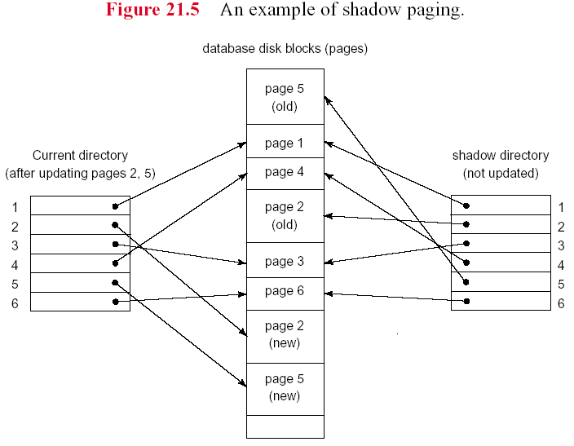
Advantages: no redo and no undo.
Disadvantages: the sizes of tables can be large; garbage collection is needed.

Slide 27
5. Recovery in multidatabase
(distributed DB) systems
A global recovery manager or coordinator is needed in addition to local recovery managers.
Two-phase commit protocol:
Phase 1: Voting phase
A global transaction is decomposed to subtransactions, each executed in a local DB. If each locate DB executes its subtransaction successfully (having force-written log records into disk), it sends an “OK” signal to the coordinator. Otherwise, the local database sends a “not OK” to the coordinator.
Phase 2: Commit phase
If the coordinator receives “OK” from all participating DBs, it sends a “commit” signal to all the DBs to commit the transaction. If any of the local DBs says “not OK”, then the coordinator sends an “abort transaction” (or rollback) to the DBs to undo the transaction.

