Slide 1
G2M Case Study
Virtual Internship program
May 13th 2024
Made by Glen Miasnychenko

Slide 2
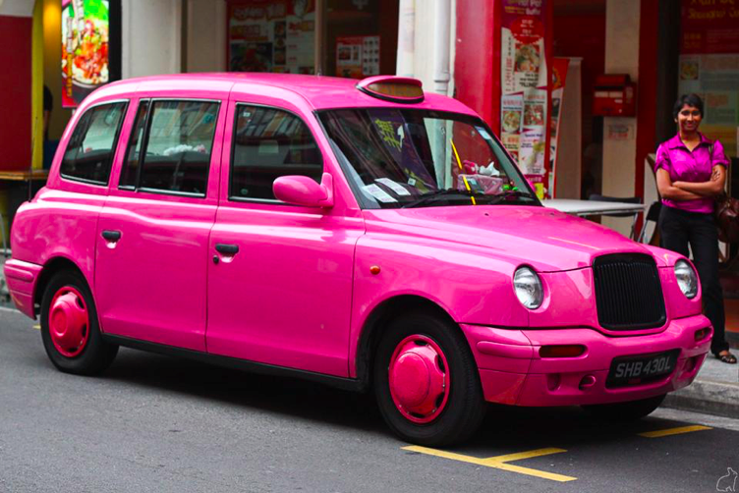
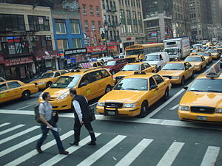
Program background
XYZ is a private equity firm in the US looking to invest into the Cab Industry.
We were given a dataset with the objective of analyzing the industry, and identify the best company to invest in.

Slide 3
Analysis structure
The analysis consists of these parts:
Profitability Analysis
Understanding Volatility
Average profit per kilometer
Average profit per ride
Geographical Analysis of Profits
Profit Forecast
Customer Analysis
Payment Method Analysis
Age Distribution
Income Distribution
Correlation Analysis
Recommendation

Slide 4
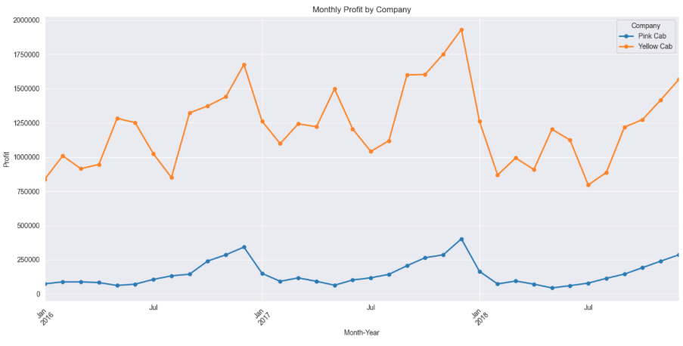
Profitability Analysis
The Pink Company makes significantly less profit than the Yellow Company;
The Profits of Yellow Company are much more volatile;
Both companies experience some seasonality, as the profits tend to rise in December.

Slide 5
Additional Metrics
Volatility in Monthly Profits (st. Dev.)
Pink Company | $90,063.96
Yellow Company | $282,089.04
Difference in average profit per kilometer
Pink Company | $2.77
Yellow Company | $7.10
Average Profit per Ride
Pink Company | $62.65
Yellow Company | $160.26

Slide 6
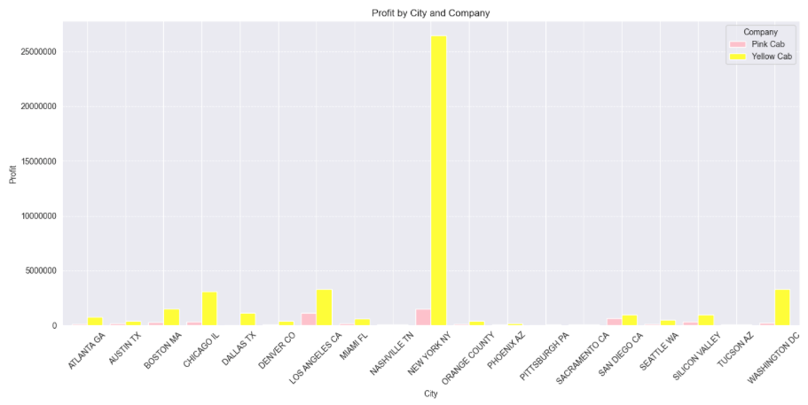
Geographical distribution of profits
The image shows that the Yellow Cab Company is heavily dependent on New York City and has some diversifications.
However, it is almost impossible to see the distribution of profit for the Pink Cab Company.

Slide 7
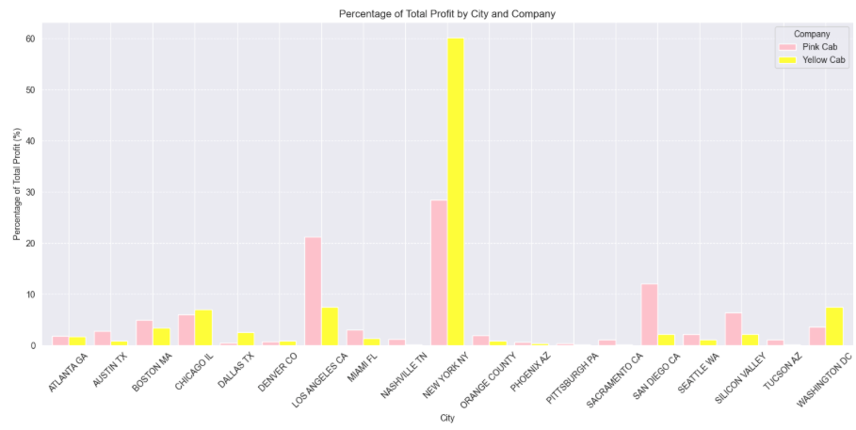
Relative geographic distribution of profits
Now that is much better. We can make the following conclusions:
60% of profits of the Yellow Cab company are generated in New York;
The Pink Company is much less dependent on the NY;
However, the Pink Company has significant portion of its profits coming from the West Coast.

Slide 8
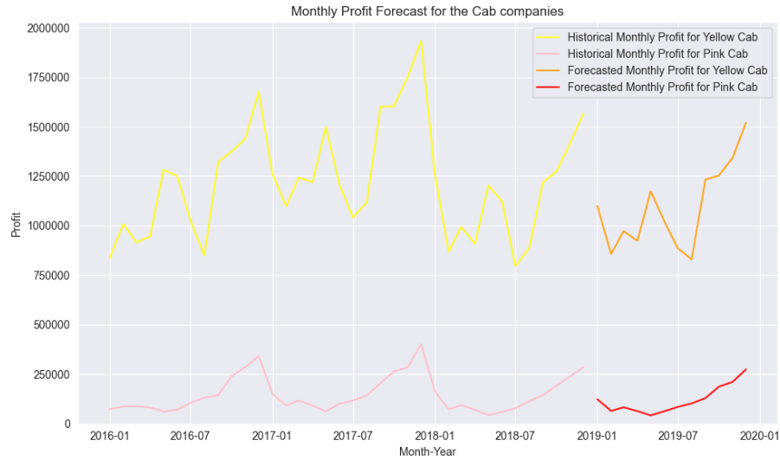
Profit forecast
We are going to use Holt-Winters Exponential Smoothing model to forecast our data. It will yield the best results as our data is highly seasonal.

Slide 9
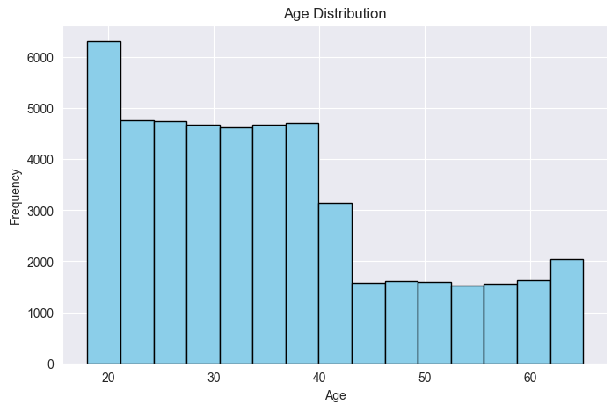
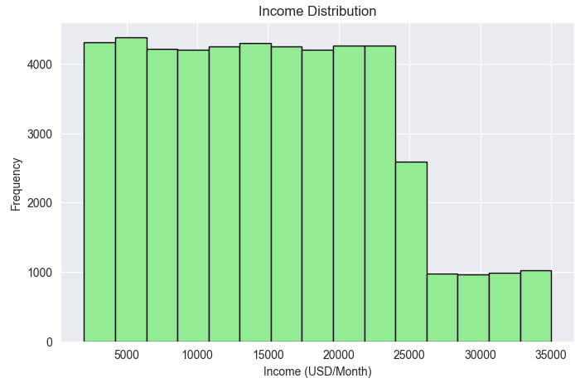
Customer analysis
Payment Method Distribution
Card | 59.98%
Cash | 40.02%
Gender Distribution
Male | 54.02%
Female | 45.98%

Slide 10
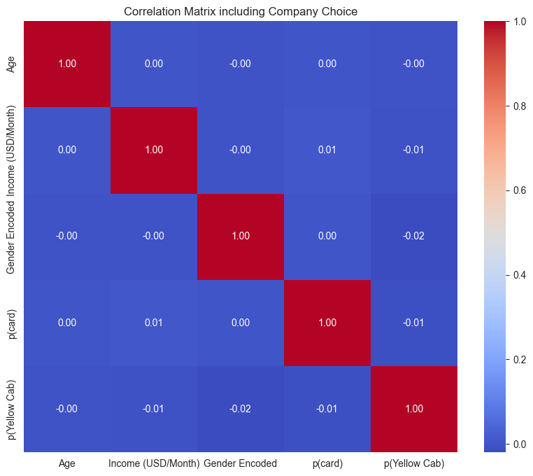
Correlation Matrix
We found out that:
there are almost 50 thousands users;
54% of them are male, and 46% are female;
60% of the transactions were paid by card, and 40% by cash;
majority of users are below age of 40 y.o.;
most of the users earn below $25,000 a month, with the distribution being uniform;
We would expect that there are some correlations. For example, it may be the case that male customers would correlate with higher income, or that age would be positively correlated with income.
Yet, the correlation matrix is telling us that there are no correlation between any of these metrics.

Slide 11
Recommendation
After the presented analysis we conclude that the Yellow Cab Company would be a better investment:
Yellow Cab Company has higher reach in the cities, while is more depended on New York;
Yellow Cab Company makes more profit per kilometer;
Yellow Cab Company has higher forecasted profit.
In order to diversify the investment portfolio, it may be beneficial to allocate some percentage into more stable, and more diversified (even though less profitable) Pink Company.

Slide 12

THANK YOU

