Slide 1
experimental design & programming
Week 15 (Seminar 3)
Part 1: The Assessment

Slide 2
This week
We will cover
Assessment information
Introduction to experimental confounds
Introduction to Stimulus Databases

Slide 3
Background to the assessment
In the Core course you have had
lectures about psychology as a science
RDA lectures including experimental design
Within these (among other things) you considered
experimental design
variables
how to improve reproducibility
the purpose of replication in psychology
controlling for extraneous variables in research studies
This assessment will require you to utilise some of that knowledge to support you in designing and implementing your assessment task

Slide 4
Dual Lexical Decision Task Reference: Meyer, D. E., & Schvaneveldt, R. W. (1971). Facilitation in recognizing pairs of words: Evidence of a dependence between retrieval operations. Journal of Experimental Psychology, 90, 227-234.
Early cognitive studies showed that when participants were presented with pairs of words that were either
related
unrelated
nonsense words/pseudowords
they responded faster and with better accuracy to the pairs of words that were related when compared with the unrelated pairs and the nonsense word pairs (Meyer and Schvaneveldt, 1971)

Slide 5
Dual Lexical Decision Task Reference: Meyer, D. E., & Schvaneveldt, R. W. (1971). Facilitation in recognizing pairs of words: Evidence of a dependence between retrieval operations. Journal of Experimental Psychology, 90, 227-234.
This is the task you will aim to replicate using PsychoPy Builder.
Read the starter reference provided to understand the aims and rationale for the task.
There is an online demonstration of a Lexical Decision Task here which you can try to see how it works for yourself

Slide 6
Weighting and deadlines
Overall Assessment Weighting (25% of 60 credits)
Method Section 12.5%
PsychoPy Experiment 12.5%
Method Section Submission Deadline:
NOON Via EDP Turnitin
PsychoPy Experiment:
Via Google Drive Repository
Please be aware that as this deadline is so late in the academic year there will be no representation opportunity. If you fail this assessment your next opportunity to take the assessment will be in August 2024

Slide 7
Method Section
Method section in format of a journal article
Word Document (maximum 600 words)
Design
Between/within/correlational?
Variables
IV - Levels
DVs
Materials
Describe the parameters that you set to control your stimuli in the experiment
See the Stimuli section of the reference provided for an example
Procedure
Describe how a participant would run the task
See the Procedure section of the reference provided for an example

Slide 8
Experiment
PsychoPy Builder Experiment
.psyexp format with any associated conds files and stimuli
Participant instructions
Practice block with 8 trials, with feedback
Trial block with 36 trials (must collect accuracy and RT data)
Debrief

Slide 9
experimental design & programming
Week 15 - Seminar 3
Part 2: Experimental confounds and controls

Slide 10
What is an experimental confound?
A confounding variable is an ‘extra’ variable that you didn't account for when designing the study
They can ruin an experiment and give you erroneous results
They are like extra independent variables that are having a hidden effect on your dependent variables

Slide 11
Why is this bad?
Confounding variables can cause two major problems
Increase variance
Introduce bias
You need to revisit RDA if you do not understand these terms
Remember that this part of the course links closely to RDA

Slide 12
Can you explain some confounds?
In the starter reference the authors identify two possible experimental confounds when using word stimuli
Word frequency
Semantic relationship between words
What do you think these terms mean?

Slide 13
Other possible confounds?
Key confounds in word stimulus studies have been mentioned in the assessment video and Activity Set and this is where literature searching will help you
Concreteness effect(Brysbaert, Warriner, & Kuperman, 2014)
Imageability effect (Richardson, 1975)
Word length effect (Jalbert et.al, 2011)
Syllabic length effect (Ferrand, 2000)
Word prevalence (Brysbaert et.al, 2019)
Word frequency effect (Brysbaert, Mandera, & Keuleers, 2018)
Homophone effect (Pexman, Lupker, & Jared, 2001)
Valence/Arousal (Kuperman, et.al. 2014)

Slide 14
Example 1: Concreteness
Definition: A concrete noun denoting a material object rather than an abstract quality, state, or action, e.g. dog, building, tree.
Behavioural studies suggest cognitive processing of concrete words > abstract words
Seen in a variety of experimental tasks:
episodic long-term memory (Jessen et al., 2000)
continuous recognition (Klaver et al., 2005)
lexical decision (Bleasdale, 1987)
working memory (Van Schie et al., 2005)

Slide 15
Example 2: Imageability
Definition: Imageability is a property of a word or concept reflecting how easy it is to visually or acoustically represent it
Behavioural studies suggest cognitive processing of high imageability words > low imageability words
Examples:
word recognition (Cortese & Schock, 2013)
word recall (Coltheart et. al., 1988)

Slide 16
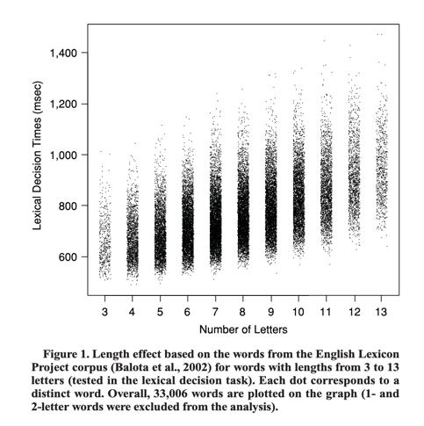
Example 3: Word length/syllabic effects
Word length – can –ve affect the time it takes us to cognitively process words
Syllabic effect can also increase the time to process (Chetail, 2014)
New, Ferrand, Pallier & Brysbaert (2006)

Slide 17
Example 4: Word frequency
When word recognition is analysed, frequency of occurrence is one of the strongest predictors of processing efficiency.
High-frequency words are
known to more people
processed faster than low-frequency words (Monsell, Doyle, & Haggard, 1989)
Homophones more frequent in language

Slide 18
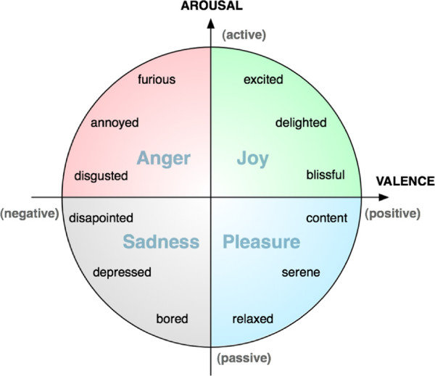
Valence/Arousal
Valence refers to emotional stimuli (words/images/sounds) and how positive or negative those stimuli are
Arousal also refers to emotional stimuli, in terms of how active or passive the stimuli are

Slide 19
So, what do we do?
What we don’t do is pluck stimuli out of thin air
THAT IS NOT SCIENCE
We read about the effects in the research literature
We decide what it is feasible to control for
We use tools to help us find appropriate stimuli

Slide 20
How do we do it?
Resource | Reference | Type
MRC Psycholinguistic Database | Wilson, M. (1988). MRC psycholinguistic database: Machine-usable dictionary, version 2.00. Behavior research methods, instruments, & computers, 20(1), 6-10. | Word database with selectable parameters
WordNorms.com | Buchanan, E. M., Holmes, J. L., Teasley, M. L., & Hutchison, K. A. (2013). English semantic word-pair norms and a searchable Web portal for experimental stimulus creation. Behavior research methods, 45(3), 746-757. | Word pair database
ARC Nonword Database | Rastle, K., Harrington, J., & Coltheart, M. (2002). 358,534 nonwords: The ARC Nonword Database. Quarterly Journal of Experimental Psychology, 55a, 1339-1362 | Nonword database

Slide 21
How does this fit with the assessment?
In the written part of the assessment
You should outline the potential confounding effects that you chose to control for
These are the parameters that you set in selecting the words/non-words
It is up to you to choose at least TWO sensible potential confounds to control for in your experiment. Justify them using previous literature

Slide 22
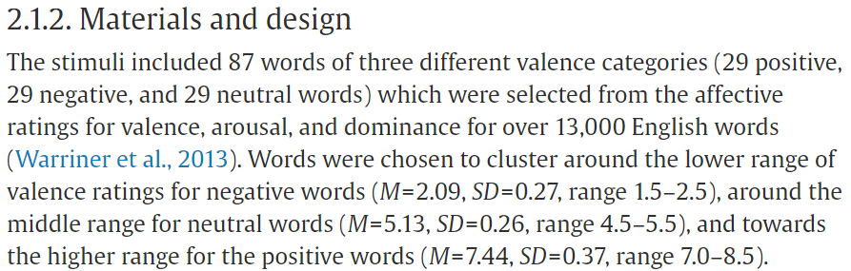
Example
Number of words used
Independent variable
Conditions/Levels
Supporting reference
Where the words came from
Parameters
From: Crossfield & Damian (2021)

Slide 23
References
Brysbaert, M., Mandera, P., & Keuleers, E. (2018). The word frequency effect in word processing: An updated review. Current Directions in Psychological Science, 27(1), 45-50. 10.1177/0963721417727521
Brysbaert, M., Mandera, P., McCormick, S. F., & Keuleers, E. (2019). Word prevalence norms for 62,000 English lemmas. Behavior research methods, 51, 467-479.10.3758/s13428-018-1077-9
Brysbaert, M., Warriner, A. B., & Kuperman, V. (2014). Concreteness ratings for 40 thousand generally known English word lemmas. Behavior research methods, 46, 904-911... 10.3758/s13428-013-0403-5
Chetail, F. (2014). Effect of number of syllables in visual word recognition: New insights from the lexical decision task. Language, Cognition and Neuroscience, 29(10), 1249–1256. 10.1080/23273798.2013.876504
Ferrand, L. (2000). Reading aloud polysyllabic words and nonwords: The syllabic length effect reexamined. Psychonomic Bulletin & Review, 7, 142-148. 10.3758/bf03210733
Jalbert, A., Neath, I., Bireta, T. J., & Surprenant, A. M. (2011). When does length cause the word length effect? Journal of Experimental Psychology: Learning, Memory, and Cognition, 37(2), 338–353. 10.1037/a0021804
Kuperman, V., Estes, Z., Brysbaert, M., & Warriner, A. B. (2014). Emotion and language: valence and arousal affect word recognition. Journal of Experimental Psychology: General, 143(3), 1065.10.1037/a0035669
Monsell, S., Doyle, M. C., & Haggard, P. N. (1989). Effects of frequency on visual word recognition tasks: Where are they?. Journal of Experimental Psychology: General, 118(1), 43.10.1037/0096-3445.118.1.43
Pexman, P. M., Lupker, S. J., & Jared, D. (2001). Homophone effects in lexical decision. Journal of Experimental Psychology: Learning, Memory, and Cognition, 27(1), 139–156. 10.1037/0278-7393.27.1.139
Richardson, J. T. (1975). Concreteness and imageability. The Quarterly Journal of Experimental Psychology, 27(2), 235-249. 10.1080/14640747508400483

