Slide 1
Building the Foundations of Success: Academic Confidence
Short Course 2024

Slide 2
Agenda
Introduce Academic Behavioural Confidence (ABC)
Activity 1 – Influencing Factors
Impact of ABC
Strategies
Activity 2 - Questionnaire
Discussion

Slide 3
Academic Behavioural Confidence
“Your confidence in your ability to organise, execute and regulate your academic performance to undertake & complete your studies at degree level”

Slide 4
Aspects of Academic Behavioural Confidence
Grades
Verbalising
Studying
Attending

Slide 5
Factors Influencing Academic Confidence
past academic performance
feedback and encouragement
perception of self and mindset
preparation

Slide 6
Activity 1

Slide 7
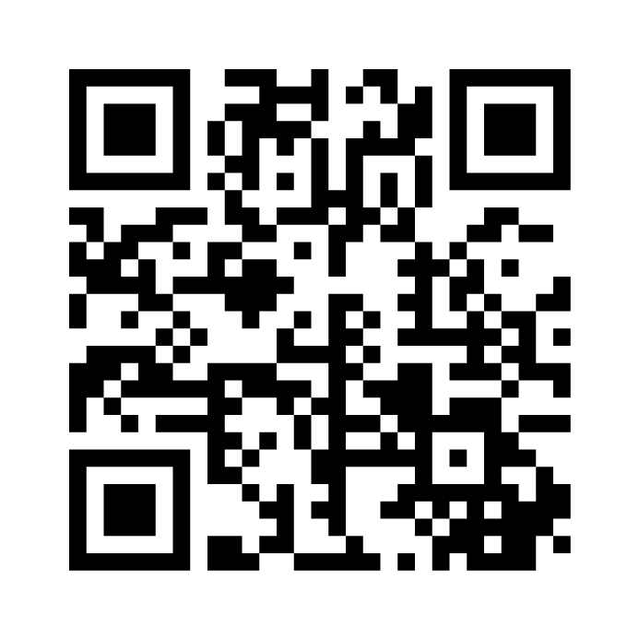
Activity 1 – Reflecting on influencing factors
https://www.menti.com/alewpcep3sbz
Notes:
https://www.menti.com/alewpcep3sbz Here I want you to reflect on the factors that have influenced your academic confidence so far. You can be free to write whatever you want, but this exercise will be most useful if you are prepared to discuss your influencing factors as you can think about this in your reflective piece and expand on it in the discussion.

Slide 8
Positive Impact of ABC
Students who are high in academic behavioural confidence exhibit…
a willingness to learn
the tenacity to face challenges head on
increased resilience

Slide 9
Discussion 10 minutes
Notes:
Discussion in breakouts
In breakout rooms you should discuss commonalities and differences in the factors that have influenced your confidence in your academic studies and how, by using the info in the last slide, you could start to think about those factors differently.
Nominate a group member to feed back to the whole group

Slide 10
Strategies to Improve ABC

Slide 11
Strategies
Goal Setting
Positive Mindset
Effective Study Habits
Managing Stress
Seek Feedback and Use it Constructively

Slide 12
Building & Sustaining ABC
Positive self-talk and affirmations
Setting and achieving small, incremental goals
Actively seeking and utilising constructive feedback
Reflecting on past successes and learning from failures

Slide 13
Feedback and Handling Criticism
Positive Feedback
Increases confidence
Fosters positive emotions
Negative Feedback
Lowers confidence
Can be upsetting

Slide 14
Activity 2

Slide 15
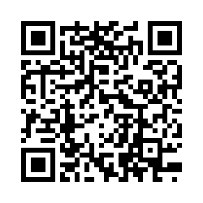
Activity 2
Scan the QR code to complete the Academic Behavioural Confidence Scale or go to https://liverpoolhope.fra1.qualtrics.com/jfe/form/SV_6u6CPvsXZ5Mou6q
Notes:
For this activity, the questionnaire will measure your personal Academic Behavioural Confidence

Slide 16
Discussion
Notes:
So how do you feel about your scores?

Slide 17
Activity 3

Slide 18
Thinking about confidence
Your own experiences
From observing others
From verbal feedback
From your emotional state

Slide 19
Discussion
Notes:
So how do you feel about your scores?

