Slide 1
Building the Foundations of Success: Confidence with Key Skills
Short Course 2024

Slide 2
Agenda
Introduce critical skills (CS)
Activity 1 - Mentimeter
Importance of CS
Activity 2 – Questionnaire
Break
Discussion

Slide 3
Critical Skills
“Critical skills are the skills that you will need to support you through university life and later employment. Attributes such as
the ability to communicate effectively, collaborate with others, employ critical thinking and the ability to use technology”

Slide 4
Why are we interested in Critical Skills
From our perspective:
Preparing students for effective learning
Preparing students for a rapidly changing employment market
Notes:
For us, if we can support you to develop your critical skill, we are helping to prepare you for an effective and more enjoyable learning environment. Hopefully, we can inspire you to want to know more. To want to learn more, to want to become the best version if yourself for whatever direction your future will take you. That is the desire for me. To help inspire a love of learning. Learning can’t and shouldn’t stop the second you complete the assessment, go to the pub after your exam, graduate…..
If you feel engaged with learning, if you feel the need to understand or know more, then we’ve done our job well. You are on the best footing for a ridiculously rapidly changing workplace.
AI for example…when I started learning about AI….it was all driverless cars…I can remember writing a seminar about intelligence and AI…will it ever be human like?….no more than 5 years later and it is something you should know about, appreciate, understand the pros and cons…..

Slide 5
Identifying critical skills?
Collaboration
Communication
Creativity
Self-Direction
Critical Thinking
Technology for Learning

Slide 6

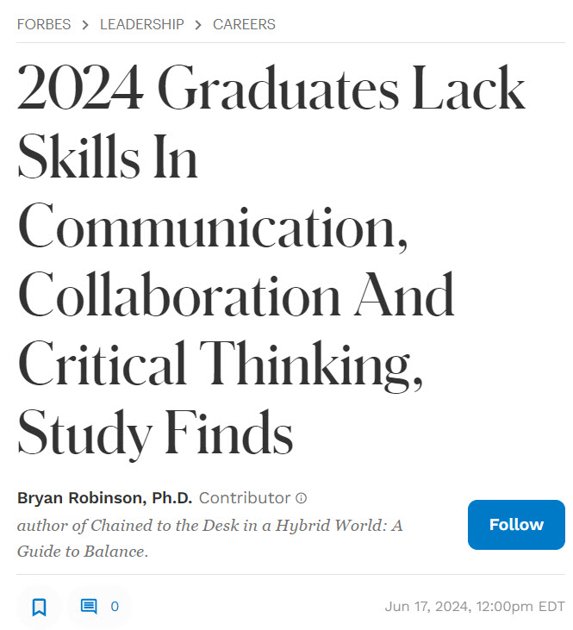

Critical Skills in the Media

Slide 7
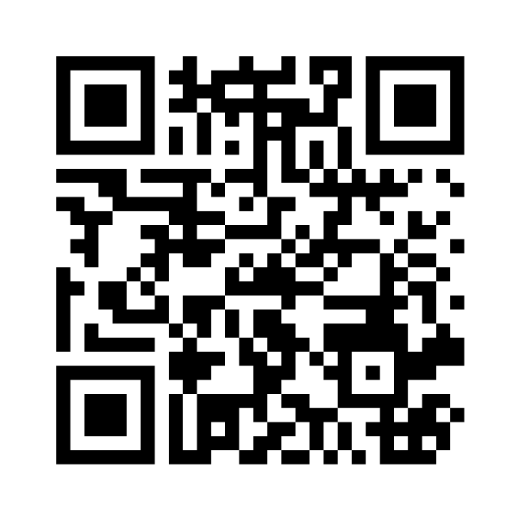
Activity 1 – Ranking Confidence in Critical Skills
https://www.menti.com/alec5ehy9tta
Notes:
https://www.menti.com/alec5ehy9tta

Slide 8
Discussion – Breakout Room

Slide 9
Supporting Critical Skill Development
Build critical skills into coursework and assessment
Depending upon your subject you might encounter assessments such as:
Verbal or Group Presentations
Reflective Essays
Traditional Essays
Research Reports
Timed In Class Tests
Statistical Analyses
Examinations
Theoretical Essays
Practical Assessments (e.g. art, software development, performances etc.)
Scientific Writing
Interventions
Writing for a naïve audience
and more….

Slide 10
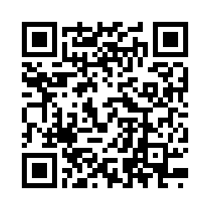
Activity 2 – Assess your Critical Skills
https://liverpoolhope.fra1.qualtrics.com/jfe/form/SV_0O3vhNsFk0CFMJE
Notes:
https://liverpoolhope.fra1.qualtrics.com/jfe/form/SV_0O3vhNsFk0CFMJE

Slide 11
Discussion

Slide 12
Activity 3 Action Plans

Slide 13
Reflective Essay Writing

