Slide 1
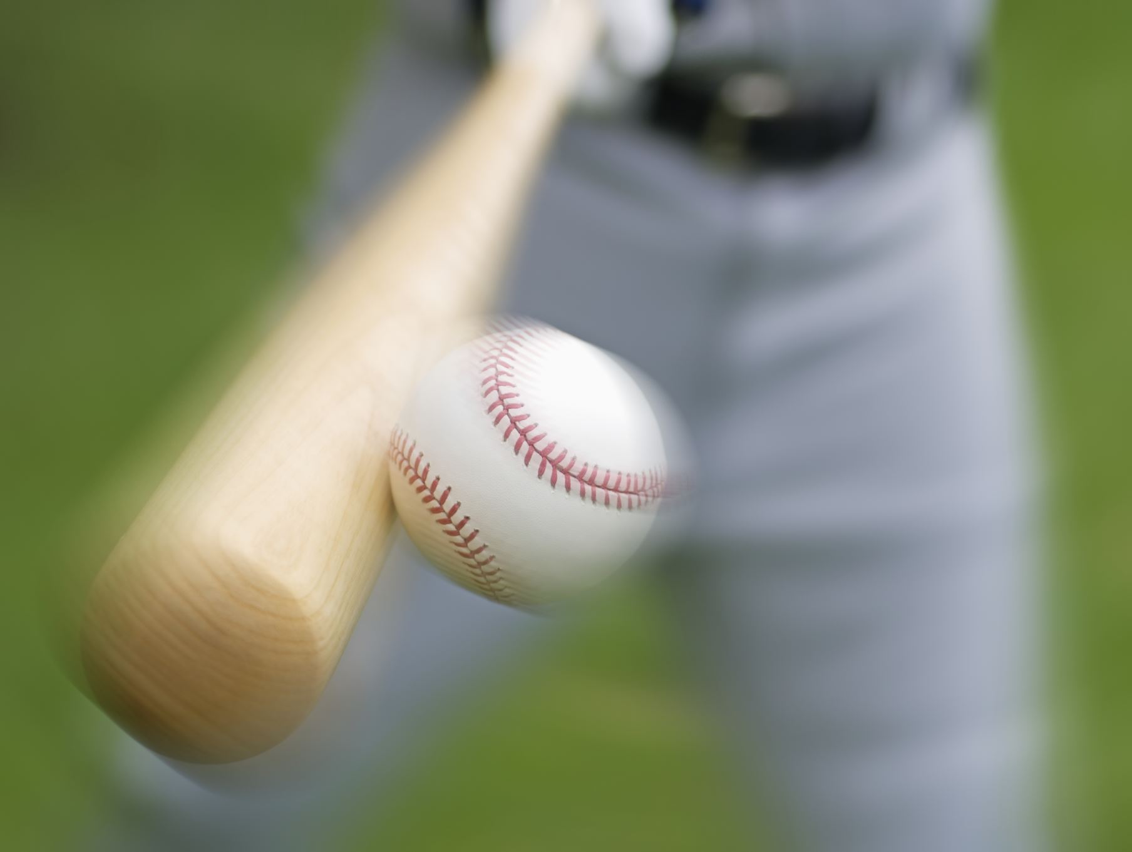
Baseball Video Detection Pipeline
Strengths & Improvements

Slide 2
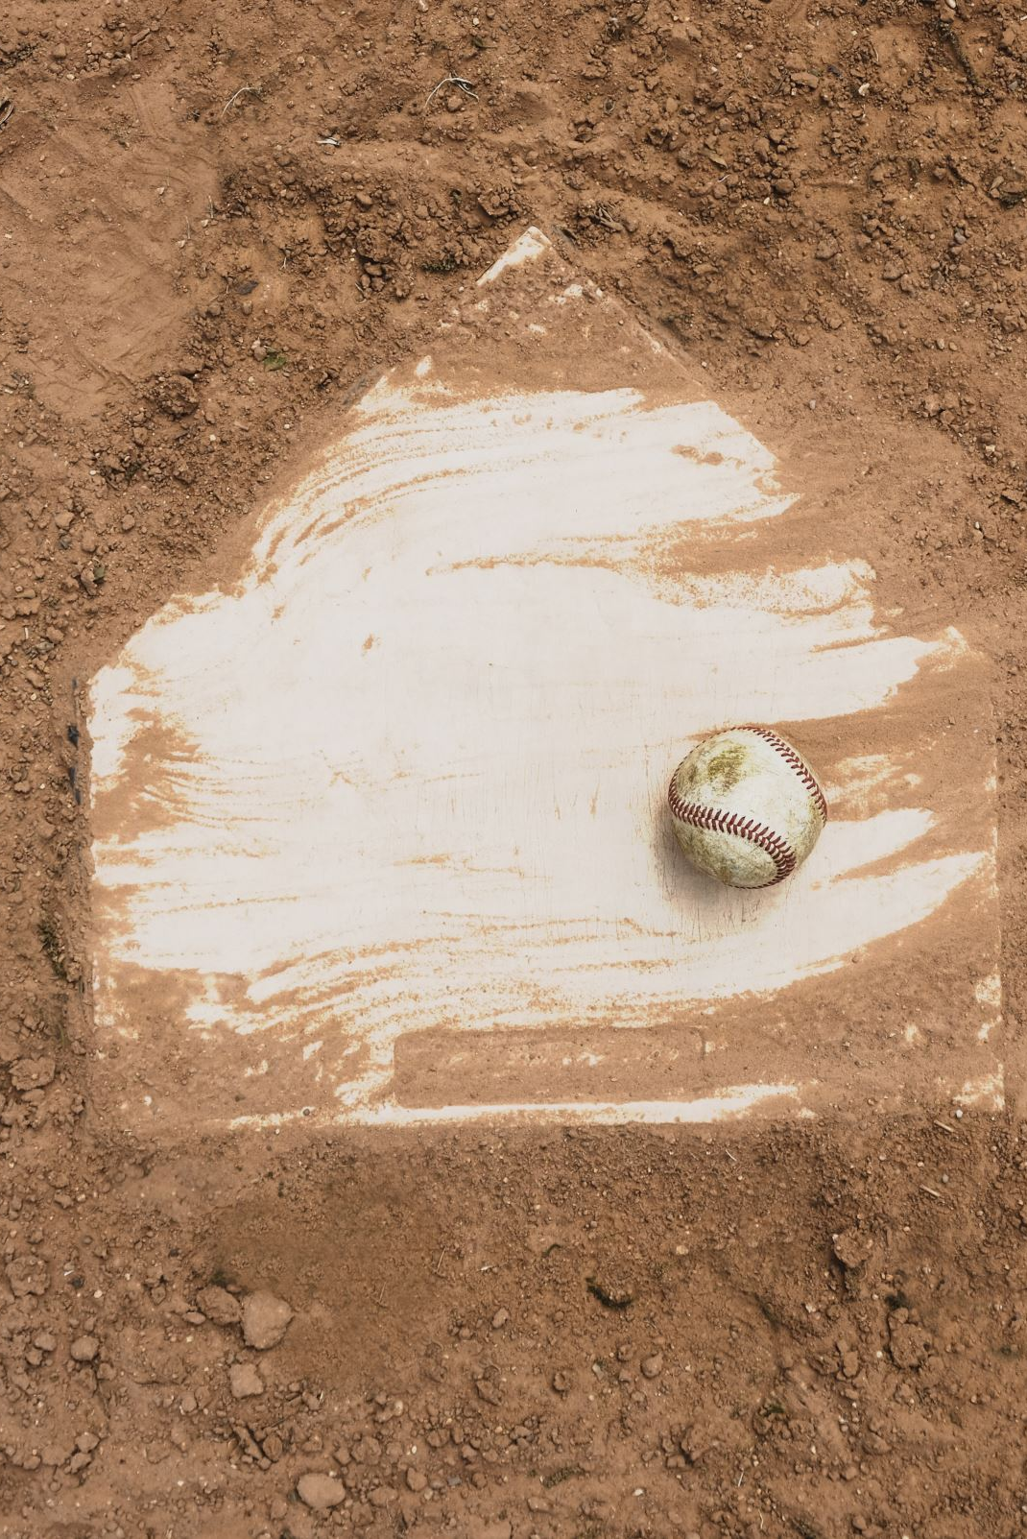
Overview
This presentation summarizes the strengths and improvement areas of the baseball video detection pipeline, which uses Faster R‑CNN for detecting moving vs. non‑moving objects in baseball footage.

Slide 3
Data Pipeline
3288 annotated frames across 76 videos

Slide 4
Model Architecture
ResNet-50 as our backbone
  ResNet-50 is a deep Convolutional Neural Network created by Microsoft in 2015
  Uses Residual Blocks to solve the vanishing/exploding gradient problem
    Activations skip layers to form residual block
  Extracts feature maps
Faster R-CNN as our feature proposal framework
Faster R-CNN’s main improvement over other Convolutional Neural Networks was Region Proposal Networks
  Integrates object proposals directly within the model
    Small network that slides over a feature map to decide an “Objectness” Score and bounding box coordinates
  Faster R-CNN pools the feature maps (Region of Interest pooling)
  Passes pooled feature maps to

Slide 5
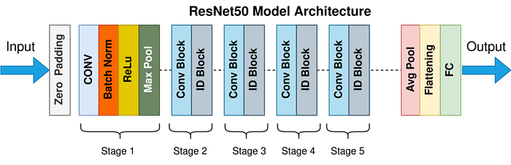
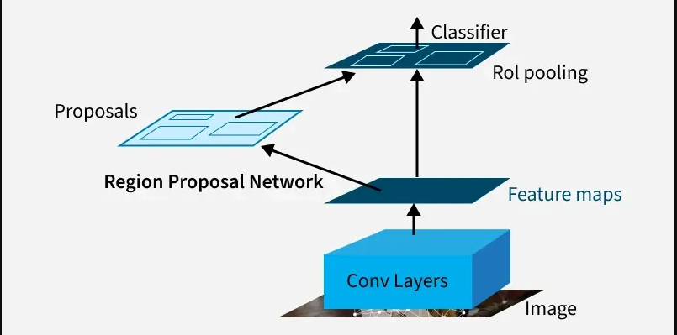
Model Diagrams
Diagram showing ResNet50’s structure
(Kundu, 2023)
Diagram of Faster R-CNN showing feature maps and region proposal network
(G4G, 2025)

Slide 6
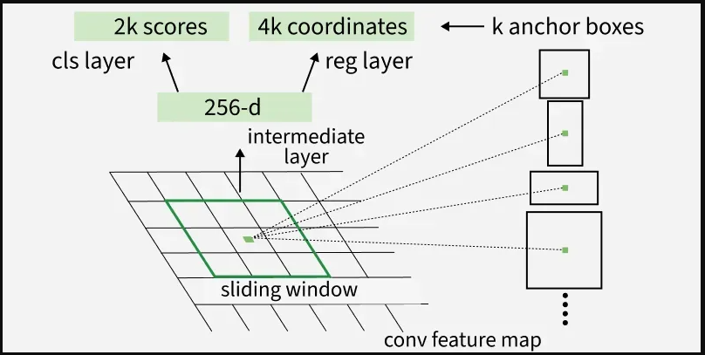
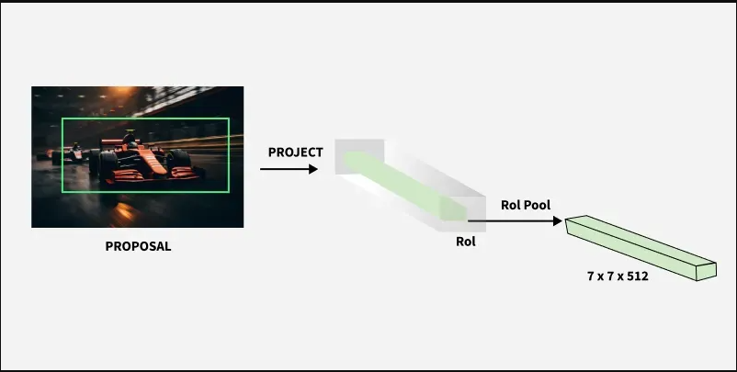
Model Diagrams Cont.
Diagram showing Faster R-CNN’s Regional Proposal Network
(G4G, 2025)
Diagram showing Faster R-CNN’s Region of Interest pooling
(G4G, 2025)

Slide 7
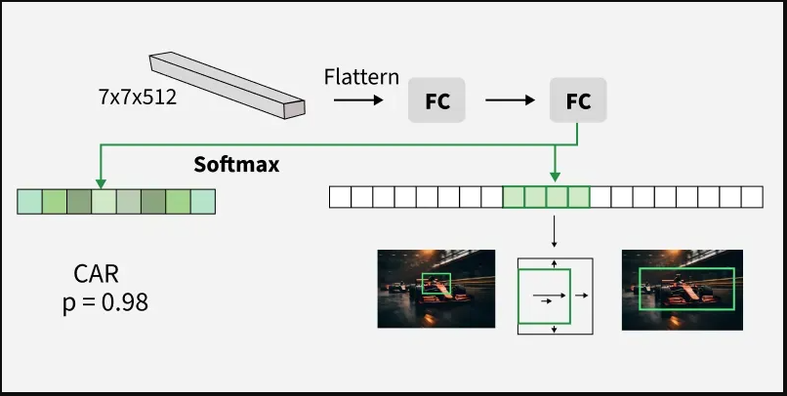
Model Diagrams Cont.
Diagram showing Faster R-CNN’s Detection Network
(G4G, 2025)

Slide 8
Key Strengths of the Pipeline
Modular design: video loading, XML parsing, dataset creation, model setup.
Preloading videos reduces frame‑level overhead during training.
Uses PyTorch’s Faster R‑CNN implementation tailored to the baseball domain.
Efficient dataset class linking videos to XML annotations.
Correct handling of class labels and safe annotation copying.
Improved accuracy evaluator with torch.no_grad() for efficient validation.

Slide 9

Areas for Improvement
  Add data augmentation to improve generalization.
  Strengthen frame–annotation alignment to prevent indexing drift.
  Consider pretrained backbones to reduce training time.
  Expand evaluation metrics beyond binary accuracy (add IoU, mAP, recall).
  Improve memory efficiency for larger datasets.
  Externalize hyperparameters into a configuration file.

Slide 10
Conclusion
The pipeline is well‑engineered, modular, and ready for research use. Enhancements—such as better metrics, pretrained models, augmentation, and scalability—will further strengthen its performance and applicability.

Slide 11
Works Cited
Kundu, N. (2023, January 1). Exploring Resnet50: An in-depth look at the model architecture and code implementation | by Nitish Kundu | Medium. Exploring ResNet50: An In-Depth Look at the Model Architecture and Code Implementation. https://medium.com/@nitishkundu1993/exploring-resnet50-an-in-depth-look-at-the-model-architecture-and-code-implementation-d8d8fa67e46f
https://www.geeksforgeeks.org/machine-learning/faster-r-cnn-ml/
https://www.geeksforgeeks.org/deep-learning/residual-networks-resnet-deep-learning/

