Slide 1



Mr Garnier
Mr Bureau
Mrs Canonne
PROJECT’S REPORT
DATA ANALYSIS, REPORTING AND VISUALIZATION PROJECT
RABERGEAU Loïs
ROUSSEL Flavien
VILLARD Paul
MAILLET Thibault
MADZOU-A-MIERE Glenn

Slide 2
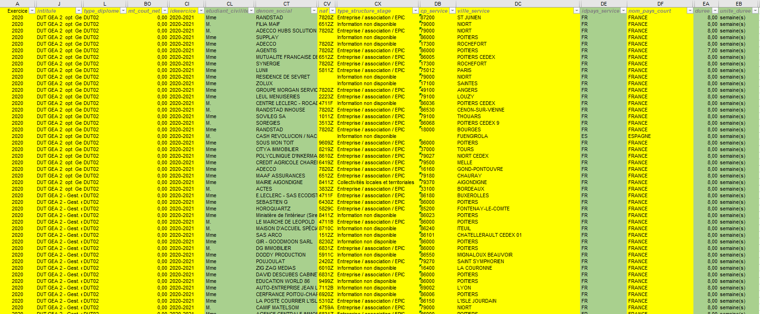
Introduction
Very important
Can be used
File : 5,000 rows and 130 columns

Slide 3



Course of action
I. Scrum Method
Flavien
II. Our Project
Thibault
III. Problems and projections
Paul

Slide 4



I. Scrum Method
II. Our Project
III. Problems and projections
Link of trello
Persona

Slide 5
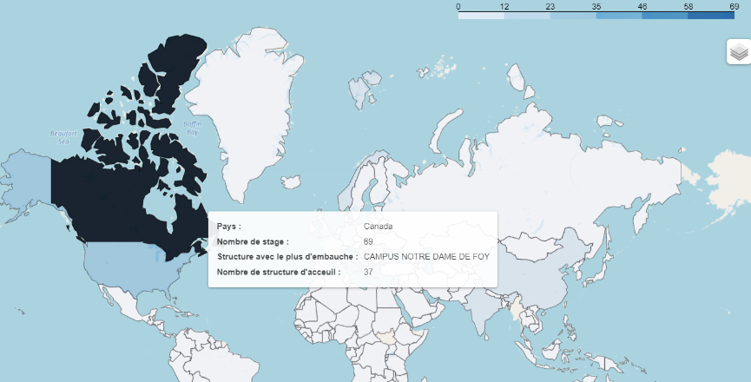
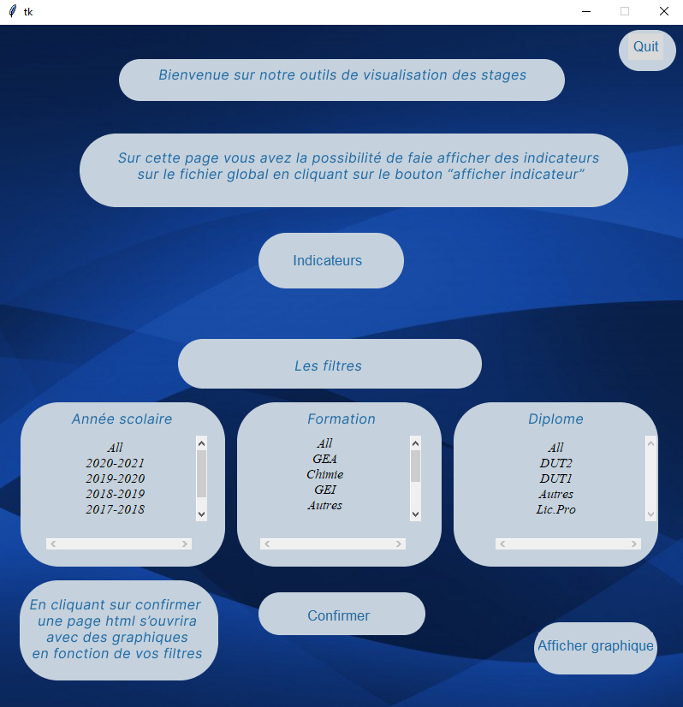
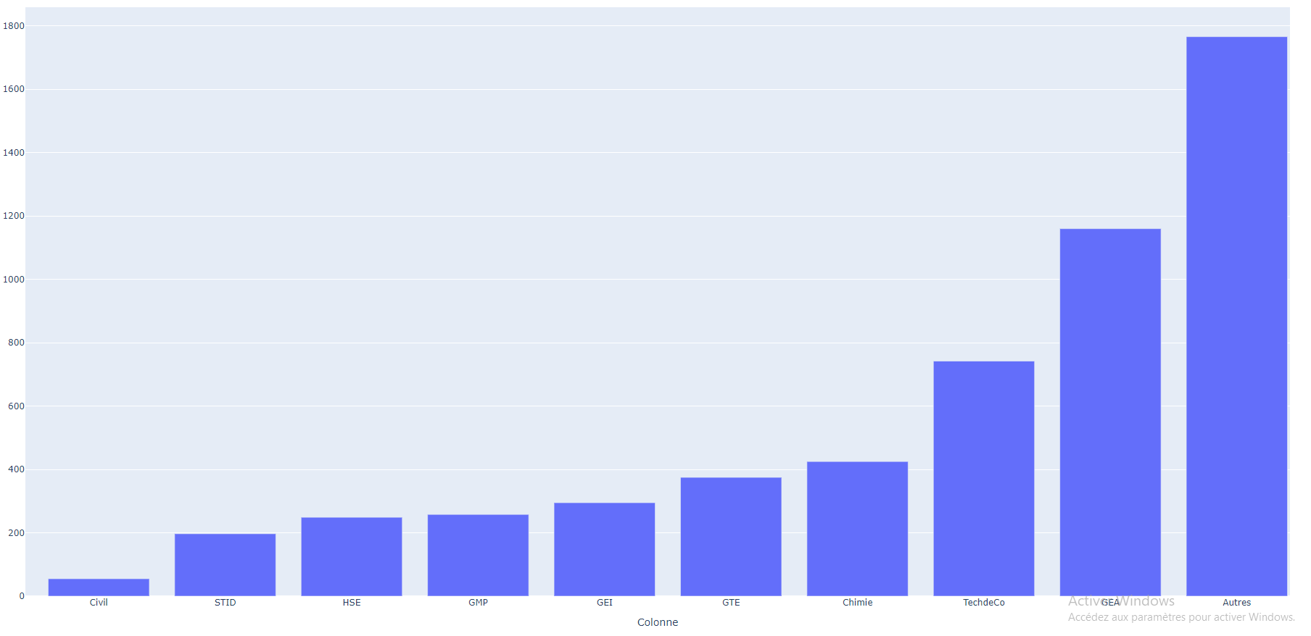
I. Scrum Method
II. Our Project
III. Problems and projections
Interface Tkinter
World map with
number of internships
per country
Distribution of internships by training

Slide 6
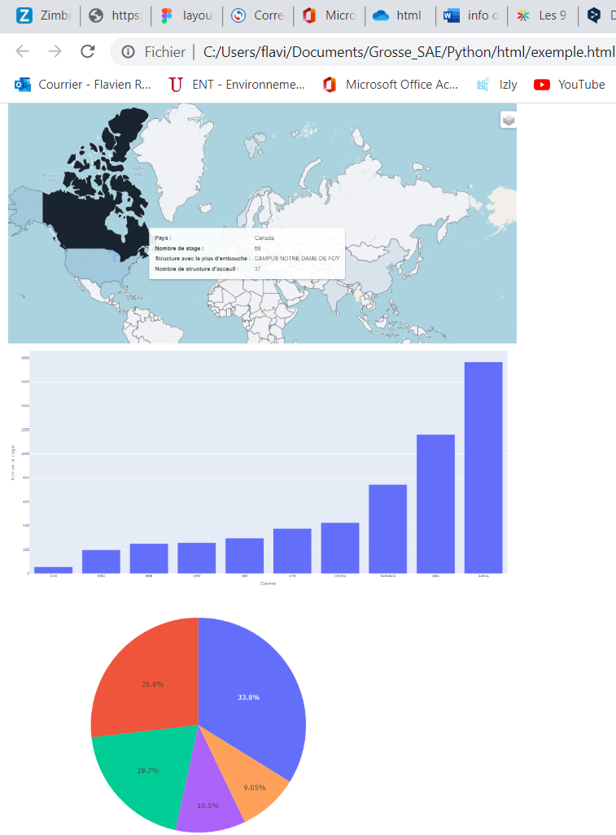
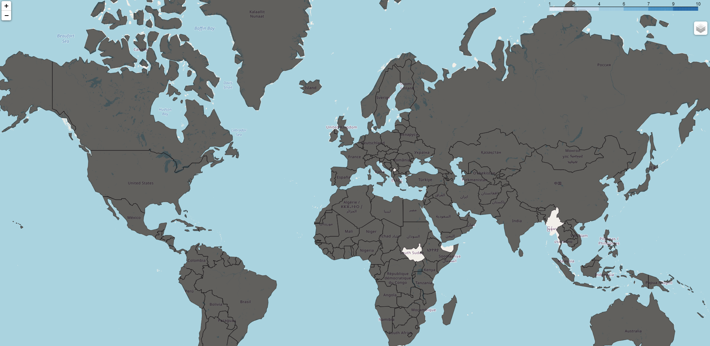

I. Scrum Method
II. Our Project
III. Problems and projections
Problems
Projections
User
Manual
Technical
Manual

Slide 7
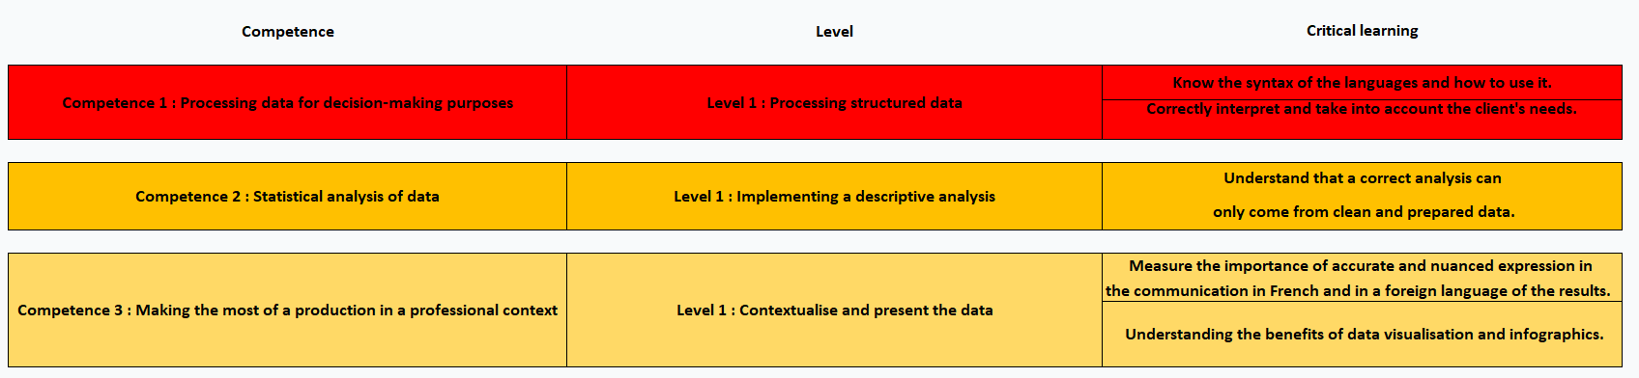
Conclusion

