Slide 1
LDPC_HW
114523057 楊善承

Slide 2
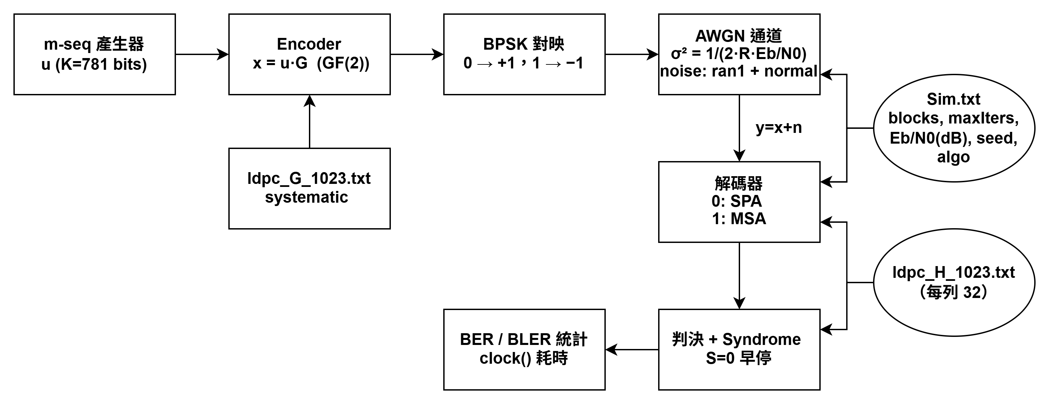
Notes:
講義用-1^x 0->1 1->-1 顛倒過來用 0->-1 1->1ok 後驗LLR判決 >0要改1 <0改-1 鄰接表測syndrome

Slide 3
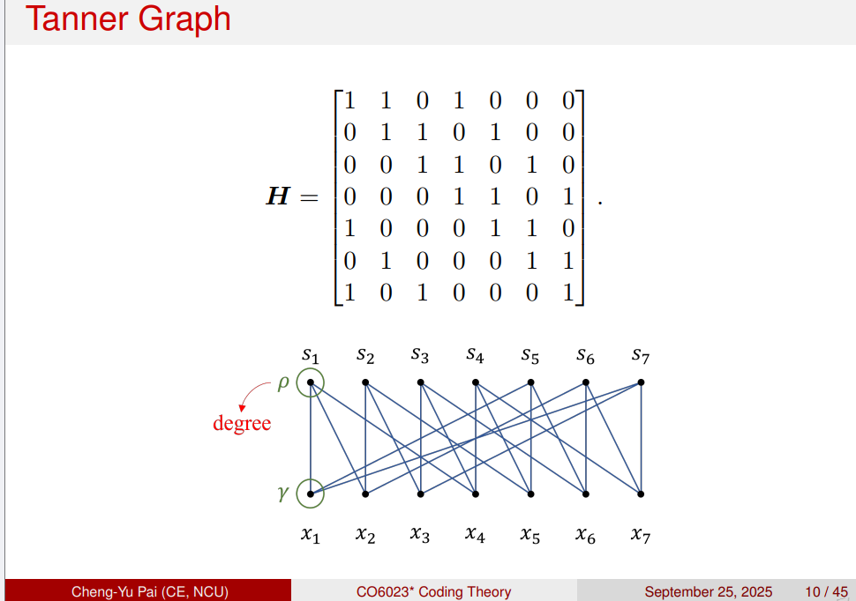

Slide 4
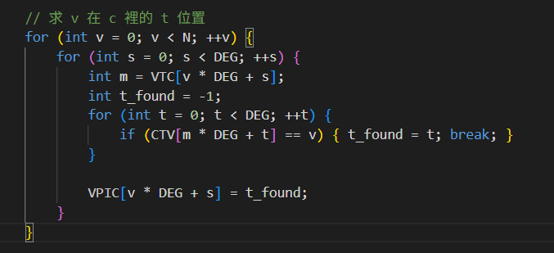
Notes:
時間複雜度 O(N·DEG) O(N·DEG²) 省40%

Slide 5
Algo | SNR_dB | DecodedBits | BitErrors | BER | BlocksTried | BLER | Sec
SPA | 1.6 | 78881 | 5449 | 6.91E-02 | 101 | 9.90E-01 | 19.859
SPA | 1.8 | 82005 | 5076 | 6.19E-02 | 105 | 9.52E-01 | 22.667
SPA | 2 | 87472 | 4712 | 5.39E-02 | 112 | 8.93E-01 | 22.766
SPA | 2.2 | 110902 | 4384 | 3.95E-02 | 142 | 7.04E-01 | 23.481
SPA | 2.4 | 167915 | 4141 | 2.47E-02 | 215 | 4.65E-01 | 25.45
SPA | 2.6 | 370194 | 4121 | 1.11E-02 | 474 | 2.11E-01 | 30.629
SPA | 2.8 | 913770 | 4161 | 4.55E-03 | 1170 | 8.55E-02 | 41.382
SPA | 3 | 3277076 | 4178 | 1.27E-03 | 4196 | 2.38E-02 | 83.75
SPA | 3.2 | 10396672 | 4658 | 4.48E-04 | 13312 | 7.51E-03 | 214.766
SPA | 3.4 | 39024227 | 4171 | 1.07E-04 | 49967 | 2.00E-03 | 444.154
SPA | 3.6 | 1.46E+08 | 4484 | 3.08E-05 | 186373 | 5.37E-04 | 1447.812
SPA | 3.8 | 6.18E+08 | 4394 | 7.11E-06 | 791781 | 1.26E-04 | 5616.29

Slide 6
Algo | SNR_dB | DecodedBits | BitErrors | BER | BlocksTried | BLER | Sec
MSA | 3 | 89815 | 7934 | 8.83E-02 | 115 | 8.70E-01 | 36.568
MSA | 3.4 | 152295 | 7704 | 5.06E-02 | 195 | 5.13E-01 | 37.369
MSA | 3.6 | 228833 | 7574 | 3.31E-02 | 293 | 3.41E-01 | 38.423
MSA | 3.8 | 484220 | 7590 | 1.57E-02 | 620 | 1.61E-01 | 41.295
MSA | 4 | 1797862 | 7765 | 4.32E-03 | 2302 | 4.34E-02 | 55.831
MSA | 4.2 | 7243775 | 7237 | 9.99E-04 | 9275 | 1.08E-02 | 110
MSA | 4.4 | 47295798 | 7204 | 1.52E-04 | 60558 | 1.65E-03 | 458.748
MSA | 4.6 | 4.11E+08 | 7587 | 1.84E-05 | 526687 | 1.90E-04 | 2593.282

Slide 7
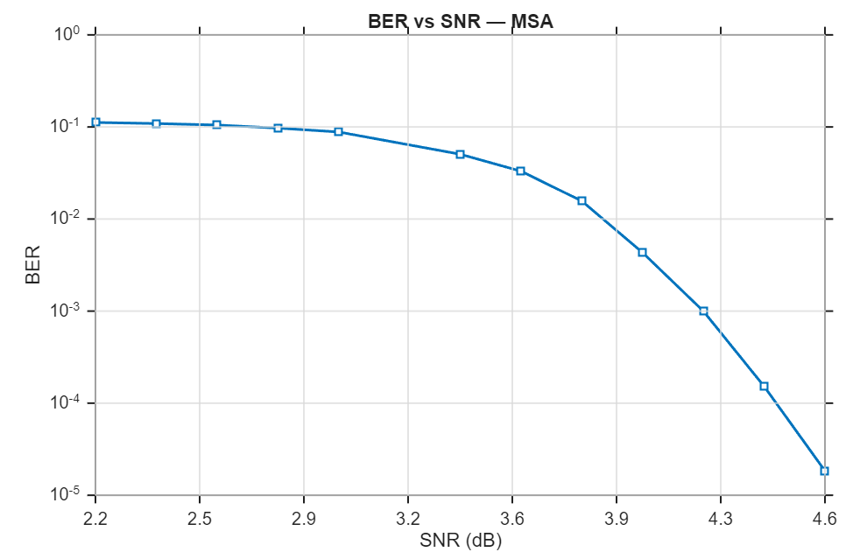
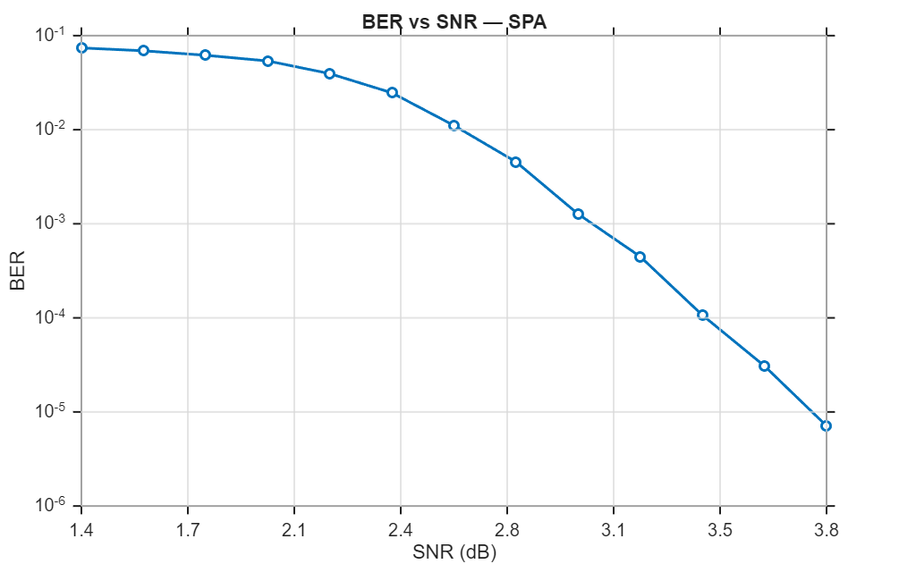
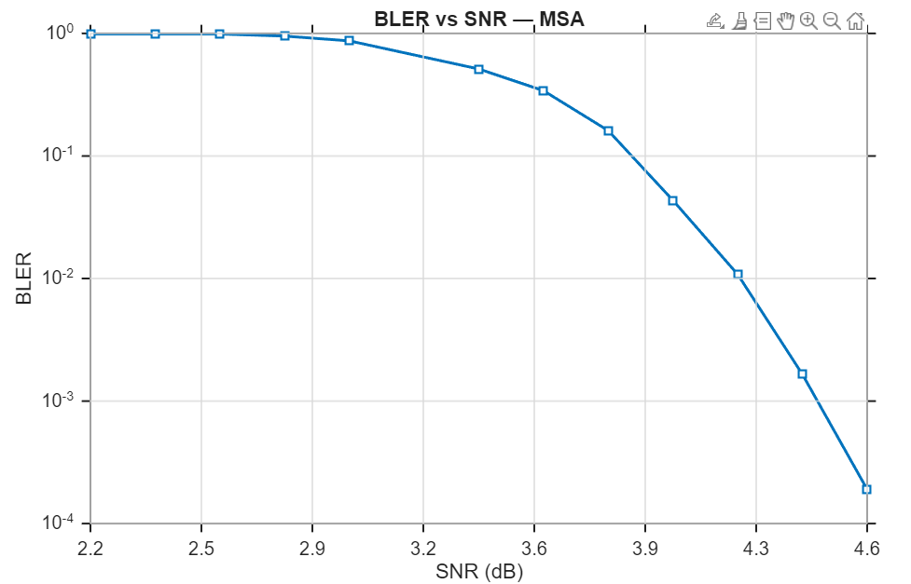
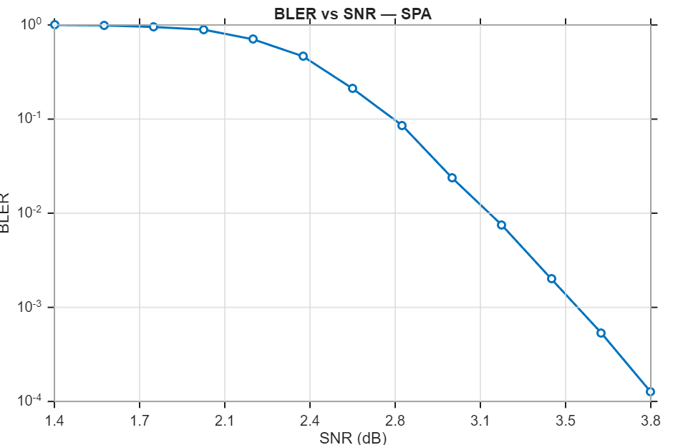
Notes:
MSA2.2 SPA1.6

