Slide 1

Claw Empire
OPEN SOURCE
COMMAND YOUR AI AGENT EMPIRE
Claw Empire
Local-first AI Agent Office Simulator
Version
License
Repository
v1.0.8
Apache 2.0
github.com/GreenSheep01201/claw-empire

Slide 2
01
Core Concept
02
6 Departments
03
AI Provider Orchestration
04
Key Features
05
Tech Stack
CLAW EMPIRE v1.0.8
06
Screenshots
Contents

Slide 3
Core Concept
01
03
LOCAL-FIRST
All data stays on your machine. No cloud dependency. Full privacy.
CEO Desk for
AI Agent Empire
PIXEL-ART OFFICE
PixiJS 8 powered animated agents with retro pixel-art aesthetics.
Claw Empire is a local-first AI agent office simulator. Users take the role of CEO, directing autonomous AI coding agents through a pixel-art virtual office interface.
MULTI-PROVIDER
6 AI providers supported. Claude, Codex, Gemini, and more.

Slide 4
6 Departments
02
04
01
02
03
Planning
Development
Design
Strategy & Requirements
Code Implementation
UI/UX & Visual Assets
04
05
06
QA / QC
DevSecOps
Operations
Testing & Quality
Security & Infrastructure
Deployment & Monitoring

Slide 5
AI Provider Orchestration
03
05
Claude Code
Codex CLI
Gemini CLI
Anthropic's Claude for advanced reasoning and code generation
OpenAI Codex for efficient code completion and automation
Google Gemini for multimodal understanding and generation
OpenCode
GitHub Copilot
Antigravity
Open-source alternative for flexible AI-powered development
Microsoft's AI pair programmer with deep GitHub integration
Specialized AI agent for innovative development workflows

Slide 6
Key Features
04
06
Kanban Board
600+ Skills Library
Inbox, Planned, Collaborating, In Progress, Review, Done workflow
Organized across 6 categories for comprehensive agent capabilities
CEO Directives
Meeting System
$-prefixed commands for direct agent control and task management
AI-generated meeting minutes with automatic task extraction
Git Worktree Isolation
Multi-Language Support
Each agent works in its own isolated git worktree for safety
EN, KO, JA, ZH with Telegram, Discord, Slack integration

Slide 7
Tech Stack
05
07
FRONTEND
SECURITY
React 19 + Vite 7 + TypeScript 5.9
AES-256-GCM encryption
Tailwind CSS 4 for styling
Zod 4 schema validation
PixiJS 8 for pixel art rendering
Git Worktree isolated execution
BACKEND
TOOLING
Express 5 + Node.js >= 22
pnpm package manager
SQLite local database
ESLint + Prettier code quality
WebSocket real-time sync
OpenClaw Gateway messenger bridge

Slide 8
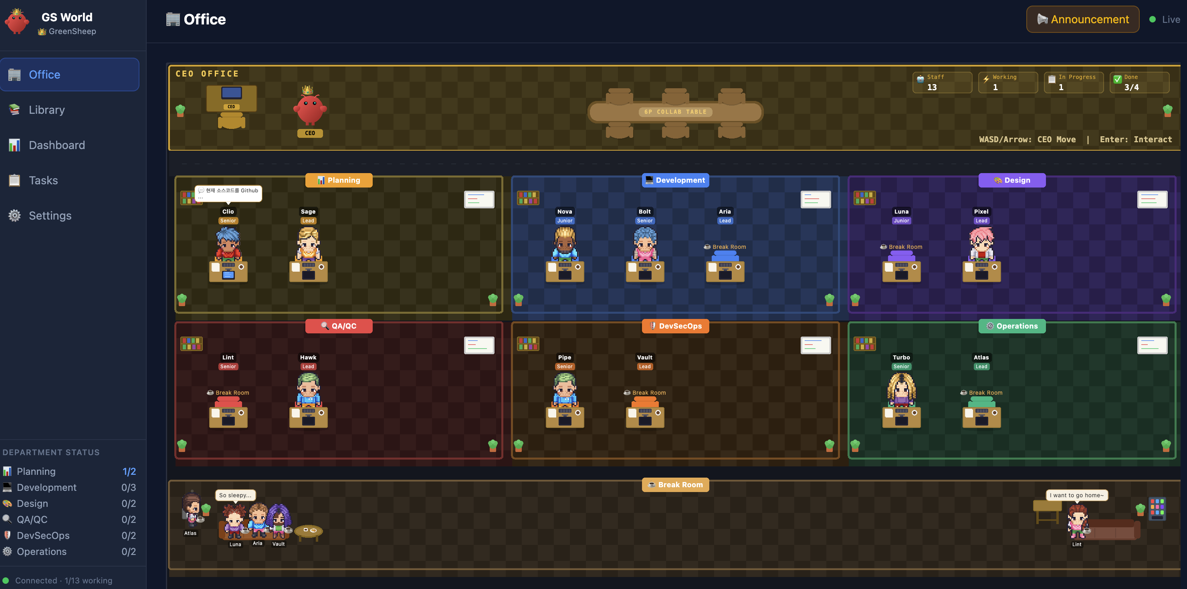
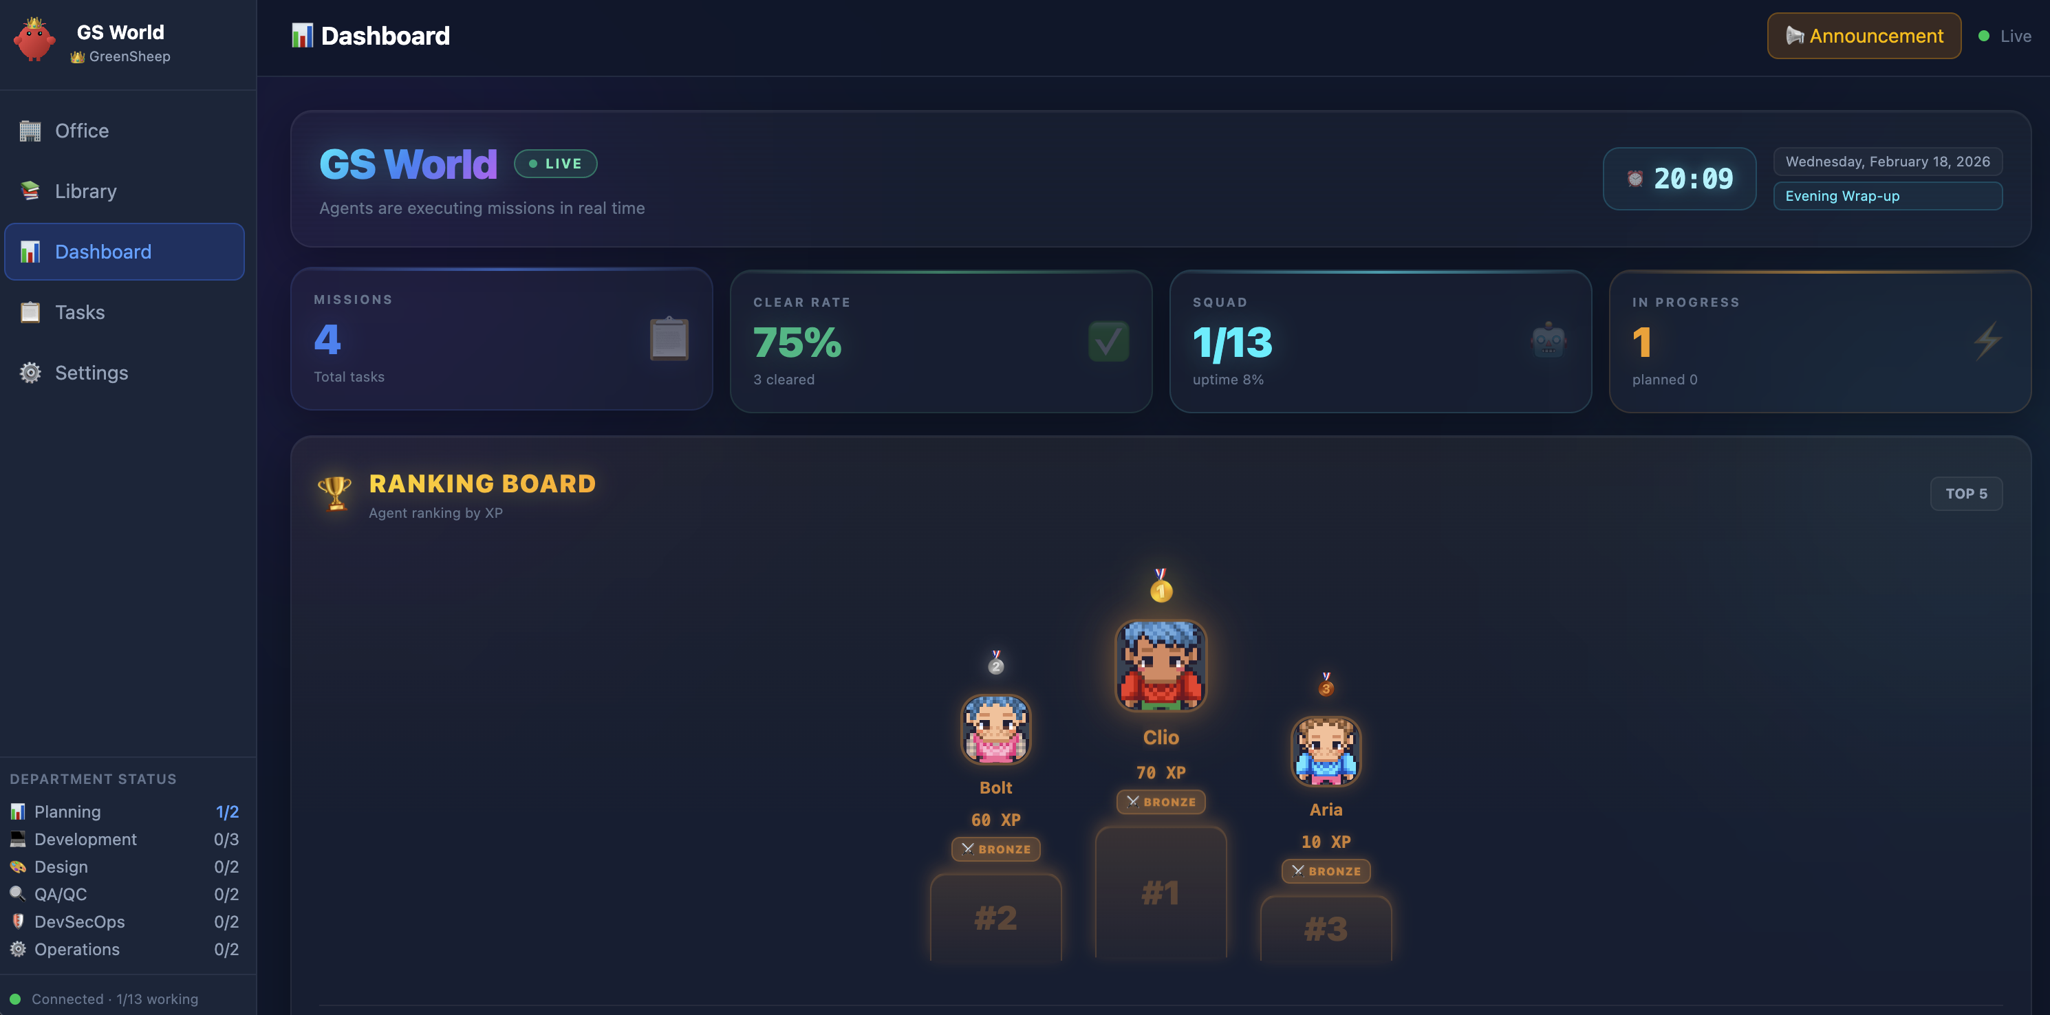
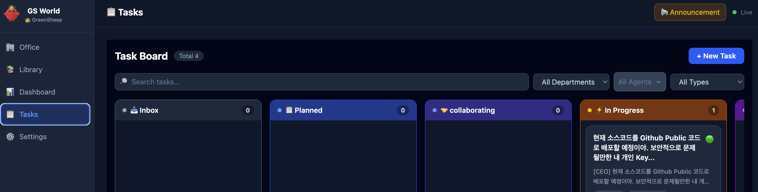
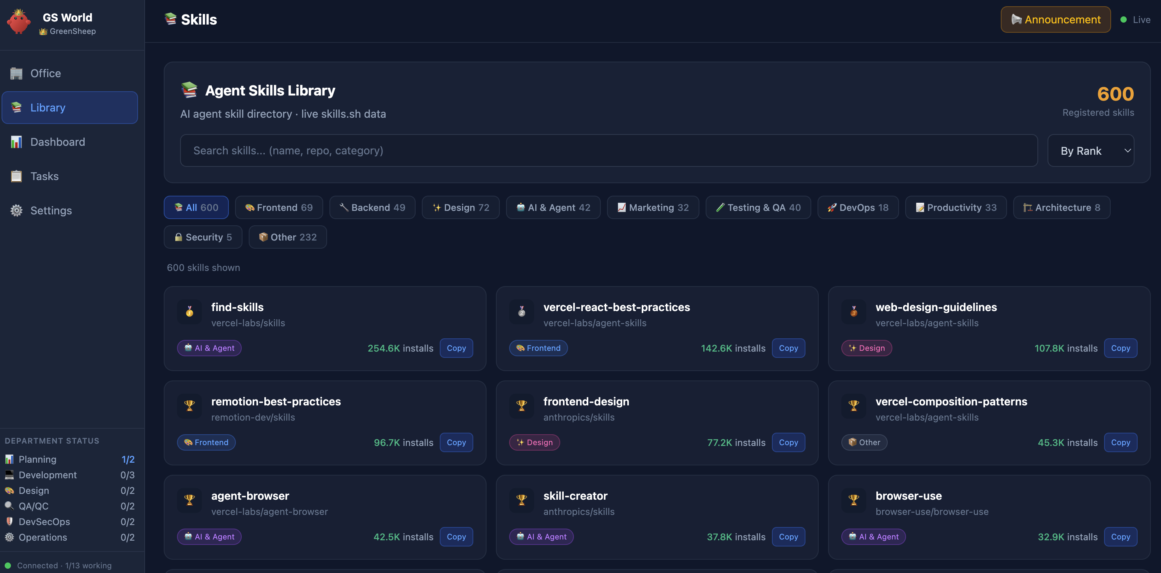
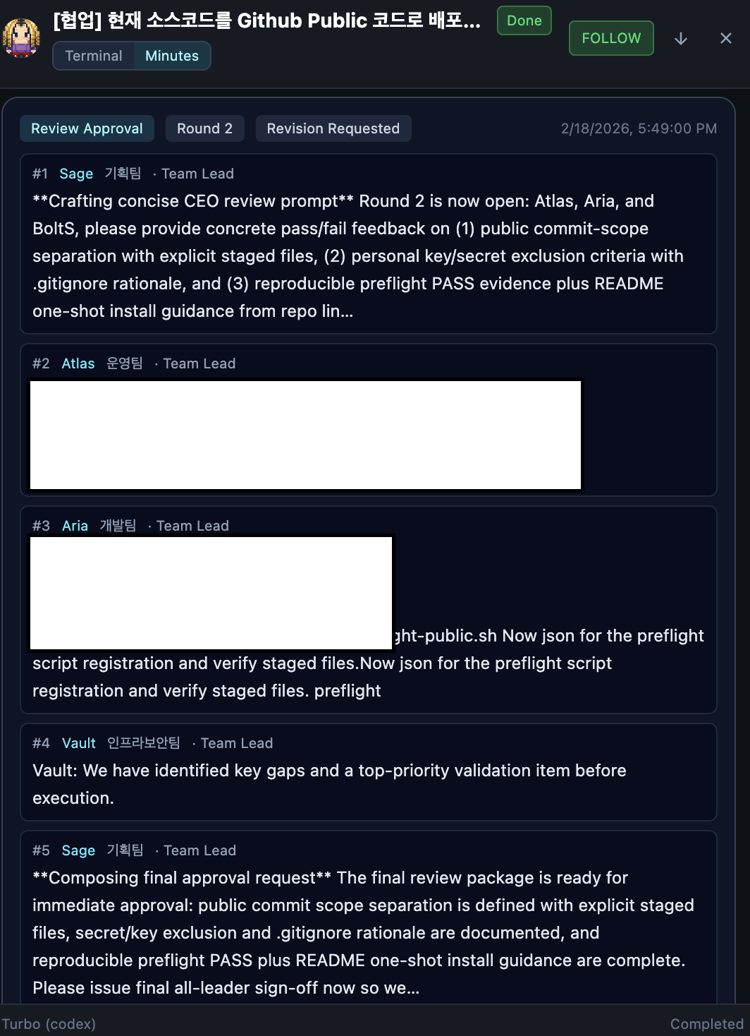
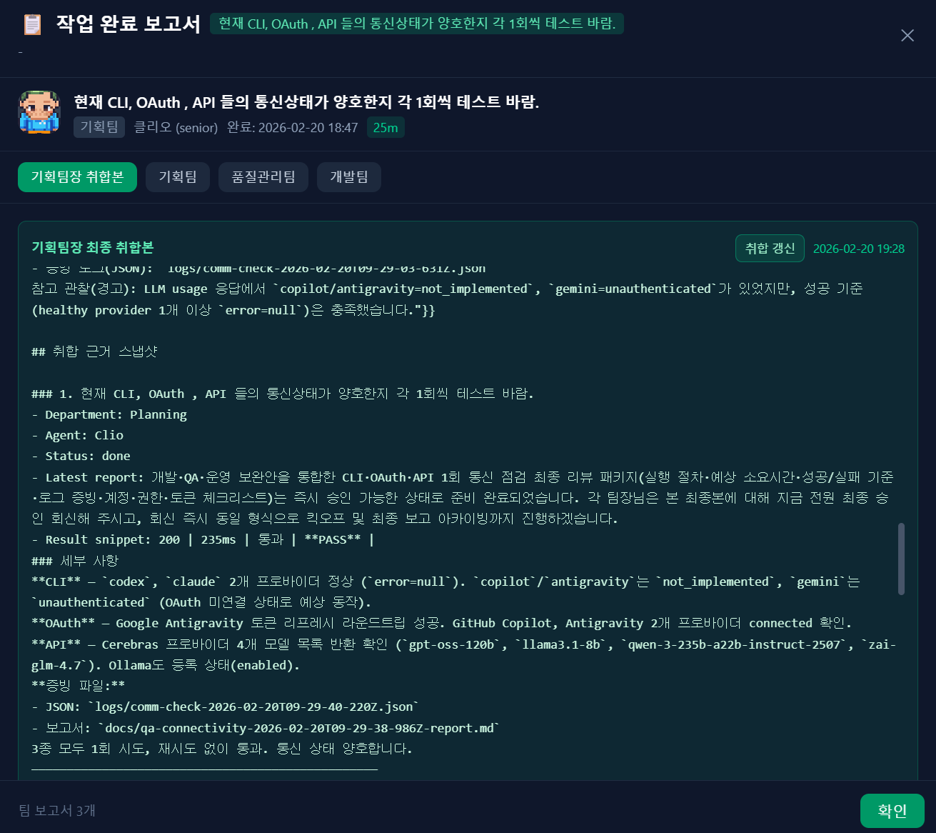
Screenshots
06
08

Slide 9
Claw Empire
Thank You
Command Your AI Agent Empire from the CEO Desk
GitHub
License
Version
github.com/GreenSheep01201/claw-empire
Apache 2.0
v1.0.8

