Slide 1
Teams Meeting
1 May 2025

Slide 2
Objectives for this week
Begin analysing pediatric dataset ✅
Wait for bulk RNA-seq data to arrive ⌛
Wrap up with HR ❌

Slide 3
Pediatric Dataset Analysis
Prep the data for analysis (convert to suitable format for edgeR) ✅
Aggregate expression values for cells from the same patient/cell type ✅
Data exploration (perform PCA to visualise variation, calculate library sizes etc) ✅
Differential expression analysis (create design matrix, fit linear model, test between conditions)❌
Visualise with volcano plots ⌛

Slide 4
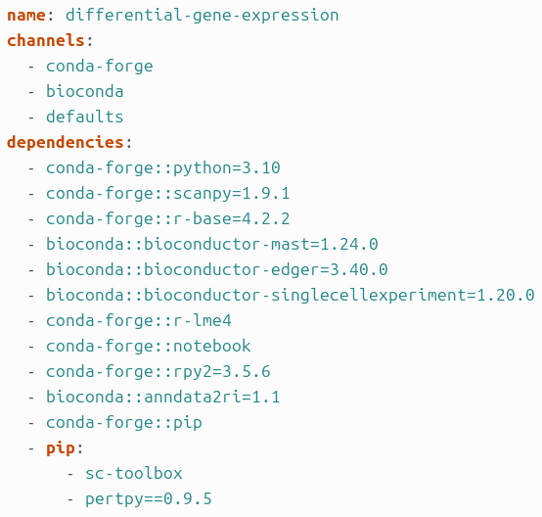
Software Compatibility Issues...
Using these various coding libraries to carry out the analysis
‘pertpy’ was initially problematic, requiring a newer version
Newer version of ‘pertpy’ requires a newer version of python
Newer version of python breaks a number of other libraries

Slide 5



Brute force solution
Do what I can in python
Export the data to a file
Complete the analysis in R

