Slide 1
Teams Meeting
06-06-25

Slide 2
Goals
Analyse Adult dataset ✅
Create UMAPs for each dataset (x6)
Plot gene expression on UMAPS (Feature plots)
Recreate Aaliya’s dotplots for 4 genes of interest
Analyse third dataset ✅

Slide 3
New pipeline (for UMAPs)
Originally, UMAPs were created in python (as Scanpy programme was being used)
New pipeline was made for UMAPs as we are now using Seurat/R.
New pipeline creates UMAPs, feature plots, and dot plots.
Couple tweaks needed to improve the appearance of the plots

Slide 4
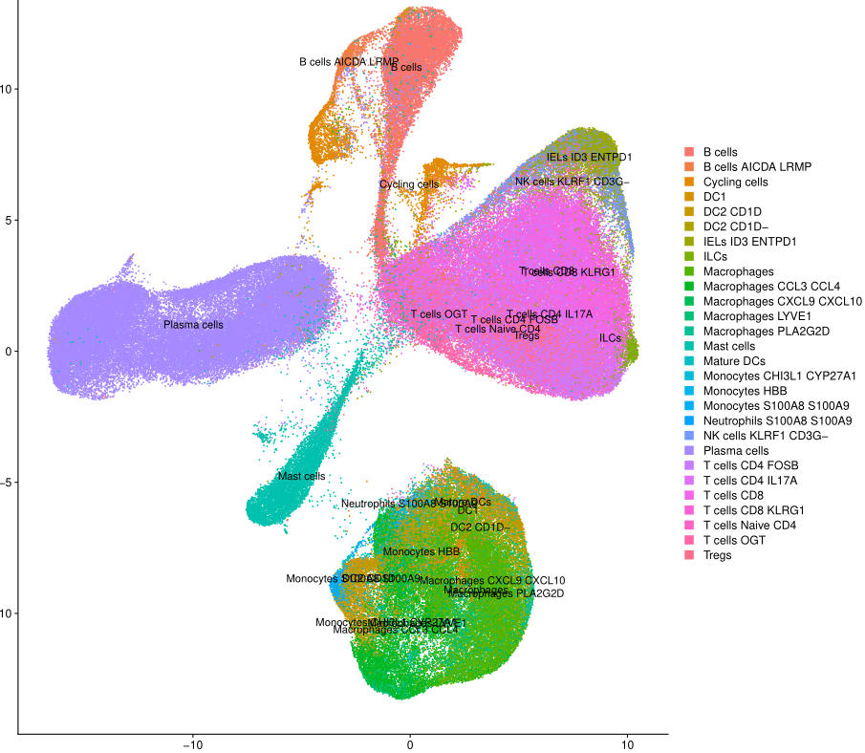
UMAP Example (Colon Immune)

Slide 5
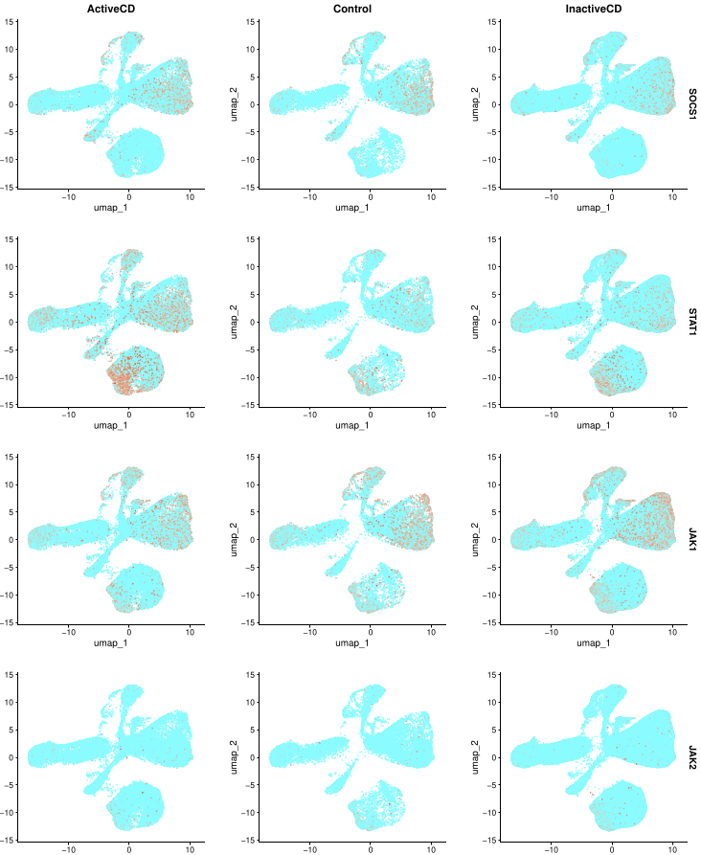
Feature Plot example (Colon Immune)

Slide 6
Feature Plot example (Colon Immune)

Slide 7
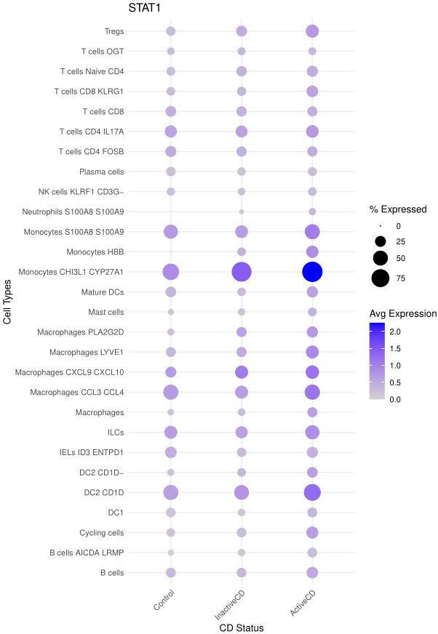
Dot Plot Example (Colon Immune)
One Dot plot per gene (to avoid visual clutter)
Significance asterisks & p-values to be included (from DGE results)

Slide 8
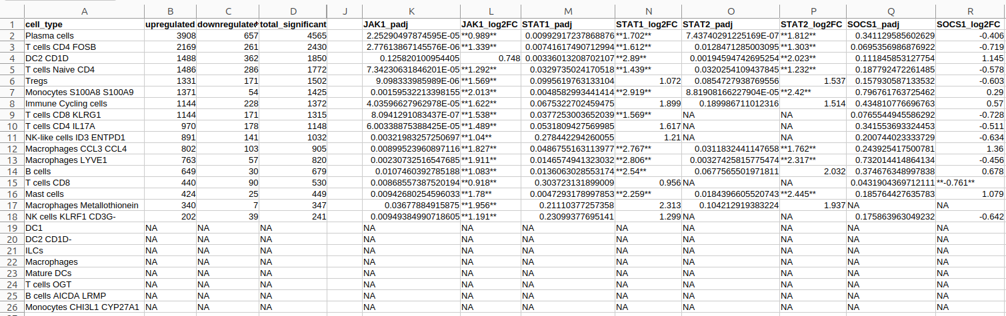
Included Jak1, Stat1, Stat2, Socs1 in DGE csv file
Colon Immune (Active vs Control)

Slide 9
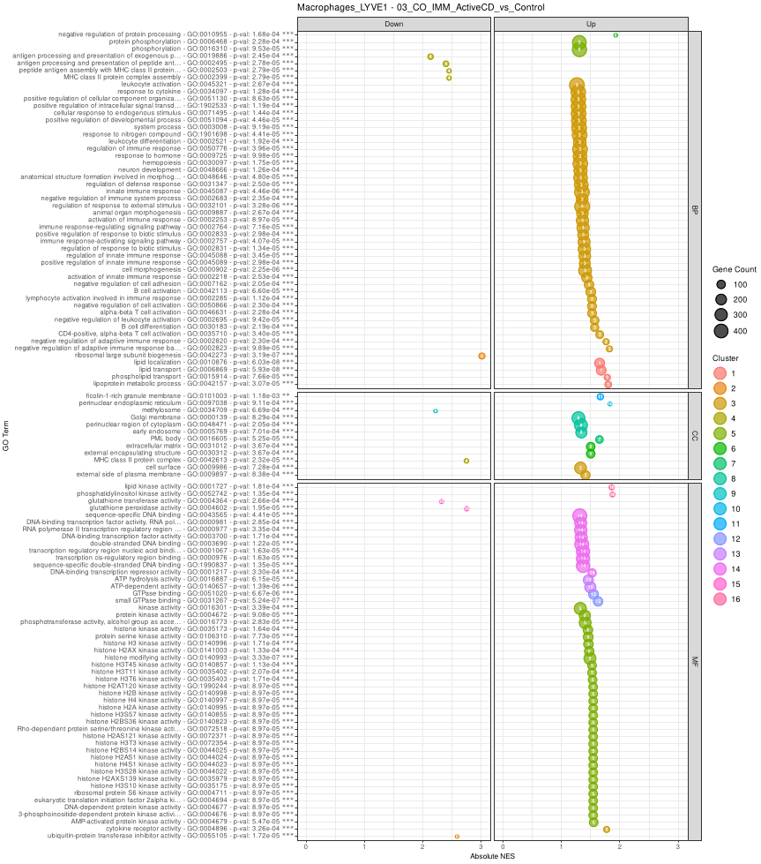
GO Enricment Example (Colon Immune Macrophage)
Same as before
One plot per cell type per dataset (2 tissue types x 3 cell type groups)

Slide 10
Next Goals
Add p-values to dot plots
Clean up feature plots (readability / include scale)
Begin KEGG pathway analysis
Create some clear research questions/hypotheses that we can test
Explore if it is possible correlate data from different studies (Meta-analysis?)

