Slide 1
Teams Meeting
13-06-25

Slide 2
Goals
Create heatmaps for KEGG pathways of interest ✅
Filter GO enrichment to JAK1/2, STAT1, SOCS1 genes⏳
Pre-filter GO terms: Query the GO database to find all GO terms containing JAK1/2, STAT1, or SOCS1, then cache these filtered term lists ✅
Modify enrichment function: Update code to accept the pre-filtered GO term list and use custom mappings instead of the full GO database⏳
Separate Epithelial cells, Immune cells, and Stromal cells⏳
Normalise dotplot scales across datasets⏳

Slide 3
JAKSTAT Pathway – Ileum – Active Crohn’s

Slide 4
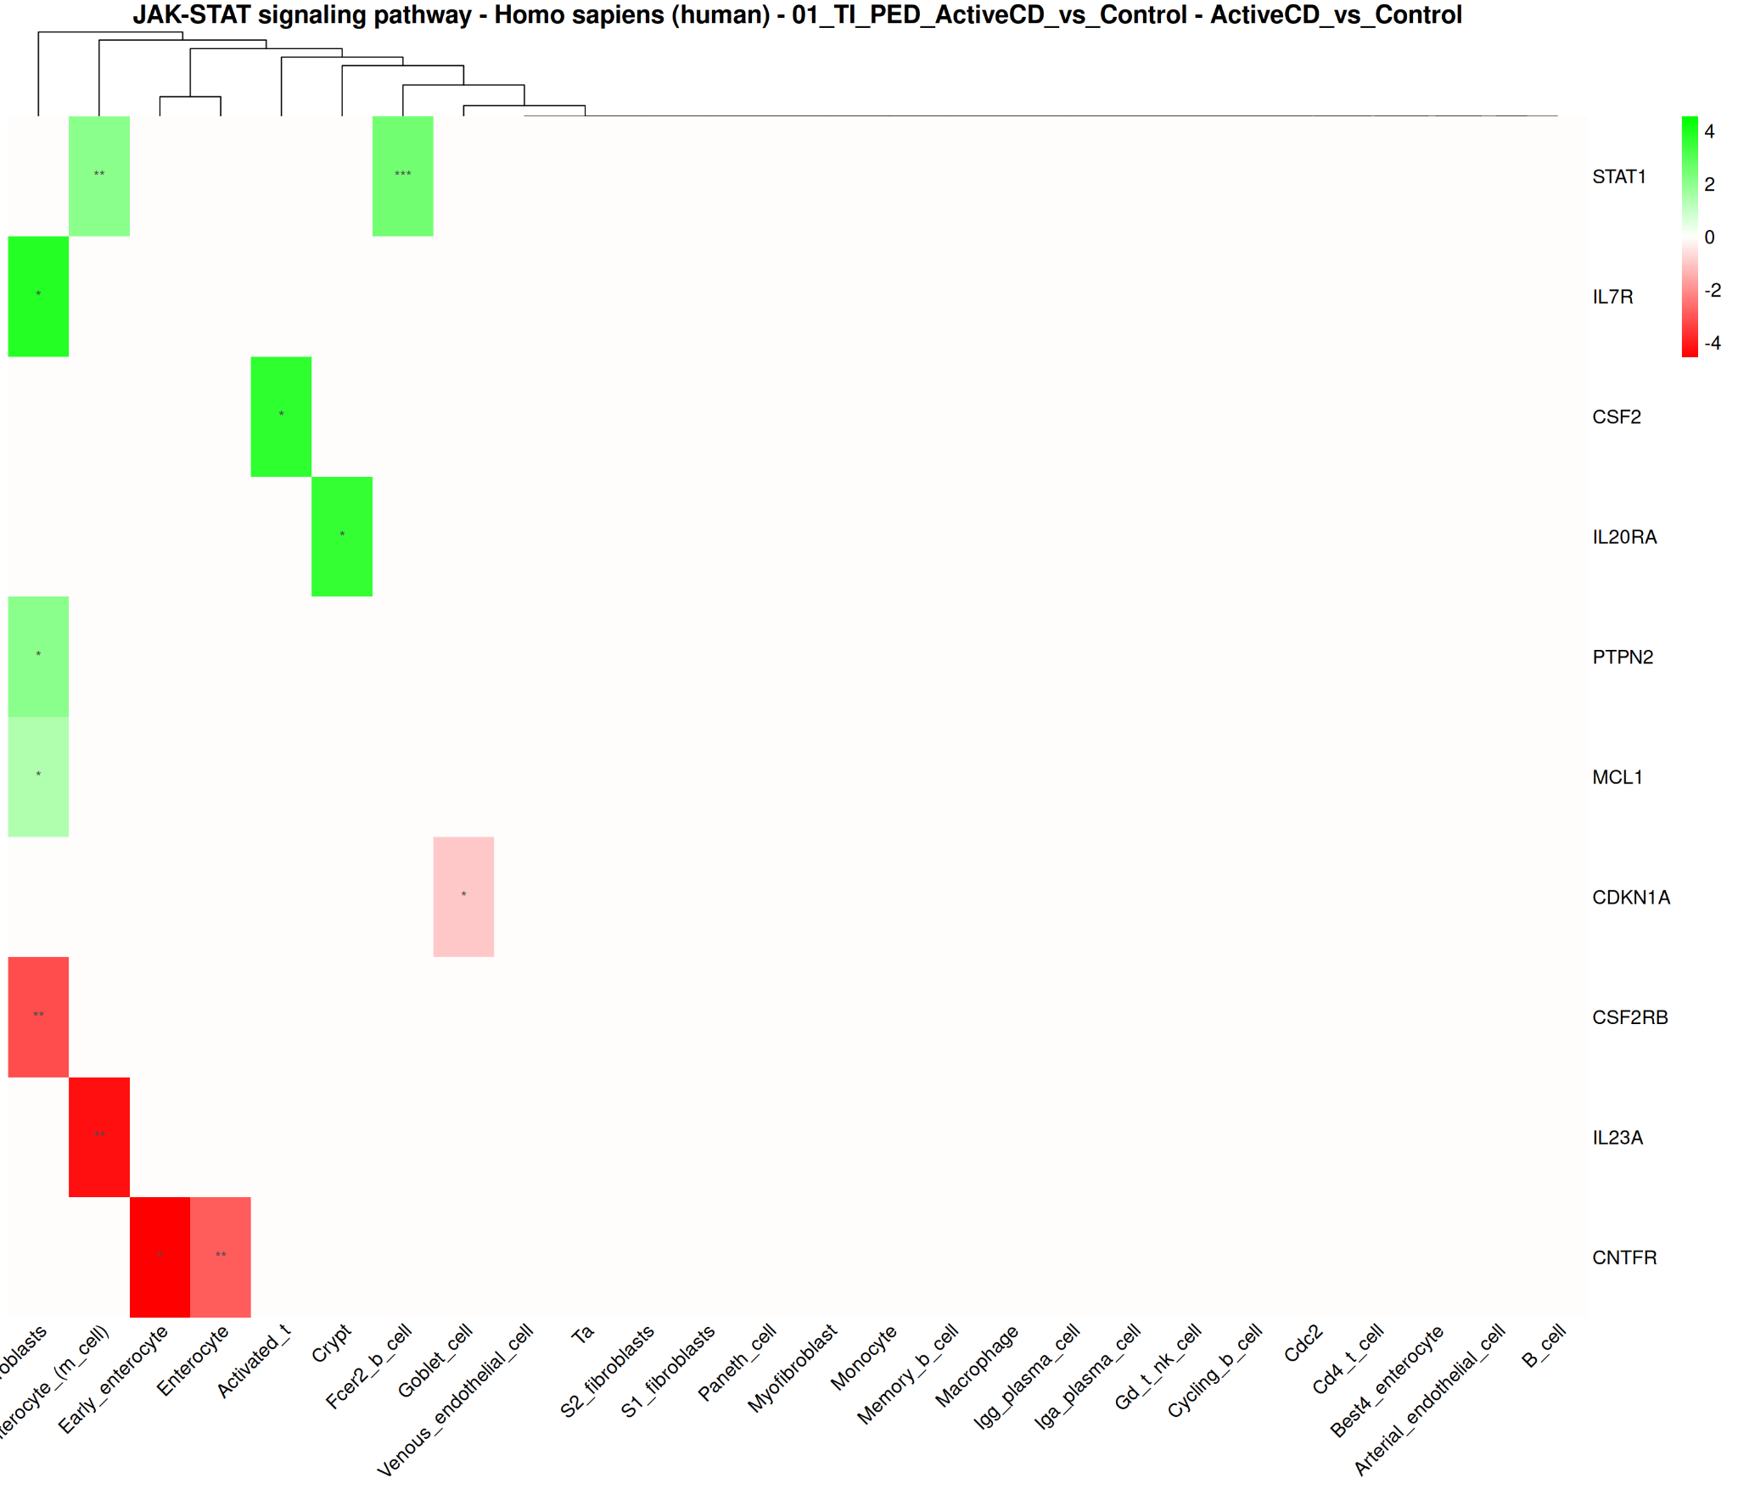
Dataset 1 - JAKSTAT Pathway (Ileum)

Slide 5
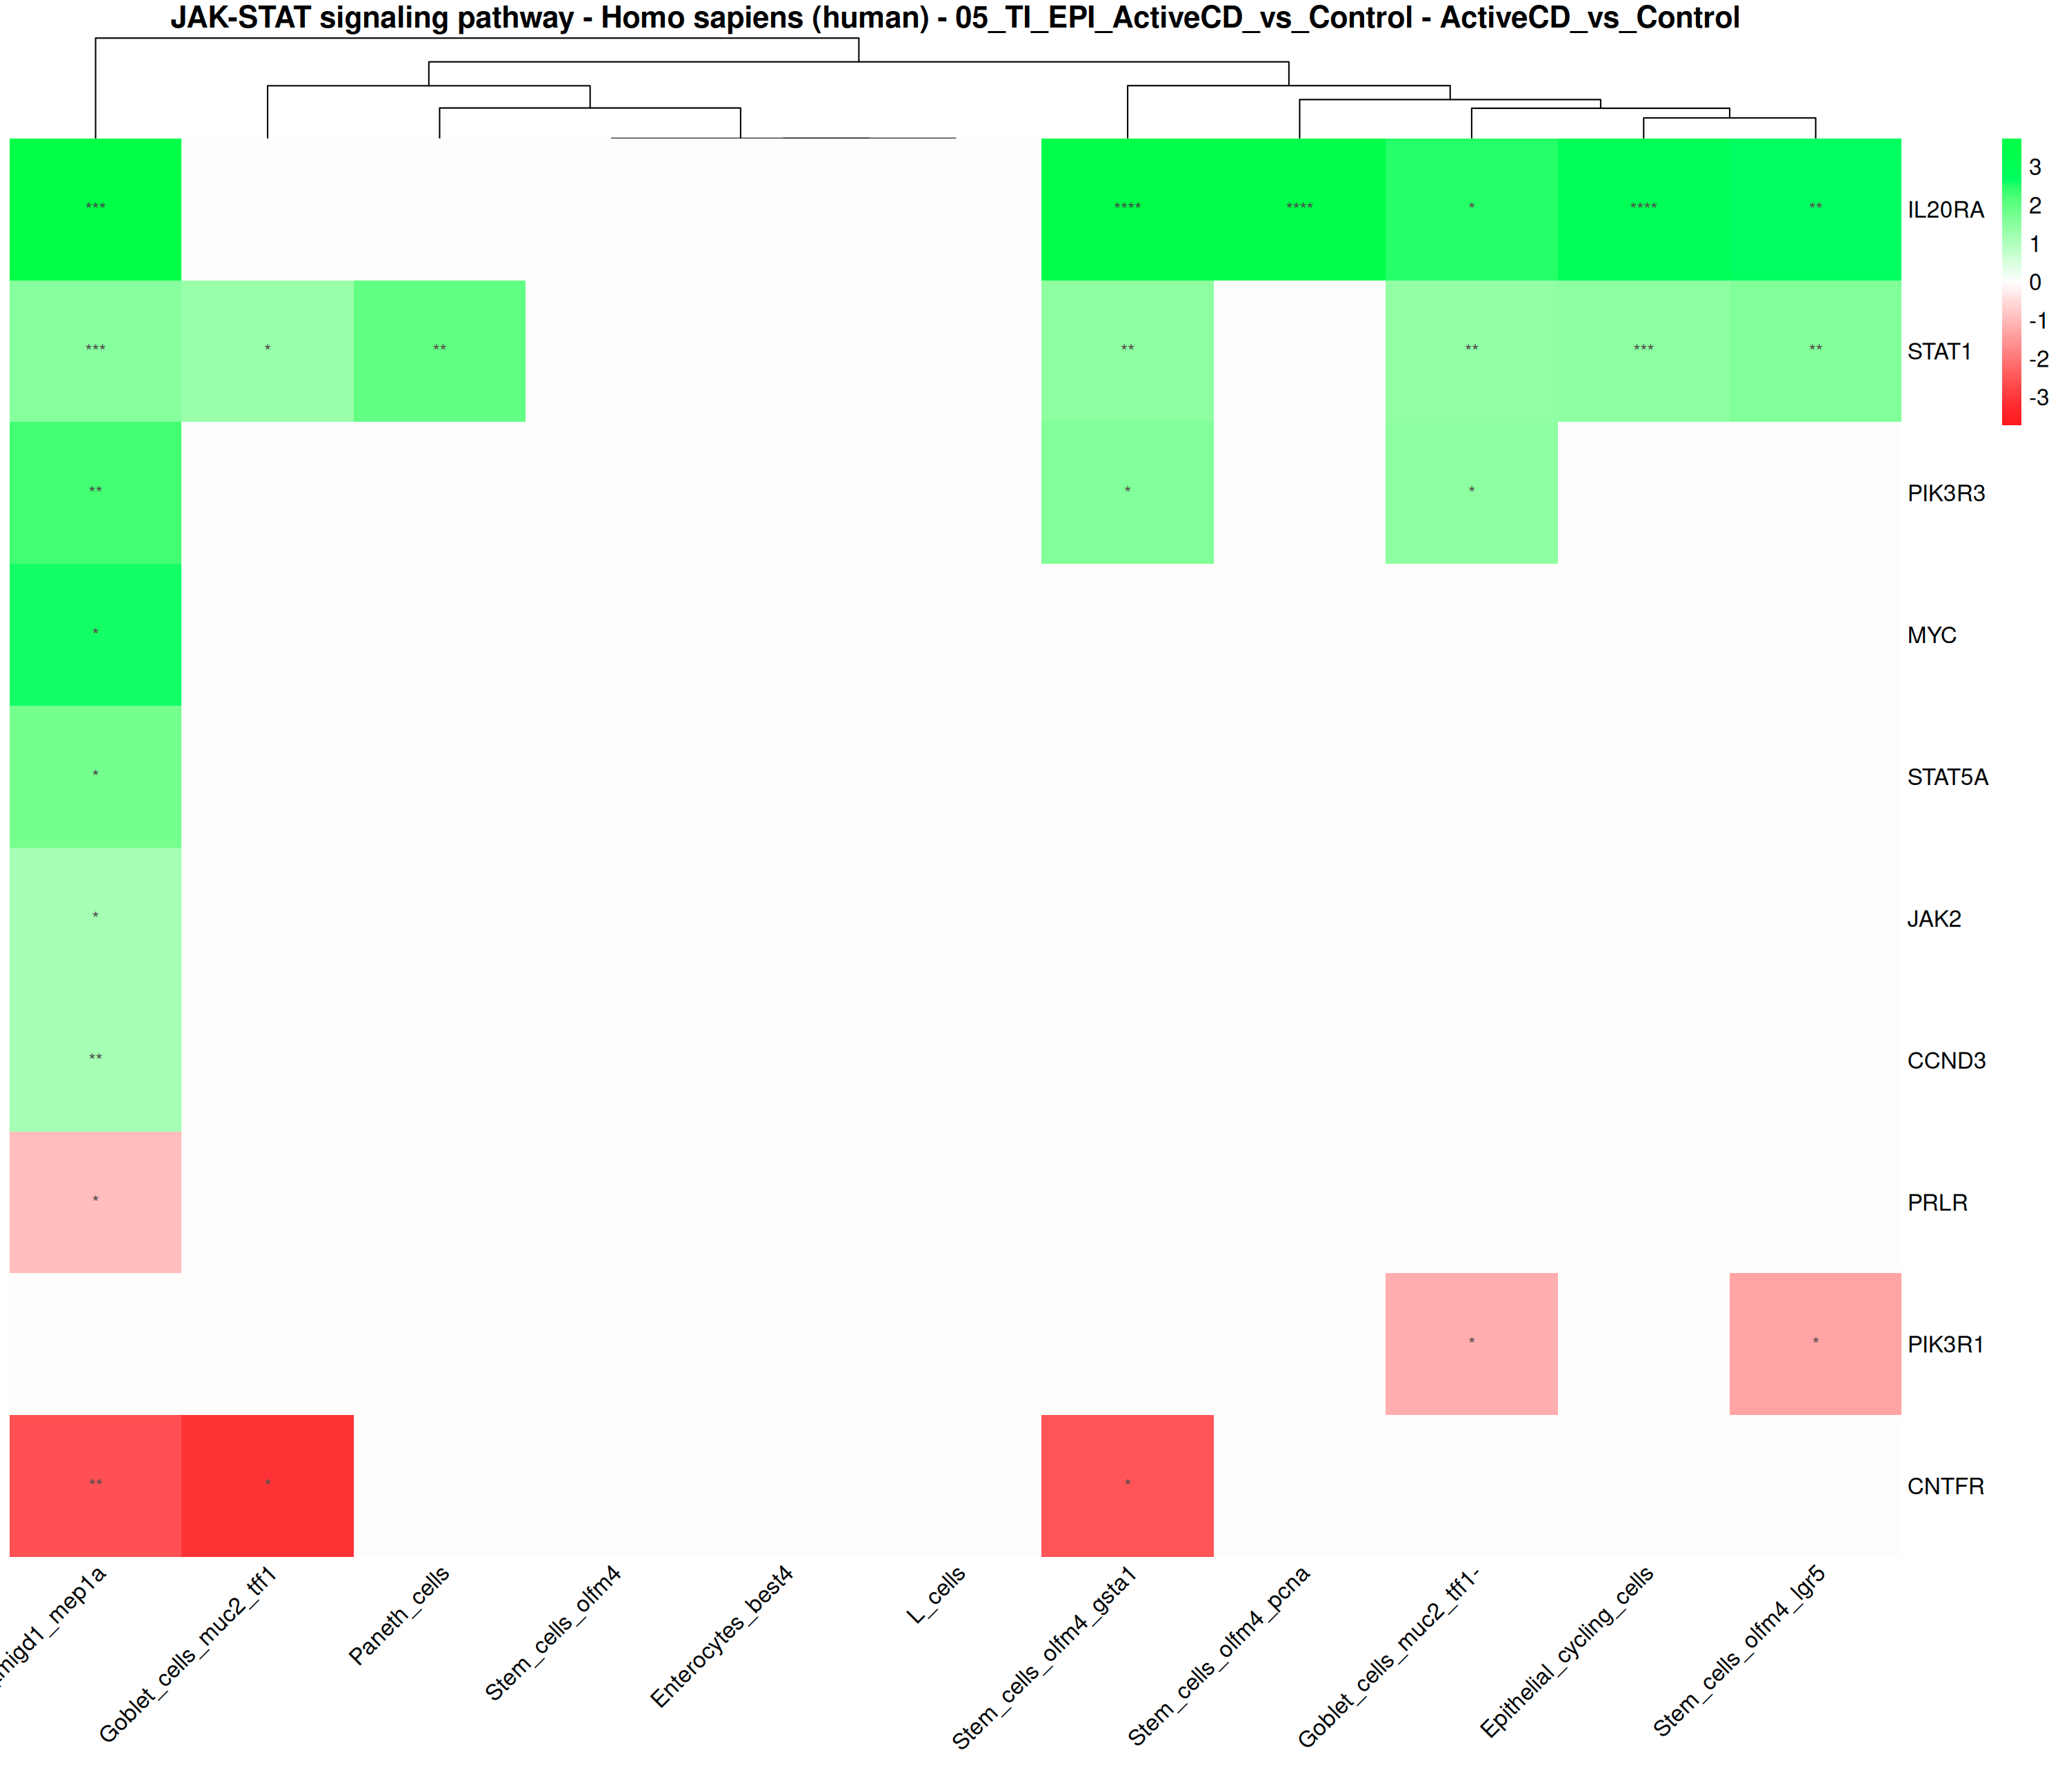
Dataset 2 - JAKSTAT Pathway (EPI - Ileum)

Slide 6
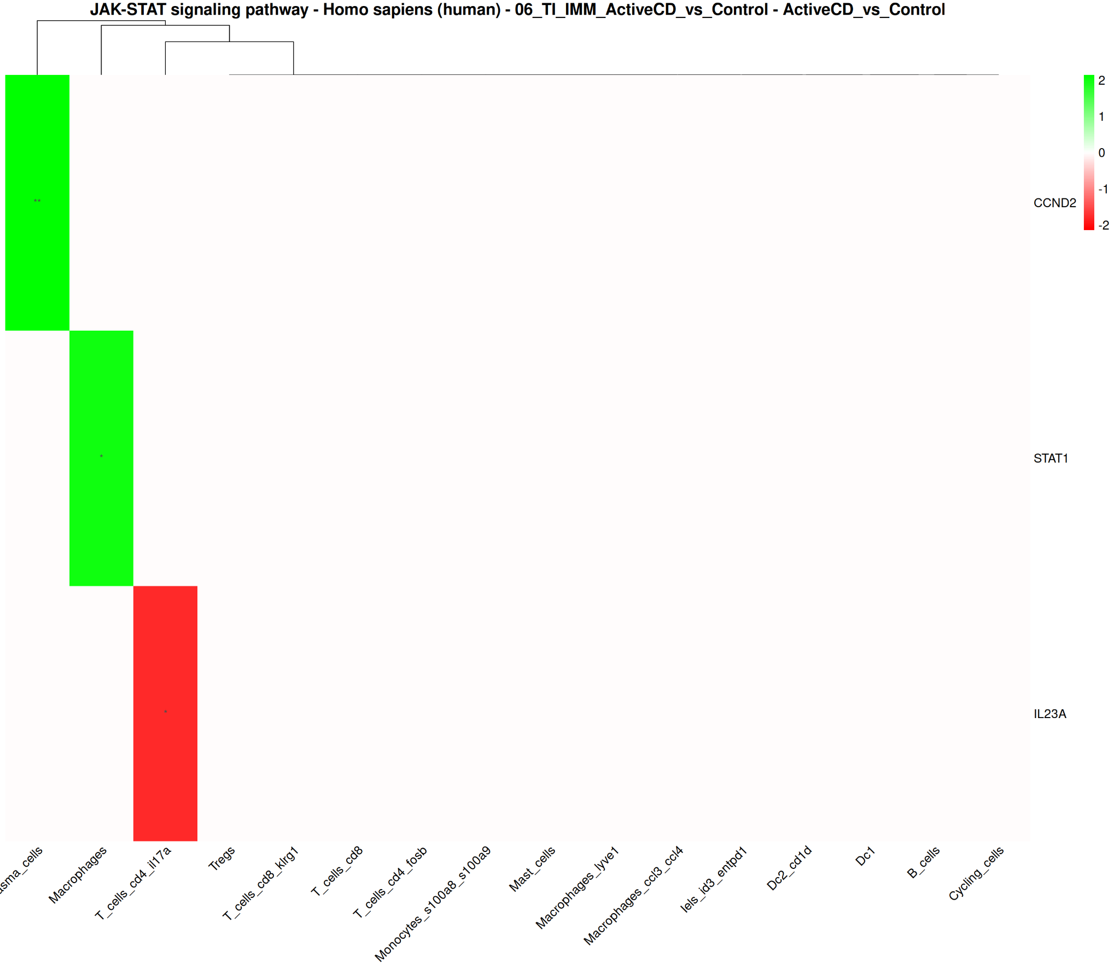
Dataset 2 - JAKSTAT Pathway (IMM - Ileum)

Slide 7
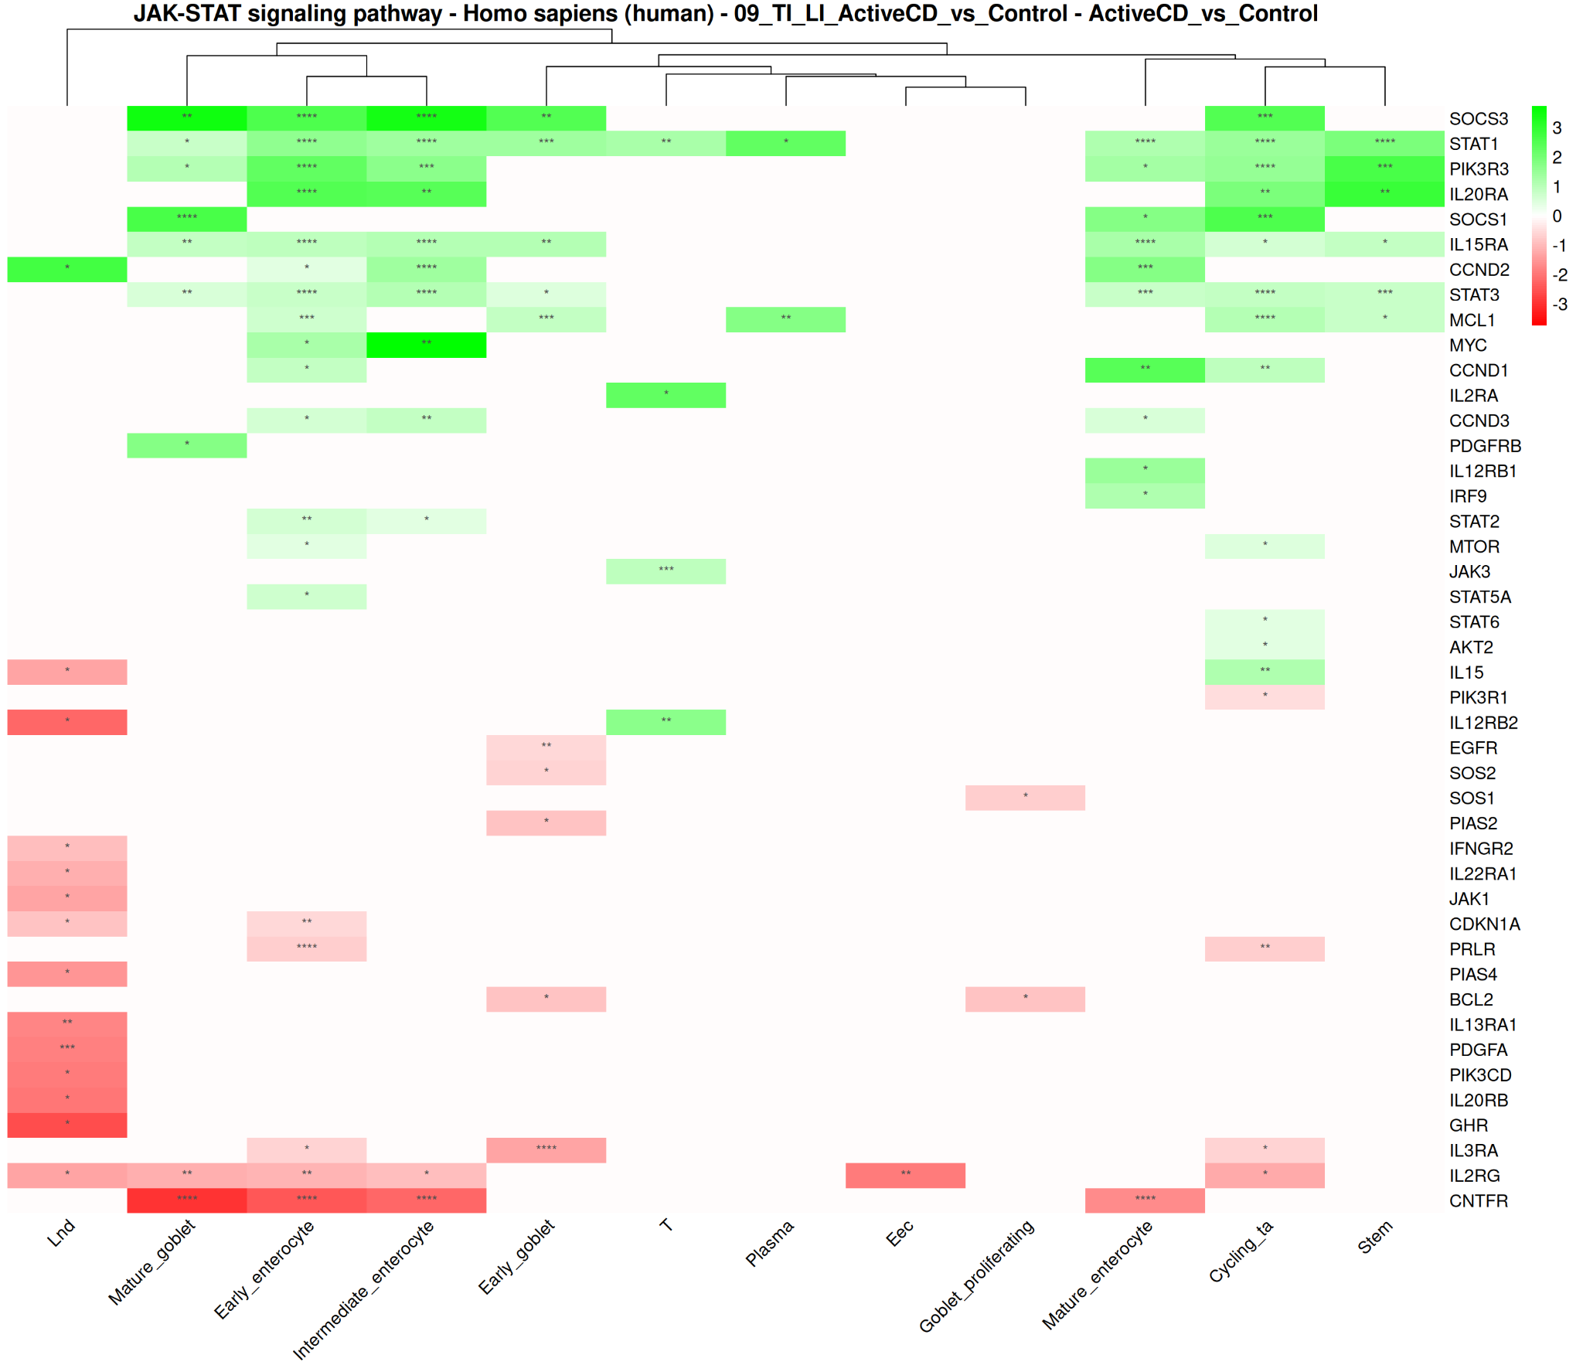
Dataset 3 - JAKSTAT Pathway (Ileum)

Slide 8
JAKSTAT Pathway – Colon – Active Crohn’s

Slide 9
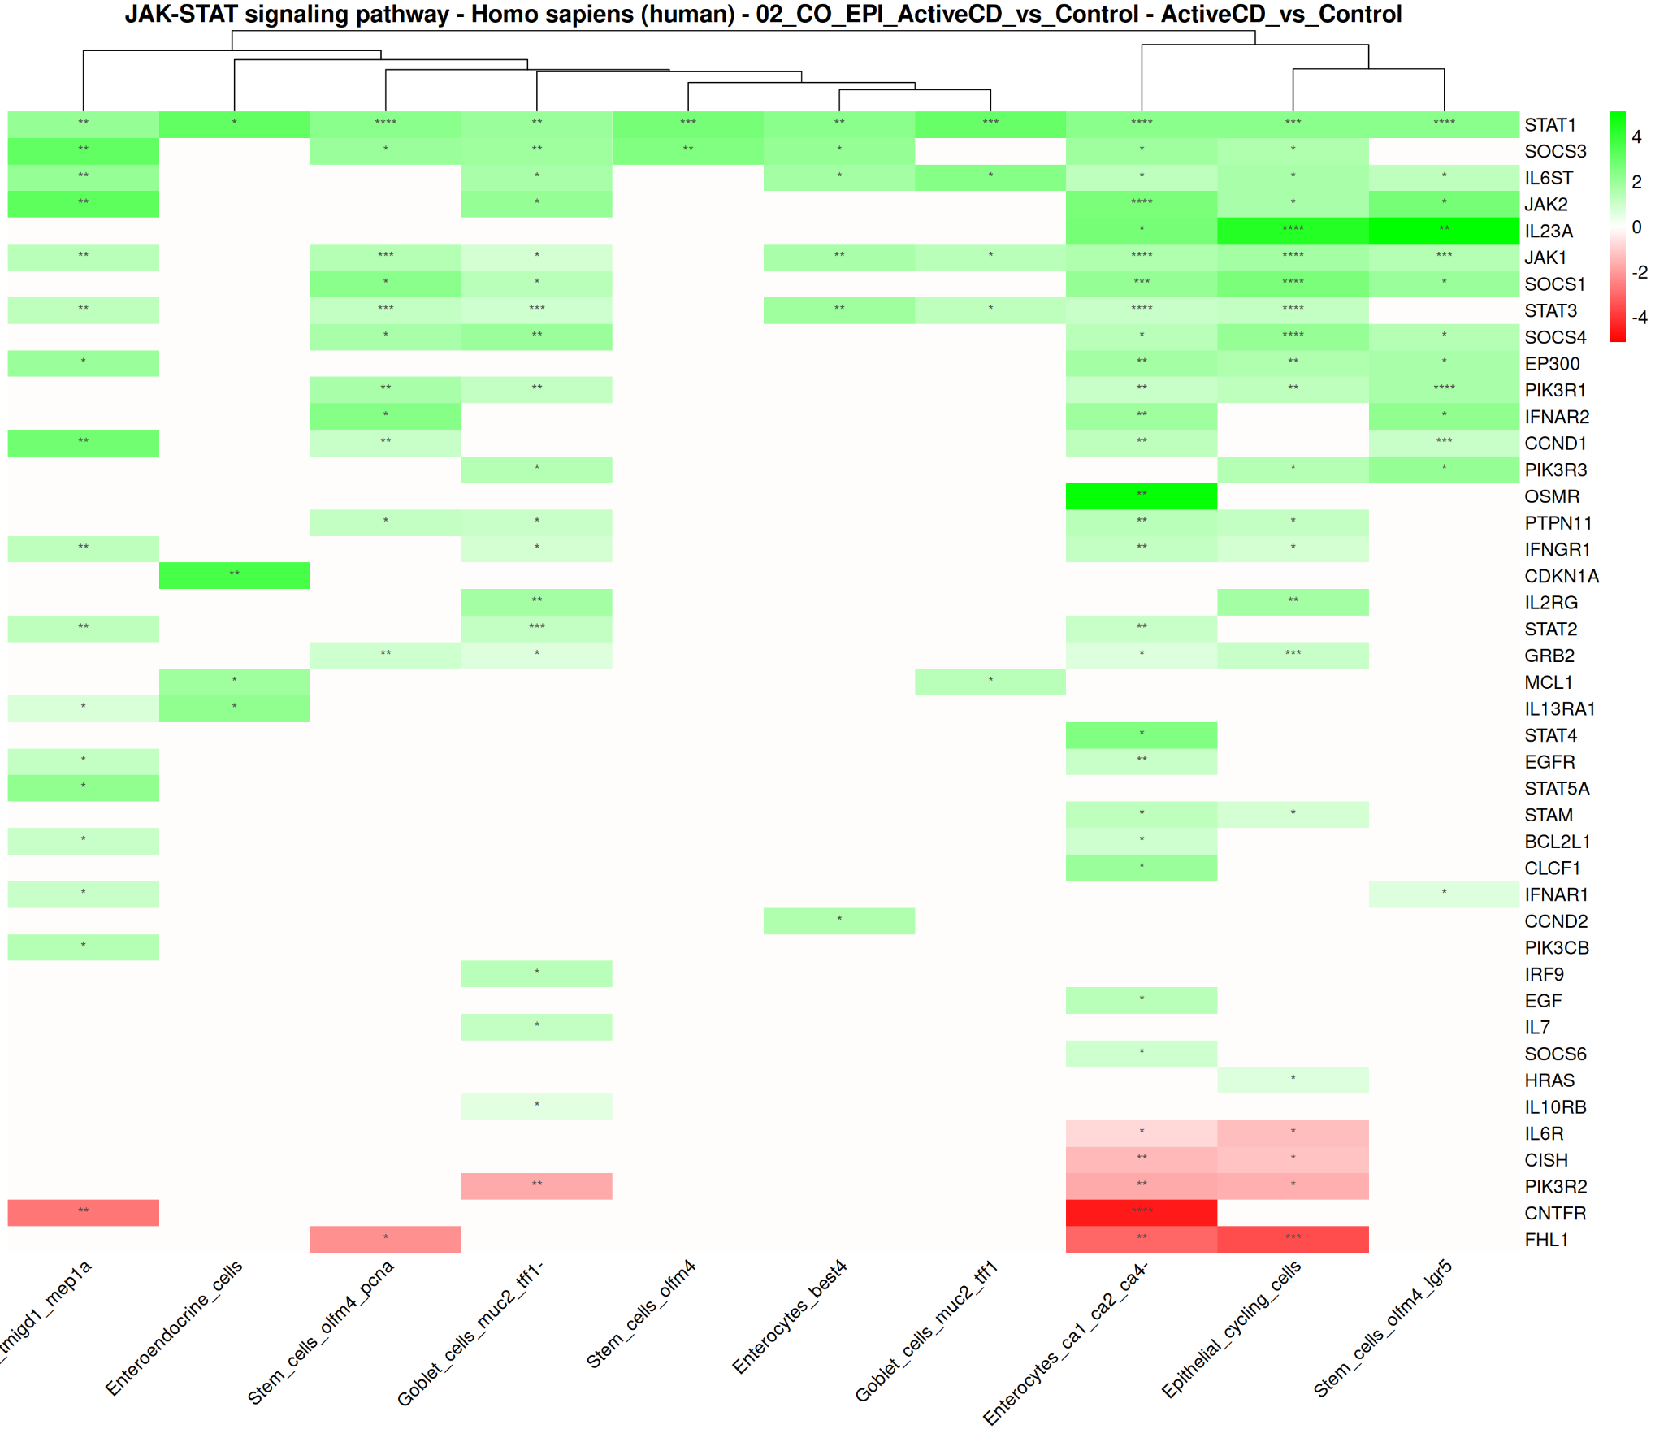
Dataset 2 - JAKSTAT Pathway (EPI - Colon)

Slide 10
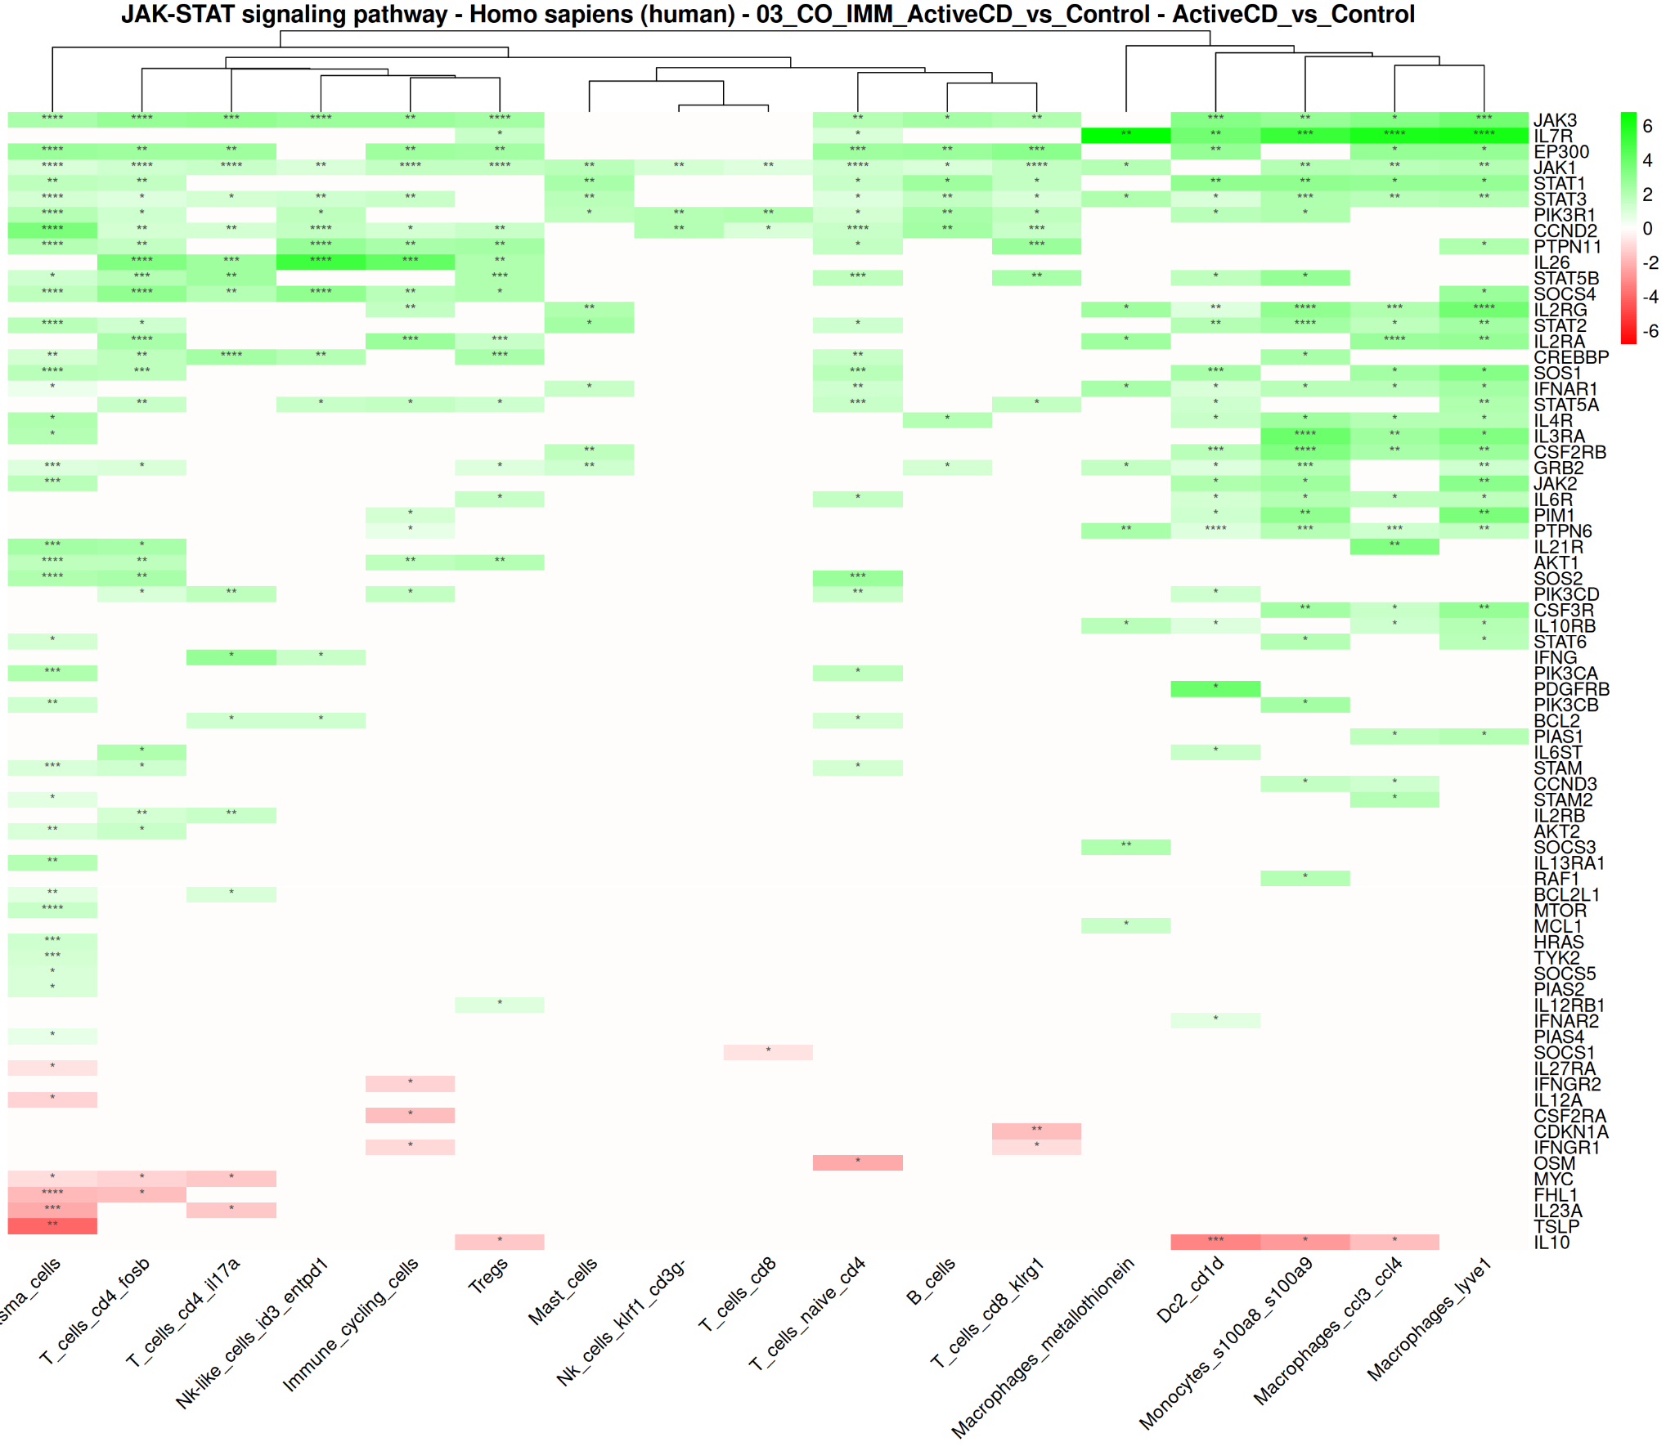
Dataset 2 - JAKSTAT Pathway (IMM - Colon)

Slide 11
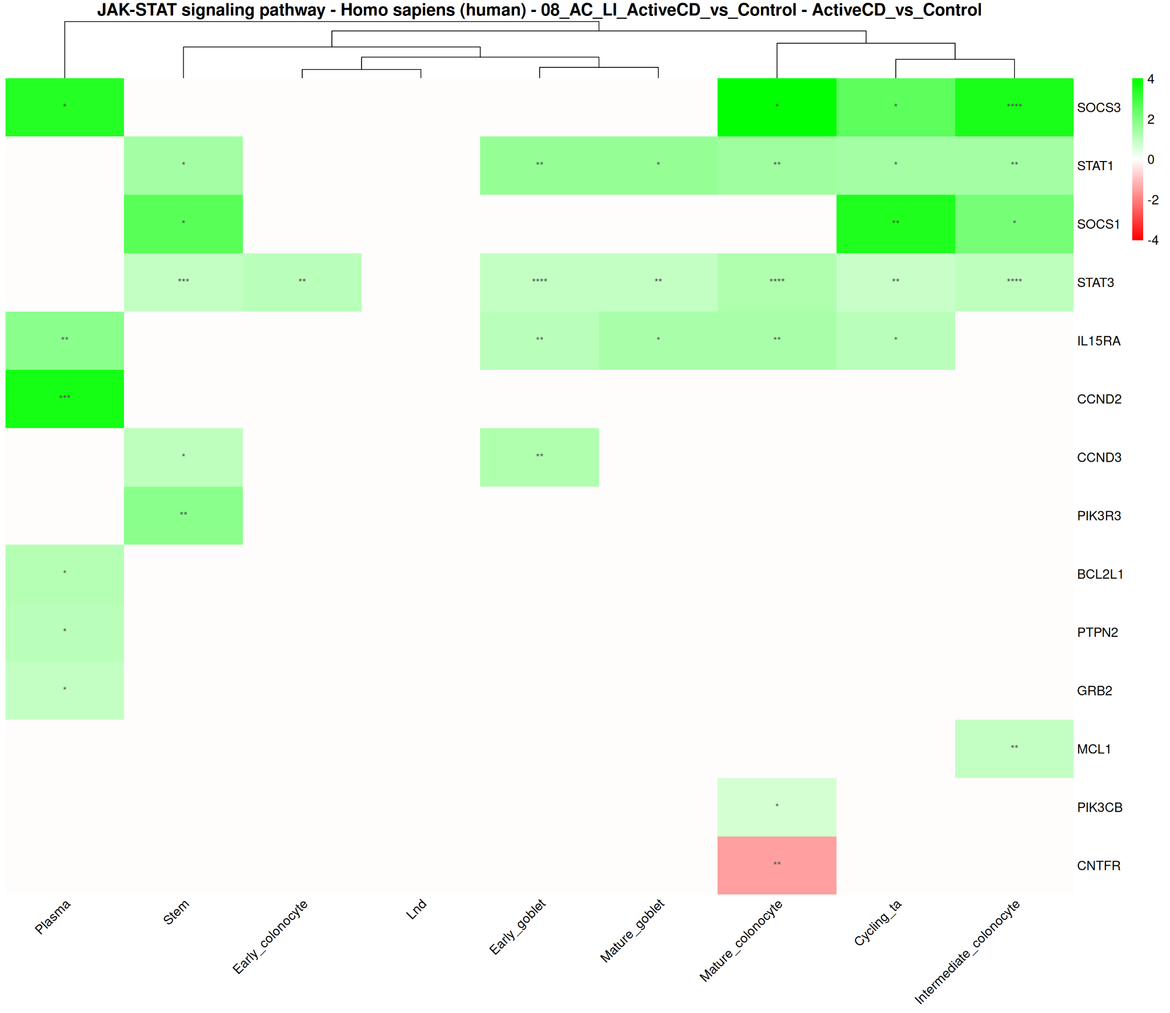
Dataset 3 - JAKSTAT Pathway (Colon)

Slide 12
Other KEGG Pathways analysed
Autophagy
MAPK
NFKB
Tight Junction
(Will view these images from PC results repository)

Slide 13
Next goals
Separate cell type groups for the first (pediatric) and third datasets
Finish GO term script
Update dotplots
Order cell types in dotplots for comparability

