Slide 1

The Social Factor of Death in the Philippines

Slide 2
Introduction
Research plays an important role in learning how to prevent and treat illnesses and has the potential to help improve care for people around the world. The Importance of Health Research like privacy, health research has high value to society.
Health is one of the most important keys for us to be given a good and safe life, that our life can be comfortable with a simple compliance to our good.
According to the Philippines Statistics Authority, the reported deaths in 2017 reached 579,237, a decrease of 0.5 percent than the previous year’s 582,183 deaths. This is equivalent to a crude death rate (CDR) of 5.5, or about six (6) persons per thousand population. In 2017, an average of 1,587 persons died daily. This translates to 66 deaths per hour or one (1) per minute. The number of deaths from 2008 to 2016 showed an increasing trend but slightly declined in 2017. The increase during the ten-year period is about a quarter, or 25.5 percent, from 461,581 in 2008 to 579,237 in 2017.

Slide 3
Problem of the Statement
Identifying the highest cases of death in a specific region and raising awareness to lessen death.

Slide 4
Expected Output
When the analysis findings are established and show a correlation between various factors and when those findings are deteriorating, they can be utilized to disseminate preventative measures to lower the probability of dying from that cause.
It can also aid in future research to develop a strong strategic plan.

Slide 5
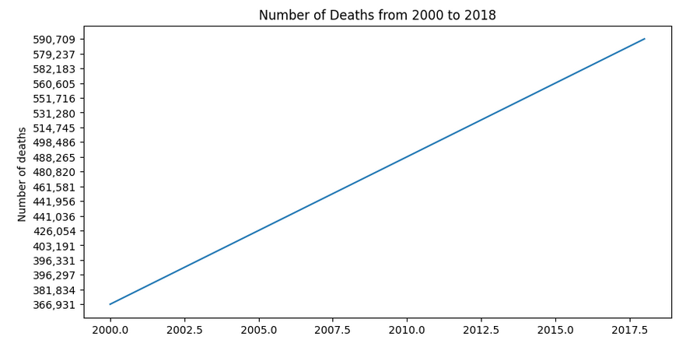
Increasing the Number Of Deaths From 2000 to 2018

Slide 6
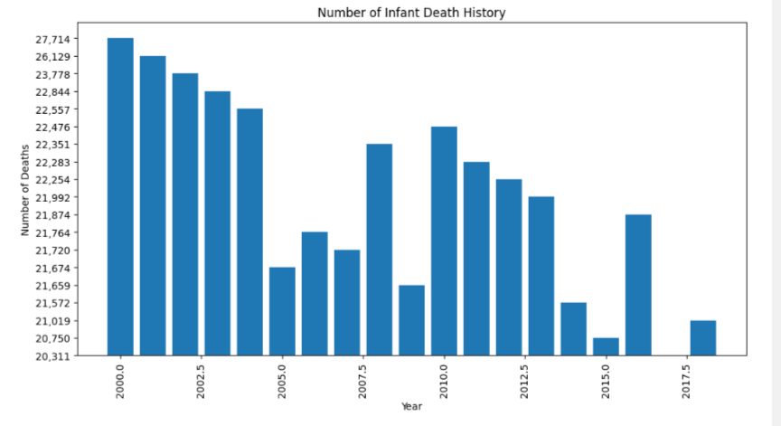
Infant deaths history from 2000 to 2018

Slide 7
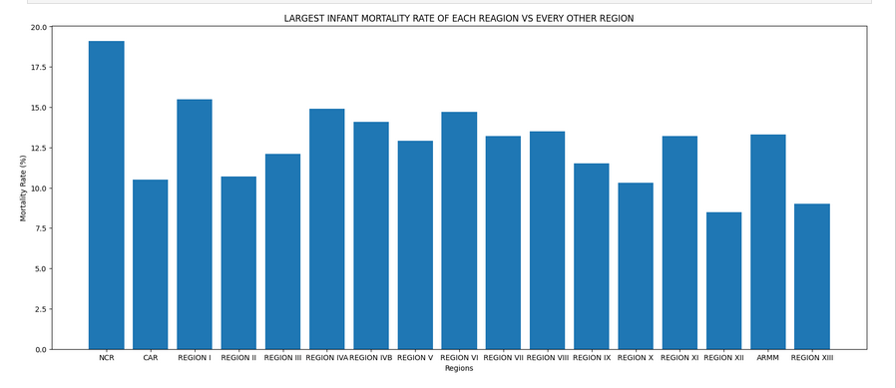
Infant mortality 2006 to 2015

Slide 8
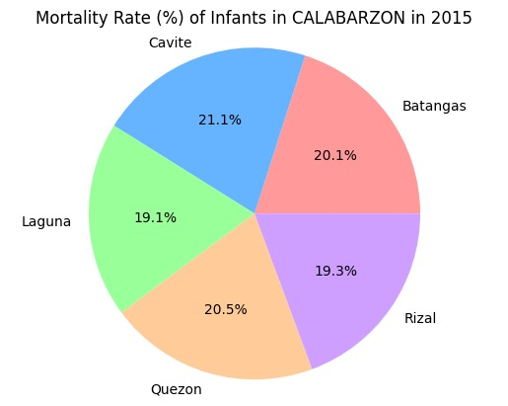
Infant mortality in CALABARZON

Slide 9
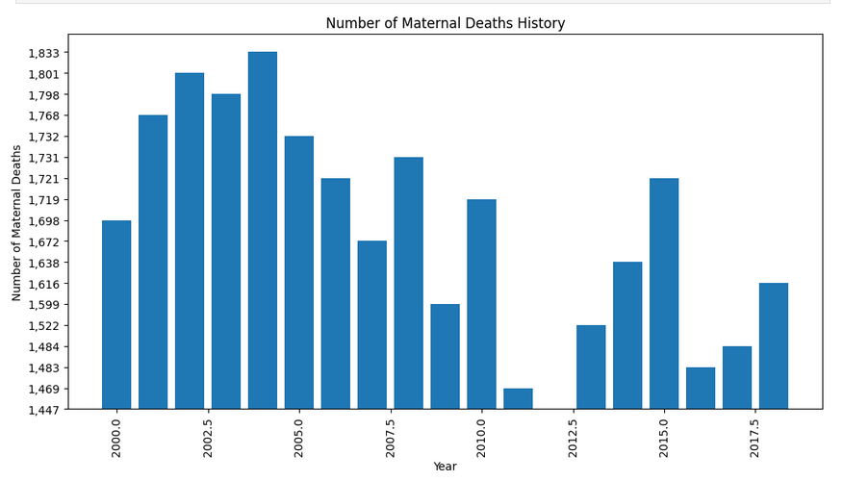
Maternal deaths history from 2000 to 2018

Slide 10
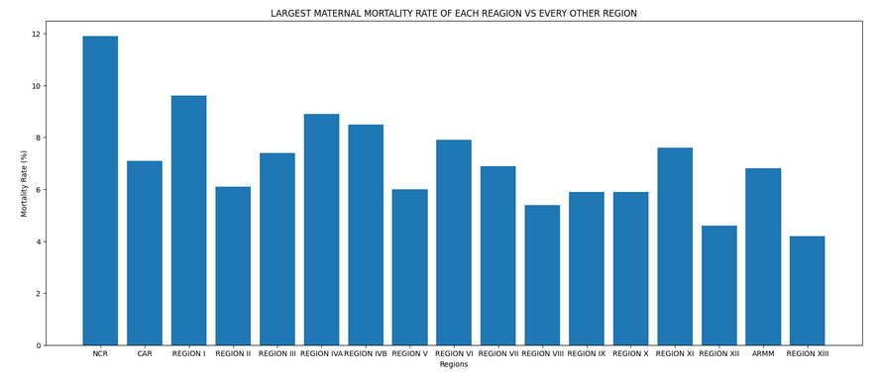
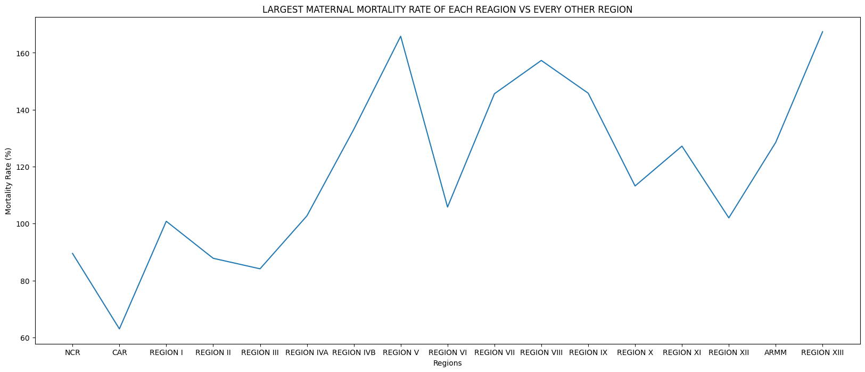
Maternal deaths 2006 to 2015

Slide 11
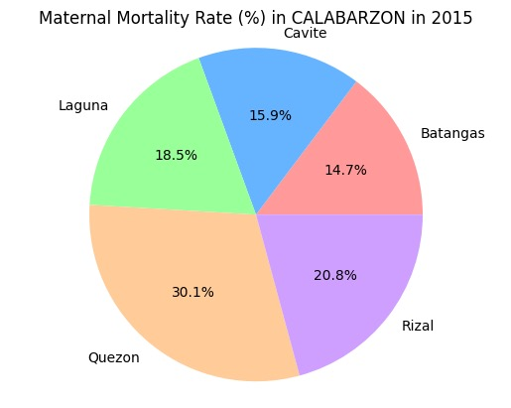
Maternal mortality in CALABARZON

Slide 12
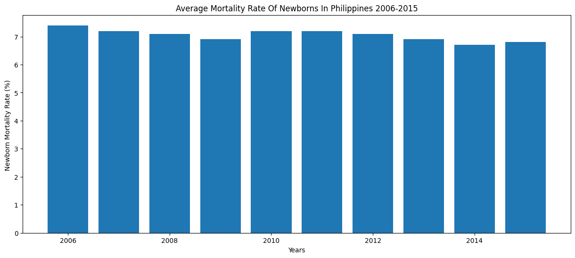
Newborns Moratlity Rate 2006 to 2015

Slide 13
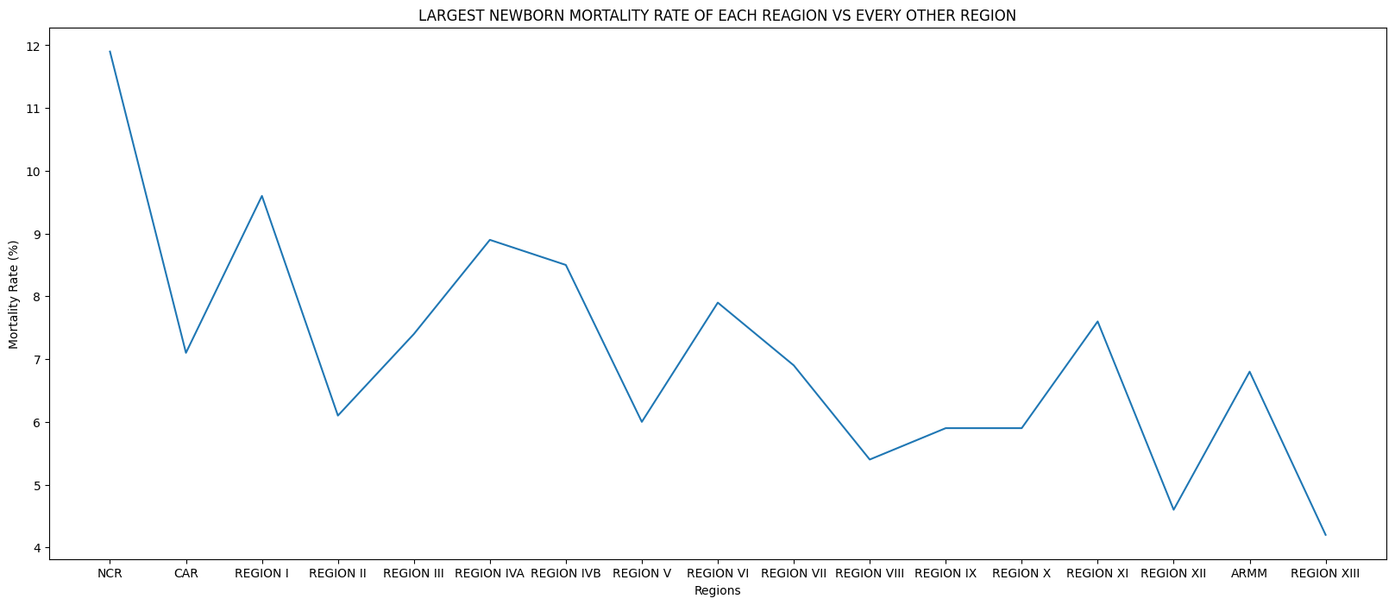
Newborn Mortality 2006 to 2015

Slide 14
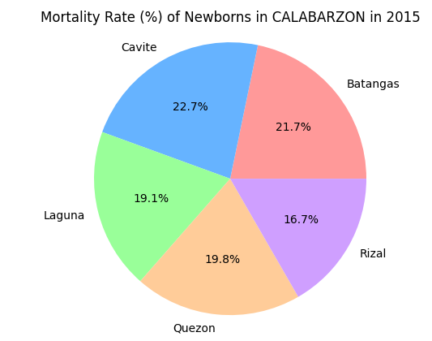
Newborn Mortality in CALABARZON

Slide 15
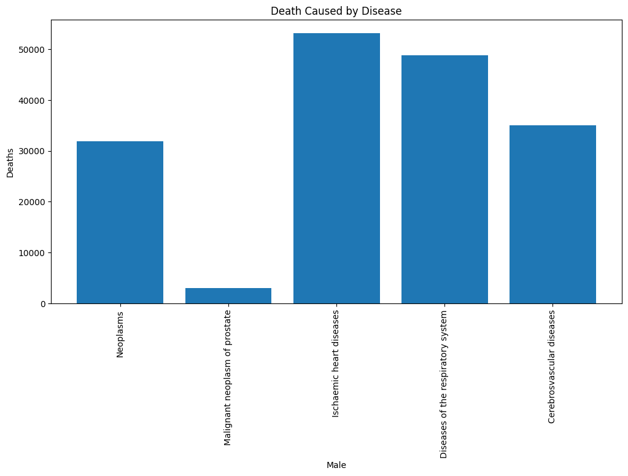
Top 5 highest Cause of death

Slide 16
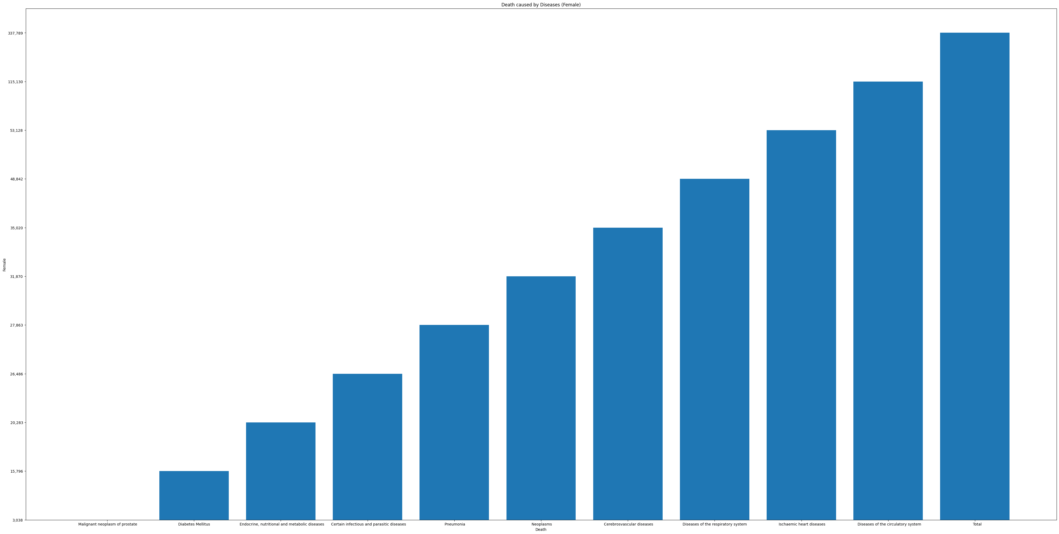
Death Rate of Female caused by Diseases

Slide 17

Death Rate of Malecaused by Diseases

Slide 18

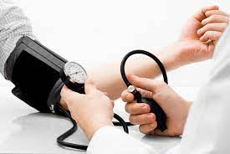



Possible Solutions:

Slide 19
THANK YOU!
Arcega, Glenn Emerson P. Fabonan, Kirt Sywin P. Manalo, John Louis P

