Slide 1


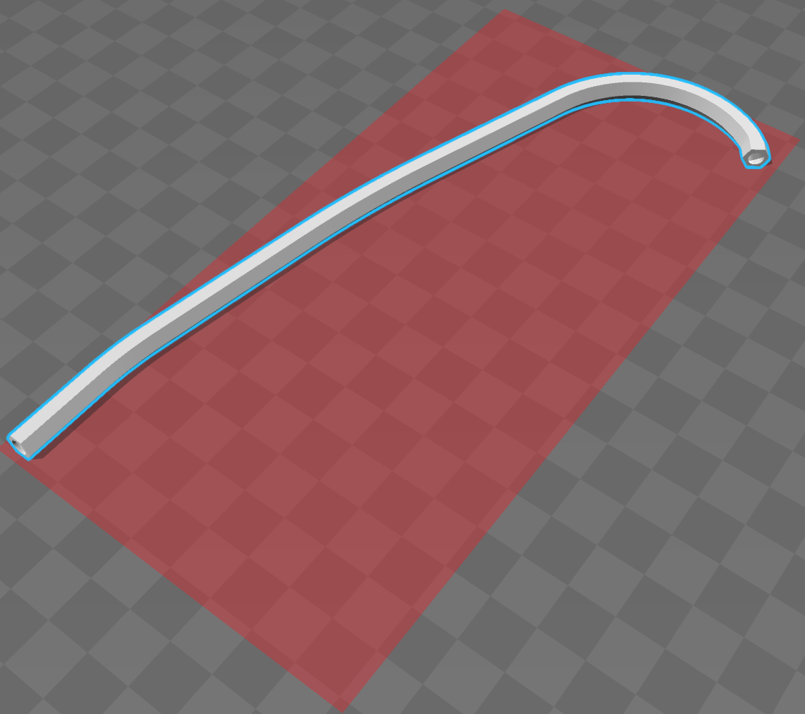
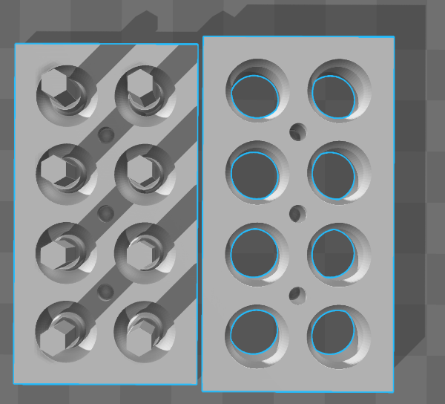
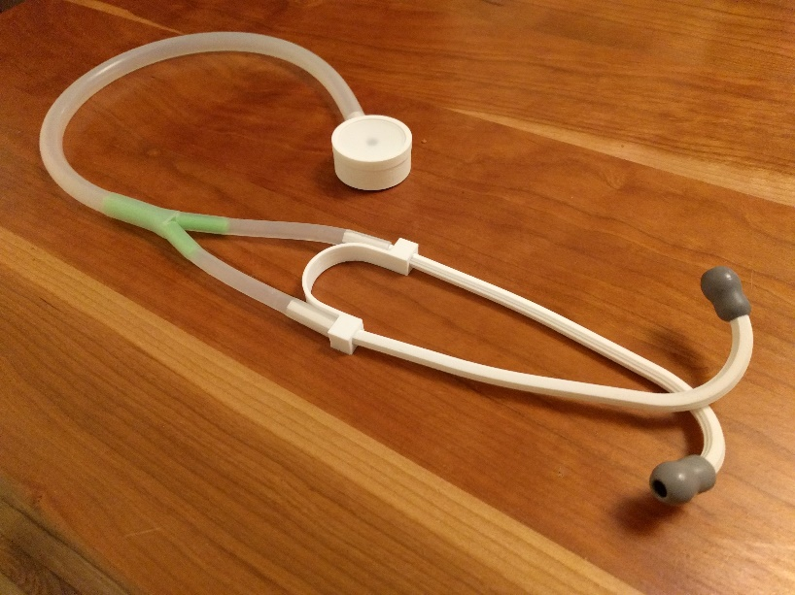
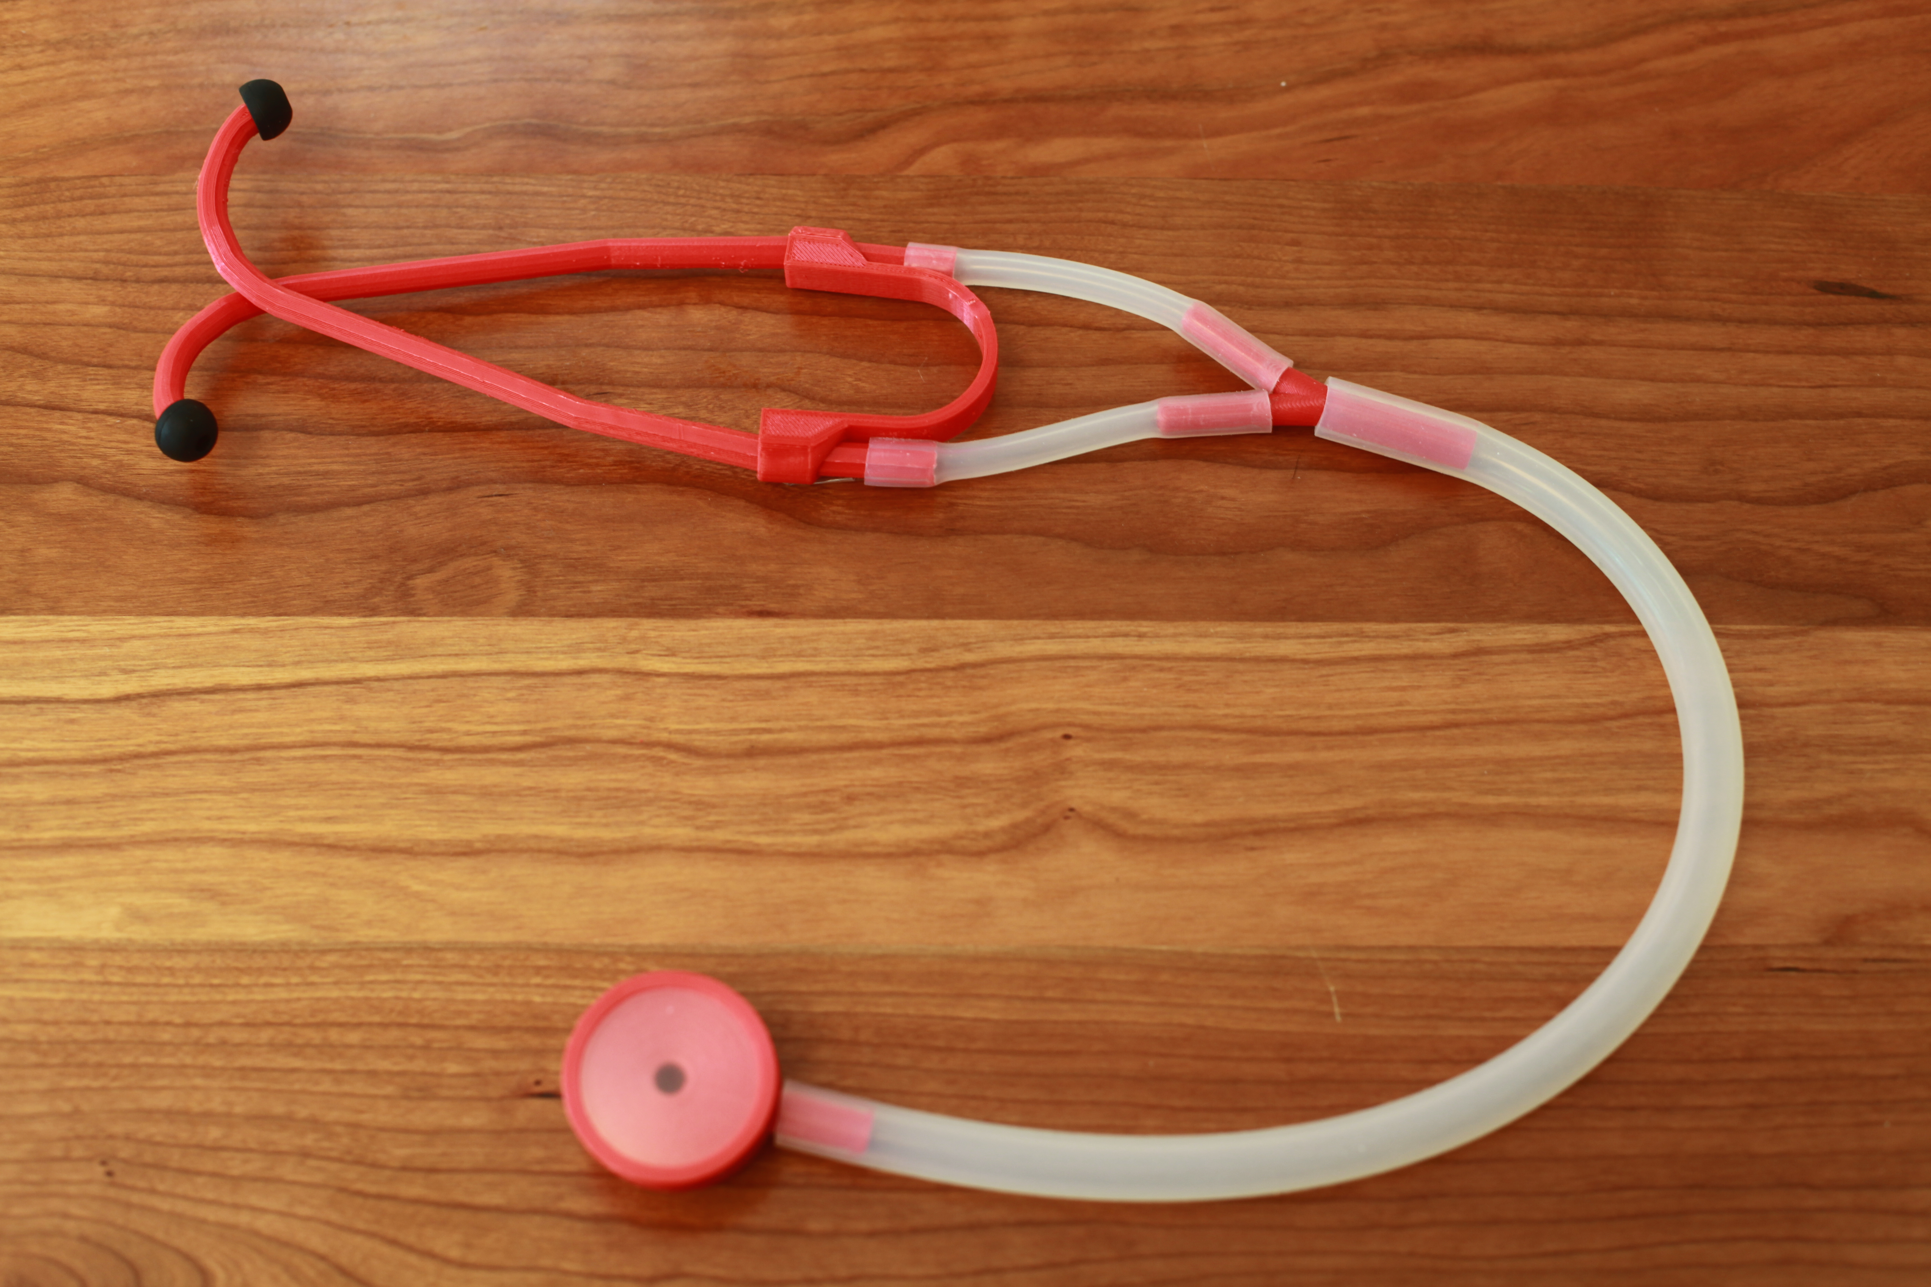
A.
B.
D.
C.
Figure 1
Notes:
Figure 1. Computer aided design and assembly of the 3D printed stethoscope. Digital models of the 3D printed stethoscope parts are shown in Figure 1A. From left to right: the head, Y piece and ear tube are shown. An earplug mold design and diaphragm ring are also shown in Figure 1B. Each part was 3D printed in PLA, with the assembled stethoscope is shown in Figure 1C using the bill of materials listed in Table 1.

Slide 2
A.
B.
Figure 2
Notes:
Figure 2. Calibration and comparison of 3D printed Glia model stethoscopes to the gold standard Littmann Cardiology III. Stethoscope output responses were measured using the equipment setup described in the methods. Each stethoscope model recorded input sound at multiple frequencies and the change in amplitude between input and recorded sound was documented (lower log attenuation is better) for each stethoscope (Figure 2A). The decibel difference in attenuation (Glia minus Littmann) is shown across all frequencies tested where values above 0dB indicate the Glia model attenuated less sound (Figure 2B).

