Slide 1
BidStream
AI Tender Intelligence · Go-To-Market Strategy
Know which contracts you can actually win.
$22B+
85%
10×
Global tender market
Tenders missed by hand
Return on matched tenders
SERIES SEED · CONFIDENTIAL · 2026
Notes:
Bidstream helps a company find the public and private contracts it has a real chance of winning. This deck covers the idea in brief, then focuses on how we go to market.

Slide 2
THE PROBLEM
BidStream
Most companies never see the contracts they could win
Hard to find
Easy to miss
Wrong bids chosen
Open contracts are spread across thousands of government and private websites. Teams spend most of their bidding time just searching.
Most procurement teams admit they miss good contracts because they find them too late. The window to respond is often only about three weeks.
Teams spend a lot of effort on contracts they end up losing — usually because the poor fit only becomes clear after the work has started.
The cost: businesses lose an estimated $340B in contracts every year simply because they never saw the right ones in time.
Notes:
Three plain problems: hard to find, easy to miss, wrong bids chosen. "Thousands of websites" rather than a precise figure.

Slide 3
OUR SOLUTION
BidStream
One place that reads the whole market and shows you what fits
1
2
3
4
5
Gather
Match
Read
Remind
Act
We collect open contracts from public and private sources in one feed.
We compare each contract to what your company does and how well it fits.
We pull out the key details — scope, budget, deadline — so you don't have to.
We track deadlines and tell you when something needs attention.
We suggest the next step for each contract worth pursuing.
How the matching actually works, in plain terms
We read the words
We learn from results
The software reads each contract document — even long PDFs — and understands what is being asked for, the way a person would.
It gets sharper over time by learning from which bids companies actually win, so the fit score keeps improving.
Notes:
No jargon: "the software reads the words the way a person would" and "it learns from which bids companies actually win."

Slide 4
POSITIONING
BidStream
We sell one clear promise, not a long list of features
Instead of saying...
...we say one thing:
"A complete tender intelligence platform"
"Know which contracts
you can actually win."
"End-to-end procurement software"
A long feature list and roadmap
You tell us what your company does. We show you a short list of contracts that fit — and why. Everything else comes later.
...which sounds like everyone else and is hard to prove.
Why one clear promise wins:
It is easy to understand
It is easy to prove
It fits a short ad
A buyer gets it in one sentence. A feature list makes them work to figure out if it is for them.
We can show, in a few weeks, whether we found a company contracts it could win. A broad platform claim can't be tested that fast.
On LinkedIn or Google you have a couple of seconds. One promise lands; a list of features gets scrolled past.
Notes:
Plain reasons: easy to understand, easy to prove, fits a short ad.

Slide 5
GO-TO-MARKET
BidStream
The 24-month plan: prove it, sell it, focus it, own it
0
6
12
18
24
START
MO 6
MO 12
MO 18
MONTH 24
1
0–6 mo
2
6–9 mo
3
9–15 mo
4
15–24 mo
Prove it works
Sell the proof
Focus on the best fits
Own the space
Let real companies use it free for 6 months
Raise the price using real results
Concentrate on the two industries we win most
Become the name people think of first
Gather proof it finds them winnable contracts
Market what the first customers said
Speak to each one directly
A monthly market report + LinkedIn teasers
500+ warm contacts, feedback + testimonials
Proof-led ads replace problem-led ones
A page and ads per industry
Industry partners and resellers
The through-line: each phase only starts once the one before it has produced real proof — evidence, then brand, then scale.
Notes:
GTM overview as a 24-month timeline: prove it (0–4), sell the proof (4–8), focus on best fits (8–14), own the space (14–24). Phases are evidence-gated, not date-gated. "Cost to win a customer" = marketing spend per new paying company, which drops across the phases.

Slide 6
STEP 1 · PROVE IT WORKS
BidStream
Get evidence that it works from real companies
THE OFFER
Reach out to people we know
Free for 6 months,
then a low fixed price
Contact all 500+ tech companies in our network, one by one. Sort them into: will use it, will recommend it, will speak on the record for us.
Our strongest, cheapest channel
In return, each company agrees to give us honest feedback (including a short video) and take two quick calls. We cap it at 200 companies and call them founding members, so the offer feels special and clearly ends.
LinkedIn — founder posts + ads
Alex shares real stories from years in bidding a few times a week. Paid ads target the exact job titles that care: bid managers and heads of business development.
Around £4–6k per month
Google Ads — only ready buyers
Show ads only to people already searching for tender alerts or a rival tool. We catch existing demand rather than trying to create it.
Around £2–3k per month
On the timeline this is month 0–6. The point of Step 1 is proof, not revenue — if the product does not find real companies contracts worth bidding on, we fix that before spending on growth.
Notes:
Warm outreach to the 500+ network is the first and strongest channel. Free window is 6 months, matching the timeline on the go-to-market slide.

Slide 7
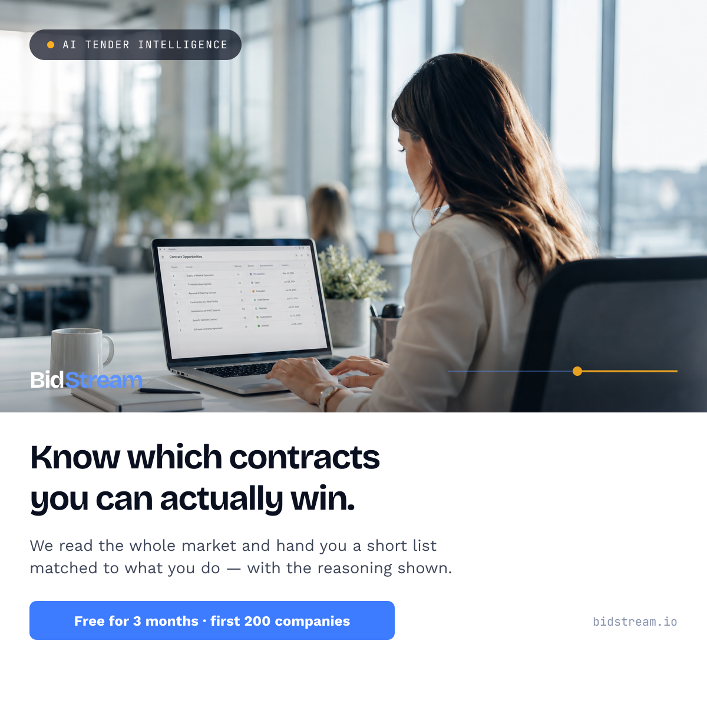
STEP 1 · THE CREATIVE
BidStream
What we actually put in front of people on LinkedIn
One promise, one real face, one clear offer. The post leads with the problem a bid manager feels, shows the product in a real workspace, and ends with the founding-member offer — nothing more.
Problem first
The headline names the pain — the noise, the missed contracts — not our features.
Show, don't tell
A real person using it in a real office. Honest, not staged stock photography.
One offer
Free for 3 months, first 200 companies. A single, clear next step.
LINKEDIN · 1200×1200 · READY TO POST
Paid targets bid managers, heads of business development and proposal managers at 50–2,000-person firms. Founder posts run alongside, a few times a week.
Notes:
The LinkedIn creative for Step 1. Left explains the three moves; right is the actual post graphic on the real office photo.

Slide 8
WHAT THE RESEARCH SAYS
BidStream
Free offers work — but a permanent free plan converts the worst
Share of free users who become paying customers
Three lessons we are building around
Median across 200 business software products, 2026
A free plan brings in more people
Always-free plan
Even though a smaller share pays, a free offer attracts far more signups — so it can still produce more paying customers overall.
2–8%
Watch the ones who use it most
Free trial, no card needed
Companies that actively use the product convert about three times better than average. Focus effort there.
8–22%
Free trial, card required
Get people using it early
35–55%
If most companies never really try it in the first two weeks, nothing else matters. Getting them to that first useful moment is the priority.
What this means for us: the founding-member offer runs free for the first 6 months while we prove the product works. After that window closes, new companies get a short, card-gated trial (about two weeks) — not a plan that stays free forever. The long free window is deliberate, and it ends on a fixed date.
Source: 2026 conversion study of 200 business software products (ChartMogul / ProductLed / Kyle Poyar); ProductLed survey of 600+ companies.
Notes:
Benchmarks argue for a short, time-boxed free window, not permanent free.

Slide 9
STEP 2 · SELL THE PROOF
BidStream
Turn what customers said into higher prices (Months 6–9)
COLLECT THE PROOF
RAISE THE PRICE
15–20
short video interviews with real customers
low intro price → $490 / $1,490 a month
5
written stories with real numbers in them
The first companies keep their low price — and we say so openly — so it feels like a reward for helping early, not a bait-and-switch. New companies get a time-limited free trial.
1
headline result we can repeat everywhere
e.g. "Companies found £Xm of contracts worth bidding on in 90 days."
THE ADS CHANGE: FROM DESCRIBING THE PROBLEM → SHOWING THE PROOF
BEFORE
AFTER
"Missing most of the contracts you could win?"
"We found this firm a £4.2m contract they'd have missed."
Describes the pain. Believable, but nothing to back it up yet.
Real customers, real names, real numbers. Far more convincing.
Notes:
Ads shift from problem-led to proof-led. Early customers keep their price, publicly.

Slide 10
STEP 2 · PRICE & REVENUE
BidStream
How the price rises — and the revenue that follows
THE PRICE RISES AS THE PROOF GROWS
MONTHLY REVENUE CLIMBS AS COMPANIES CONVERT
Illustrative monthly recurring revenue by month
Months 0–6
£290k
Founding members
Free
200 companies, in exchange for feedback
↓
£110k
Months 6–9
First paid tier
$99 / mo
Founding cohort locks this rate for a year
£40k
↓
Months 9+
Standard pricing
$490–1,490 / mo
£0
£0
New companies, priced on proven value
M3
M6
M9
M12
M18
Free while we gather proof, then revenue builds fast once the founding cohort converts and standard pricing kicks in.
Revenue figures are illustrative and follow the funnel on "The model" slide. The free window is a deliberate investment in proof before revenue.
Notes:
New slide per note: shows the price ladder (free → $99 → $490/$1,490) and the revenue that follows once companies convert. The zero-revenue bars in the free window are intentional — Step 1 buys proof, and revenue climbs from month 9. Figures illustrative, tied to the funnel model.

Slide 11
THE NUMBERS
BidStream
What we expect to pay to win a customer
Where we find them
Typical cost per lead
Our target cost to win a customer
Why it matters
People we already know
Free
Under £150
Our best source. The backbone of Step 1.
LinkedIn — founder's own posts
Free
Under £300
Builds over time. Alex's experience is the draw.
LinkedIn — paid ads
£50–120
Under £1,200
Lets us target the exact right job titles.
Google Ads
£20–70
Under £900
Catches people already looking to buy.
Industry newsletter (Step 3)
Free
Under £250
Built once, keeps bringing people in.
Be patient with LinkedIn. On average it takes a long time — often most of a year — from someone first seeing a LinkedIn ad to actually buying. If we judge it after 30 days we will wrongly switch off our best channel. We give it at least 90 days.
Sources: 2026 LinkedIn and Google Ads cost-per-lead benchmarks (Dreamdata; Stackmatix / SaaSHero). "Cost to win a customer" = total marketing spend divided by new paying companies.
Notes:
Plain terms: cost per lead, cost to win a customer. The 281-day figure is "often most of a year."

Slide 12
WHO ELSE DOES THIS
BidStream
Similar companies — and what we take from each
These are other companies in our space, shown for comparison — not partners or customers. Each one proves part of our approach works, and shows what to copy and what to avoid.
GovWin IQ (Deltek)
GovSpend
The big established name for US government contract data. Won by having the deepest data and selling to large organisations from the top down.
Aggregates government spending and contract data. Grew on data rivals can't easily copy, plus easy links into the tools sales teams already use.
Take: deep data is the lasting advantage. Leave: selling only to big enterprises is too slow for us right now.
Take: hard-to-copy data as the hook, and easy integration to keep customers.
Tenderstria
Brainial · GovRadar · TenderFix
A newer, AI-first tool (launched 2024). Matches each contract to a company and explains the score in writing. Starts at $299/mo with a free trial on real contracts.
A group of newer European AI tools (Netherlands and Germany, 2019–2022). Each does one thing well — finding, qualifying, or writing bids — rather than everything.
Take: a low entry price and a free trial on real contracts — the closest match to our Step 1.
Take: doing one thing well beats doing everything for a young company in this space.
Sources: G2 (Government Procurement Software category); CB Insights company profiles. Summaries as of July 2026.
Notes:
Tenderstria is the closest analogue to our Step 1 offer.

Slide 13
STEP 3 · FOCUS ON THE BEST FITS
BidStream
Stop selling to everyone; win the two industries that fit best (Months 9–15)
This is the "niching" phase on the timeline. Once Step 1 shows where we win most, we put our effort into those two industries and speak to each directly — a defence supplier should land on a page that talks about defence.
Construction & engineering
Defence suppliers
Government contractors
FOCUS
FOCUS
$28k/yr
$48k/yr
$42k/yr
Missing big infrastructure contracts
Hard-to-track, high-value work
Bids across many regions
Telecoms
IT & consultancies
Healthcare suppliers
$35k/yr
$22k/yr
$19k/yr
Network and spectrum contracts
Manual searching for work
Health-service contracts
$ figures show the average yearly amount a customer in that industry would pay us.
A page for each industry
Separate ads for each
An industry newsletter
One landing page per industry, in that industry's own language.
Ads written for one industry work far better than one general ad for all.
e.g. a weekly construction-contracts email that quietly brings in new companies.
Notes:
"Focus on the best fits" fully explained. ARR shown as "average yearly amount a customer would pay us."

Slide 14
STEP 4 · OWN THE SPACE
BidStream
Become the name people think of first (Months 15–24)
OUR MONTHLY MARKET REPORT
Work with partners
Publish data no one else has.
Let consultancies and integrators resell it. We treat each partner as a test first, since a partner can't fix an unclear message — only spread it.
Which industries win most, and who wins them
Go where our buyers are
How long companies typically get to respond, by country
Show up at construction, defence and healthcare events — where bid managers actually go — not generic software conferences.
How many good contracts go unnoticed
Sell our data
Each month we post a sneak peek on LinkedIn — one striking finding — and people subscribe to get the full report. It builds our list, feeds the brand, and makes buyers see us as the experts.
Let other tools pay to use our contract data. A second income stream on top of subscriptions.
The goal: when a company thinks about winning contracts, it thinks of Bidstream first.
Notes:
Report is now monthly (was yearly) and doubled with a LinkedIn sneak-peek each month that drives subscriptions — building the list and the brand at once. Plus partners, events and data licensing.

Slide 15
THE MODEL
BidStream
How the numbers add up
18,000
People who see us
Our network plus LinkedIn and Google ads
900
Sign up
About 1 in 20 of those who see us
380
Actually start using it
About 4 in 10 of sign-ups — the key number
200
Join as founding members
The capped early group who give feedback
120
Paying by Step 2
About 6 in 10 of the founding members
$3.5m
150+
Under £4,200
120%
yearly revenue by month 18
paying companies
to win each customer
revenue kept & grown
Beyond these numbers: the tender data we build up is itself a valuable asset — worth selling and licensing down the line.
Sign-up and usage rates are based on 2026 business-software benchmarks. Every number here is an assumption we will test — the one to watch most is how many actually start using it.
Notes:
Funnel in plain words. Activation is the number that matters most.

Slide 16
THE RISKS
BidStream
Two ways this could fail — and how we prevent each
1
People take the free offer but never pay
2
Step 2 has nothing to show
The usual problem with anything free: people sign up because it costs nothing, then leave the moment it doesn't.
Step 2 depends on Step 1 producing real success stories. If the product doesn't find companies good contracts, there is nothing to market.
HOW WE PREVENT IT
HOW WE PREVENT IT
We only give free access in exchange for a feedback commitment. That attracts companies who actually mean to use it, and gives us a reason to talk to them at renewal. We also cap the group and end the free period after three months.
We treat the free period as a test of the product. Feedback goes straight to the engineers. If most companies aren't really using it within two weeks, we stop spending on growth and fix the product first.
Notes:
Both risks come down to one discipline: the free period buys proof, and proof only exists if the product genuinely works.

Slide 17
GETTING STARTED
BidStream
The first 90 days
WEEKS 1–2
WEEKS 3–6
WEEKS 7–10
WEEKS 11–13
Set up
Warm launch
Turn on ads
First proof
Cut the website to one promise; build early traction on it
Alex personally contacts the best contacts first
Reach out to more warm leads from the network
Record the first 5 video interviews
Set up the brand profile, LinkedIn and outreach format
Open the founding-member offer — 200 places
Run LinkedIn ads, testing three messages
Check how many companies are really using it
Make sure we can see when a company starts using the product
Start posting on LinkedIn a few times a week
Run Google ads for people already searching
Decide whether we're ready for Step 2
Checkpoint at week 13: at least 150 active companies, most using it within their first two weeks, and at least 5 success stories with real numbers. If we don't hit this, we fix the product before raising prices.
Notes:
The week-13 checkpoint is the gate to Step 2.

Slide 18
THE ASK
Series Seed: $4.5M
The money funds the go-to-market, not the idea
WHERE IT GOES
WHAT $4.5M BUYS IN 18 MONTHS
Product & engineering
$3.5m yearly revenue
45%
150+ paying companies
Sales & marketing
Live in 30 countries
30%
full contract coverage
Data
Ready for the next raise
15%
at $5m+ revenue
Running the company
A bid-writing helper
10%
early version live
alex@bidstream.io · bidstream.io/investors
Notes:
The ask. Convergence motif and amber node carry the brand through to the final slide.

