Slide 1
Problem statement
Problem statement chosen : Create a mobile app that uses computer vision to identify fish species from images and provide species-specific insights.
Identifying fish species is traditionally done by experts, which can be time-consuming and expensive.
There's a clear need for an AI-powered tool that can assist in fast and accurate classification of fish, especially in regions with rich aquatic biodiversity.
Manual classification can lead to inconsistencies and potential mislabeling in markets or research. Our goal is to automate and simplify this process using modern machine learning.
Team Name: The Innovators
Team Members:
Aparajith Venkatesh
Aravind G

Slide 2
AI-Based Fish Classifier (Our Solution)
Our solution is a mobile-based AI model that classifies fish species from images taken via the device camera or gallery.
The model is lightweight and optimized for mobile deployment using TensorFlow Lite.
Users receive the species prediction within seconds, with no internet needed.
The app interface is intuitive and requires no technical knowledge, making it ideal for vendors, researchers, and even students. It bridges the gap between advanced AI and field-level practicality.

Slide 3
Technical Stack
Languages: Java (Android), XML (UI), Python (model training)
Libraries/Frameworks: TensorFlow Lite, Keras, NumPy, OpenCV
Tools: Android Studio, VS Code, Git & GitHub
The CNN model was trained using a dataset of fish images with multiple species classes from Kaggle.
PCA and Random Forest were also explored during the experimentation phase for performance comparison.
The app uses Android’s native camera and image picker features, integrated with the TFLite model for real-time inference.

Slide 4
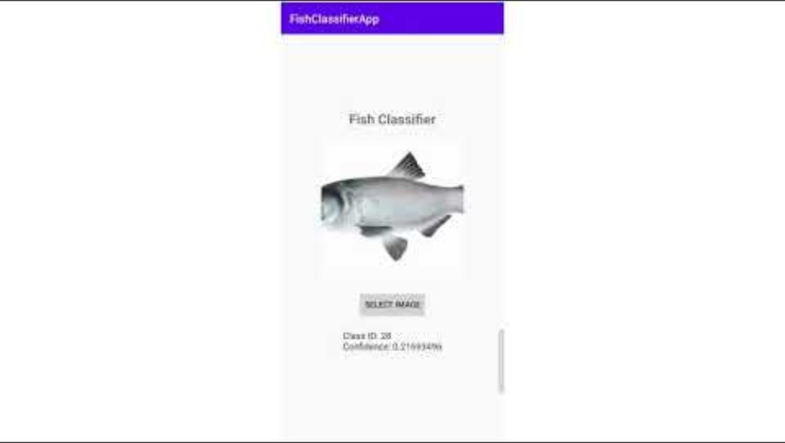
Embedded/Linked YouTube Demo Video

Slide 5
Business Analytics (Use Case, Market Impact, Scalability)
This app has potential in various industries — fisheries, marine research, environmental conservation, and even tourism. In developing regions, it can support small-scale fishermen in identifying and pricing fish correctly.
With added language support and region-specific models, it can scale across countries and ecosystems.
A marketplace or inventory tracking feature can be added for B2B use in fish markets.
Long-term, the solution can evolve into a multi-species detection suite for both aquatic and terrestrial classification.

