Slide 1
RF & Microwave Power Amplifier Design Goals & Stability Analysis- Spring 2019
Name:
Eric Valentino
Contact Information: evalentino@mail.usf.edu
Notes:
Is this the “abstract title”?
Did we have Paul Herzig’s name in abstract?
AG: Yes, it’s the abstract title. Paul’s name was not there in the abstract, but I remember you asking me to have his name in the presenatation.

Slide 2
QPD 1022 Class F PA Design Goals
Parameter | Assignment min. | Datasheet Max | Goal
P_out_max | 38 dBm | 40 dBm | 38 dBm
Maximum Efficiency | 60 % | 66.1 % | 75%
Gain | N/A | 33.1 dB | 27 dB
Efficiency: 10% less than theoretical maximum

Slide 3
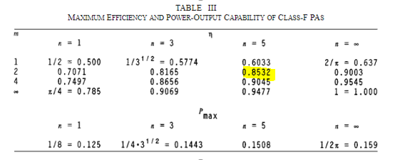
How Goals were arrived at
Efficiency: 10% less than theoretical max as described in Class F supplemental paper using 5 reflected harmonics
Gain: Max gain – 6dB as shown in the “cheat sheet” given in the class notes for Module 1
Power: Power shown at maximum efficiency match – 2dB

Slide 4
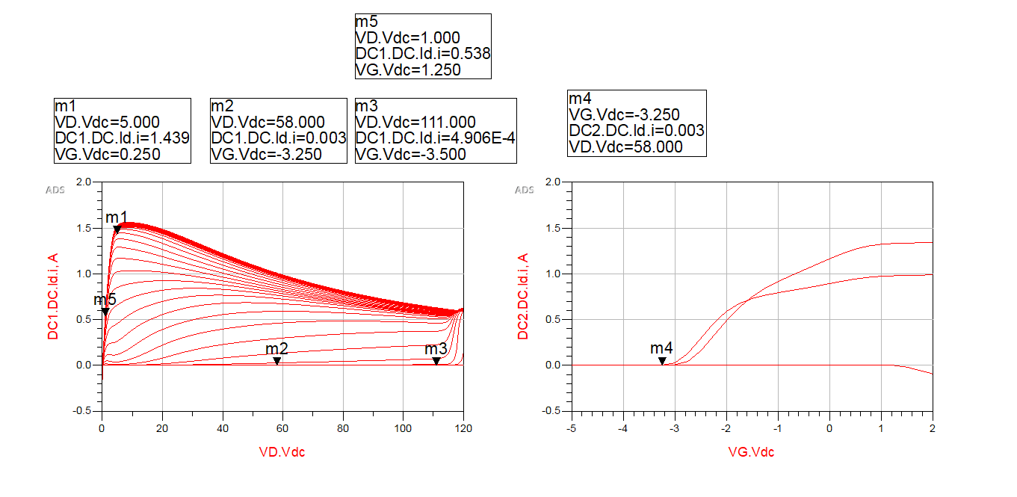

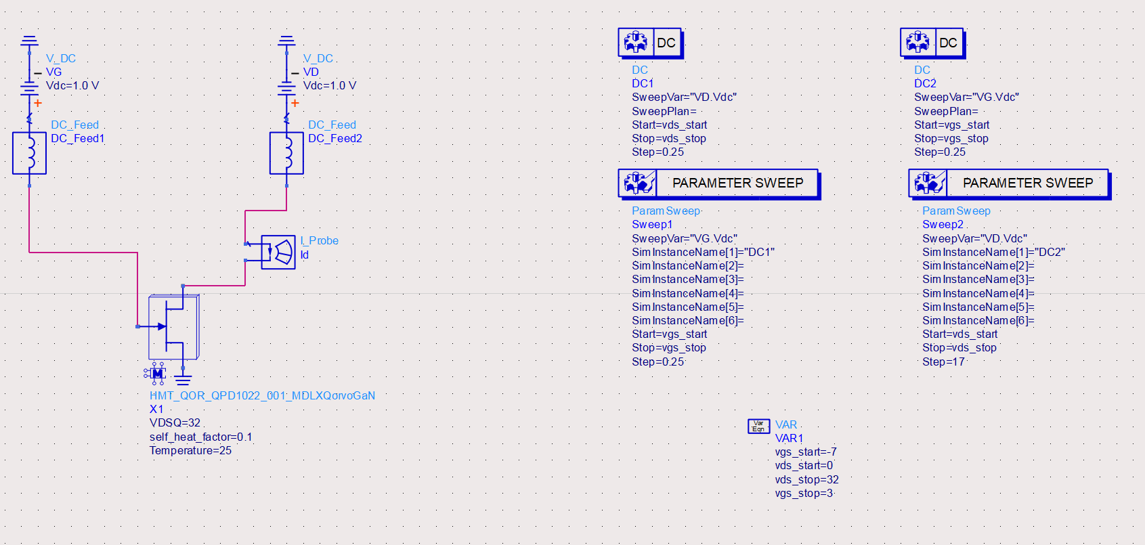
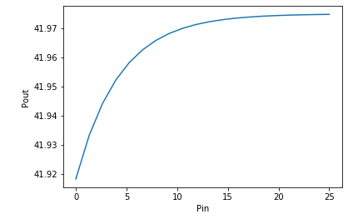
IV Characteristics
Optimum Load Resistance
Given that our bias point is 32 V max, and our knee voltage is 5 V, that means that our maximum peak to peak drain voltage for class B is: ((32-5)+ 32) - 5 = 54 V.
P_lin and P_sat:
Estimated in same manner as HW4

Slide 5
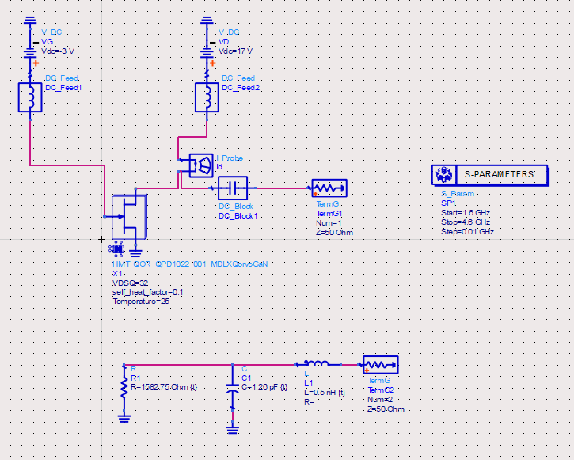
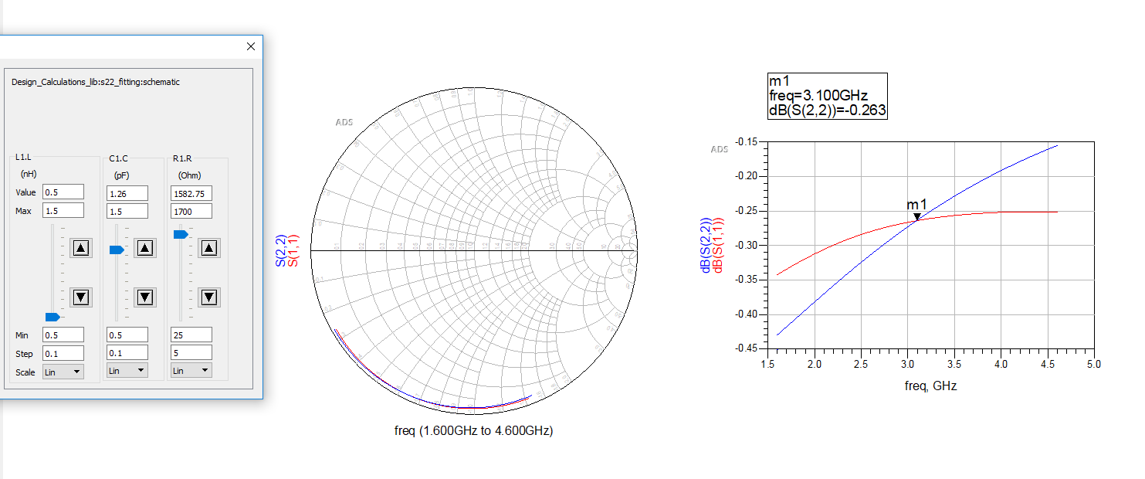
Fitting S22
Parasitics Fit By RLC Network:
Ld = 0.5 nH
Cdg = 1.26 pF
Rd = 1580 Ω
Red – S22 of device Blue – RLC Fit

Slide 6
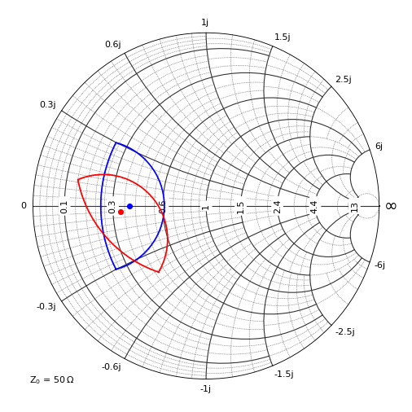
Plotting Cripps Contours
Same approach as Homework 5 was used to plot the -2 dB contours for R_opt = 19.28 Ω, Ld = 0.5 nH and Cdg = 1.26 pF
See contours right
Z opt at extrinsic reference plane: 16.8 – j1.43
Seems to disagree slightly with datasheet’s Z_max_power of 13.6 + j11.98
Red – Extrinsic Reference Plane Blue – Intrinsic Reference Plane

