Slide 1
RF & Microwave Power Amplifier Design Goals & Stability Analysis- Spring 2019
Name:
Eric Valentino
Contact Information: evalentino@mail.usf.edu
Notes:
Is this the “abstract title”?
Did we have Paul Herzig’s name in abstract?
AG: Yes, it’s the abstract title. Paul’s name was not there in the abstract, but I remember you asking me to have his name in the presenatation.

Slide 2
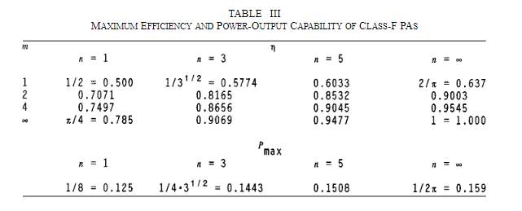
Design Project Specifications goals (1 slide)
Parameter | Assignment min. | Datasheet Max | Goal
P_out_max | 38 dBm | 40.4 dBm | 38 dBm
Maximum Efficiency | 60 % | 68.8 | 75%
Gain | N/A | 41.4

Slide 3
Calculations (3-5 slides)
Paste in your calculations using whatever combination of ADS , hand calculations, or computer-assisted approximate calculations, make sure you show the steps and equations you used as well as summarize your approximate design results for:
the optimal load resistance (intrinsic plane) for maximum Class B power
the maximum linear and saturated power capability of the device assuming the supply voltage specified in your assignment.
Fit an RLC model to S22 of the device model and estimate the complex load impedance/reflection coefficient that would maximize power at your design frequency and plot this on a Smith chart.
Plot the 2dB “Cripps” load-pull contours on a 50 ohm chart at the intrinsic and extrinsic reference planes.
Include your calculations into your PPT from Step A1.

