Slide 1
RF & Microwave Power Amplifier Design Preliminary Design Report
Name: Eric Valentino
Date: 2/27/19

Slide 2
Design Project goals
Parameter | Assignment min. | Datasheet Max | Goal
P_out_max | 38 dBm | 40.4 dBm | 38 dBm
Maximum Efficiency | 60 % | 68.8 | 75%
Gain | N/A | 41.4

Slide 3
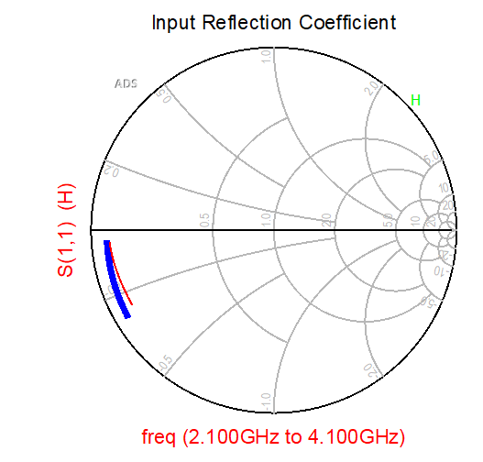

Summary of Design Approach & Procedures: Input Match
In order to evaluate the input match, we want to make sure we are trying to match to something that will be close to Γ_in*, and not S_11*.
In order to get a better picture of what the Γ_in* would look like when the PA was appropriately matched, I decided to present the Z_l,opt at the extrinsic plane which was solved for in the stabilization exercise: 16.8 – j1.43
Γin for 50 Ω and 16- 1.4 Ω

Slide 4
Re-Evaluating Stability
Looking back on stability exercise, it turned out dB(s21) of the stability network was around 6 dB at the design frequency
Went back and tuned to get
Series R: 4.9 Ω
Seriec C: 14.41 pF
Shunt R: 113 Ω
Shunt C : 100 pF
Unconditionally stable again, but instead with 1.8 dB of insertion loss at design frequency

Slide 5
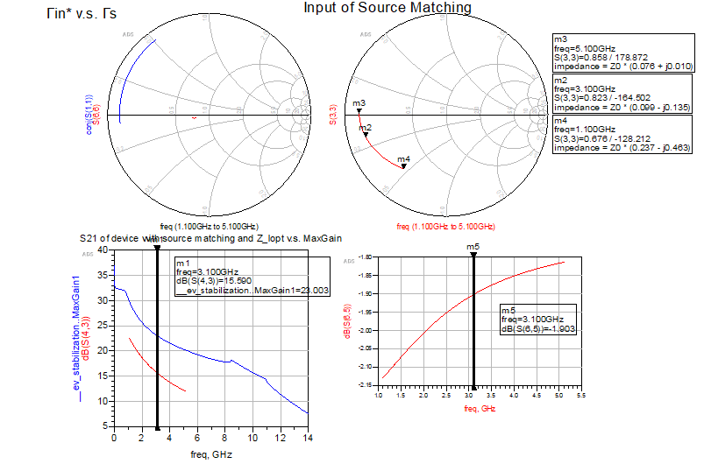
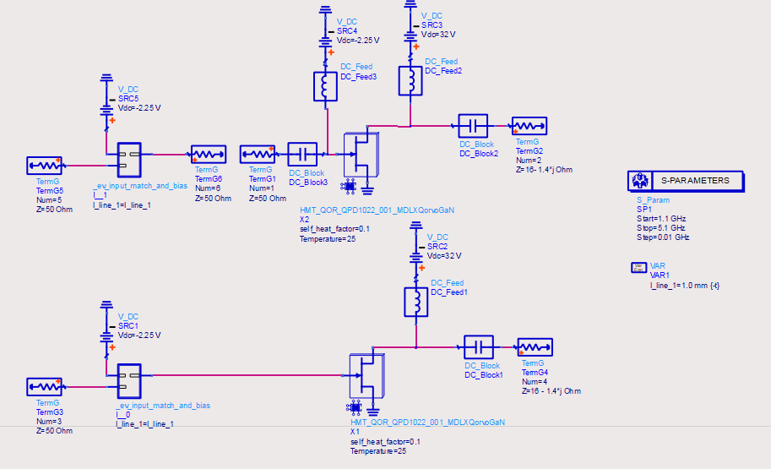
Initial Match
Now input match was assessed.
The input matching network, transistor with Zl = Zl,opt, and input matching network connected to transistor with Zl = Zlopt were all simulated in order to generate plots shown
R_in about 5 ohms, but low Q at design frequency
Decided to employ Vendelin matching

Slide 6
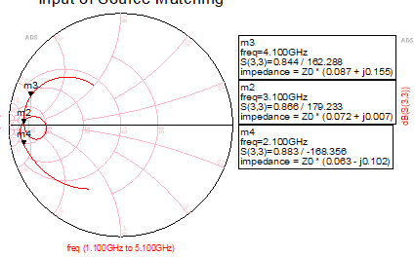
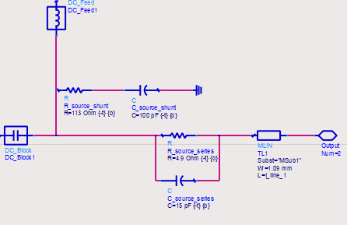
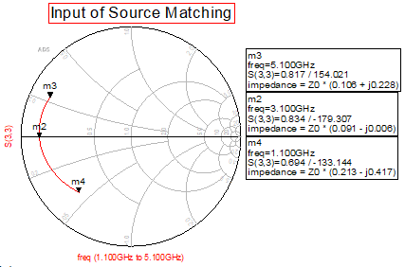
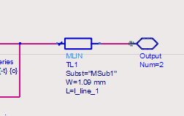
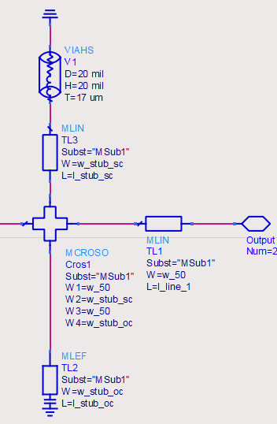
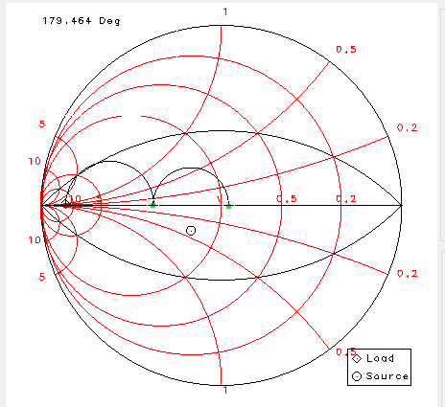
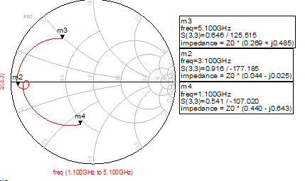
Input Match Design
Tuning Stub Lengths
Original
Addition of Mlin
Addition of stubs
Markers now at 2.1 and 4.1 GHz
Don’t want to directly use quarter wave transformer because Q will be high, so will use series of high impedance transmission line sections and shunt capacitors to reach 50 Ω while staying below a Q of 1 which the gate impedance started at.
One option two quarter wave transformers
9 Ω then 35 Ω

Slide 7
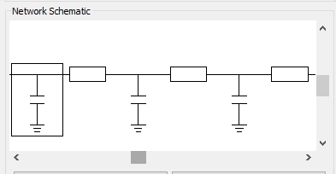
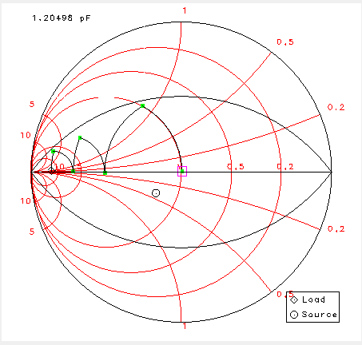
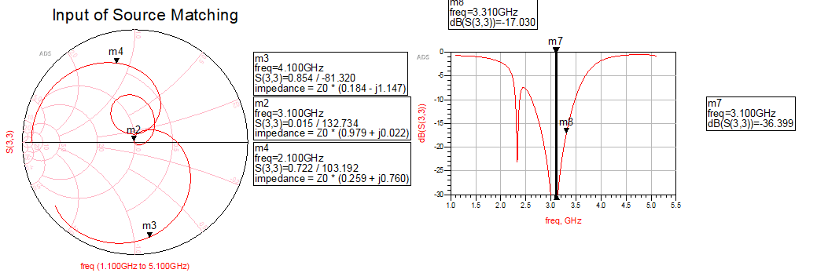
Input Match Design
Another option: Series T-lines and capacitors
L1: Z0 = 30Ω , 7.1°
C1: 6.8 pF
L2: Z0 = 35Ω, 13.5°
C2: 3.01 pF
L3: Z0 = 50Ω, 30.1 °
C3: 1.2 pF
Ended up getting excellent match with about 1.1 GHz BW:

Slide 8
Output Matching Design

Slide 9
Best Effort Results
Show |S11|, |S21|, |S22| vs. freq. (same graph)
Gain , Pout & PAE vs. Pin (may be able to use 1 graph) at center frequency.
Gain , Pout & PAE at design bandwidth edges.

Slide 10
Best Effort Schematic
Show input & output matching networks in as much detail as you can on 1 or 2 slides max.

Slide 11
Best Effort Layout
Make sure you show estimated outer dimensions.

Slide 12
List of Materials/Components Needed
Be as complete as possible in terms of components, connectors and other materials you may need.

Slide 13
Summary of Design Readiness And Remaining Issues or Steps
How close are you to “submitting to fabrication”?

