Slide 1
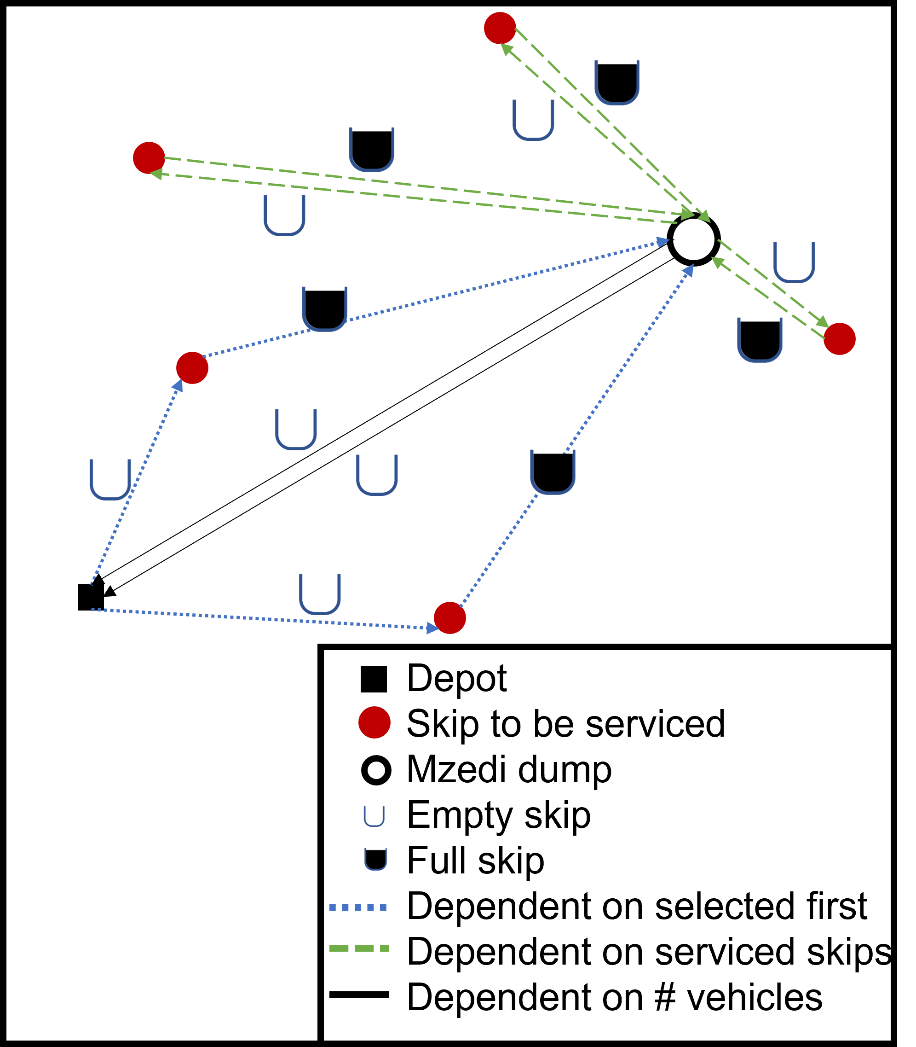
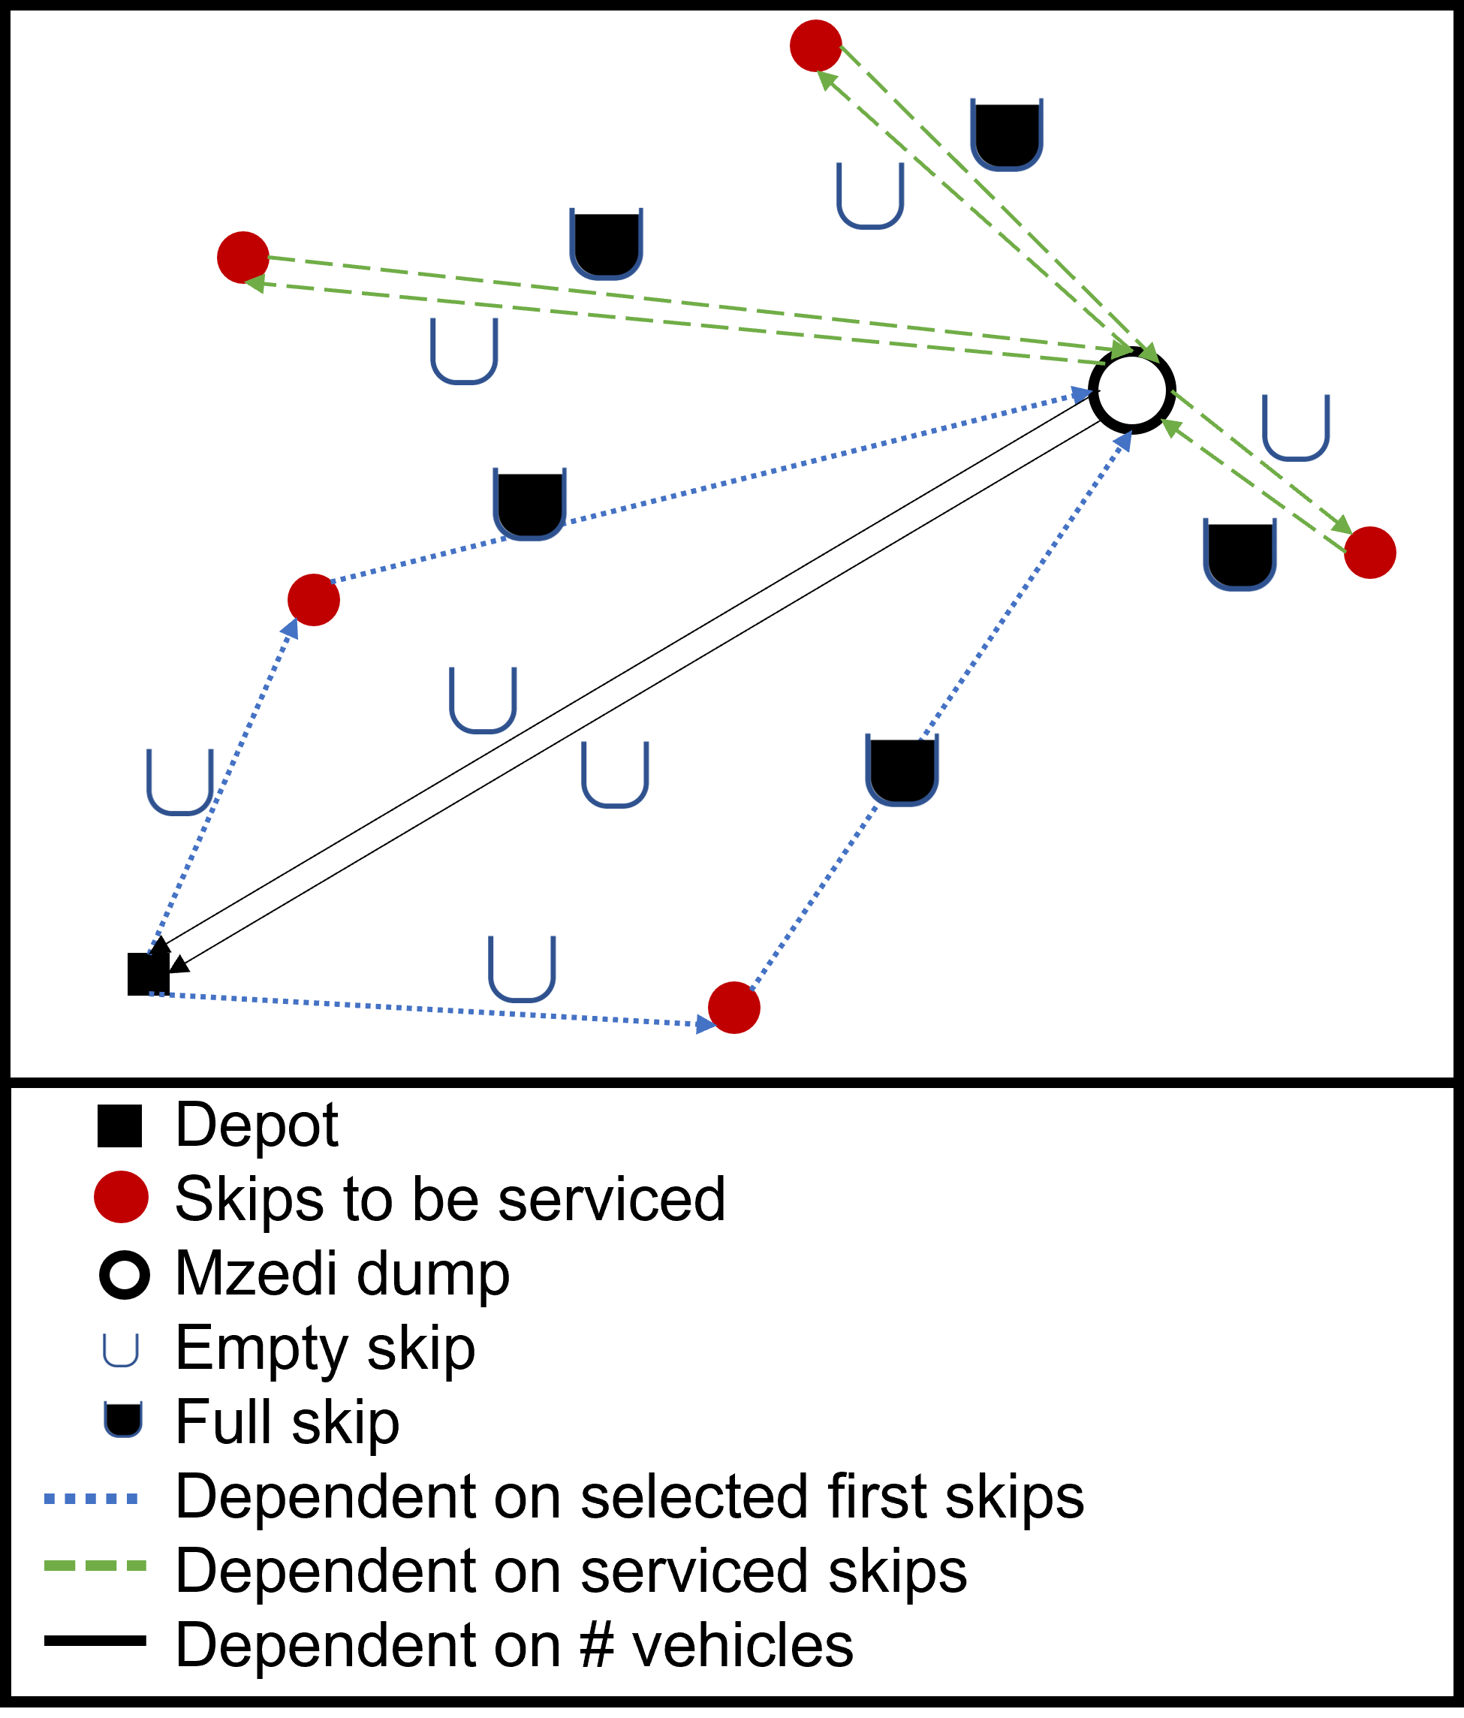

Slide 2
Mzedi dump
Truck storage

Slide 3


Mzedi dump
Truck storage

Slide 4
Mzedi dump
Truck storage

Slide 5
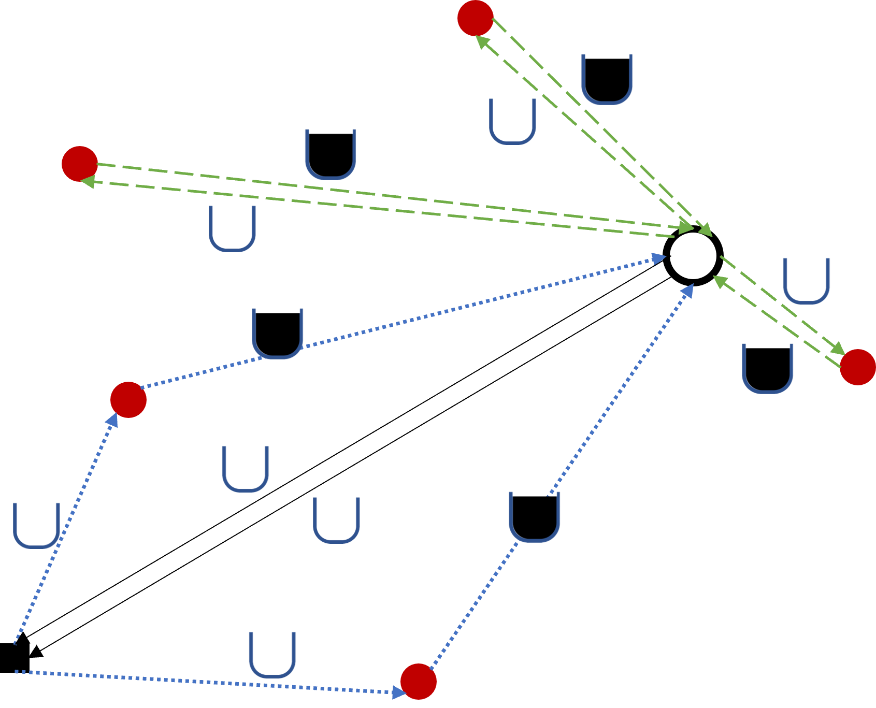


Depot
Skips to be serviced
Mzedi dump
Empty skip
Full skip
Dependent on selected first skips
Dependent on serviced skips
Dependent on # vehicles

Slide 6
Mzedi dump
Truck storage

