Slide 1
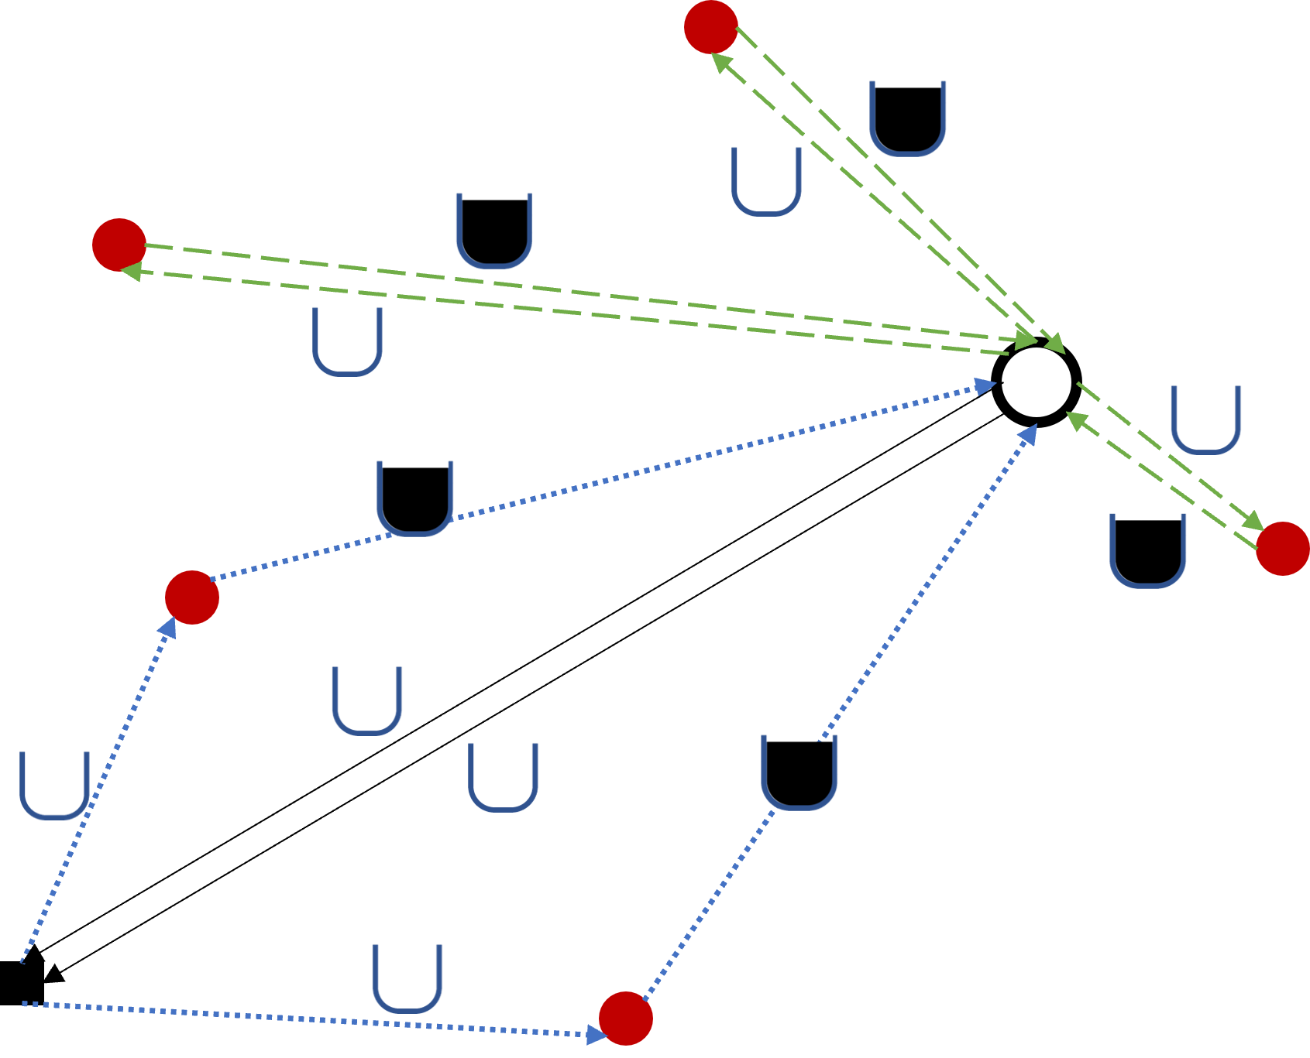


Depot
Skips to be serviced
Mzedi dump
Empty skip
Full skip
Dependent on selected first skips
Dependent on serviced skips
Dependent on # vehicles

Slide 2
