Slide 1




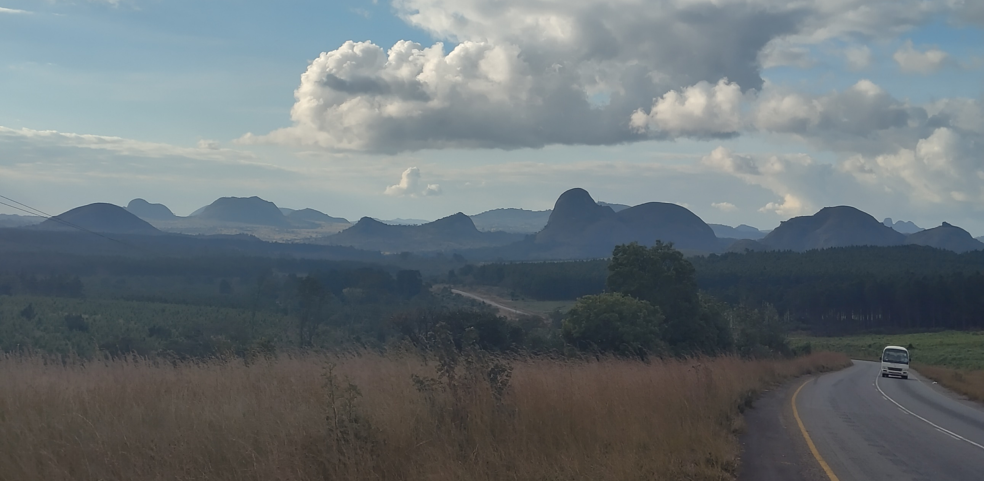
Energy and Device Data Collection in Healthcare Facilities in Malawi
Gian Teufen & Till Häussner
Research project presentation
Mzimba District Health Office, Malawi
27 July 2025

Slide 2
Introduction
Goals
Methods
Results
Conclusions
Problem Statement
Donated energy systems lack long-term support
Who is accountable for operations & maintenance varies and is sometimes unclear
Energy systems are often insufficient or poorly maintained
25 July 2025
2
Notes:
2

Slide 3
Introduction
Goals
Methods
Results
Conclusions
Operations & Maintenance of Energy Systems in Malawi
Energy systems in HCF in sub-Saharan Africa often lack sufficient capacity or are underfunded for operations & maintenance (O&M).
(UNICEF, 2018)
74 percent of all health financing in Malawi comes from donors. The volatility of donor funding contributes to a weakness in organizing long-term support.
(Borghi et al., 2018)
Poor load management leads to frequent disconnects, unmet priority needs, and reduced medical equipment functionality.
(Ngongoma et al., 2025; Suhlrie et al., 2018)
25 July 2025
3
Notes:
3

