Slide 1
Data privacy for METER/GRASP/DEER
South Africa example (POPIA)
Country info from https://dataprotection.africa/south-africa/

Slide 2
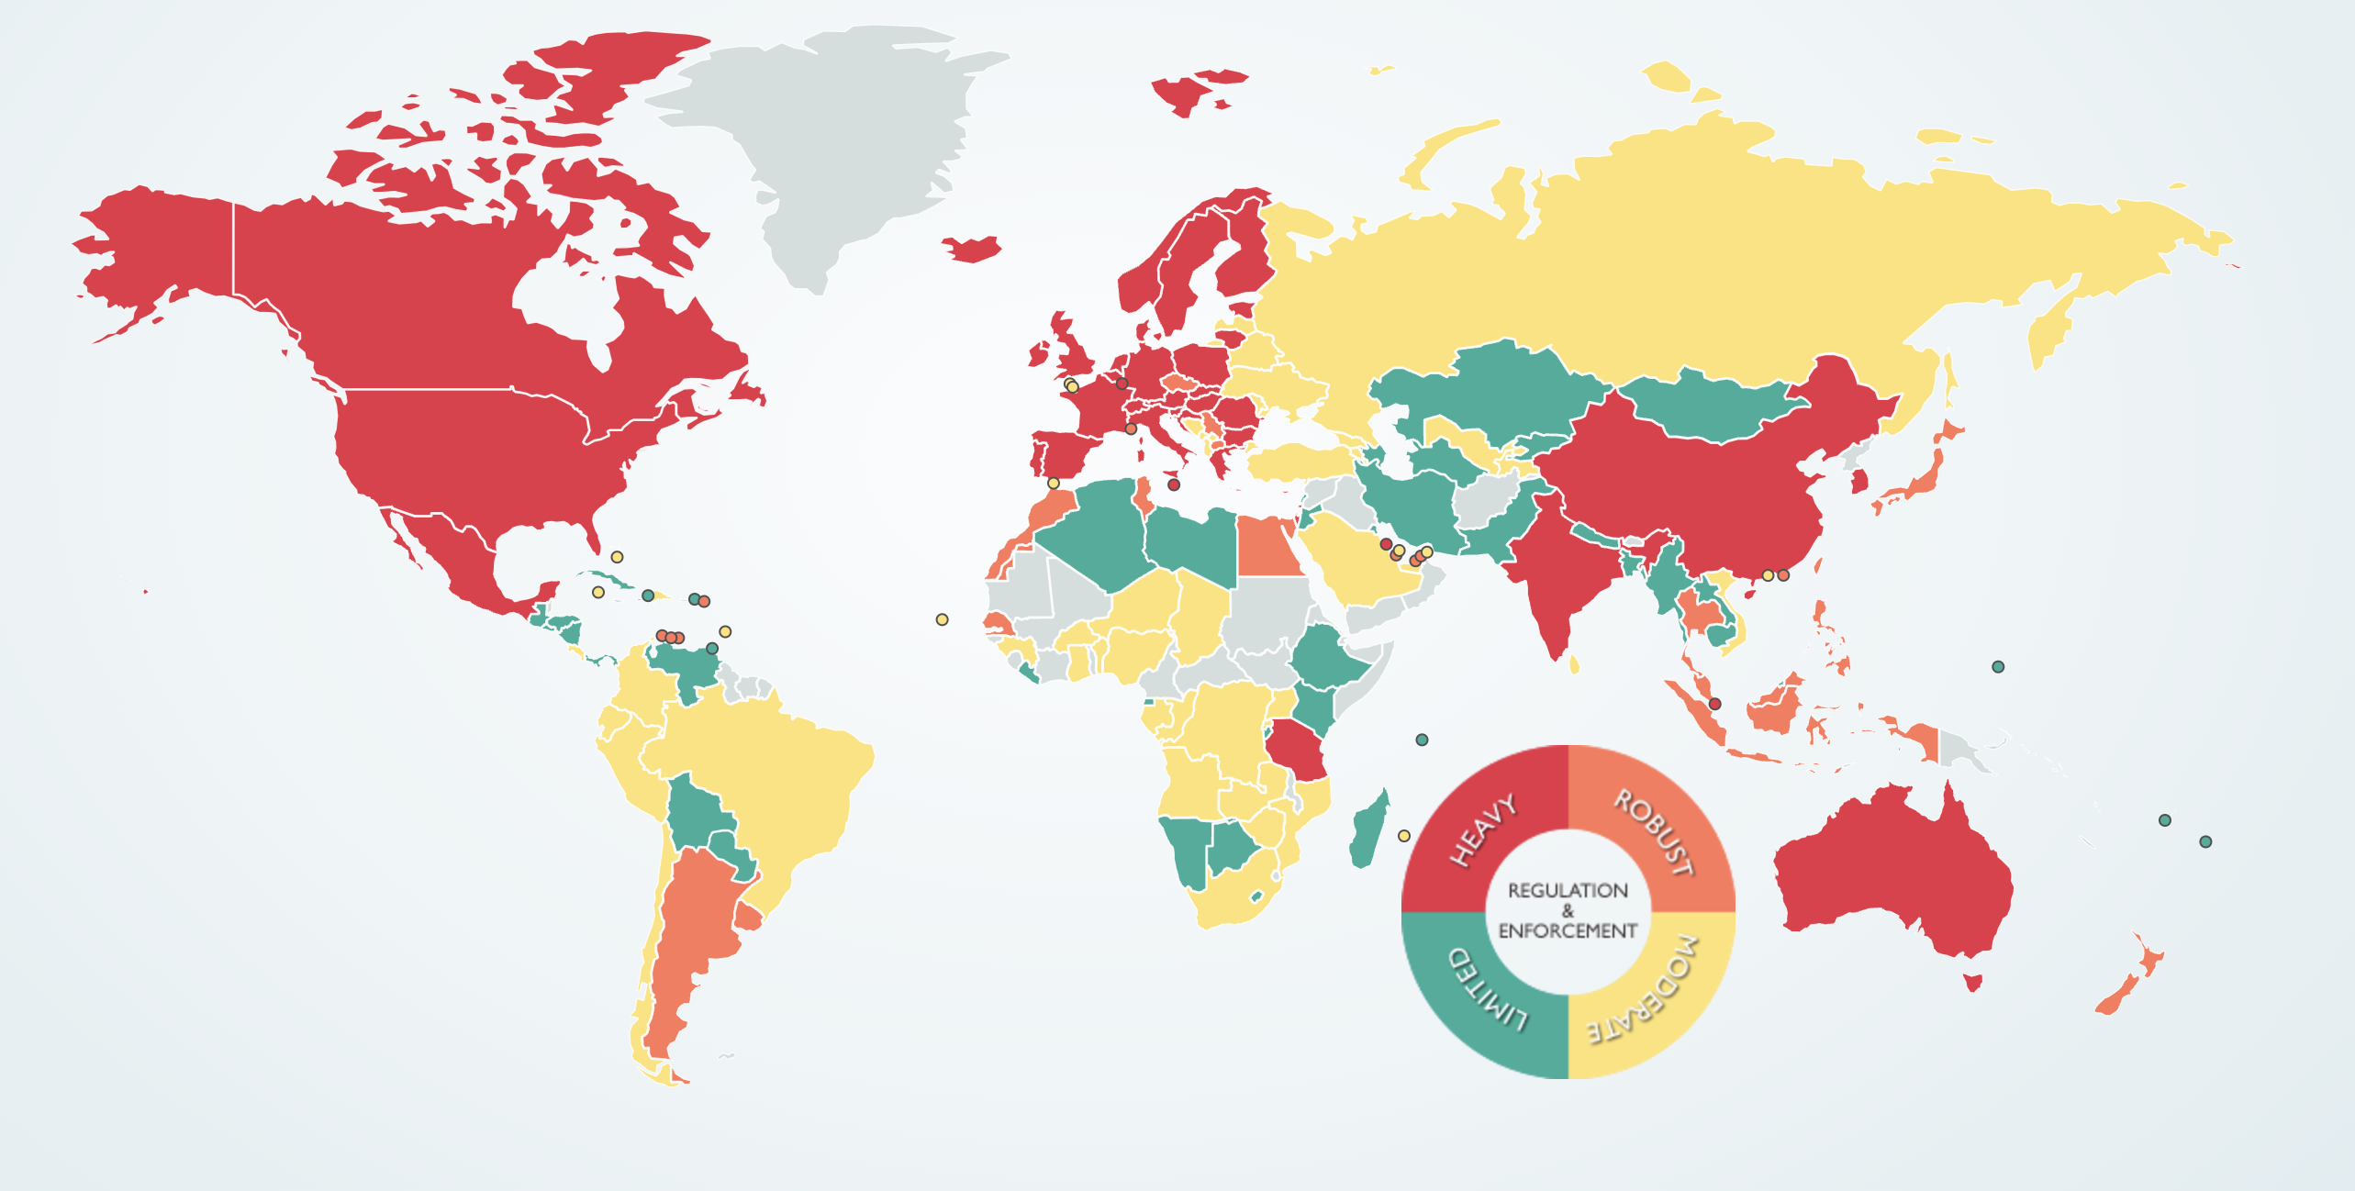
Data protection around the world
https://www.dlapiperdataprotection.com/index.html?t=world-map&c=ZA

Slide 3
South Africa

Slide 4
South Africa

Slide 5
Definition of personal data Includes but not limited to
South Africa
information relating to gender, sex, pregnancy, marital status, and nationality;
information relating to the education or the medical, ﬁnancial, criminal or employment history of the person;
any identifying number, symbol, e-mail address, physical address, telephone number, location information, online identiﬁer, or other particular assignment to the person;
personal opinions, views, or preferences of the person;
correspondence sent by the person that is implicitly or explicitly private and would reveal the contents of the original correspondence;
views or opinions of another individual about the person; and
the name of the person if it appears with other personal information relating to the person or if the disclosure of the name itself would reveal information about the person.

Slide 6
Definition of personal data Includes but not limited to
Morocco
Personal data is any information regardless of its nature and format, relating to an identified or identifiable person.
Sensitive data is personal data that reveals the racial or ethnic origin, political opinions, religious or philosophical beliefs, union membership of the person concerned, or information relating to his, her or their health, including genetic data.
Sensitive data shall not be processed without affirmative consent from the data subject or unless an exception applies.

Slide 7
Subjects have a right to:
South Africa
Establish whether personal information is held, and request access;
Request that their personal information be deleted, corrected or destroyed;
Object to the processing of their personal information, provided that such objection is reasonable, unless the data subject was allowed to object free of charge, and failed to do so upon the initial collection of the data;
Object to the processing of personal information for direct marketing purposes at any time
Not have their personal information processed by means of unsolicited electronic communications;
Submit a complaint to the Information Regulator and institute civil proceedings in relation to the alleged interference with the protection of their personal information.

Slide 8
Subjects have a right to:
Morocco
Establish whether personal information is held, and request access;
Request that their personal information be deleted, corrected or destroyed;
Object to the processing of their personal information, provided that such objection is reasonable, unless the data subject was allowed to object free of charge, and failed to do so upon the initial collection of the data;
Object to the processing of personal information for direct marketing purposes at any time
Not have their personal information processed by means of unsolicited electronic communications;
Submit a complaint to the Information Regulator and institute civil proceedings in relation to the alleged interference with the protection of their personal information.

Slide 9
8 conditions for lawful processing of PI
South Africa
Accountability: responsible party must ensure compliance
Processing limitation: revocable consent, non-excessive processing of data in the interest of the subject
Purpose specification: subject informed of purpose of information
Further processing limitation: must be compatible with original purpose
Information quality: personal information provided is accurate, complete and not misleading
Openness: documentation of all processing operations and notify the data subject when collecting personal information
Safety safeguards: required to safeguard the integrity and confidentiality of personal information in its possession and / or under its control by taking the appropriate, reasonable technical and organisational measures to prevent loss, damage or unauthorised destruction. Necessary measures are also to be taken to prevent unlawful access to or processing of personal information.
Data subject and participation: must allow data subjects to exercise their rights under POPIA

Slide 10
Personal data must be:
Morocco
processed fairly and lawfully;
processed to the extent necessary, relevant, and not to excess;
collected for specific, explicit, and legitimate purposes;
accurate and kept current; and
kept in a form enabling the person concerned to be identified.
compliance with a legal obligation;
the commencement or execution of a contract to which the data subject is a party;
the protection of the vital interests of the data subject, if he or she cannot consent;
the performance of a task of public interest or related to the exercise of public authority; or
the fulfilment of the legitimate interests pursued by the data controller or by the recipient, when not outweighed by the interests or fundamental rights and freedoms of the data subject.
Consent by default, except:

Slide 11
Cross border transfers
South Africa
By default prohibited, unless:
Third party provides adequate protection
Data subject consents
Transfer is necessary for performance of a contract between subject and responsible party
Transfer is necessary for performance of a contract between responsible party and third party
“The transfer is to the benefit of the data subject and it is not reasonably possible to obtain the consent of the data subject, and it is highly likely that consent would be given if it were possible to obtain.”

Slide 12
Cross border transfers
Morocco
The person in charge of the processing operation can only transfer personal data to a foreign state if the state has an adequate level of privacy protection regarding the data.
Requires prior authorisation from the CNDP, unless:
The data subject has expressly consented to the transfer; or
The transfer and subsequent processing are required for:
compliance with a legal obligation;
the commencement or execution of a contract to which the data subject is a party;
the protection of the vital interests of the data subject, if he or she cannot consent;
the performance of a task of public interest or related to the exercise of public authority; or
the fulfilment of the legitimate interests pursued by the data controller or by the recipient, when not outweighed by the interests or fundamental rights and freedoms of the data subject.

Slide 13
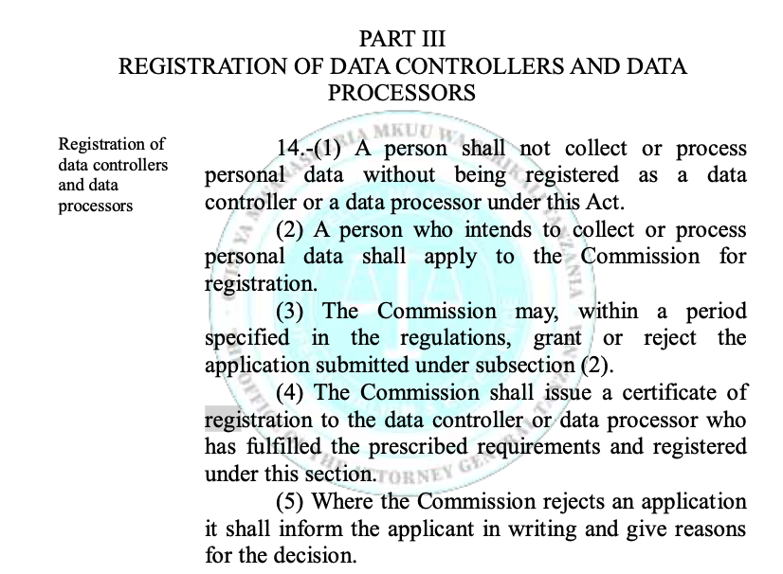
Tanzania

Slide 14
What this means for us:
Depending on the project, we need to position ourselves as:
Responsible party (e.g. ETHZ-led research where we control the servers)
Third-party (e.g. agreement with providers to send us some data)
Overall required measures:
Consent from subjects (biogas end-users) for all processing and cross-border transfers of data, and well layed out agreements.
Minimizing personal data, anonymization where possible.
IT security.
Contact channels for between responsible party and subjects
In open-source development:
Documentation of data privacy responsiblities
Privacy measures by default in any developed solution

