Slide 1

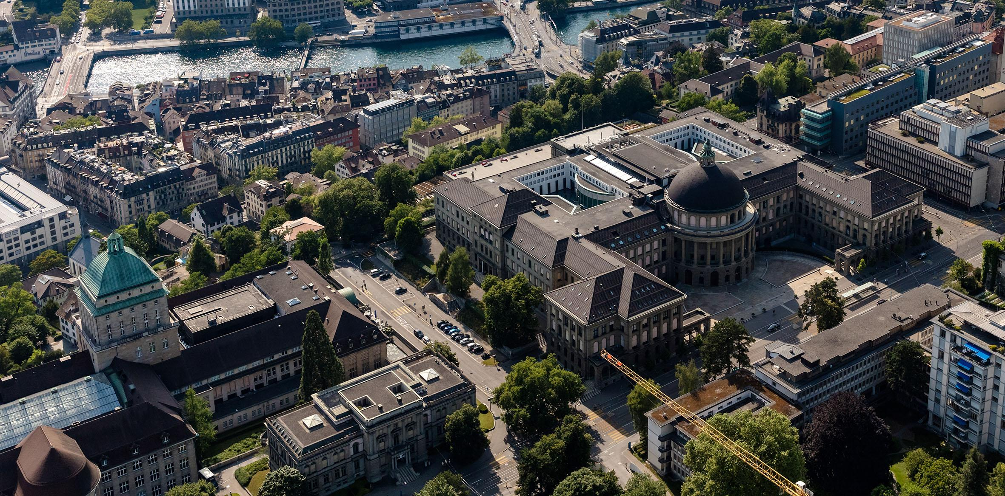
Development of Pediatric IV Flow Rate Monitor for Humanitarian Setting
Leandro Catarci
Bachelor’s thesis
07.08.2025
Date

Slide 2
Introduction
Goals
Methods
Results
Conclusions
Slide Subtitle of section “Introduction”
Describe the problem you are trying to solve and the background of the problem.
Tips for preparing the slides:
The presentation should follow a logical order, like the one from your manuscript.
The subtitle is not always necessary. It can be helpful in some situations, e.g., if you discuss multiple methods and multiple corresponding results.
The often-adopted length of a presentation is 1-2 min/slide. If you prepare a talk for 10 minutes, you can make up to 10 slides + the closing “Thank you”.
Try not to put more than 5 elements on a slide. It is said that the viewer can’t focus on more. If you have 5 elements, use animations so the viewer focuses on what you want to say at given moment and is not distracted by things you will discuss next.
Author‘s name
Date
‹#›
Notes:
‹#›

Slide 3
Introduction
Goals
Methods
Results
Conclusions
Slide Subtitle of section “Goals”
Describe the goals of the thesis and put down the research questions.
This slide/these slides can contain more text than the others.
Tips for preparing the slides:
Keep the presentation simple. Simple means something different to everyone.
As a presenter, your focus is to keep the audience engaged. They should feel like they are learning valuable information and that they are following a storyline your created.
Highlight the most important pieces on a slide with bold font/colors/shapes.
Guy Kawasaki, a venture capitalist and one of the original marketing specialists for Apple, said that the best slideshow presentations are less than 10 slides, last at most 20 minutes, and use a font size of 30. Following this strategy can help you condense your information, eliminate unnecessary ideas, and maintain your audience’s focus more efficiently.
Author‘s name
Date
‹#›
Notes:
‹#›

Slide 4
Introduction
Goals
Methods
Results
Conclusions
Slide Subtitle of section “Methods”
Describe the methods you used achieve the results without presenting the results.
Tips for presenting:
Talk to the audience, not to the screen. To do so, you need to know the content of your slides. Try to keep the eye-contact with the audience from time to time.
It is likely that you will feel stressed. To mitigate stress, you can:
Practice in front of the mirror.
Time yourself while practicing.
Speak out loud while practicing, do not practice by repeating the talk in your mind.
After you practiced yourself, show the presentation to your colleague/friend/family member.
If you do not know what to do with your hands while presenting and you feel awkward by standing just straight, you may hold something in your hands, e.g., a pen or a remote control for the presentation (don’t play with it too much).
Author‘s name
Date
‹#›
Notes:
‹#›

Slide 5
Introduction
Goals
Methods
Results
Conclusions
Slide Subtitle of section “Results”
Present the results visually and discuss them orally.
Once again, the slides are here to help you speak, try not overloading them with text. Use tables, images, and figures.
Author‘s name
Date
‹#›
Notes:
‹#›

Slide 6
Introduction
Goals
Methods
Results
Conclusions
Conclusions & recommendations can be bullet points, therefore can be plain text.
Author‘s name
Date
‹#›
Notes:
‹#›

Slide 8
Introduction
Goals
Methods
Results
Conclusions
Additional insights into methods/results useful for Q&A
You may add additional slides after the last “Thank you/ETH” slide.
These slides are here to help you answer the questions you may get after you finish presenting.
You should not show, nor discuss these slides during your main talk.
Add here information which did not fit in the main presentation plot or some supplementary information regarding the results or the methods.
Author‘s name
Date
‹#›
Notes:
‹#›

