Slide 1


Weekly Update
Leandro Catarci
Bachelor’s Thesis
20.05.2025
Date

Slide 2
New BOM
Expense | Price (1 of 1) | Price (1 of 1000)
MCU Chain | 2.31 | 1.07
IR LED Chain | 2.35 | 0.79
IR Sensor Chain | 2.64 | 1.39
Power Chain | 4.84 | 2.39
PCB | 25.57 | 0.46
UI & UX | 14.08 | 8.18
Casing | 4.42 | 3.72
Miscellaneous | 2.6 | 0.03
Total | 58.81 | 18.03
Link: https://docs.google.com/spreadsheets/d/1pk6jNq9gG_7C5ho5Edl_WbWOz5cEIb6d

Slide 3
IV Drip Inaccuracy Due to Clamp Drift & Hysteresis
Observation (Prototype Testing):
My optical drip sensor showed significant deviation between actual drip rate and the value set on the roller clamp.
This discrepancy increased over time, especially after multiple flow adjustments.

Slide 4
IV Drip Inaccuracy Due to Clamp Drift & Hysteresis
Root Cause:
Hysteresis & mechanical drift in the roller clamp:
The same clamp position did not produce the same drip rate when approached from above vs. below.
Literature:
Clamp and tubing variability leads to up to 45% deviation over time (Flack & Whyte, 1974; Crass et al., 1985).
ISO standards (8536) allow ±10% error, but real-world deviations can exceed that without monitoring.

Slide 5
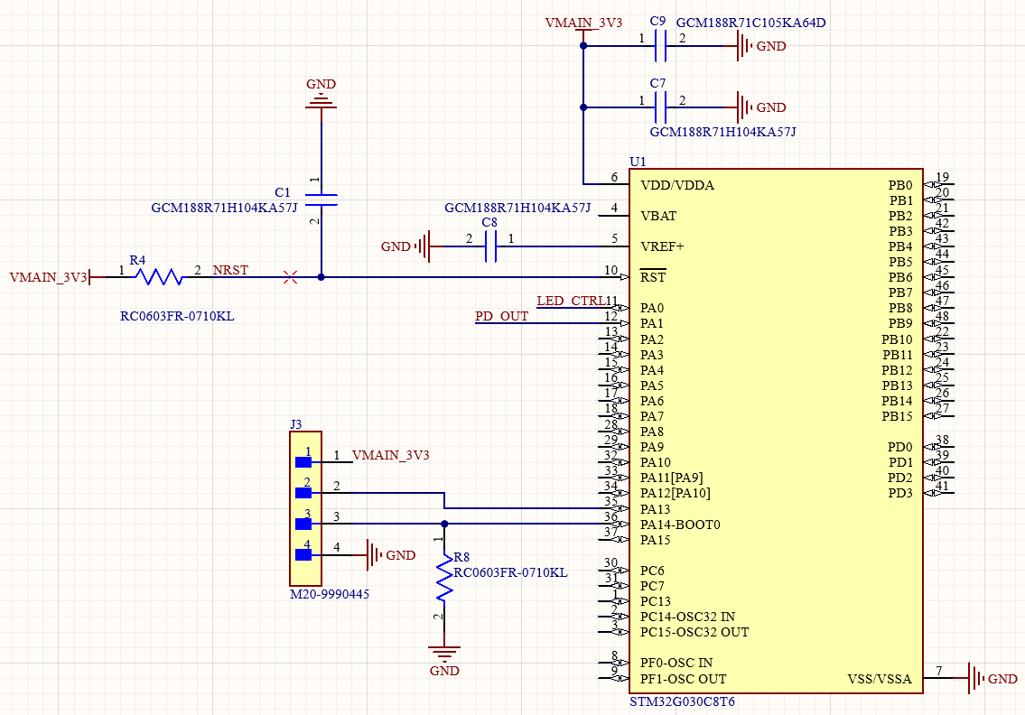
Schematics - MCU

Slide 6
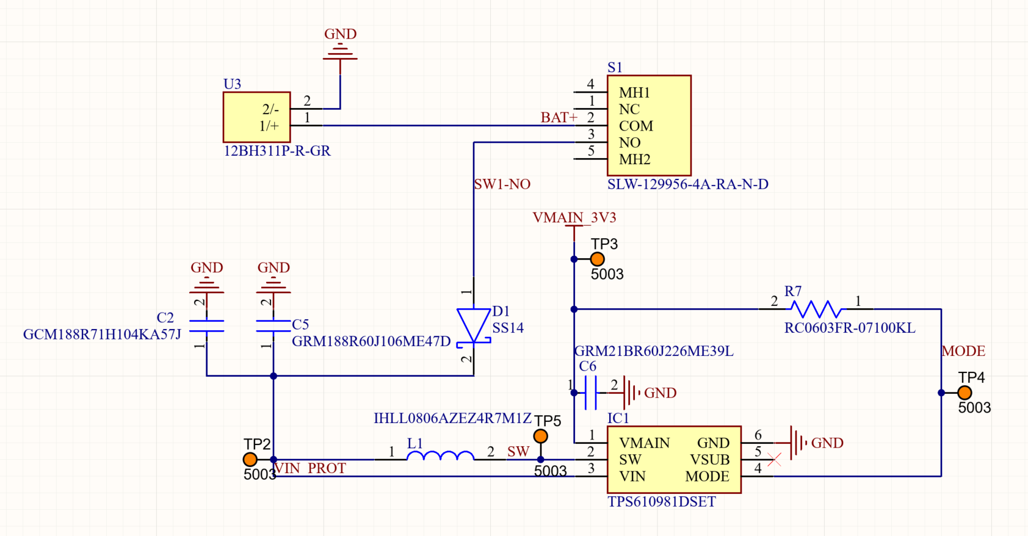
Schematics - Power

Slide 7
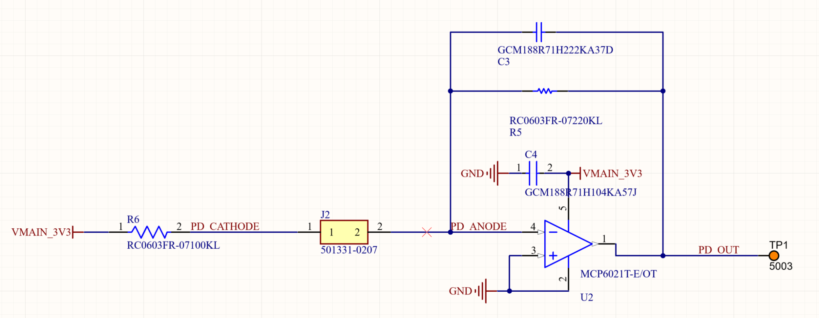
Schematics - Photodiode

Slide 8
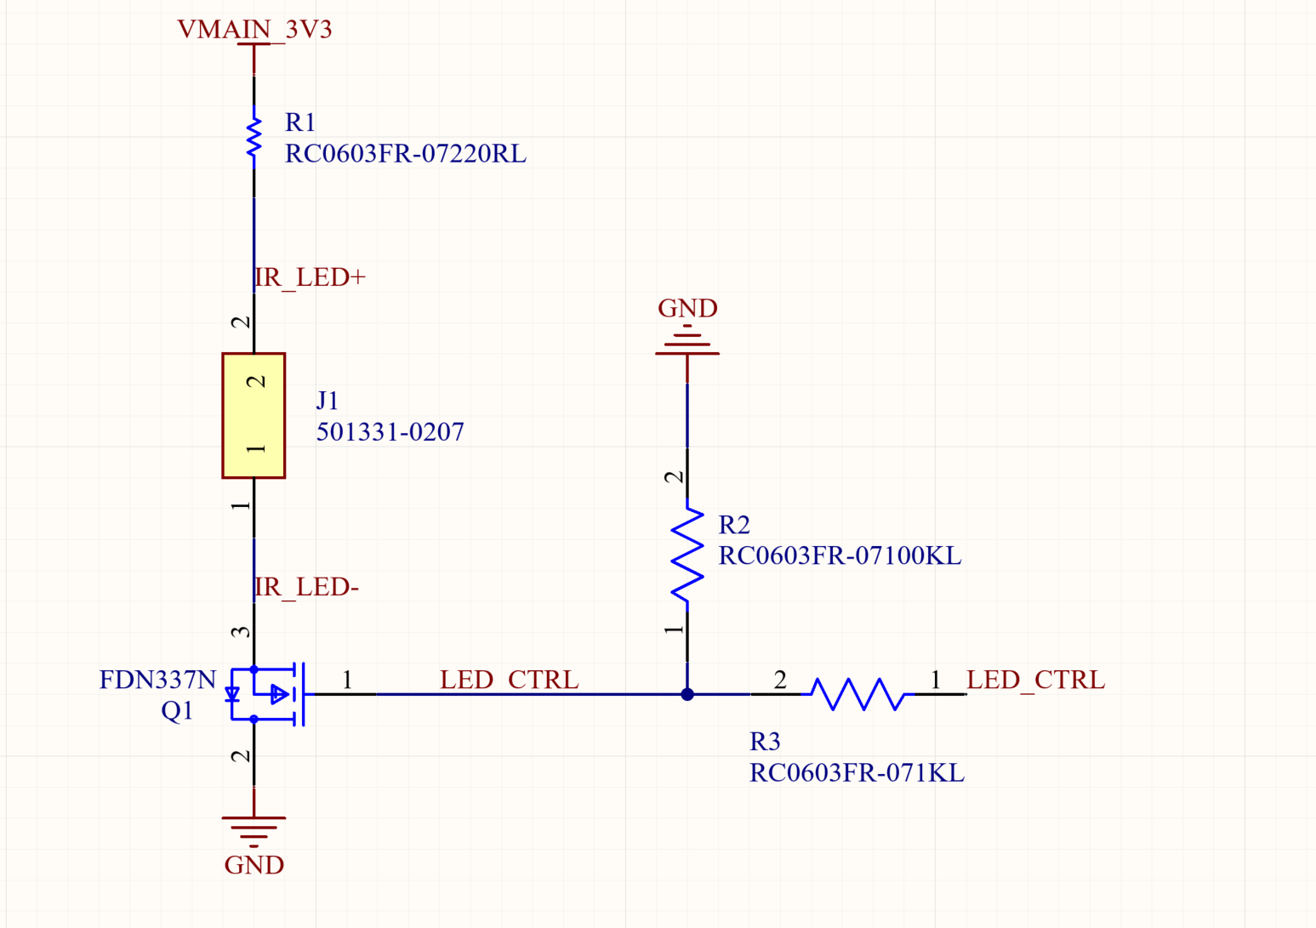
Schematics - IR LED

Slide 9
Improvements and next steps
EE
ME
Add 32 kHz crystal, UI
Draw PCB Layout
Order PCB & Components
Universal compliant clamp for 15mm - 20mm.

Slide 10
Validation Planning - Objectives
±1 % drop-count accuracy over continuous flow (target: 300+ drops)
< 15 s alarm delay for occlusion or flow drift > ±10 %
Battery runtime ≥ 360 h under realistic duty cycle

Slide 11
Validation Planning - Setup
Arduino Pro Mini + INA219 current sensor for Power consumption profile
Analytical Scale (0.01g Accuracy) for flow accuracy
Testing begins in July

Slide 12
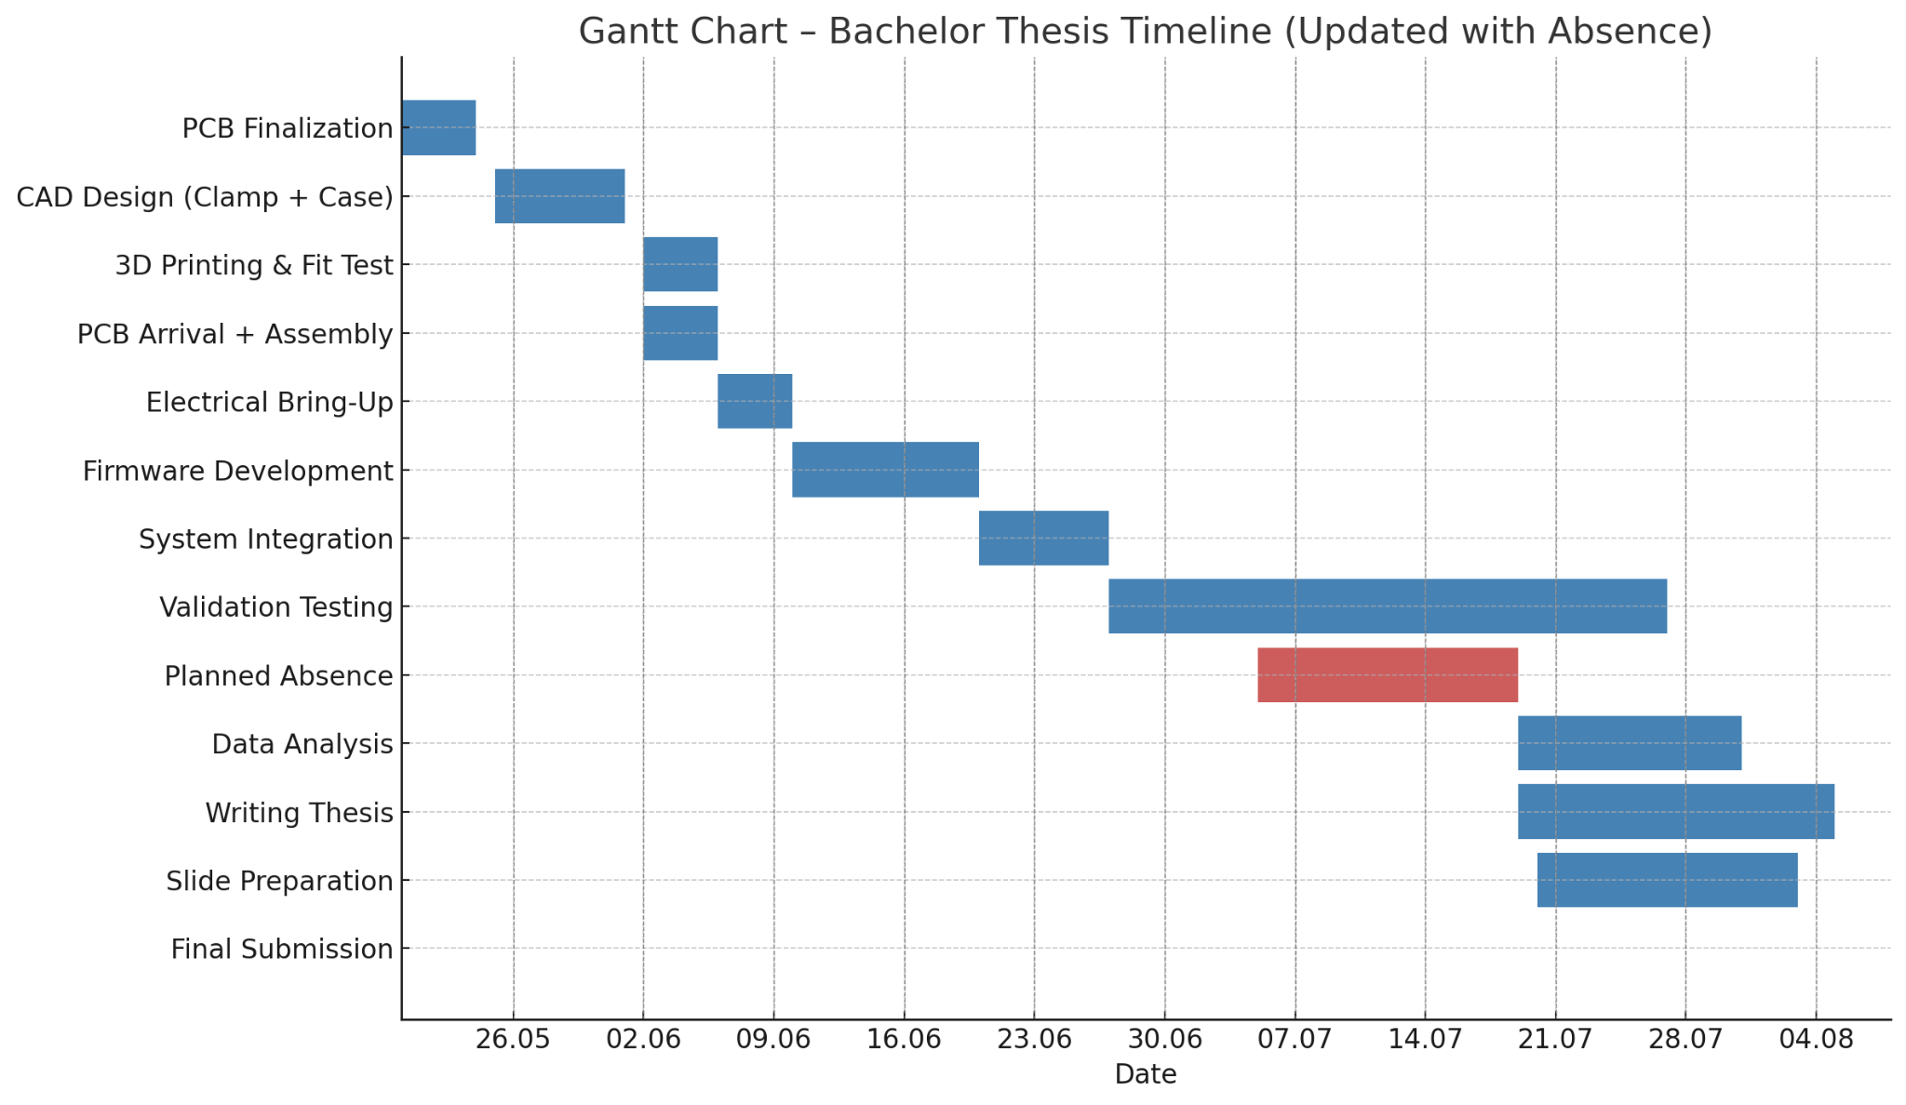
Timeline

