Slide 1

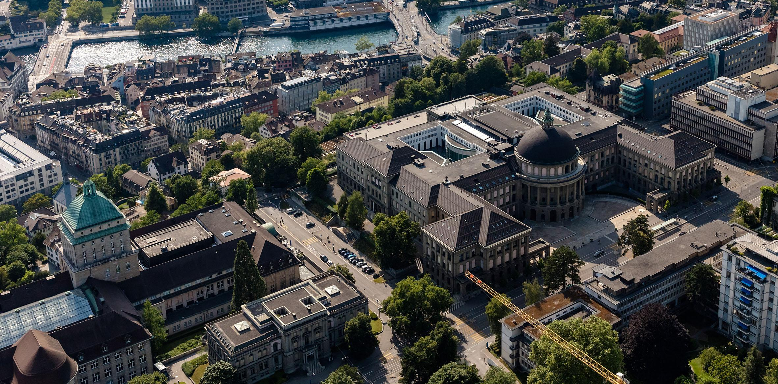
Weekly Update
Leandro Catarci
Bachelor’s Thesis
10.06.2025
Date

Slide 2
Electronic Hardware
DONE:
Experiment to see how much “shadow” a drop produces. (1 day)
Finalised schematic & PCB layout (10 days)
Ordered two-layer PCBs. (1 day)
TODO:
Hand solder last things on. (½ day)
Bench-Test (2 days)

Slide 3
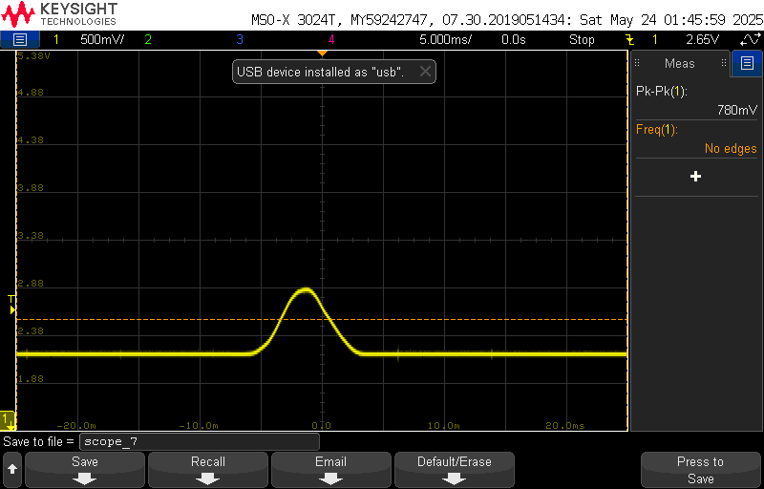

Slide 4
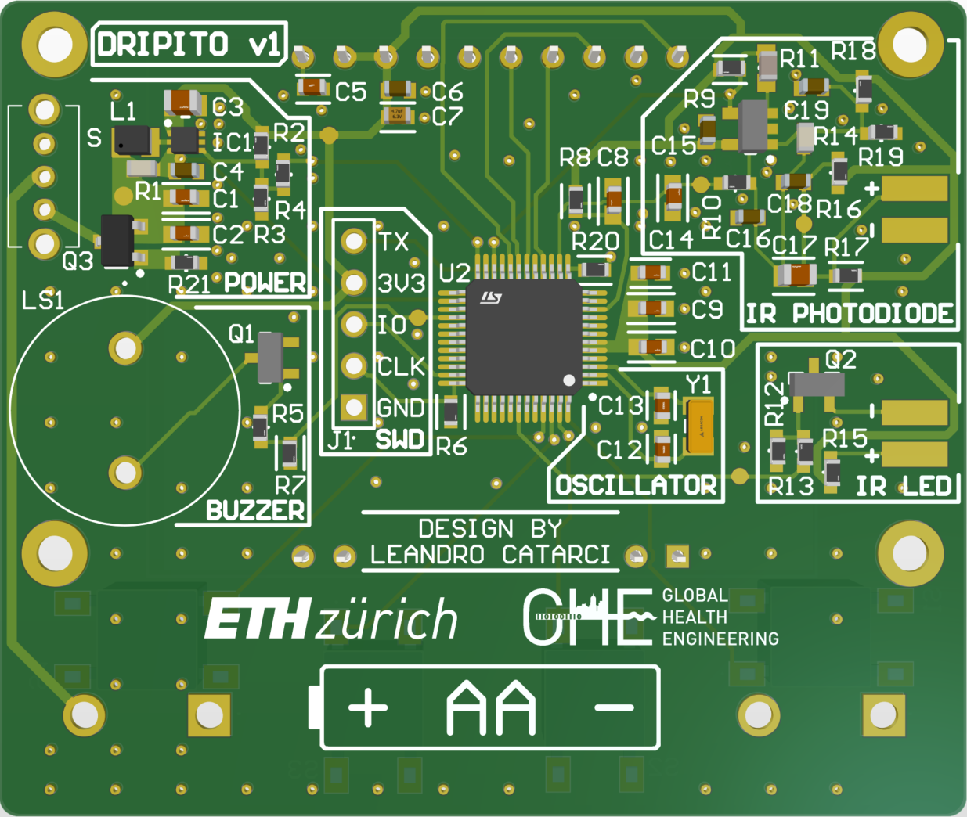

Slide 5
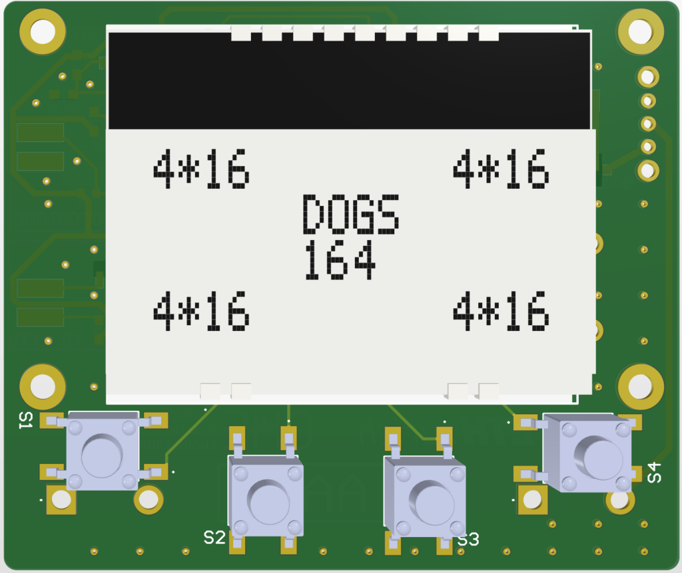

Slide 6
Embedded Firmware
DONE:
Set up STM32CubeIDE project (alongside PCB)
Planned Drop-detection algorithm
TODO:
Bring-up MCU peripherals (½ day)
Implement drop-detection (2 days)
Integrate UI

Slide 7
Documentation
DONE:
Began writing in Overleaf
Documented the experiment
TODO:
Put all PDF Schematics and PCB files on Drive

Slide 8
New BOM
Expense | Price (1 of 5) | Price (1 of 1000)
PCBA (JLCPCB) | 19.4 | 1.93
Additional Parts UI Sensor LED Battery Holder Boost Converter | 10 | 5.121
Casing Filament Heat Inserts Screws | 4.42 | 3.72
Miscellaneous Silica Gel | 2.6 | 0.03
Total | 36.42 | 10.83
Not including Shipping, 3D Printing cost except filament, manufacturing cost etc.

Slide 9
New Character Unlocked
Nurse from Kispi Zürich
Organizes Micro-Drip Sets
Knows Humanitarian Doctors
Would let me test on her patients
What is required for a proper visit from ETH side?

Slide 10
Next Steps
Final, functional casing.
Solder all components and PCB Bring-Up
Firmware Development
Then - Validation, Logging, Documentation

