Slide 1

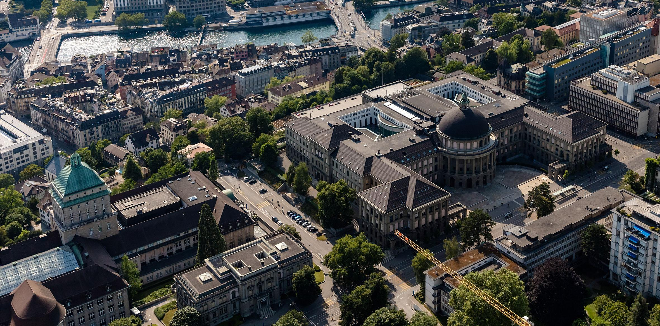
Weekly Update
Leandro Catarci
Bachelor’s Thesis
27.06.2025
Date

Slide 2
Electronic Hardware
DONE:
Experiment to see how much “shadow” a drop produces. (1 day)
Finalised schematic & PCB layout (10 days)
Ordered two-layer PCBs. (1 day)
TODO:
Hand solder last things on. (½ day)
Bench-Test (2 days)

Slide 3
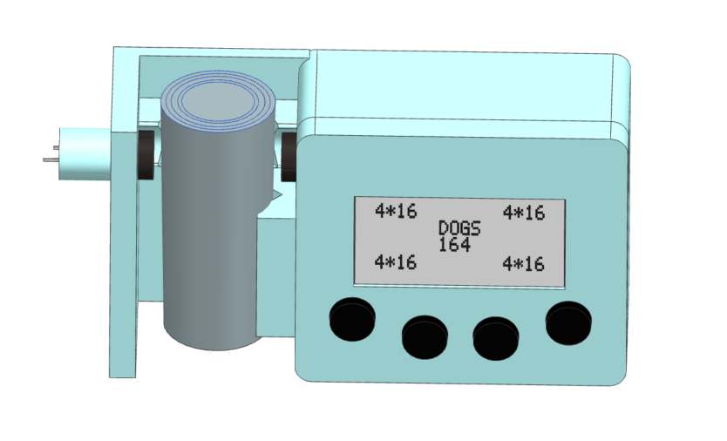

Slide 4
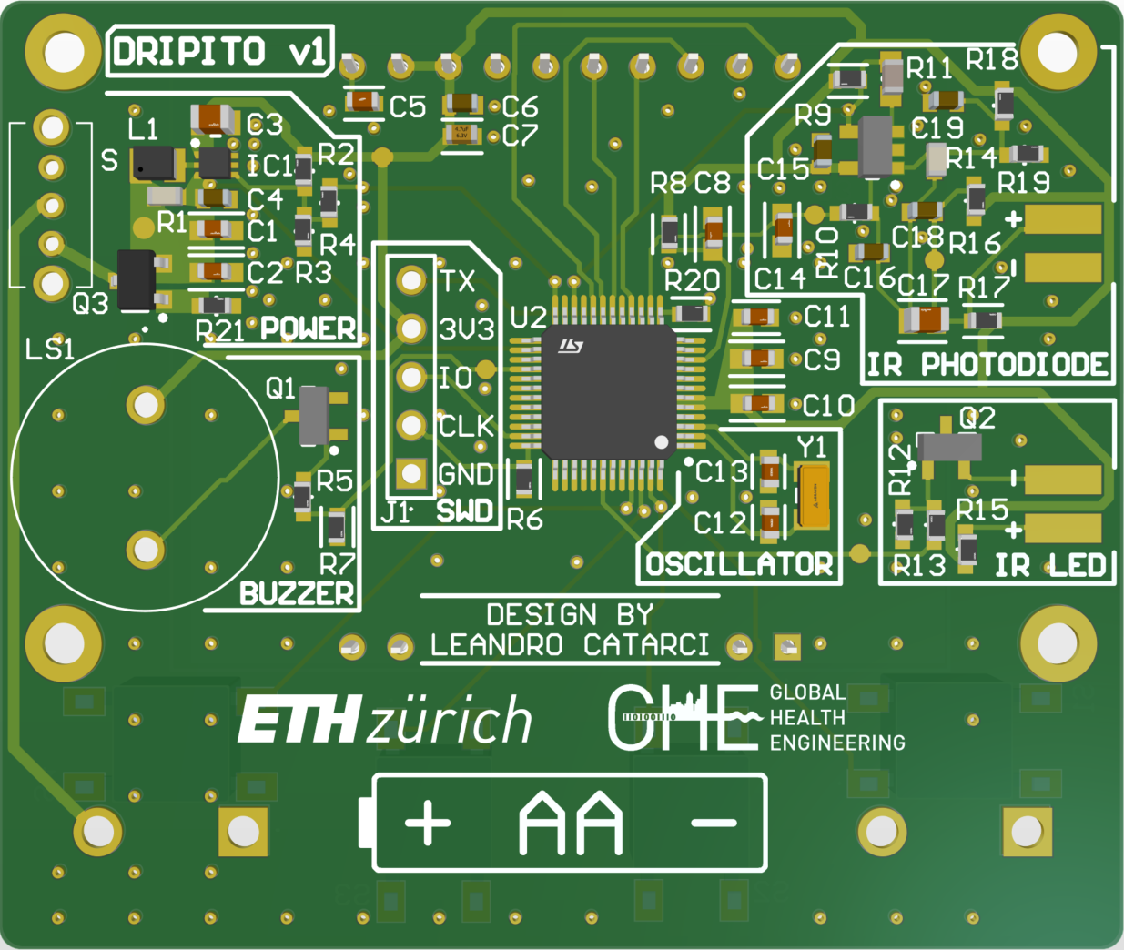

Slide 5
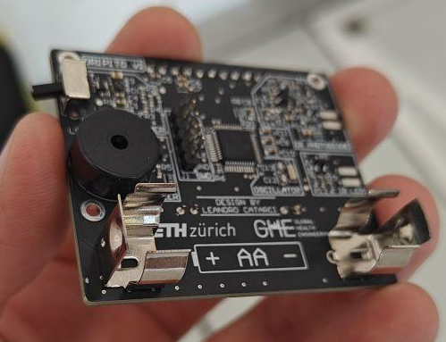

Slide 6
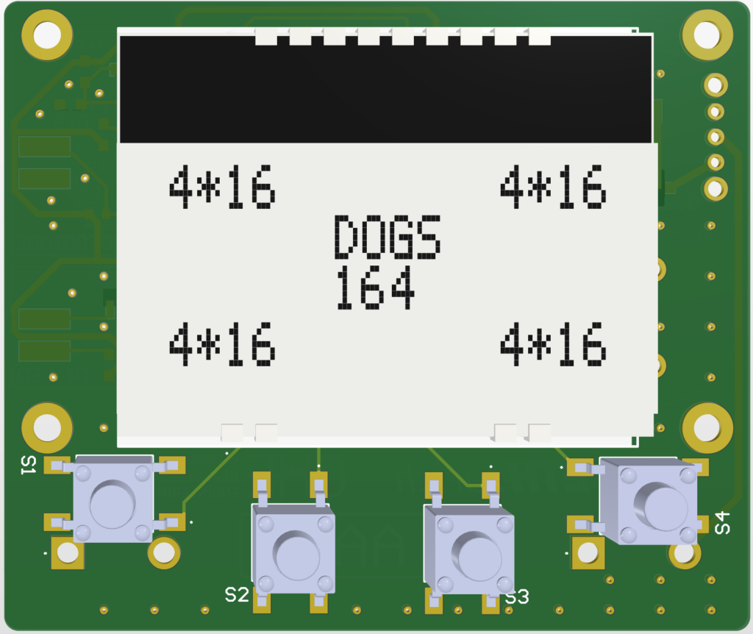

Slide 7
