Slide 1

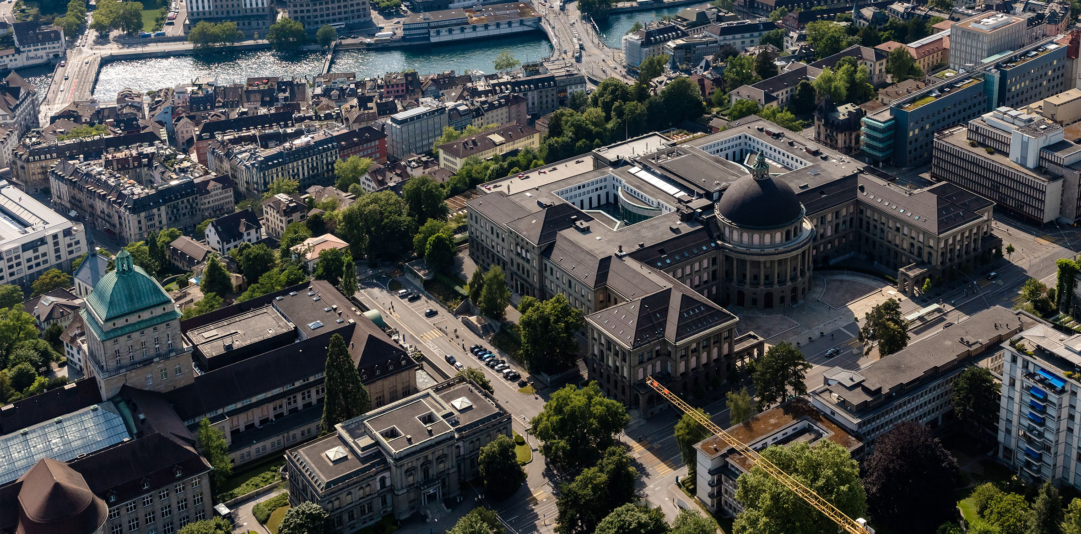
Product Development of a Substrate Mixer and Portioning Device
Peter Siegenthaler
Bachelor’s thesis
11.06.2026
11.06.2026

Slide 2
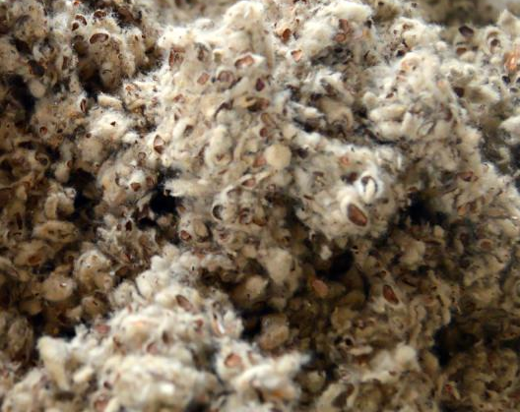
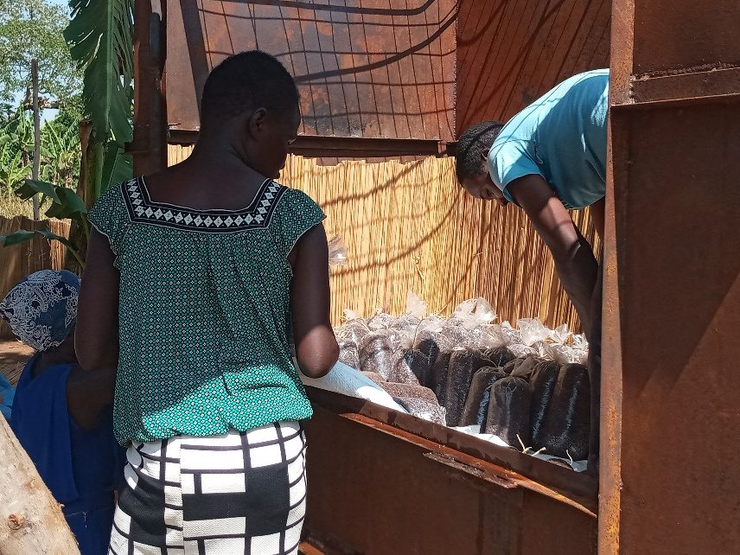
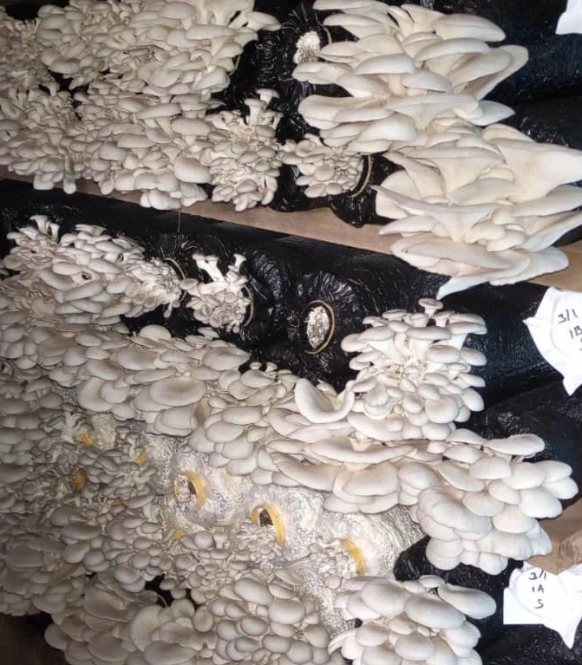
Introduction
Goals
Methods
Results
Conclusions
Substrate for mushroom cultivation
Mix and water agricultural waste products
Bag, pasteurize and insert mushroom spawn
Harvest edible mushrooms
Peter Siegenthaler
11.06.2026
2
Notes:
2

Slide 3
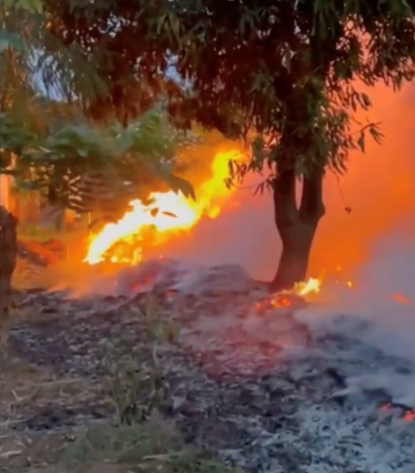
Introduction
Goals
Methods
Results
Conclusions
Benefits of mushrooms cultivation in developing countries
Circular Economy: “From waste to money”
Waste disposal
Agricultural waste
Source: https://www.youtube.com/watch?v=6FmEJcynxZE
Environmental pollution
Mushroom growing
Income generating
Peter Siegenthaler
11.06.2026
3
Notes:
3

Slide 4
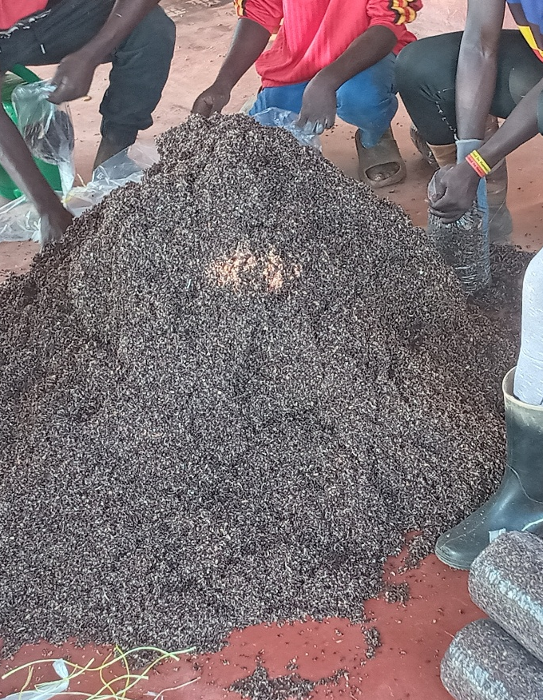
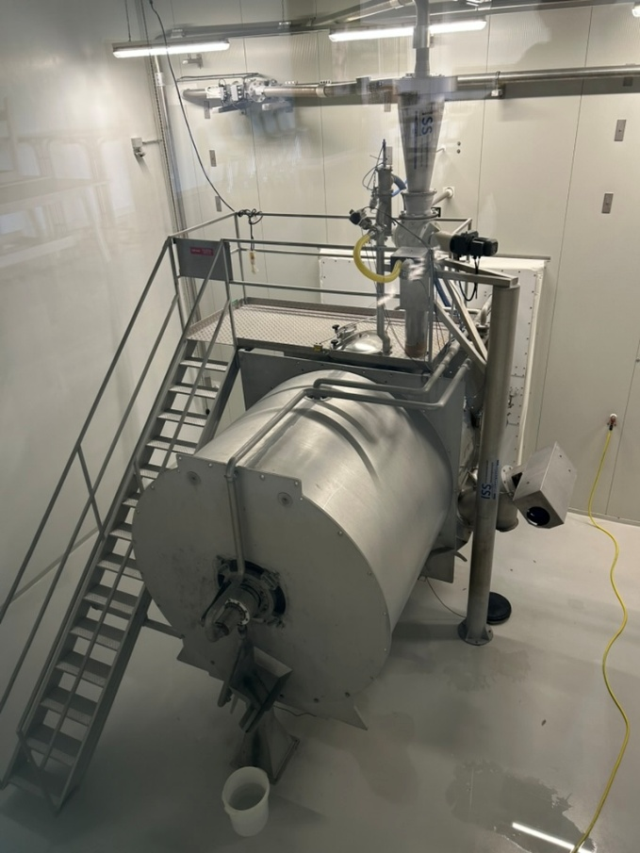
Introduction
Goals
Methods
Results
Conclusions
Mushroom cultivation in resource-limited settings
Ugandan baseline
Industrial processing
Manual substrate preparation:
High labor cost
Inconsistent yields
Mechanized substrate preparation:
High capital requirement
High energy consumption
Peter Siegenthaler
11.06.2026
4
Notes:
4

Slide 5
Introduction
Goals
Methods
Results
Conclusions
Mushroom cultivation in resource-constraint settings
Ugandan baseline
Industrial processing
Constraints in Kampala:
Low capital (smallholders)
Limited material availability
Unreliable energy supply
High energy cost
Goal of this project
Peter Siegenthaler
11.06.2026
5
Notes:
5

Slide 6
Goals
Introduction
Goals
Methods
Results
Conclusions
Requirements for the device (Research Questions)
Mixing
How can heterogeneous agricultural residues be processed to achieve a homogeneous substrate composition throughout the mixing vessel?
Watering
How can the substrate be uniformly hydrated to achieve a target moisture content of 60-70 wt%?
Portioning
How can the processed substrate be portioned into bags with deviations within a tolerance of ±10 wt%?
Peter Siegenthaler
11.06.2026
6
Notes:
6

Slide 7
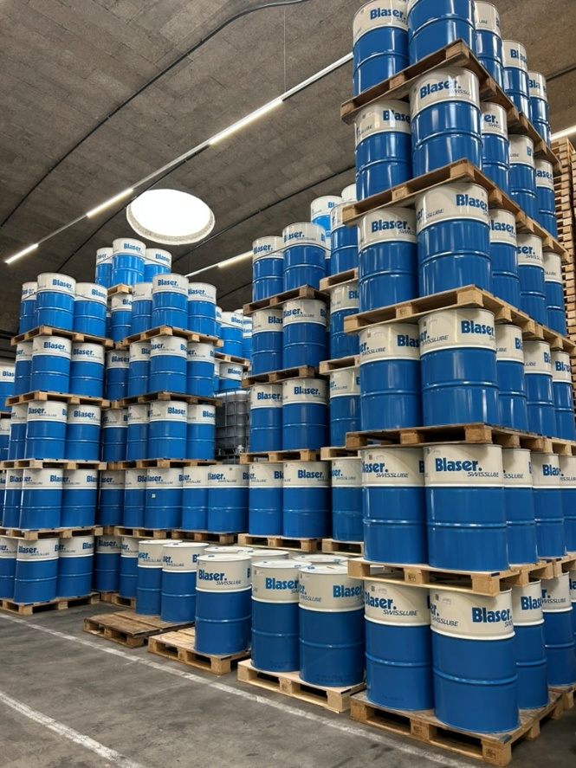
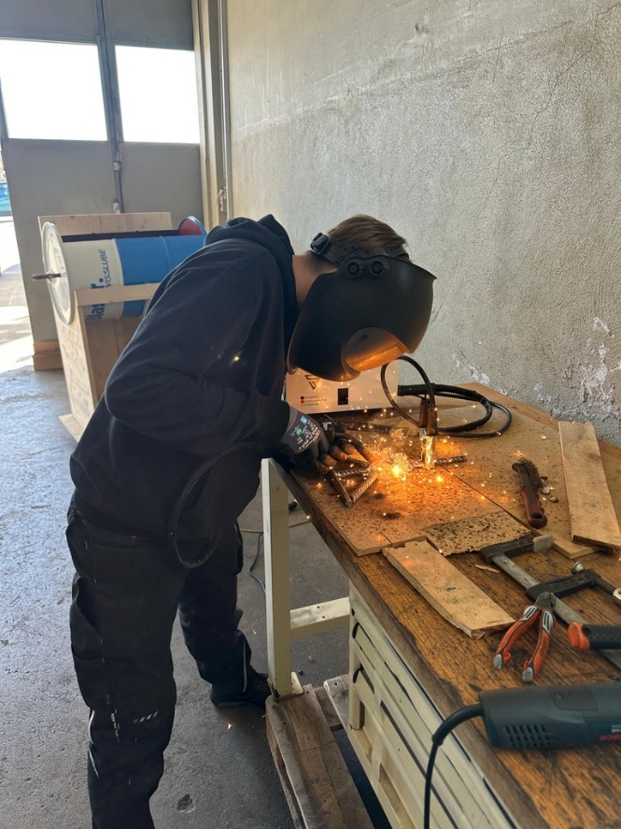
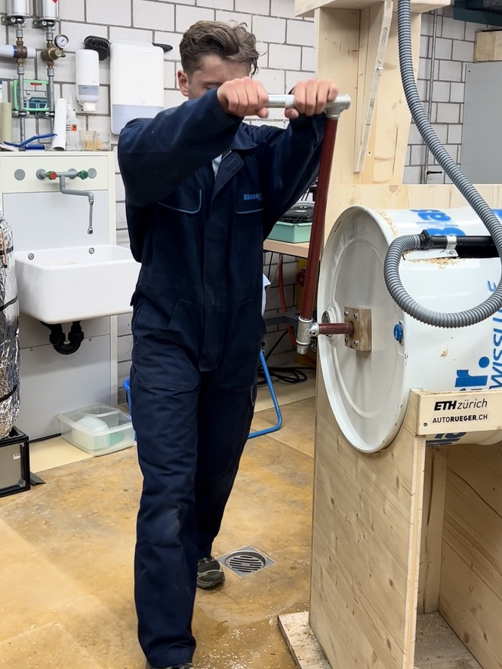
Introduction
Goals
Methods
Results
Conclusions
Product Development - Methodology
Reproducibility
“Simplicity is the ultimate sophistication.” – Leonardo da Vinci
Globally available materials
Simple manufacturing
Low-tech & low-cost
Peter Siegenthaler
11.06.2026
7
Notes:
7

Slide 8
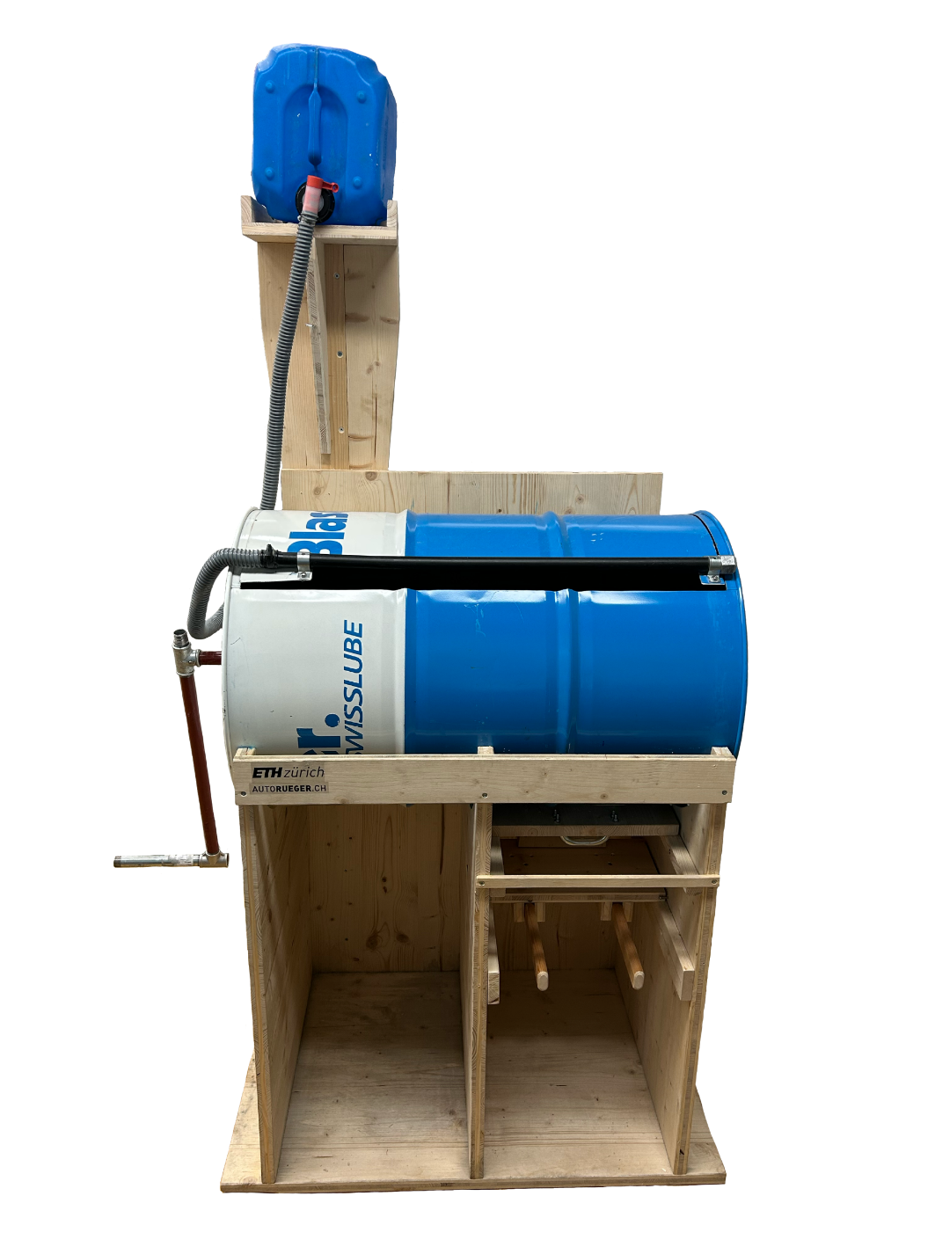
Introduction
Goals
Methods
Results
Conclusions
Product Development
Oil drum
Wooden panels
Globally standardized materials & items
Peter Siegenthaler
11.06.2026
8
Notes:
8

Slide 9
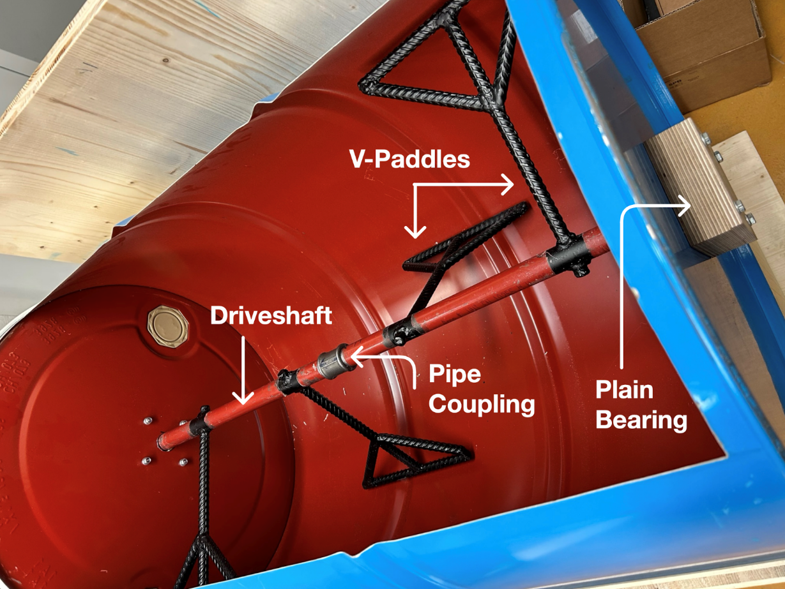
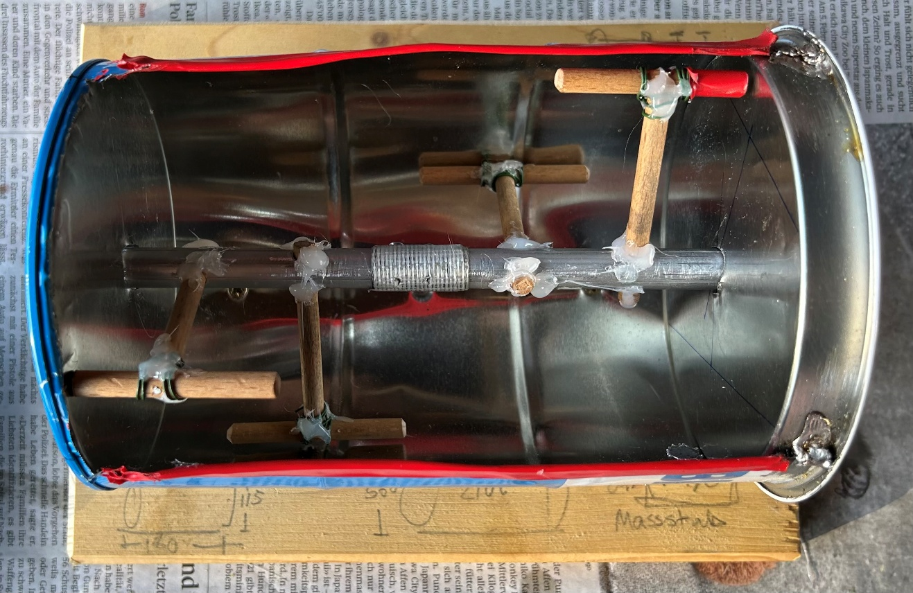
Introduction
Goals
Methods
Results
Conclusions
Product Development - Mixing
Final agitator
Model scale 1:5 – Testing different paddle geometries
Steel pipes
Pipe couplings
Rebar Paddles
Wooden Bearings
All materials used on construction sites
Peter Siegenthaler
11.06.2026
9
Notes:
9

Slide 10
Introduction
Goals
Methods
Results
Conclusions
Product Development - Watering
Hydrostatic Reservoir
Manifold (sprinkler)
Gravity driven (no energy supply)
Peter Siegenthaler
11.06.2026
10
Notes:
10

Slide 11
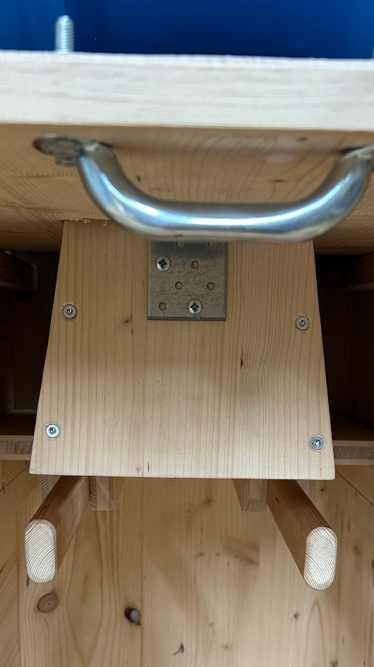
Introduction
Goals
Methods
Results
Conclusions
Product Development - Portioning
Sealing Valve
Conveyance Duct
Slide Valve
dosing
bagging
Peter Siegenthaler
11.06.2026
11
Notes:
11

Slide 12

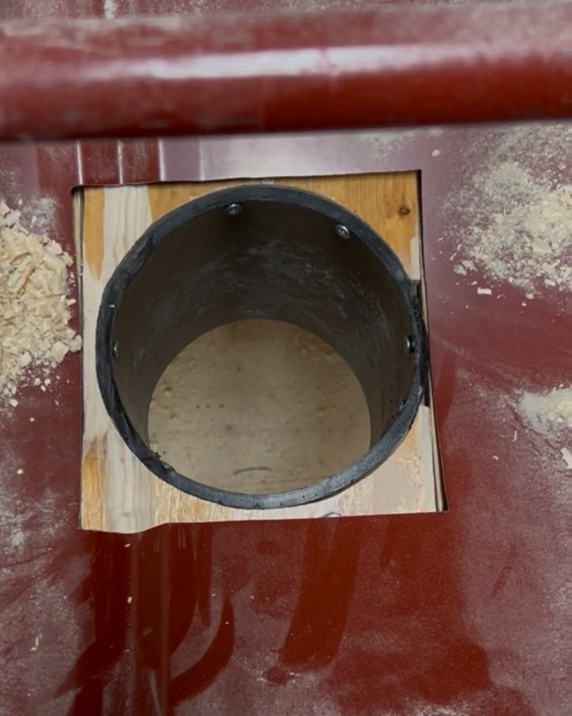
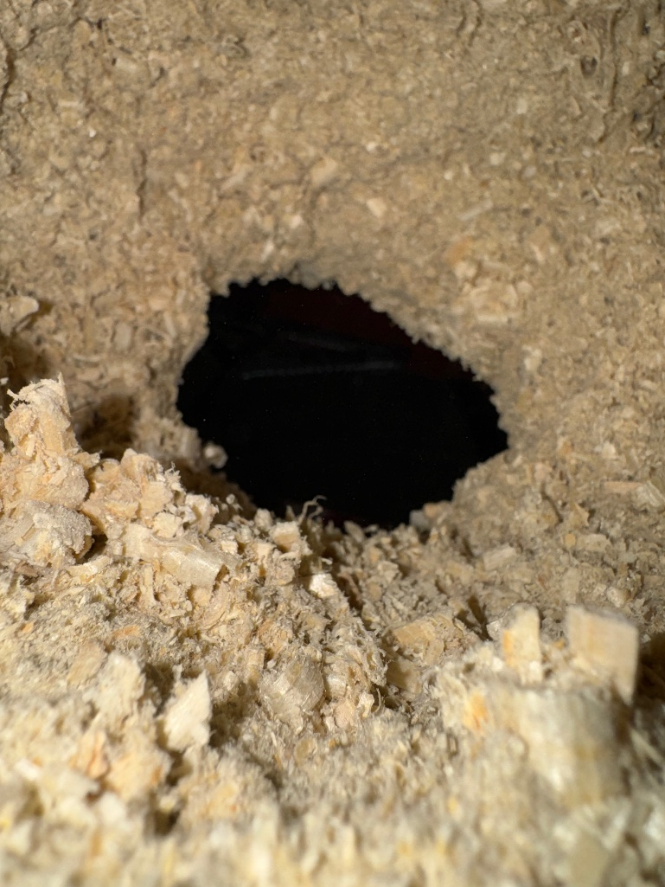
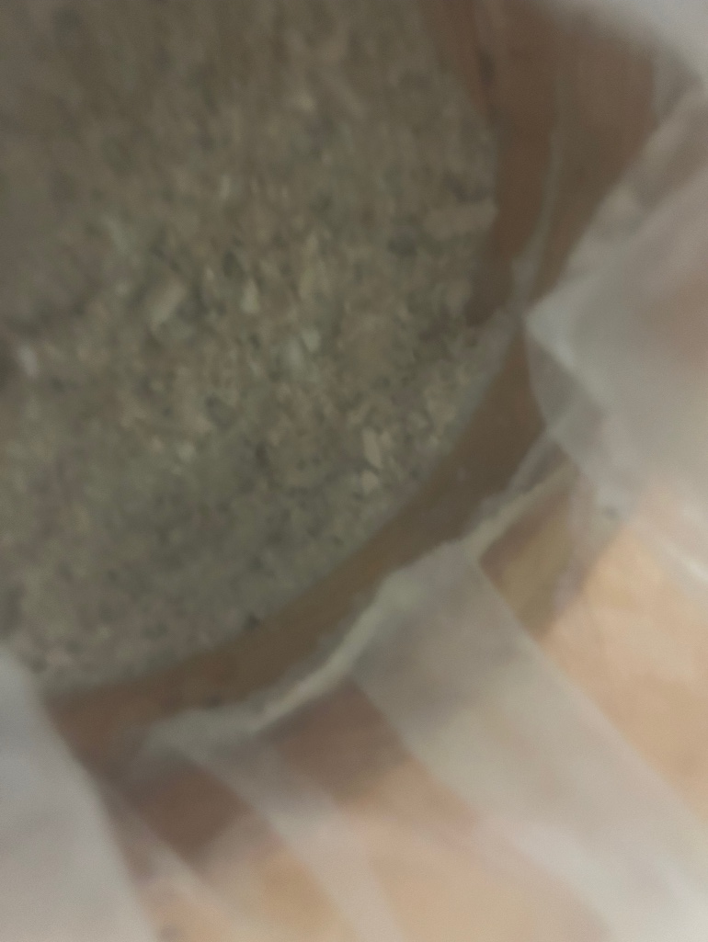
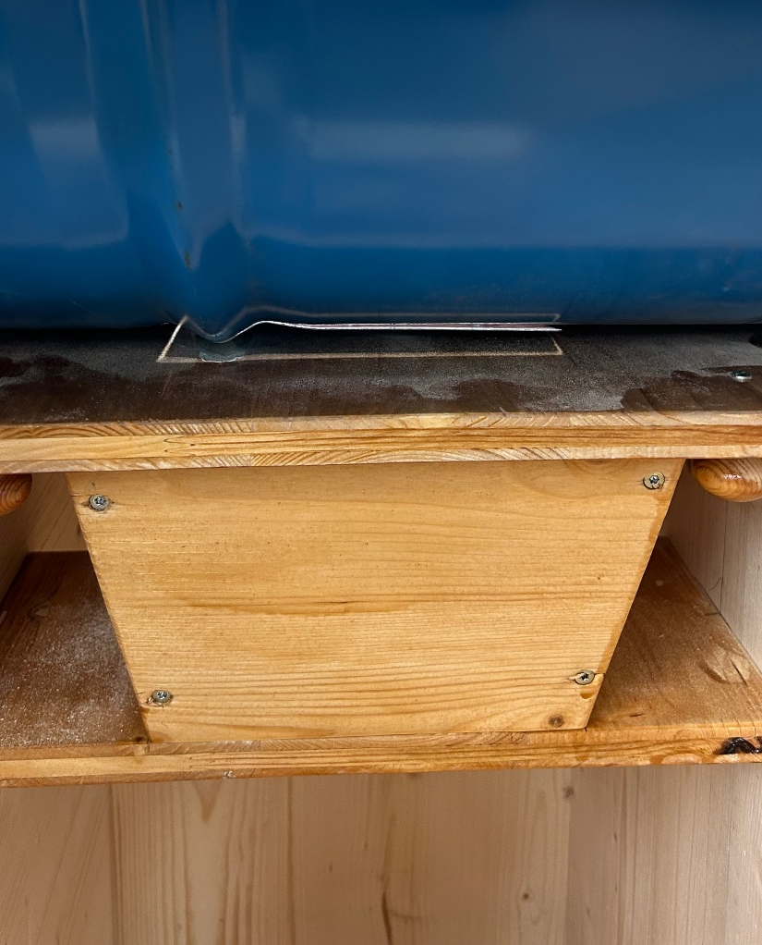
Introduction
Goals
Methods
Results
Conclusions
Product Development - Portioning
Substrate blockages in conveyance duct
Peter Siegenthaler
11.06.2026
12
Notes:
12

Slide 13
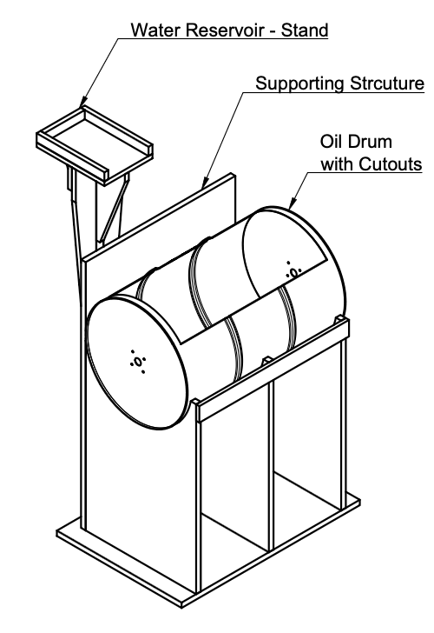
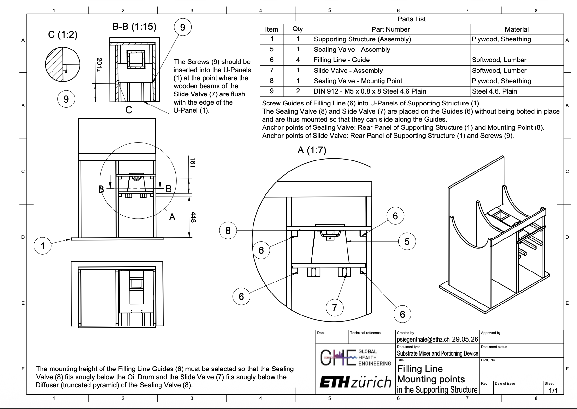
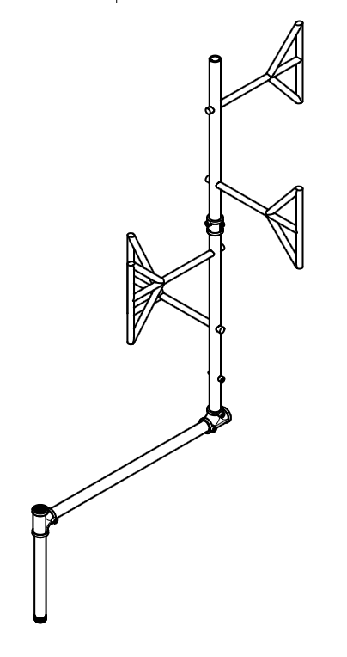
Introduction
Goals
Methods
Results
Conclusions
Deliverables – Technical Drawings, User Manual
Peter Siegenthaler
11.06.2026
13
Notes:
13

Slide 14
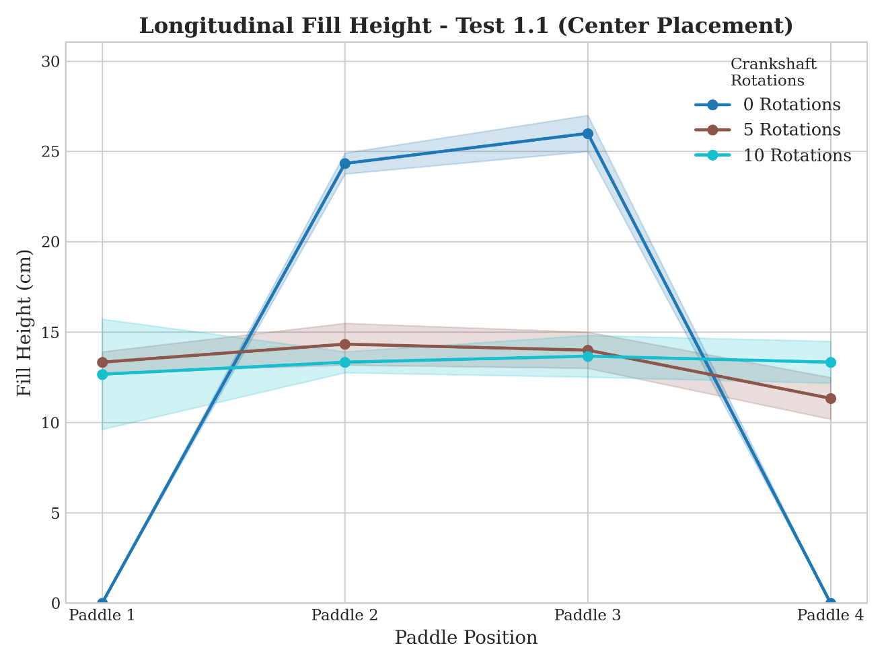
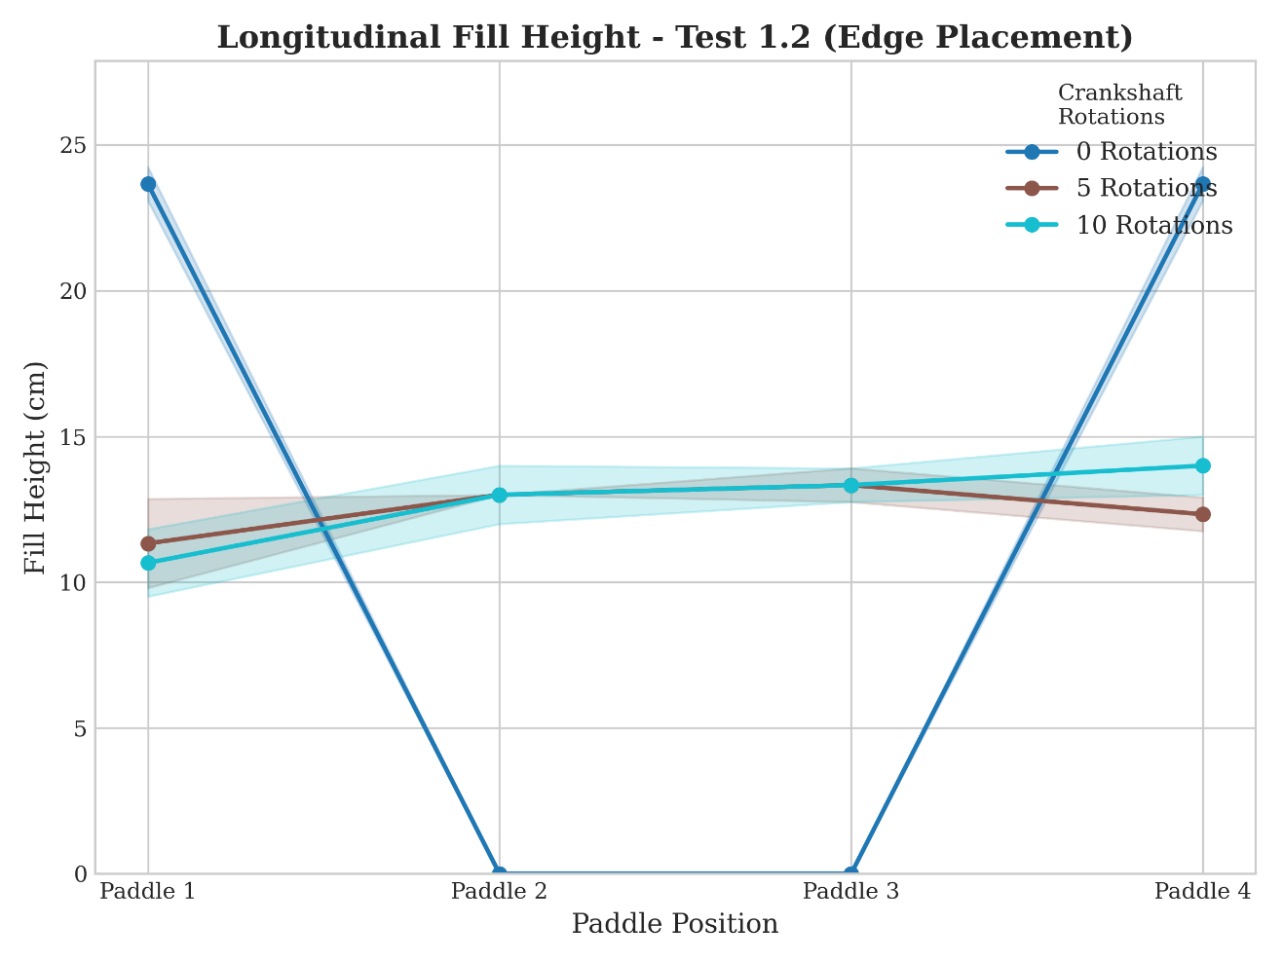
Introduction
Goals
Methods
Results
Conclusions
Mixing – Longitudinal Transport Efficiency
Equalized fill height already after five agitator rotations.
Rapid, bidirectional longitudinal transport.
Peter Siegenthaler
11.06.2026
14
Notes:
14

Slide 15
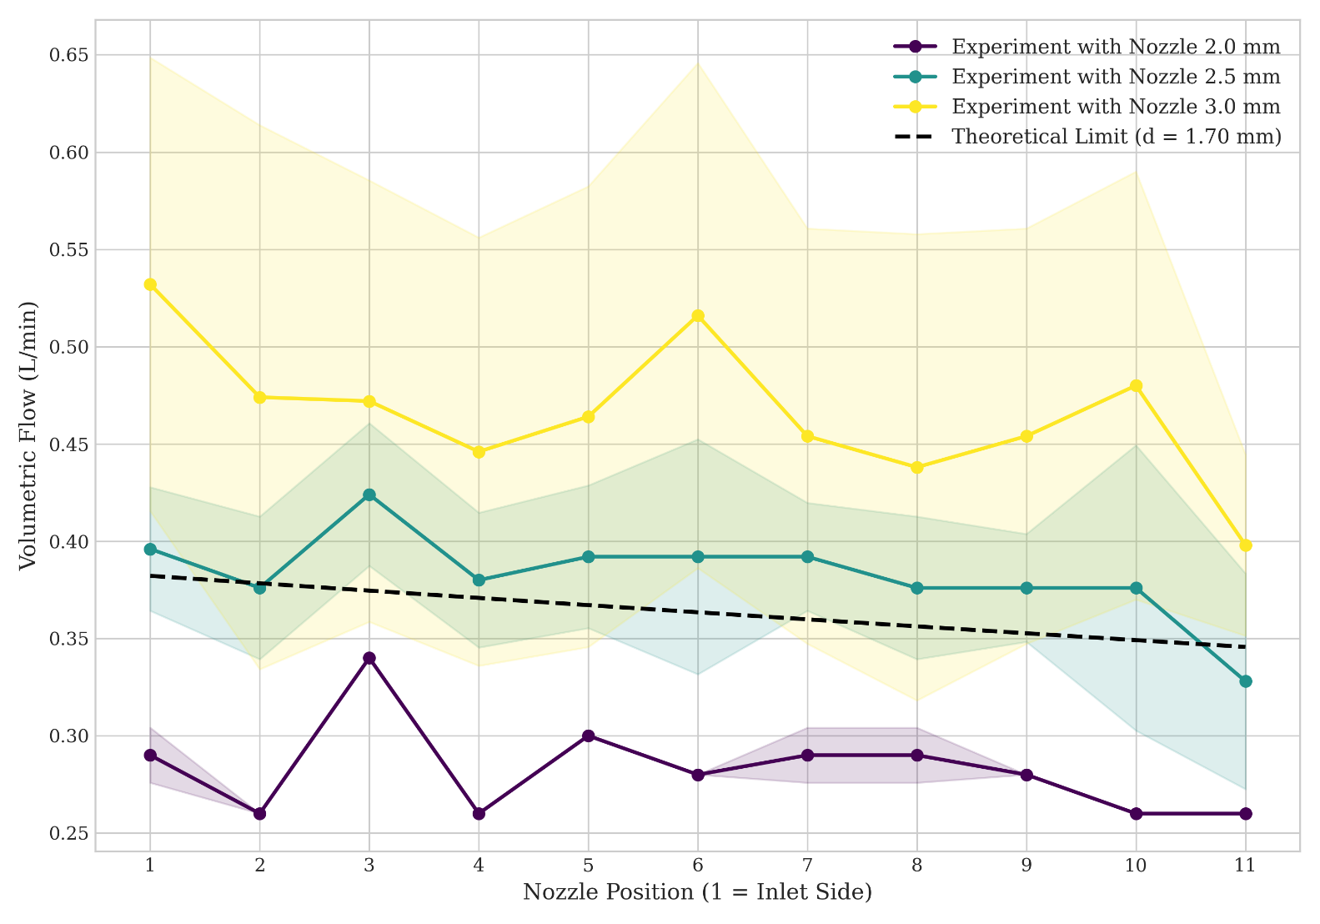
Introduction
Goals
Methods
Results
Conclusions
Watering – Nozzle Outflow
Manufacturing inaccurancies dominate.
10% drop threshold not reached (3mm bore).
Total outflow increased: 4.21 L/min (2.5mm bore) to 5.13 L/min (3.0mm bore)
Peter Siegenthaler
11.06.2026
15
Notes:
15

Slide 16
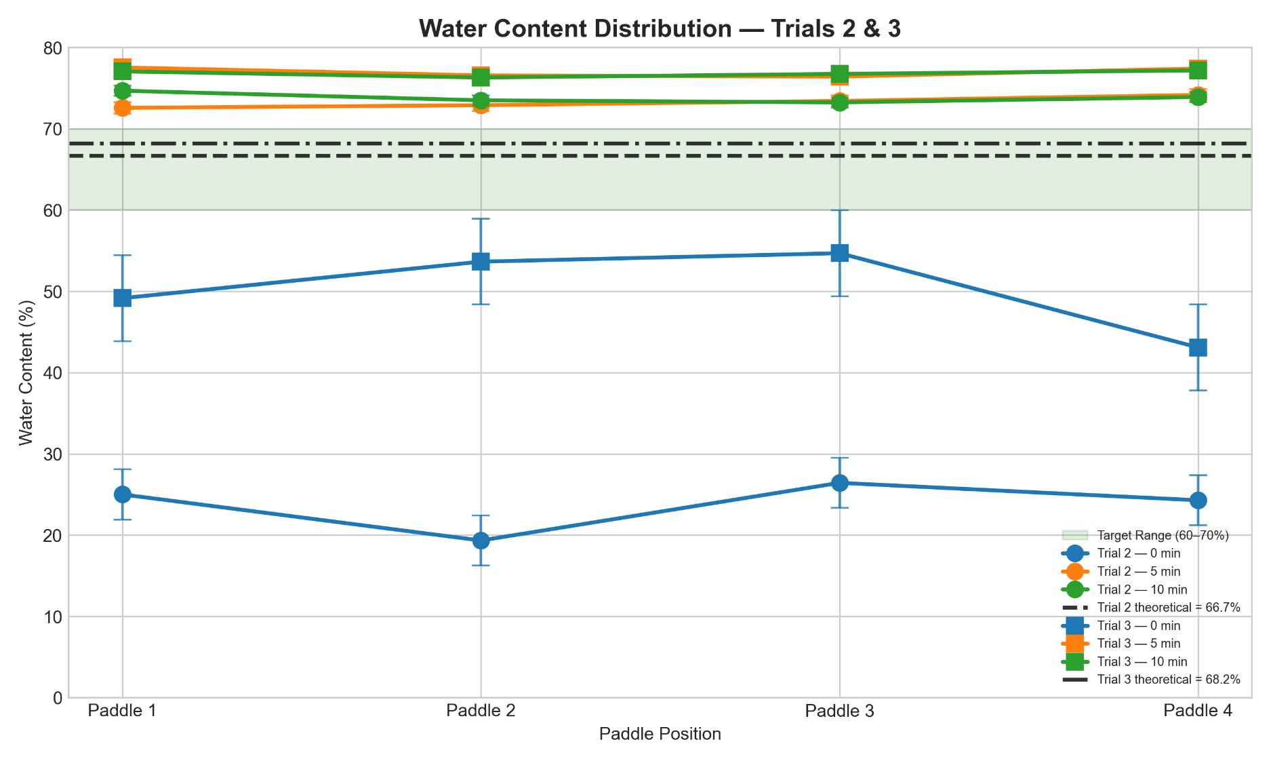
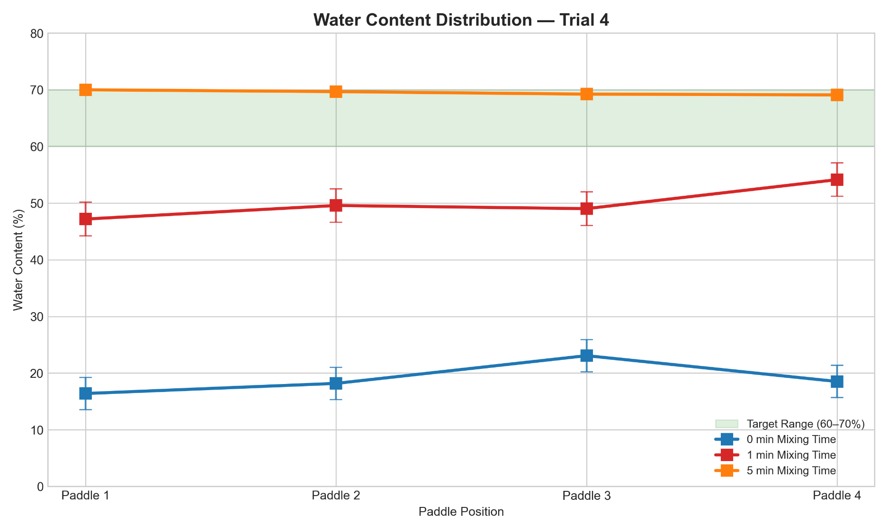
Introduction
Goals
Methods
Results
Conclusions
Mixing & Watering – Water Content Distribution
Mixing Vessel
(69.50 ± 0.41) wt%
Portioned Bags
(69.55 ± 0.62) wt%
Samples deviation (5’)
(0.45 ± 0.06) wt%
Water content very homogeneous distributed.
Water content between 60-70 wt% reached.
Peter Siegenthaler
11.06.2026
16
Notes:
16

Slide 17
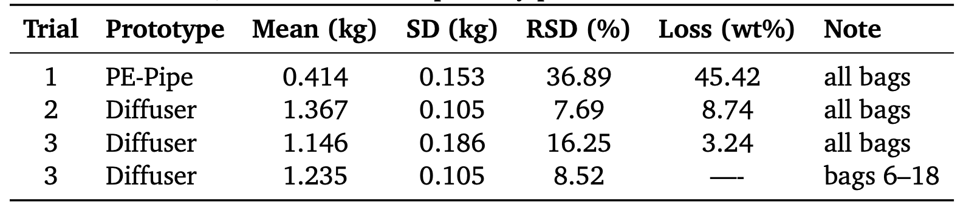
Introduction
Goals
Methods
Results
Conclusions
Portioning – Bagging Performance
Diffuser can reach ±10% threshold.
Sensitive to user errors.
Peter Siegenthaler
11.06.2026
17
Notes:
17

Slide 18
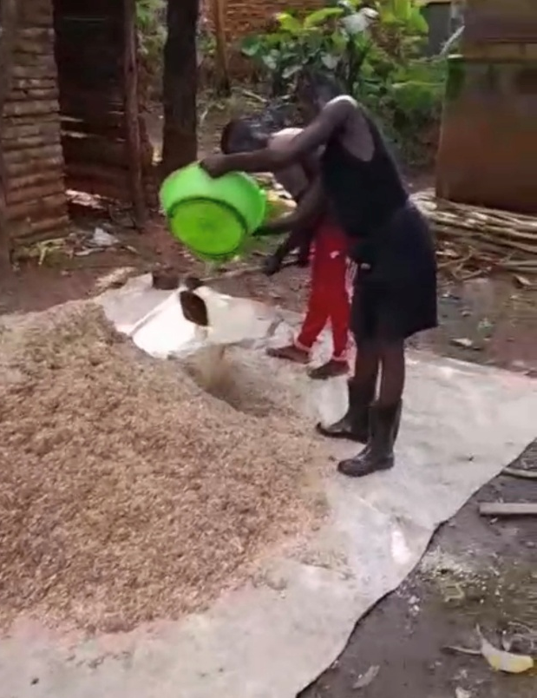
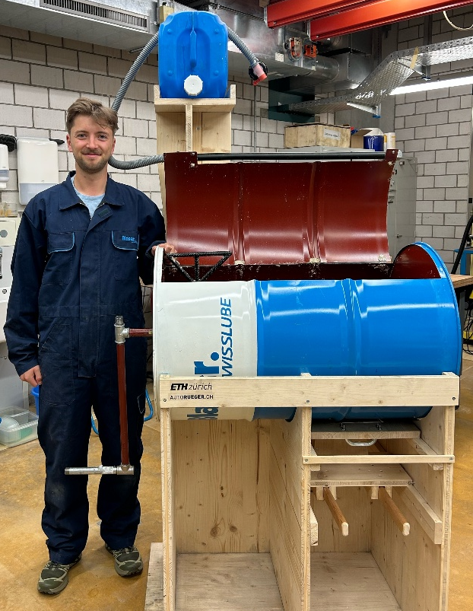
Introduction
Goals
Methods
Results
Conclusions
Working Prototype
Hand-driven, low-cost mechanical solutions can successfully standardize substrate processing.
Big reduction of labor estimated.
Peter Siegenthaler
11.06.2026
18
Notes:
18

Slide 19
Introduction
Goals
Methods
Results
Conclusions
Outlook – Recommendations
Field Validation in Uganda:
Analysis of user acceptance, reproducibility, durability.
Peter Siegenthaler
11.06.2026
19
Notes:
19

Slide 21
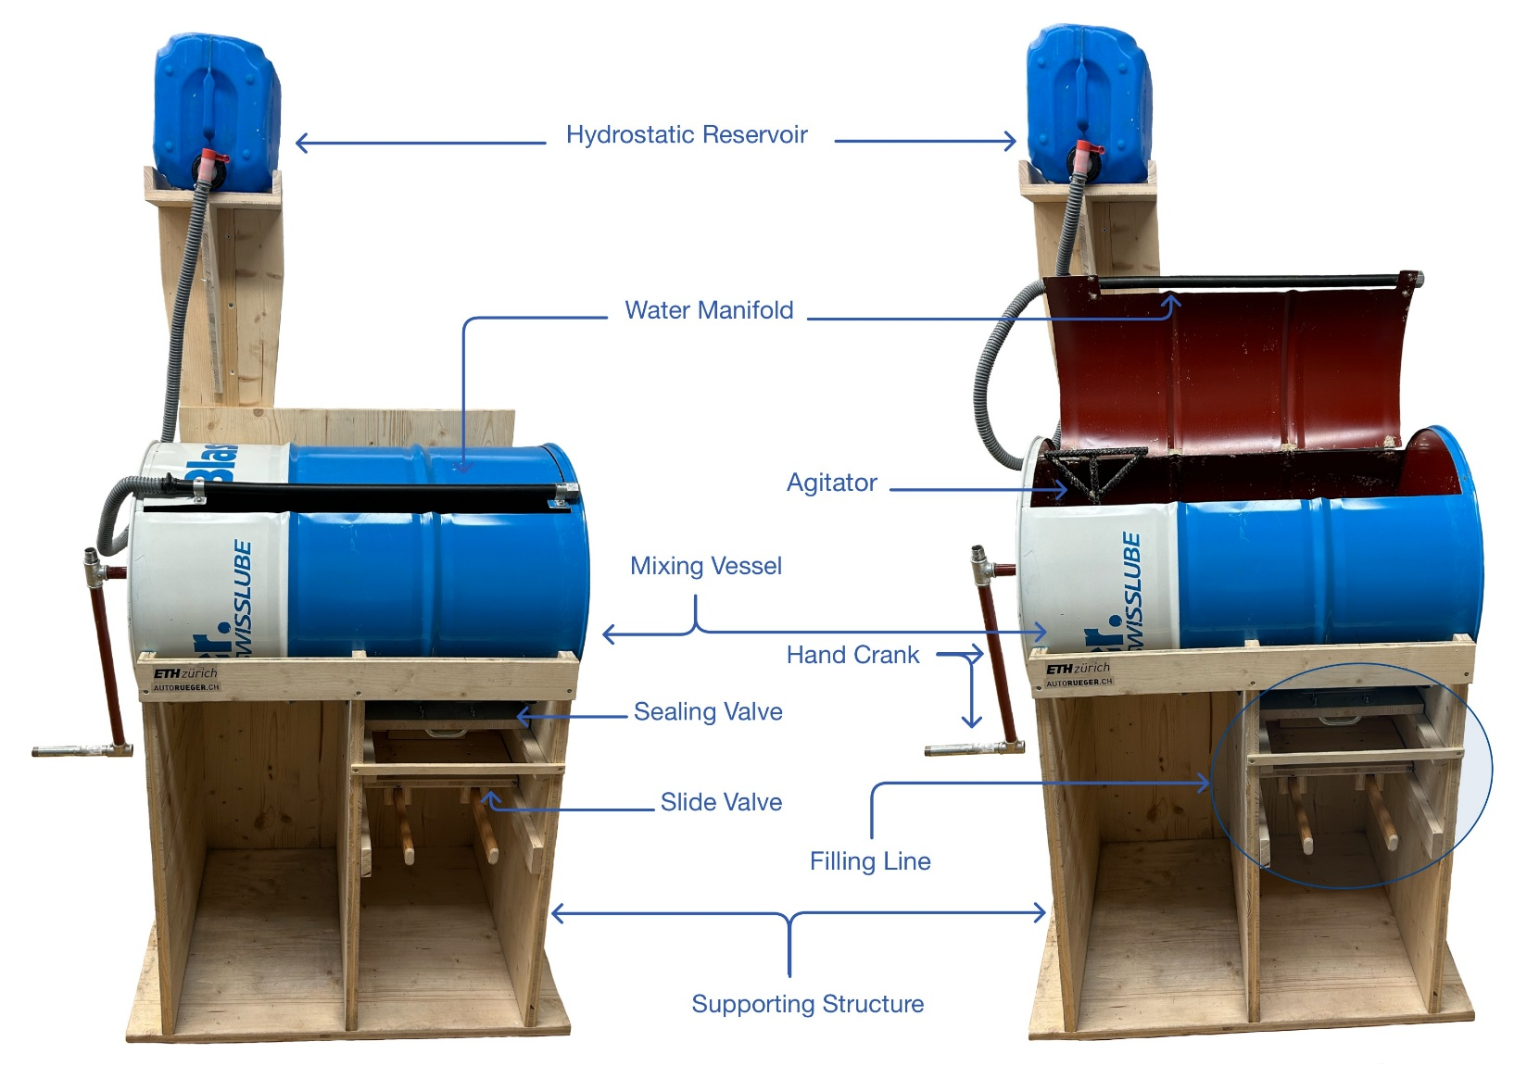
Introduction
Goals
Methods
Results
Conclusions
Final Prototype
Peter Siegenthaler
11.06.2026
21
Notes:
21

