Slide 1
SwissRN
Data Stewardship Lars Schöbitz

Slide 2
Hands-up
Who has an ORCID iD?
Who has published a scientific article in a journal?
Who has published data separately from a scientific article with a separate unique id (DOI)?

Slide 3
I am a data steward
I am a data steward working in a research group of about 10 people
Profile
What I have
10+ years work experience (5 in research)
empathy, compassion, patience, persistance
an affinity for IT
What I do not have
a doctoral degree
a qualification in IT related disciplines
…

Slide 4
Your turn
For my example role of a data steward,
Who do you think should pay for this resource?
How do you think the data steward should be rewarded scientifically?
included as an author on publications?
Which career paths are there for data stewards with my profile?

Slide 5
Three stages of data

Slide 6
(Research) Data Management
term | folder | explanation | file format
unprocessed raw data | raw | data that is not processed and remains in its original form and file | often XLSX, also CSV and others
processed analysis-ready data | processed | data that is processed to prepare for an analysis and is exported in its new form as a new file | CSV
final data underlying a publication | final | data that is the result of an analysis (e.g descriptive statistics or data visualization) and shown in a report, but then also exported in its new form as a new file | CSV
Examples of terms used when managing data.

Slide 7
Data Management Strategy

Slide 8
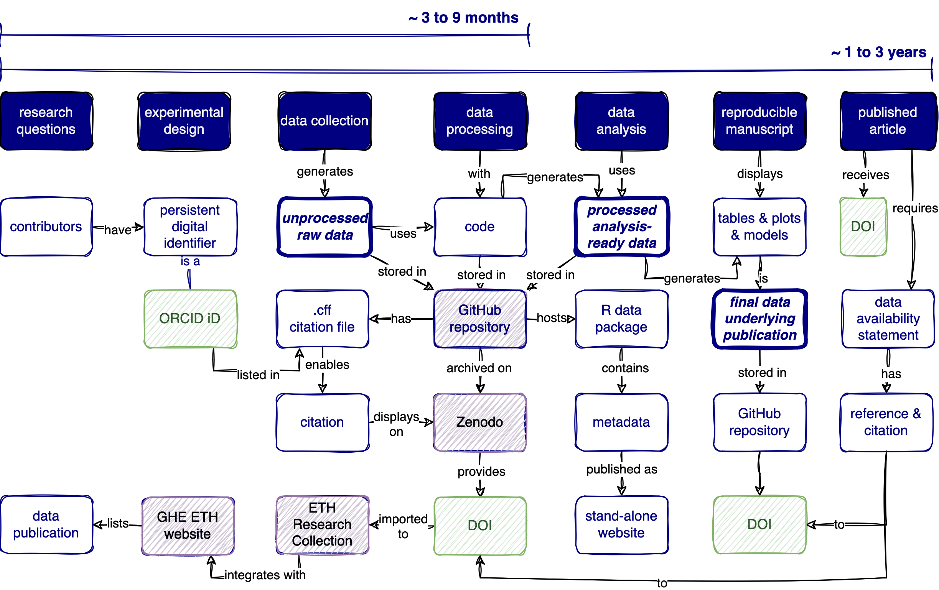

Slide 9
GHE est. 2021
committees
proposals

