Slide 1
Hamilton STAR Training
Last updated 9/24/2024

Slide 2
Outline: Hamilton STAR Training
System overview
Installation instructions
Basic user experience
Lateral flow assay example experiments
PCR example experiments
Advanced user tools and troubleshooting

Slide 3
System Overview

Slide 4
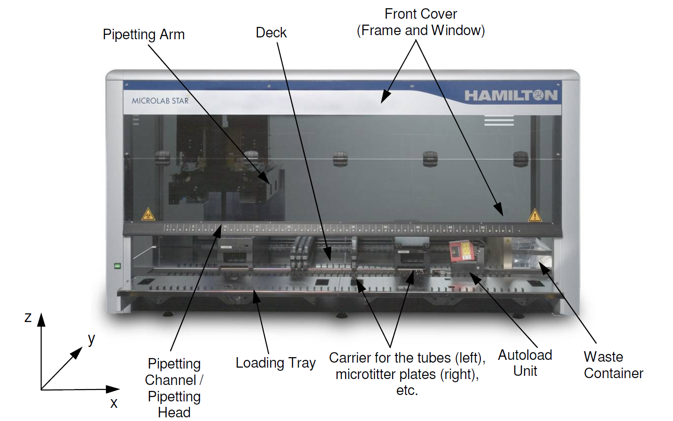
Hamilton STAR Liquid Handling Robot
About the Hamilton STAR(s)
Eight 1000µL channels
Run by VENUS software
On board camera
Circulated refrigerator with cooling deck
HEPA filter with UV LAMP
iSWAP for moving plates
Custom LFA holders

Slide 5
High level protocol overview

Slide 6




Detailed workflow – LFA experiments
Indicates existing software
Plan
Make exp files
Run exp
Get data
Analyze data
csv worklist file to feed into Hamilton method + supporting documentation (csv)
LFA(s) imaged on deck and images saved on desktop attached to Hamilton
Experimental plan
Folder(s) with png file(s)
LFA Software (Python)
Hamilton Method:
.med with associated .lay file (input is csv)
Raw images: png, one per LFA per timepoint imaged
Multiple timepoints possible, depending on experiment
Data processing software: Python
Outputs (per input csv file, can batch as many as needed):
Combined csv file for all images in folders analyzed
Columns = parameters (filename, signal/test line, group, and guid)
Rows = LFAs
PDF with signal curves and images of strips (including ROI cropping)
Experimental plan
Worklist(s) and associated supporting documents
Raw data
Currently too large for database, set up alternative storage method
Analyzed data
Information to be stored in database

Slide 7
Detailed workflow – NAAT experiments
Indicates existing software
Plan
Make exp files
Run exp
Get data
Analyze data
csv worklist file to feed into Hamilton method + supporting documentation (txt)
Plate(s) transferred to thermocycler(s) and read using specified protocol
Experimental plan
csv data file(s)
RADA Web App:
AWS web application with SQL database
Hamilton Method: .med with associated .lay file (input is csv)
Thermocycler Raw data
Primary File Structure:
columns = 1 well
row = 1 read point
sheet = 1 fluorescent channel
Note: Secondary files have supporting experimental information (date, time, protocol run, etc).
Data processing software: Python
Outputs (per input csv file, can batch as many as needed):
Csv file with parameters of interest (e.g. fluorescence and CT)
Columns = parameters
Rows = wells
PDF with amplification curve per well, in structure of plate run (96 or 384)
Experimental plan
Worklist(s) and associated supporting documents
Raw data and
Secondary files
Analyzed data
Information to be stored in database

Slide 8

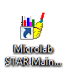
VENUS Software Components
VENUS 6 Software – Used to validate and run experiments on STAR
Microlab STAR Maintenance – Daily, weekly, and monthly maintenance
Notes:
For the developer there is also the liquid class editor and the labware editor… add here or make a separate module?

Slide 9
Installation Instructions

Slide 10
Overview: Installing Hamilton Software
Install VENUS software per manufacturer instructions
Load the following libraries:
Animations
LVK (not for today)
Load Methods with corresponding Layouts
NAAT: DROP_NAAT_Method_v2.med
LFA: DROP_LFA_Method_v2.med
Training: DROP_Training_Method.med
Load Liquid Classes: DROP_Liquid_Classes.mdb
Load Shortcuts into Run Control: VENUS-Export-Shortcuts
Test for proper installation with the following files:
NAAT: NAAT_test_worklist.csv
LFA: LFA_test_worklist.csv
Refer to Installation Instructions document for more detailed installation information

Slide 11
Using the Hamilton STAR – overview
Execute daily maintenance
Open VENUS software
Run protocol in simulation mode
Set up instrument deck and prepare reagents
Run protocol on the instrument
Clean up

Slide 12
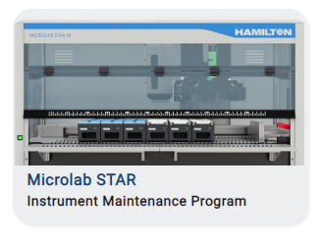

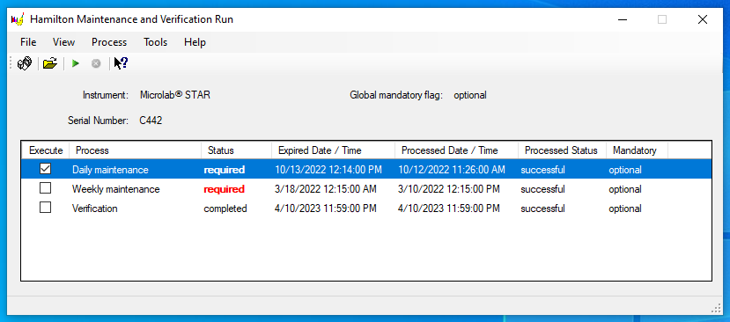
Step 1. Execute daily maintenance
1.1 Open the Microlab STAR Maintenance and Verification application through Windows or by selecting the instrument on the VENUS 6 maintenance tab.
1.2 Select the check box next to “Daily maintenance” and click the green arrow along the icon bar.
or
2
1

Slide 13
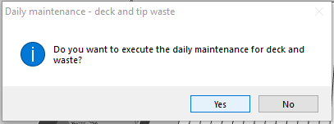
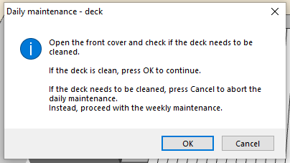
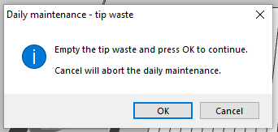
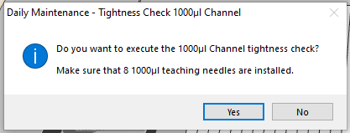
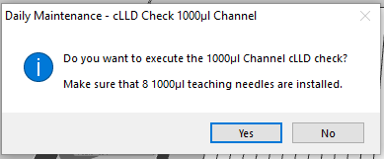
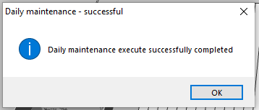
Step 1. Execute daily maintenance
1.3 Run Control will open automatically and walk the user through the maintenance steps. The steps are shown below. Follow the instructions as requested to complete maintenance.
1. Start daily maintenance. Click ‘Yes’
2. Confirm deck is clean. Click ‘OK’.
3. Empty tip waste. Click ‘OK’.
4. Check channel tightness.
Click ‘Yes’.
5. Check capacitive measurement.
Click ‘Yes’.
6. Daily maintenance complete.
Click ‘OK”.

Slide 14
Operator Notes for Daily Maintenance
Some things to note about daily maintenance:
Daily maintenance should be run at the beginning of the day before starting an experiment. The goal of daily maintenance is to ensure that the deck is clean and that the pipette tips are picked up and can measure pressure and capacitance correctly.
Daily and weekly maintenance are the same, so we only run daily maintenance.
Daily maintenance cannot run when Run Control is left in simulation mode. If you have this problem, open Tools>System Config Editor>System Settings>Runtime Settings and change Simulation to OFF.
If daily maintenance does not pass, contact _____so that we can have the Hamilton service representative come to fix the machine.

Slide 15
Step 2. Open Hamilton VENUS Software
2.1 Open VENUS software by selecting shortcut or loading from programs.

Slide 16
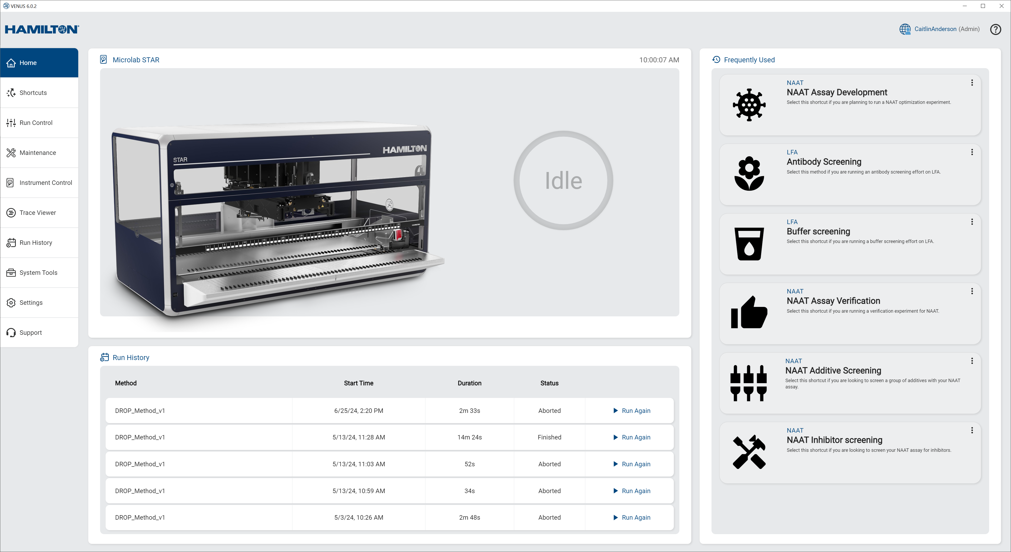
Step 2. Overview of Hamilton VENUS Software
2. Instrument Status
4. Frequently used shortcuts
1. Navigation Bar
3. Recent runs

Slide 17
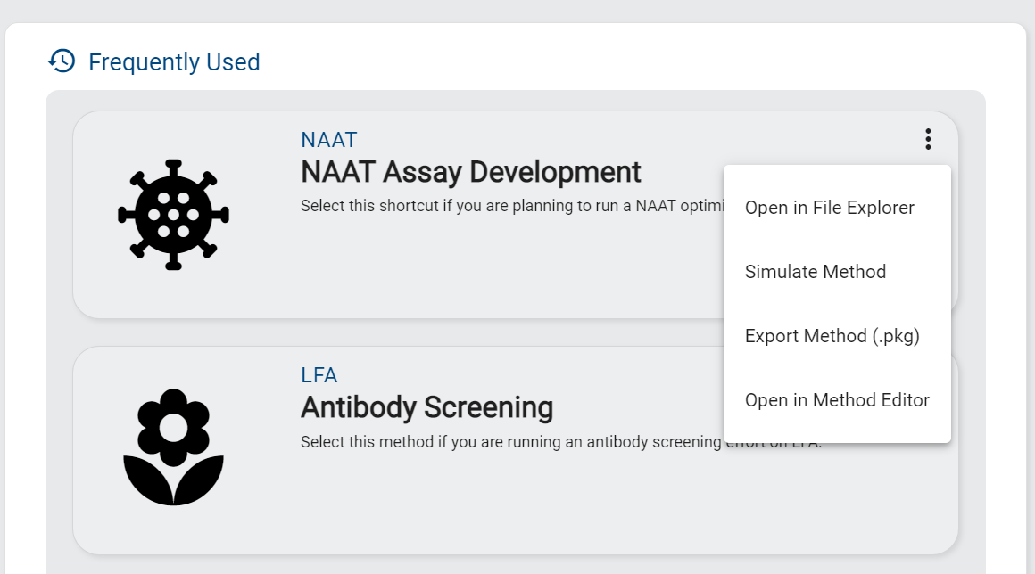
Step 3. Run Method in Simulation Mode
Note: All methods MUST be run first in simulation mode to identify any potential problems before running the full method.
3.1 Using the three dots on the relevant shortcut, in either the “Frequently Used” or “Shortcuts” section, select “Simulate Method”.
Once selected, Run Control will open and prepare to run the method in simulation mode.
1. Select icon to open menu
2. Select ‘Simulate Method” from the drop-down to launch simulator

Slide 18
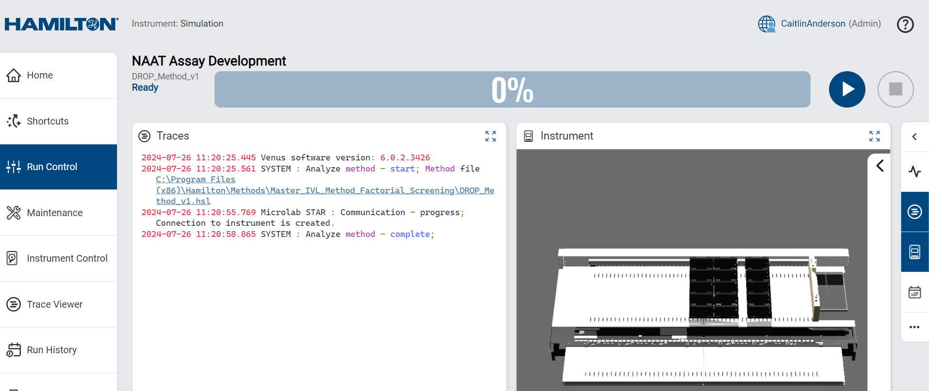
Step 3. Run Method in Simulation Mode
3.2 Confirm that the system is in simulation mode by noting what is listed under “Instrument”. Once confirmed, click on the blue play button to begin the simulation
1. Confirm that Instrument selected is “Simulation”
2. Click ‘Play’ to start simulation

Slide 19
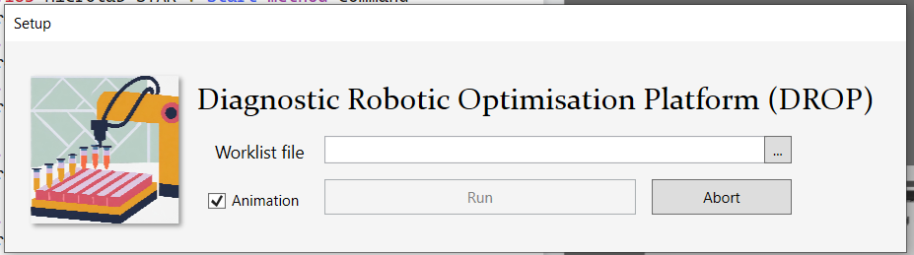
Step 3. Run Method in Simulation Mode
3.3 The following setup pop-up will appear. Attach the worklist file that corresponds to the experiment being run and select “Run”.
Note: The simulation can be run with or without animation. Animation can be helpful for troubleshooting.
Navigates to folder for worklist file selection

Slide 20
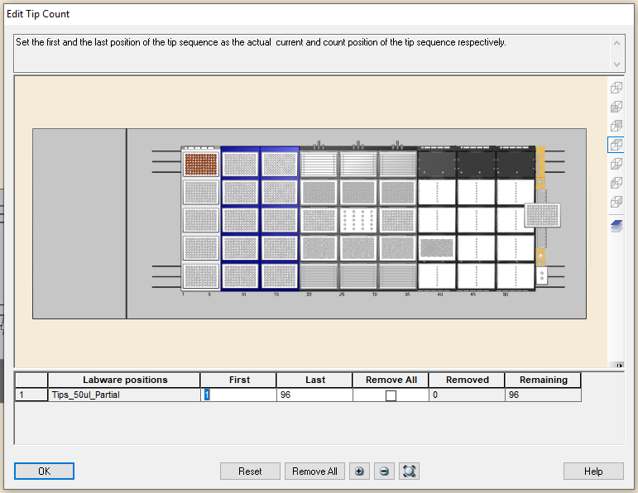
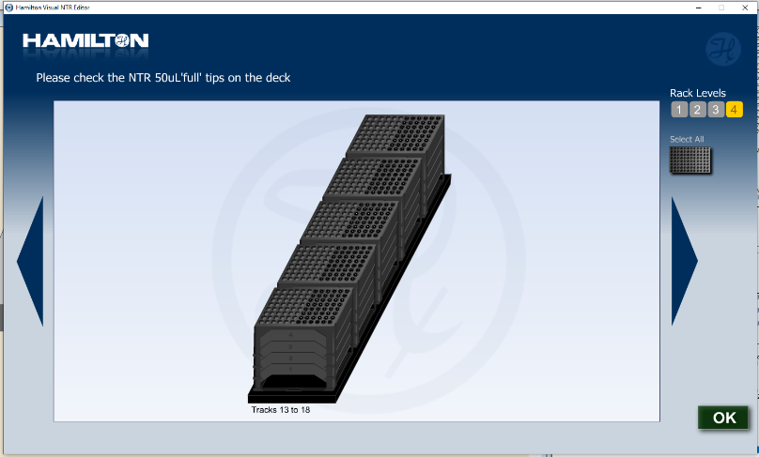
Step 3. Run method in simulation mode
3.4 Update tip count for all tip types by clicking on the first available tip in each rack. Make sure to be precise. Click “ok” when done.
Recommendation: in simulation mode we recommend loading all available tip locations for each tip type. This will inform the total number of tips that need to be loaded onto the instrument.
Update tip count - Partial tips
Update tip count - Full tips
Tip counter: goes from back to front, left to right
1
96
Notes:
Last set of tips will vary depending on the deck. We can document exactly which is the last one here once we have finalized the deck layout.

Slide 21
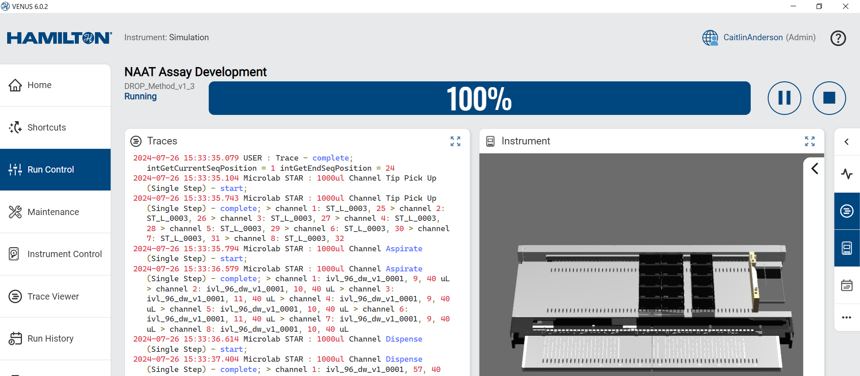
Step 3. Run method in simulation mode
3.5 Run simulation, watching the simulation and/or the trace for any potential errors.
1. Trace – Visual output of method, enables additional troubleshooting and/or debugging
2. Instrument – Runs hardware commands sent to the robot. Allows the user to visualize each step and troubleshoot as needed.

Slide 22
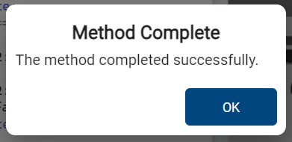
Step 3. Run method in simulation mode
3.6 Verification and troubleshooting
If everything ran correctly, you will receive a “Method Complete” pop up.
If not, there will be a pop up indicating there was an error. Note the error listed in the error popup before exiting. Open the logfile to get more information about the problem before continuing. Refer to the Troubleshooting section for common problems and how to solve them.
If the error you experienced is not in the Troubleshooting section contact GH Labs team (caitlin.anderson@ghlabs.org and luis.alonzo@ghlabs.org) for support.

Slide 23
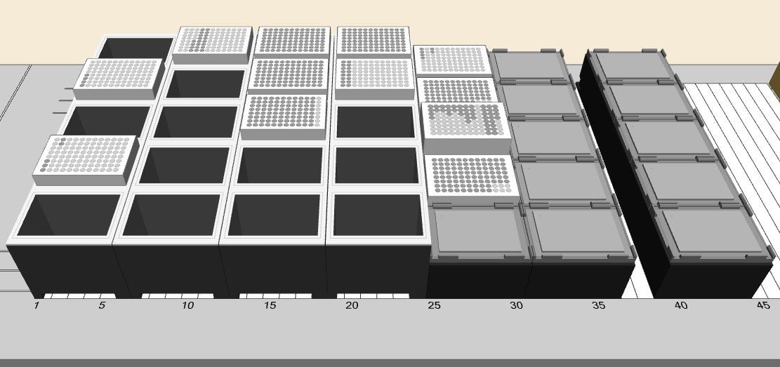
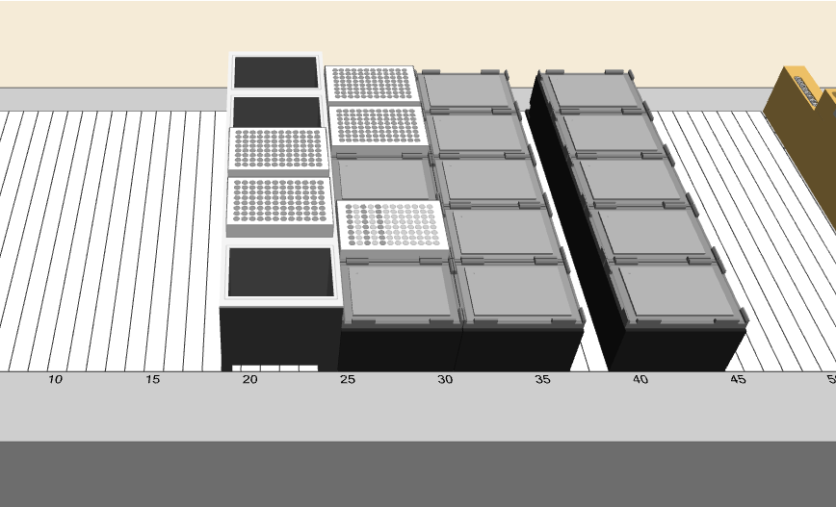
Step 3. Run method in simulation mode
3.7 Note plate and tip locations
If the run is completed successfully, note the location of the plates and tips used.
We recommend taking a screenshot and saving into a virtual laboratory notebook to assist in experiment set up.
Example 1:
Example 2:

Slide 24
Step 4A. Instrument set up (NAAT)
4A.1 If required, start refrigerated circulator
4A.2 Zip the UV jacket closed and run UV lamp for 15 minutes.
4A.3 Prepare reagents required for experiment in clean space
Recommend loading stock reagents into either a 96 well PCR plate or deep well plate
4A.4 Load required tips, reagent plates, and empty plates into their corresponding locations. See the deck layout on the following slide for more information about locations.

Slide 25
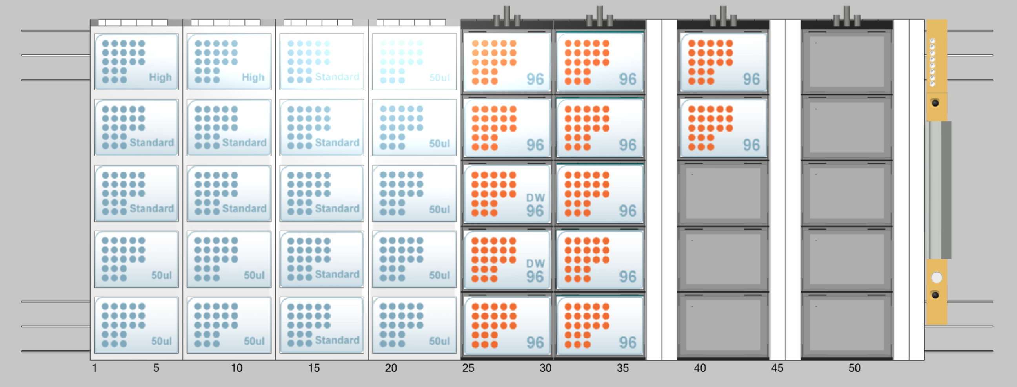
DROP_NAAT_Layout_v2: Deck positions
Labware and position
flat_96_0001
flat_96_0002
dw_96_0001
dw_96_0002
flat_96_0003
pcr_96_0001
pcr_96_0002
pcr_96_0003
pcr_96_0004 or pcr_384_0001
pcr_96_0005 or pcr_384_0002
template_96_0001
template_96_0002
A
F
K
P
1
6
11
B
G
L
Q
2
7
12
C
H
M
R
3
8
D
I
N
S
4
9
E
J
O
T
5
10
Partial tip racks
Full tip racks
Deck positions for:
2 racks of 96 1000uL tips (1 partial, 1 full)
9 racks of 96 300uL tips (4 partial, 5 full)
9 racks of 96 50uL tips (4 partial, 5 full)

Slide 26
Step 4B. Instrument set up (LFA)
4B.1 If required, start refrigerated circulator
4B.2 Prepare LFAs or RDTs. These can be done in advance of the experiment.
4B.3 Prepare reagents required for experiment in clean space
Recommend loading stock reagents into either a 96 well PCR plate or deep well plate
4B.4 Load tips, reagent plates, and LFAs/RDTs into their corresponding locations. See the deck layout on the following slide for more information about locations.

Slide 27
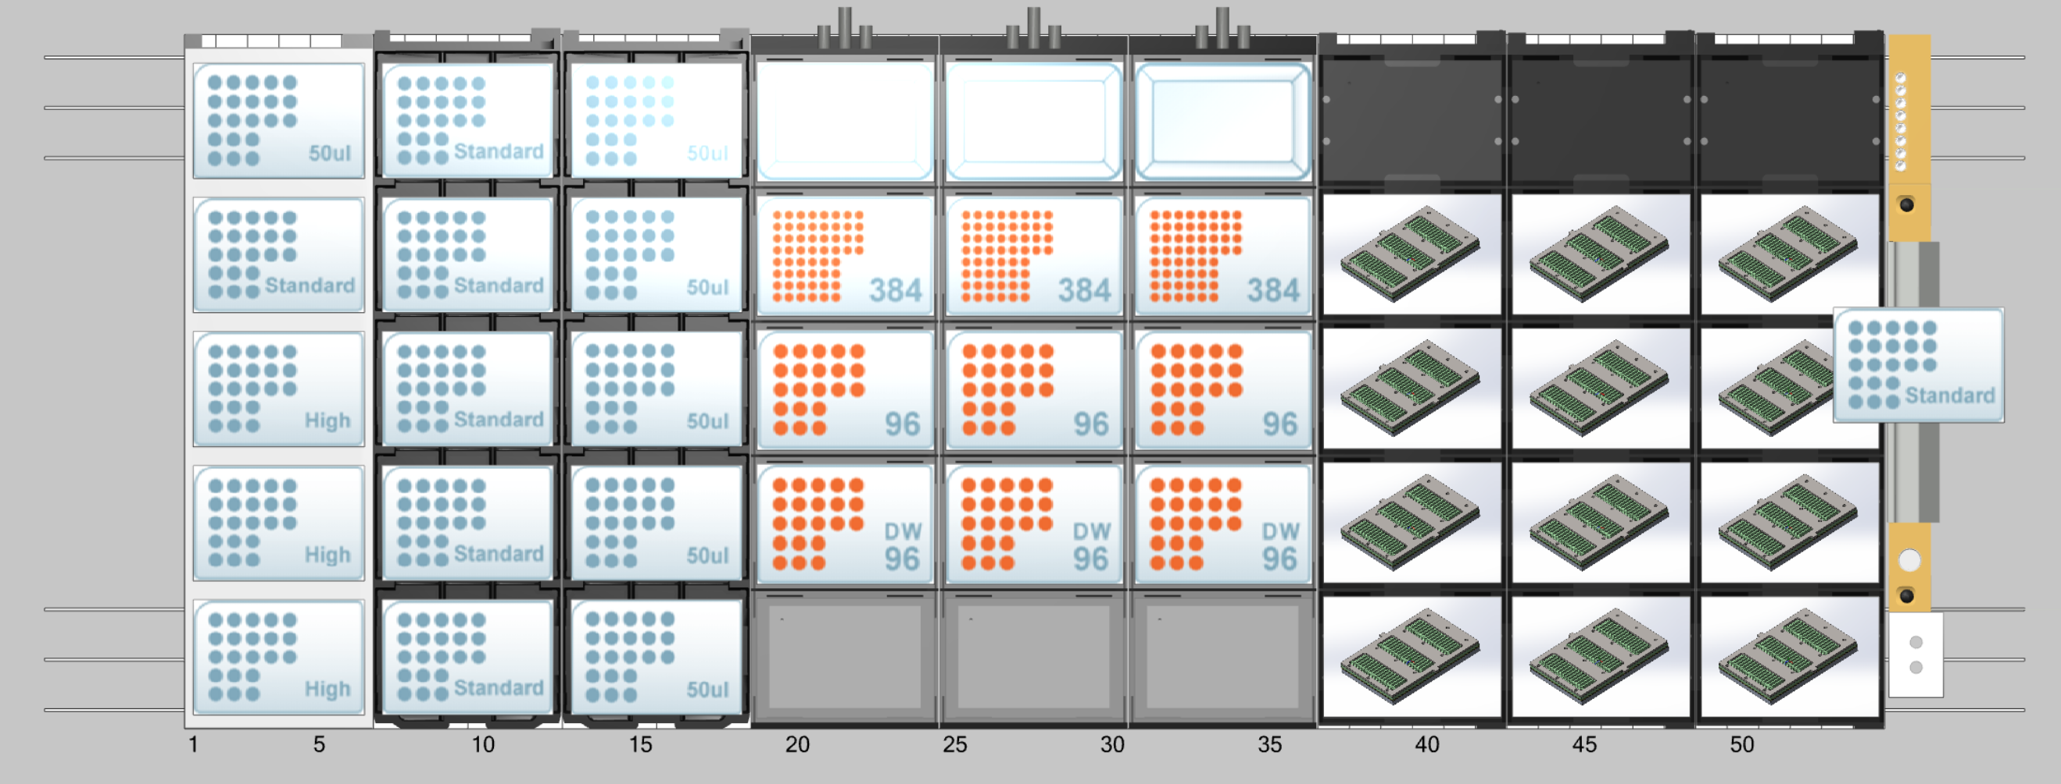
DROP_LFA_Layout_v1: Deck positions
Labware and position
flat_reservoir_0003
flat_384_0003
flat_96_0003
dw_96_0003
empty
flat_reservoir_0002
flat_384_0002
flat_96_0002
dw_96_0002
empty
flat_reservoir_0001
flat_384_0001
flat_96_0001
dw_96_0001
empty
A
F
K
1
6
11
B
G
L
2
7
12
Partial tip racks
C
H
M
3
8
13
D
I
N
4
9
14
E
J
O
5
10
15
Full tip racks
(NTR stacking tips)
Plate locations
LFA or RDT holders
Strips: IVL_Plate_v2a_16strips_plastic_col_first_0001 to 0012
Cassettes: IVL_Plate_v3_96cassettes_ABformat_0001
Deck positions for:
NTR stacking tip racks
5 x 4 300uL tips
5 x 4 50uL tips
Individual racks
3 racks of 96 1000uL tips
1 rack of 96 300uL tips
1 rack of 96 50uL tips

Slide 28
Step 5. Run method on instrument
5.1 Using the information you gathered from the simulation run and the layout file, set up the deck using the proper labware.
5.2 Replace the biohazard waste bag with a fresh bag.
5.3 Ensure there are no potential obstructions to movement of the channels.
5.4 Close the front shield of the instrument.

Slide 29
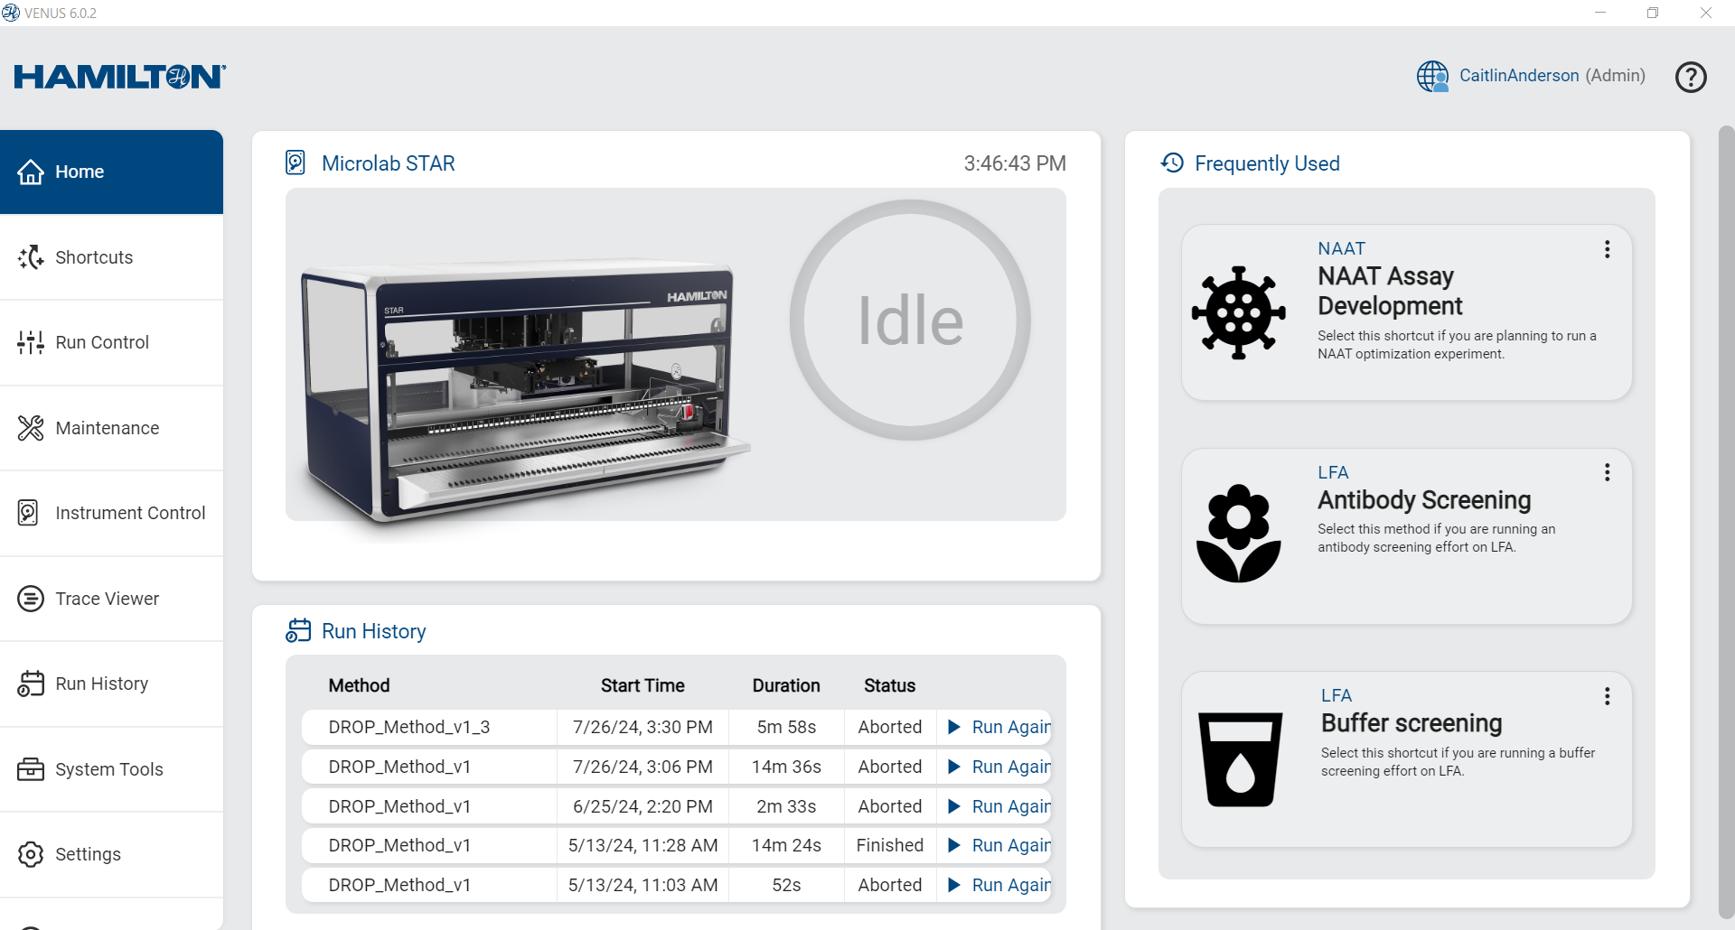
Step 5. Run method on instrument
5.5 Return to the Home page in the Navigation Bar. Load the method by selecting the shortcut button or choosing from “Run History”.
or

Slide 30
Step 5. Run method on instrument
5.6 Confirm that you are in instrument mode by noting what is listed under “Instrument”. Once confirmed, click on the blue play button to begin the run.
1. Confirm that Instrument selected is the one connected
2. Click ‘Play’ to start run
Instrument: C442

Slide 31
Step 5. Run method on instrument
5.7 The following setup pop-up will appear. Attach the worklist file that corresponds to the experiment being run and select “Run”.
Note: The instrument can be run with or without animation.

Slide 32
Step 5. Run method on instrument
5.8 Using the information gained from simulation mode, load the number of tips required for the experiment. Update tip count for all tip types by clicking on the first available tip in each rack. Make sure to be precise. Click “ok” when done.
Update tip count - Partial tips
Update tip count - Full tips
Tip counter: goes from back to front, left to right
1
96
Note: Before clicking the final “ok” on the last set of tips (which may vary by deck layout), MAKE SURE the front cover is closed
Notes:
Last set of tips will vary depending on the deck. We can document exactly which is the last one here once we have finalized the deck layout.

Slide 33
Step 5. Run method on instrument
5.9 Run method, watching the instrument and/or the trace for any potential errors.
Instrument: C442
1. Trace – Visual output of method, enables additional troubleshooting and/or debugging
2. Instrument – Runs hardware commands sent to the robot. Allows the user to visualize each step and troubleshoot as needed.

Slide 34
Step 5. Run method on instrument
5.10 The first time a new method or new worklist is run, stay by the instrument in case of incident. Should a problem arise, select the “Pause” or “Abort” buttons in the run control window.
5.11 Verification and troubleshooting
If everything ran correctly, you will receive a “Method Complete” pop up.
If not, there will be a pop up indicating there was an error. Note the error listed in the error popup before exiting. Open the logfile to get more information about the problem before continuing. Refer to the Troubleshooting section for common problems and how to solve them.
If the error you experienced is not in the Troubleshooting section contact GH Labs team (caitlin.anderson@ghlabs.org and luis.alonzo@ghlabs.org) for support.

Slide 35
Step 6. Clean up
6.1 Remove all consumables on the deck, with the exception of the tips
6.2 Empty the waste container
6.3 Spray down the deck with:
For NAAT experiments: Cleaning spray capable of removing nucleic acid contamination from the surface, such as bleach-based laboratory cleaners or RNAse awayTM
For LFA experiments: Ethanol and/or bleach (experiment/sample dependent)
6.4 Clean up spills and debris as necessary
6.5 Turn off cooling pump if used

Slide 36
General Precautions
Runtime and Performance
Do not switch tubes around after processing has begun
Do not reuse tips that have been discarded into the waste
Do not empty the tip waste while the instrument is running
Do not leave tips on the pipetting channels for extended periods (such as overnight)
Shield the instrument from direct sunlight or intense artificial light
Nothing on the deck should sit higher than 145mm above the deck’s surface
The front cover is monitored by software and will abort the method if the cover is opened
Low volume (10µL) tips do not reach the deck or the bottom of sample tubes in standard sample carriers
50µL and 300µL tips have the same shoulder height, be sure to load tips correctly

Slide 37
Demo experiments/PQ
Pipetting liquids
Mixing liquids
Aliquoting liquids
Pipetting onto an LFA cassette location
Taking images of a mock LFA cassette

Slide 38
LFA

Slide 39
DROP Experiment Checklist: LFA
Experiment preparation
Design experiment protocol
Design, source and build LFA components
Define additional liquid classes or hardware definitions if required
Source appropriate reagents, pipette tips, devices, and plates
Generate worklist
Validate worklist in simulation mode
Running the experiment
Prepare instrument deck
Run daily maintenance
Clean the deck and load all reagent tips required
Load reagents into plates and load plates onto deck at designated locations.
Load LFAs and associated custom LFA hardware onto deck at designated locations.
Run worklist on Hamilton STAR
Finalizing experiment
Clean deck and dispose of materials appropriately
Analyze data
Repeat as needed

Slide 40
DROP Experiment Checklist: NAAT
Experiment preparation
Design experiment protocol
Define additional liquid classes or hardware definitions if required
Source appropriate reagents, pipette tips, devices, and plates
Generate worklist
Validate worklist in simulation mode
Running the experiment
Prepare instrument deck
Run daily maintenance
Start refrigerated circulator if required
Clean the deck and load all reagent tips required
Load reagents into plates in PCR hood and load plates onto deck
Run worklist on Hamilton STAR
Seal assay plate(s), vortex and spin down (or equivalent), and place into thermocycler
Finalizing experiment
Clean deck and dispose of materials appropriately
Analyze data
Repeat as needed

