Slide 1

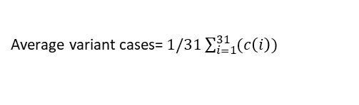

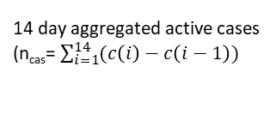




Region-wise Population dataset
Inputs
If region matches
Country
Risk of Hospitalization*
Risk of Death*
Ratio (Facebook Surveys Cases/Reported cases)
Johns Hopkins & Oxford University confirmed cases dataset
14 day aggregated active cases (n_{cas}= $\sum_{i=1}^{14}{(c\left(i\right)−c\left(i−1\right))}$
Active cases per unit population*
Region
Active Cases for a specific region
$$rh=r\text{c}\text{ ∗}\text{fa}\text{1}\text{∗}\text{fc}\text{1}\text{∗}\text{fg}\text{1∗}\text{fv}\text{1}$$
$rd=r\text{c}\text{∗}\text{fa}\text{∗}\text{fc}\text{∗}\text{fg}$ $\text{∗}\text{fv}\text{1}$
Inputs
Date
Risk of Hospitalization & death Dataset
Age, Gender, Variant, Chronic Illness data
GISAID variants dataset
If date, $i$matches,
Risk factor Current Active Cases (r_{ac})*
Average variant cases= $1/31\sum_{i=1}^{31}{(c\left(i\right)) }$
Average active Variants Cases
1-Alpha variant efficacy
Vaccine Type & Dose
1-Beta variant efficacy
$rv=nα∗eα+nβ∗eβ+n\text{Δ}∗e\text{Δ}$
Vaccine Risk Reduction
(r_{v})*
Risk Factor* (Cumulative)
COVID19 Vaccine Efficacy dataset
No vaccine, efficacy reduction = 1
1-Gamma variant efficacy
$$rc=r\text{o} \text{+} \text{ri}$$
Mask Type
1-Delta variant efficacy
Risk Factor (r_{o}) (Outdoors)*
Risk Factor (r_{i}) (Indoors)*
Mask Fitted Filtration Efficacy dataset
1- Normal efficacy
Mask Risk Reduction (r_{m}) (1 – mask FFE)
People passed (Outdoors)
$ro=rac∗rv∗rm∗\text{n}\text{o}$
n_{o}
Risk factor (No mask) = 1
People passed (Indoors)
n_{i}
$ri=rac∗rv∗rm∗\text{n}\text{i}$
*: Consists of a range (lower limits & upper limit)

