Slide 1
Introduction to Netention http://netention.org
Presentation Revision 3
19 Nov 2012

Slide 2
What is Netention?
Netention is a system for
interactively describing a community's
present situation &
potential future situations.

Slide 3
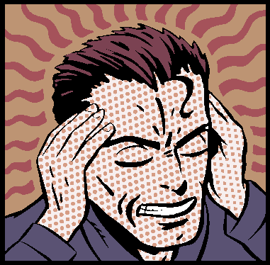
Semantic Stories
A semantic "story" of an individual consists of statements that specify its concerns and interests.

Slide 4
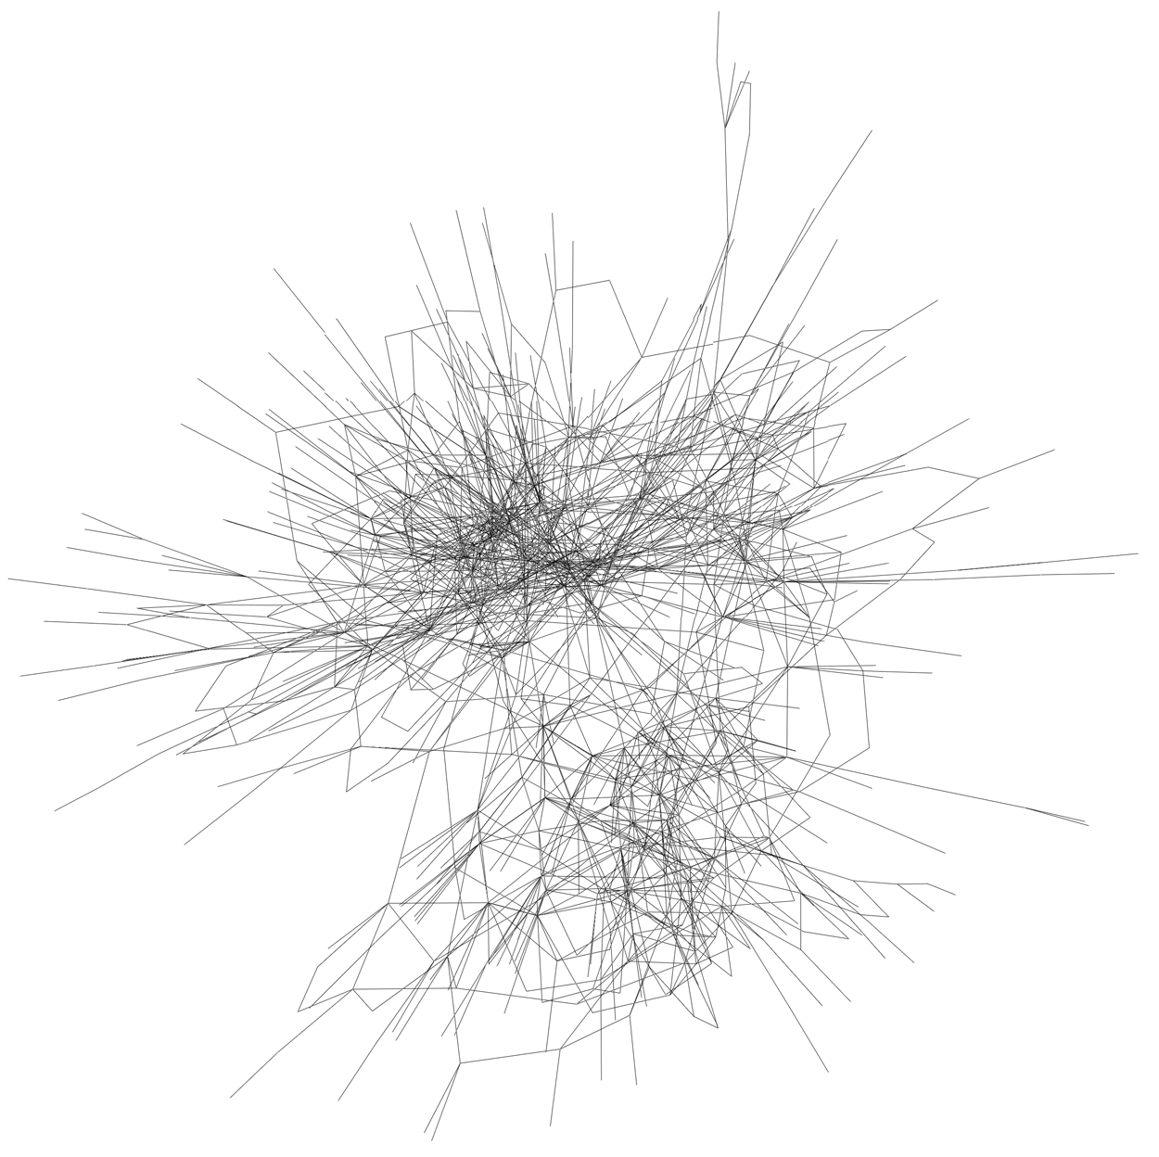
Networked Stories
Netention combines a community of peoples' stories

Slide 5
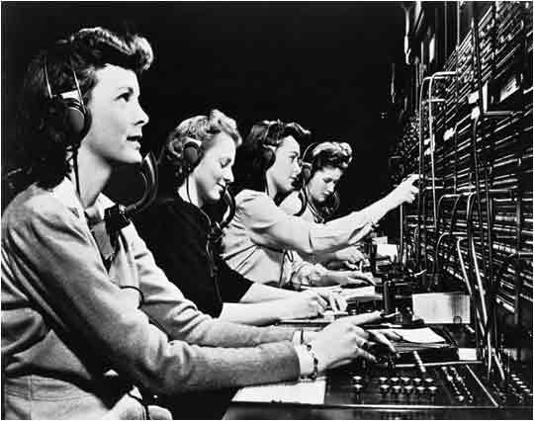
Networked Stories
...and interlinks them, automatically discovering opportunities that are mutually inter-satisfying

Slide 6
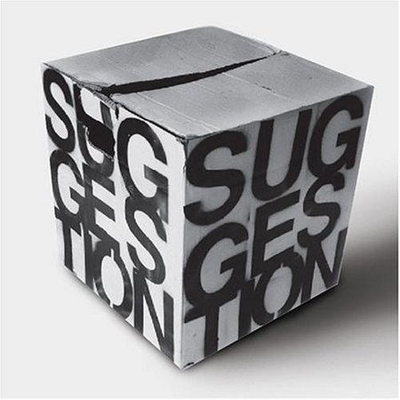
Networked Stories
...essentially suggesting to its participants how they could realize the desired futures they have described

Slide 7
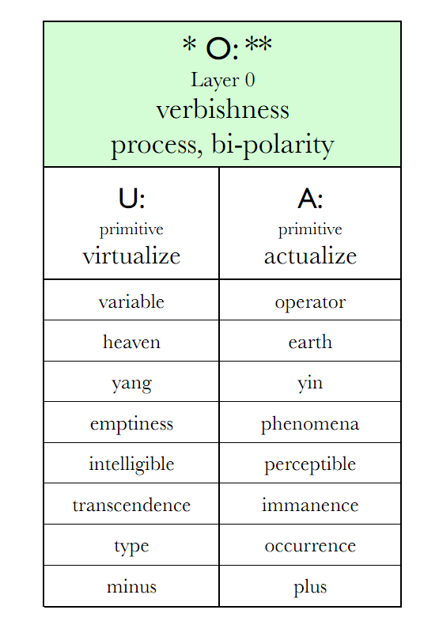
Actual and Virtual
Actual | Virtual
How things are, seem to be, or are measured to be | How one believes things ”should” be
Definite Values | Indefinite (Acceptable) Ranges
Non-Fiction | Fiction
Present | Future
Corresponds to IEML layer 0!
http://www.ieml.org/

Slide 8
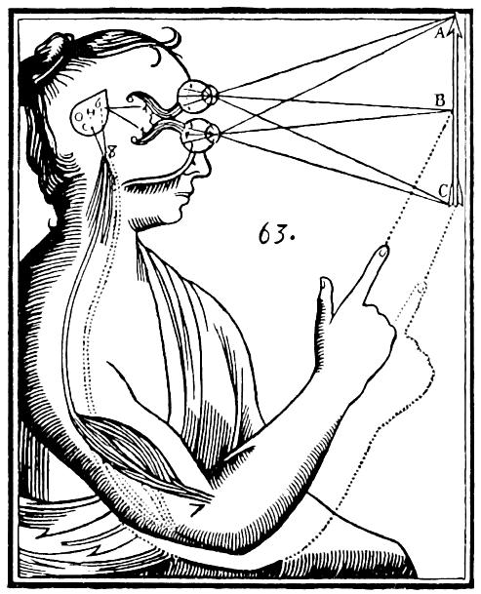
Physical and Conceptual
Managing both:
  Real Objects (Outside mind) &
  Conceptual Objects (Inside mind)
Physical | Conceptual
Materials Devices & Tools People Food Buildings Art Energy | Goals Education Relationships Knowledge & Communication Services and Jobs States and Priveleges Housing

Slide 9
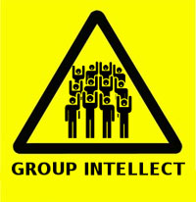
Network Intention
The term Netention is a portmanteau of the words Network, and Attention or Intention.
It refers to a community's collective abilities.

Slide 10

Describe What You Want
Don't ”search”.
Instead, describe what you want.
Edit it at any time to adjust or improve the description.

Slide 11
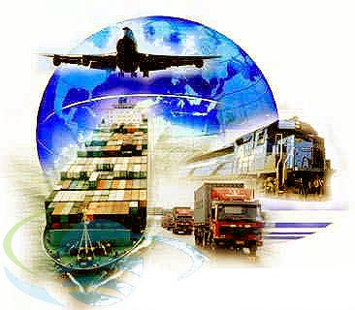
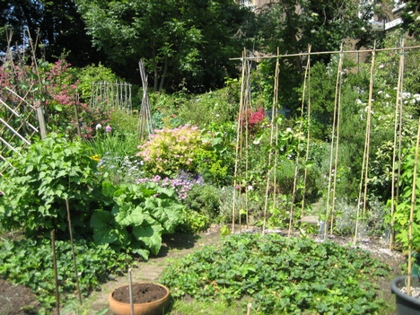
Resource Management
Netention aims to solve, in general, all resource management and planning issues that occur amongst communities of participants.

Slide 12
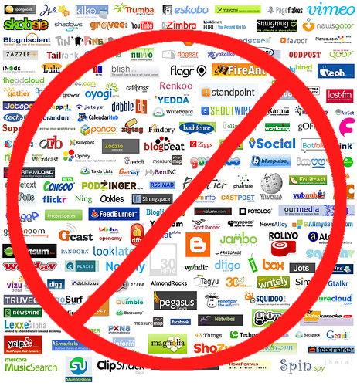
Unification
Eliminate the balkanization of various separate online services
They only serve relatively narrow subsets of the more general problem
Bal·kan·ize: To divide (a region or territory) into small, often hostile units.

Slide 13
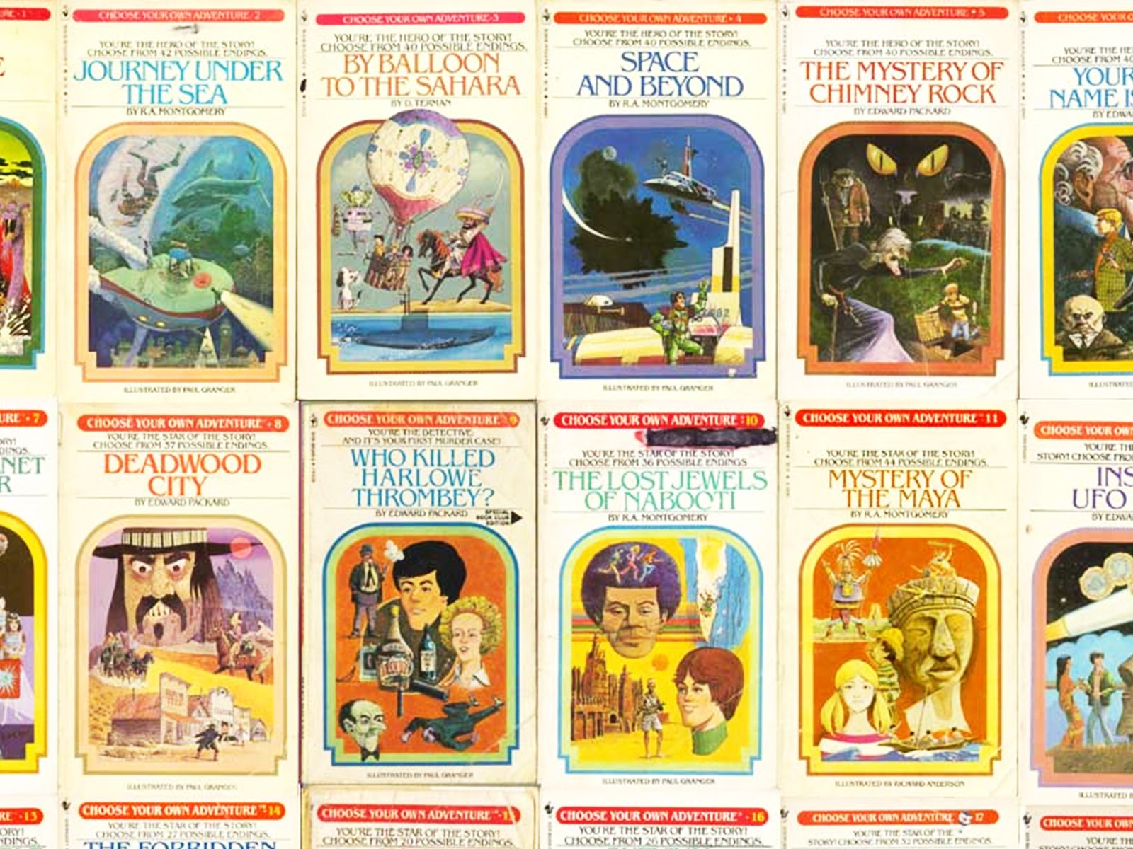
Authoring Life Stories
Portrays one's life as an open-ended, revisable story
Interwoven with people that they know, and the people that they haven't met (yet).

Slide 14

Engineering Reality
A 100%-transparent internet-powered, distributed, planetary world-brain
Managing earth's resources towards ecstatic survival of all beings...
...and the manifestation of all humanity's dreams for the future

Slide 15
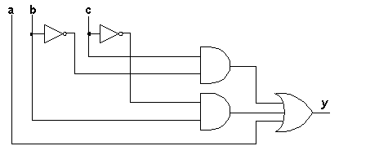

Explaining Reality
Netention explains all of its conclusions in terms of data which is
  published by participants
  accumulated from sensor networks

Slide 16
Using Netention
Easy to use
No more complex than e-mail software, like a word-processor and personal blog / diary
So simple anyone can use it
  Children
  Elderly
  Mentally Handicapped
  Animals
Guides you by suggesting extra details you might want to specify

Slide 17
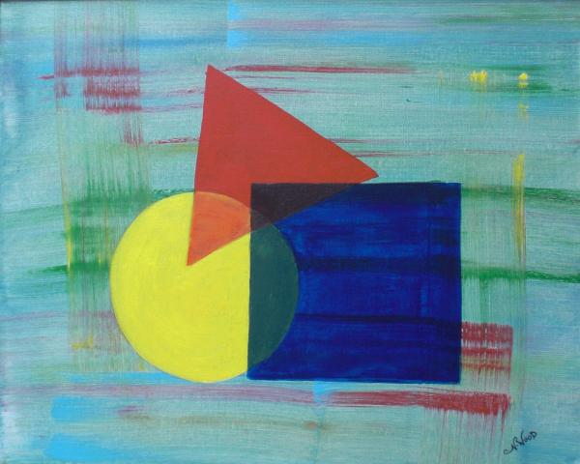
Patterns
Netention organizes data in easy, recognizable patterns
One or more overlapping patterns can be applied to describe each detail
Applying patterns helps the system to suggest more appropriate, related information to add

Slide 18
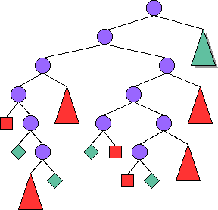
Reach Specific Goals
An evolving database of instructions, recipes, procedures, and plans explain how to reach certain goals by decomposing it into a series of necessary ”ingredients” and actions
http://www.wikihow.com
http://www.ehow.com
http://www.instructables.com

Slide 19
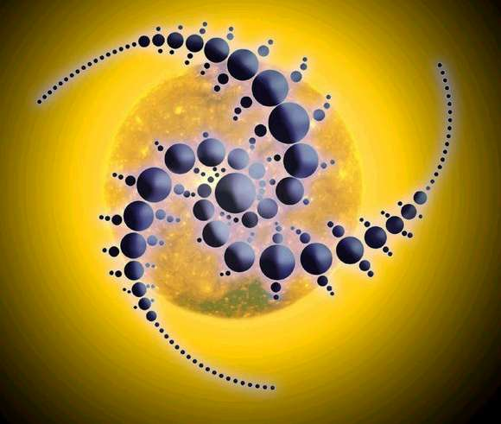
Discover Possible Goals
Identifies what can possibly be built, given what is available or could potentially be available
...while considering necessary “adjustments”
  With more quantity of an item
  With movement (purchase or borrowing) from nearby location

Slide 20
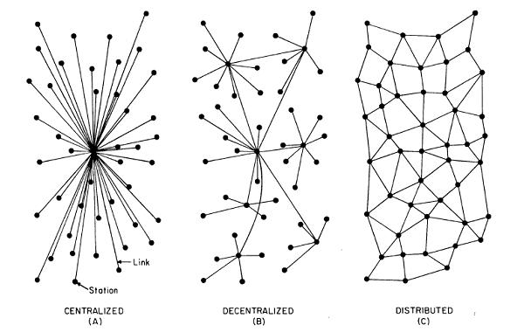
Distributed Network
Since complete story linking is most efficiently computed in smaller communities, geo-regional supernodes most effectively distribute the computational load
Individual communities, with implicit trust, are ready to benefit from the system:
  Schools
  Businesses
  Organizations
  Families
  Etc...

Slide 21
Free and Open-Source
Can you trust the most intimate and private details of your life with a closed-source .COM system?

Slide 22
Types
Type=Tag=Pattern=Class
Soft, evolvable semantic ontology
Specify the information ”shape” of details
Multiple types can be applied (overlapped) to describe each detail
Helps you by suggesting more appropriate, related information
Improves algorithmic efficiency by partitioning data

Slide 23
How You Can Help
Understand all of the material in this presentation (and ask questions about anything which isn't clear)
Show this presentation to others who have yet to see it
Support the developers
  Help develop and improve the software
  Donate money, technology, housing, publicity, etc..

Slide 24
For More Information...
http://automenta.com/netention

