Slide 1
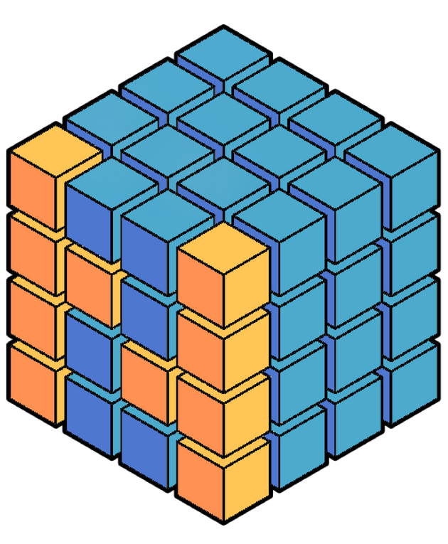
Project NumPy
Inaugural Community Survey
ROSS BARNOWSKI
BERKELEY INSTITUTE FOR DATA SCIENCE
UC BERKELEY
SURVMETH 670
SURVEY RESEARCH CENTER, INSTITUTE FOR SOCIAL RESEARCH
UNIVERSITY OF MICHIGAN, ANN ARBOR, MI, USA
JANUARY 28H, 2020

Slide 2
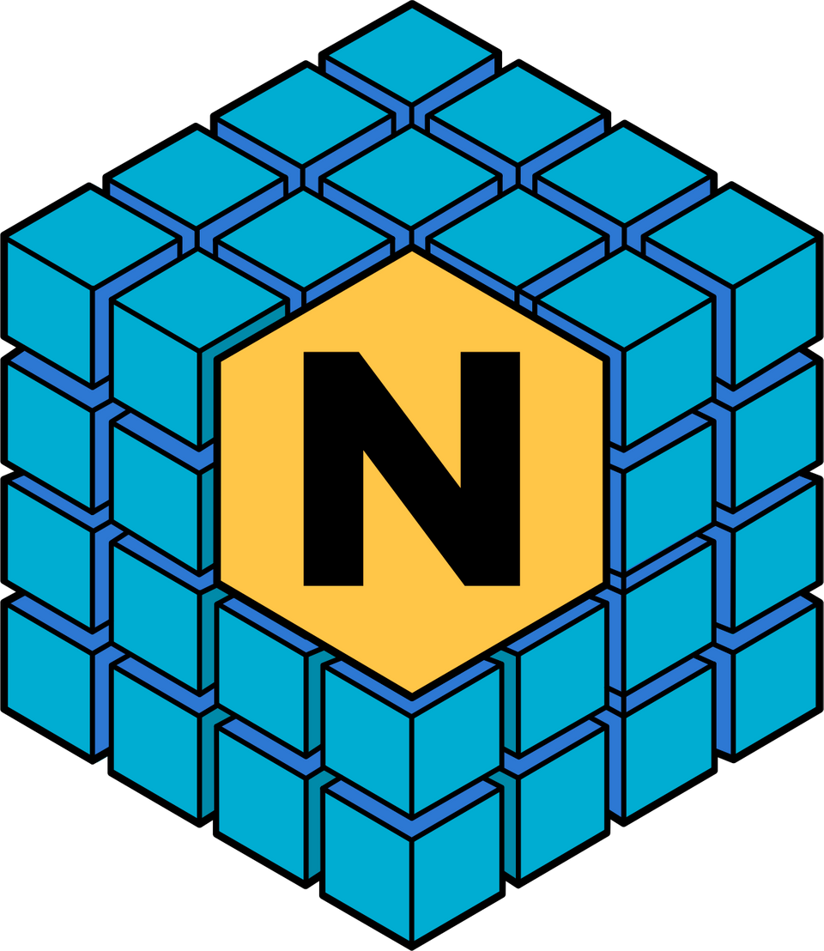

UMich Class of 2010, College of Engineering,
Nuclear Engineering and Radiological Science
PhD in Nuclear Engineering, UC Berkeley
Scientific Software Developer (NumPy)
BIDS, UC Berkeley
Believer in open-everything

Slide 3
INDUSTRY
Google, Netflix, State Farm,
Walmart, Amazon, Tesla
RESEARCH
NASA, NIH, Mayo Clinic, BIDS,
University of Michigan
NumPy is a library that adds efficient numerical and array computation to Python.
EDUCATION
most courses on Data Science or
Machine Learning with Python

Slide 4
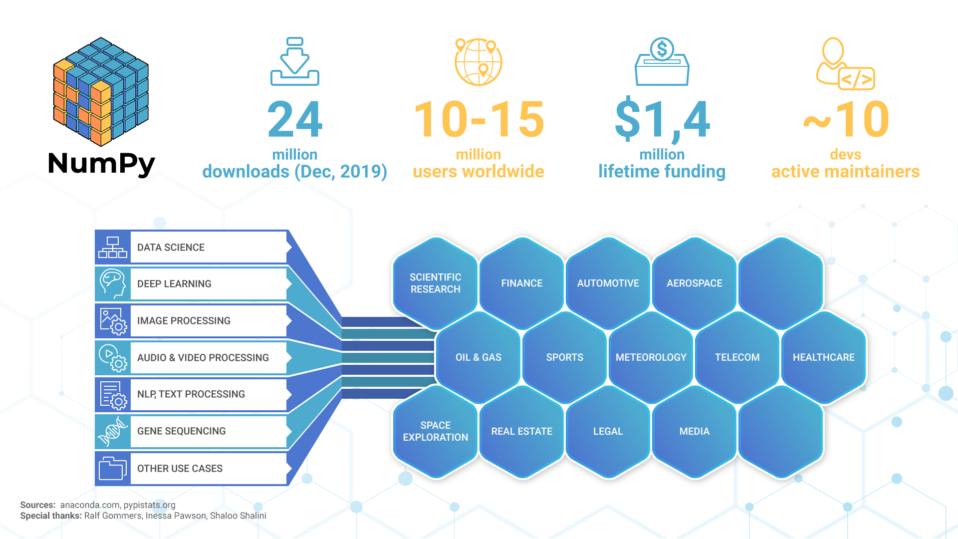

Slide 5
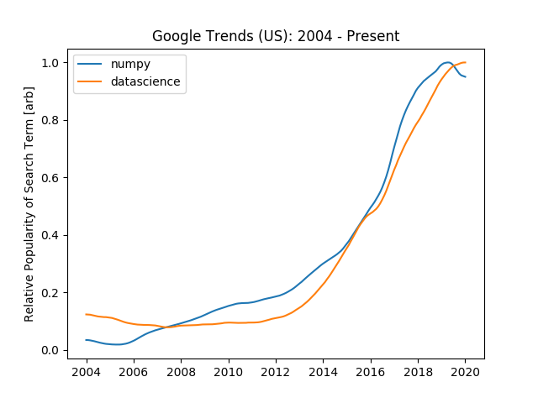

Slide 6

Starting with
why
Meaningful and structured dialogue with all stakeholders to make the best decisions about the development of NumPy as software and a community.

Slide 7

With limited resources efficiency is a must.

Slide 8
LISTEN
Invite all stakeholders to share thoughts about NumPy as software and as a community project
GAIN INSIGHTS
Objectives
Understand their needs and expectations
TAKE ACTION
Develop or refine policies, processes, and practices

Slide 9
TRANSPARENCY
Guiding
Principles
CONFIDENTIALITY
SUSTAINED ACTION

Slide 10
COMMUNITY DEMOGRAPHICS
CONTRIBUTION
MENTORSHIP
PROJECT PRIORITIES
FUTURE OF NUMPY
Topics & Questions

Slide 11



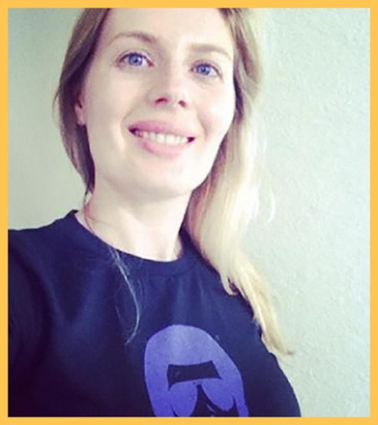
MEET YOUR PROJECT COORDINATORS
Ross Barnowski
Sebastian Berg
Ralf Gommers
Inessa Pawson

