Slide 1

Project NumPy
Inaugural Community Survey
ROSS BARNOWSKI
BERKELEY INSTITUTE FOR DATA SCIENCE
UC BERKELEY
SURVMETH 670
SURVEY RESEARCH CENTER, INSTITUTE FOR SOCIAL RESEARCH
UNIVERSITY OF MICHIGAN, ANN ARBOR, MI, USA
JANUARY 28H, 2020

Slide 2
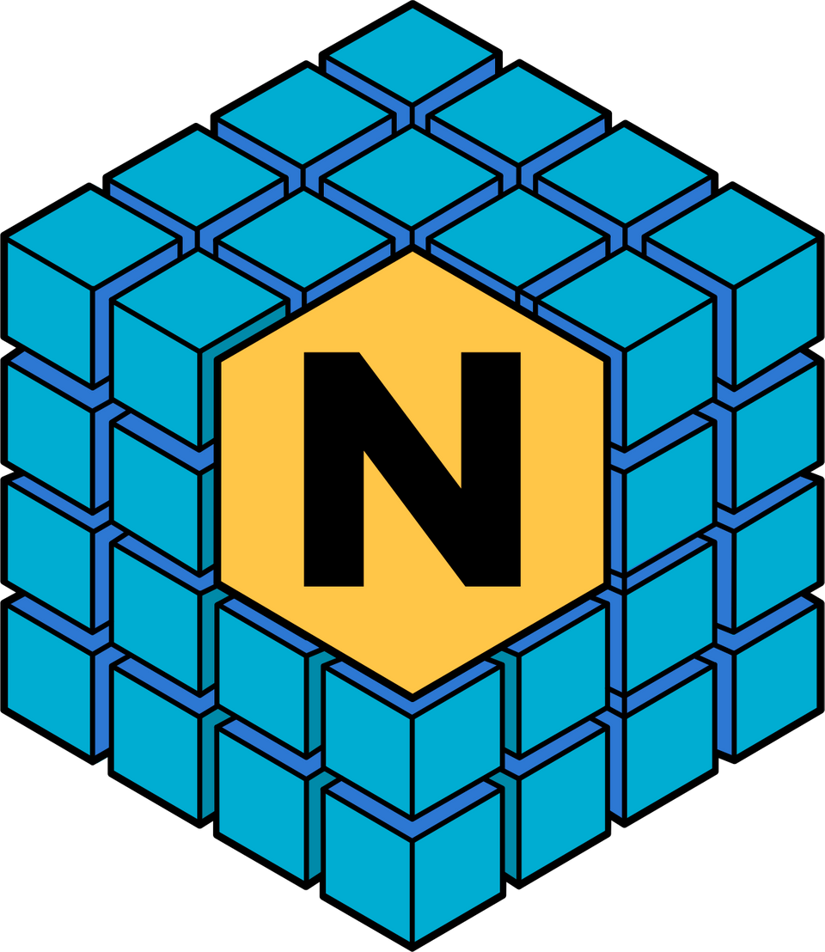

UMich Class of 2010, College of Engineering,
Nuclear Engineering and Radiological Science
PhD in Nuclear Engineering, UC Berkeley
Scientific Software Developer (NumPy)
BIDS, UC Berkeley
Believer in open-everything

Slide 3
INDUSTRY
Google, Netflix, State Farm,
Walmart, Amazon, Tesla
RESEARCH
NASA, NIH, Mayo Clinic, BIDS,
University of Michigan
NumPy is a library that adds efficient numerical and array computation to Python.
EDUCATION
most courses on Data Science or
Machine Learning with Python

Slide 4
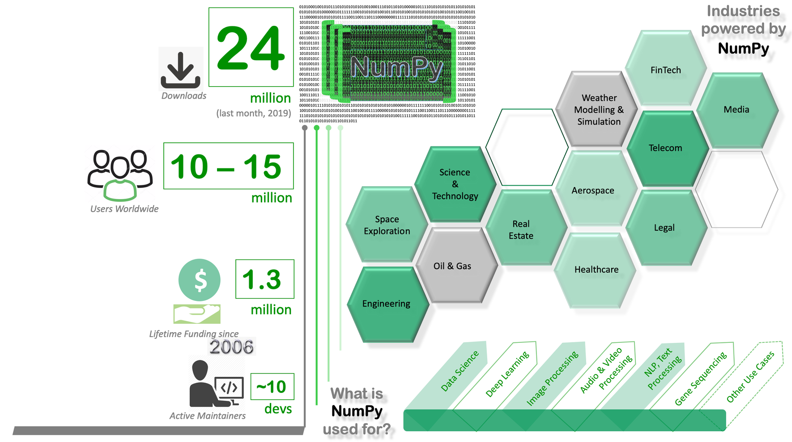

Slide 5
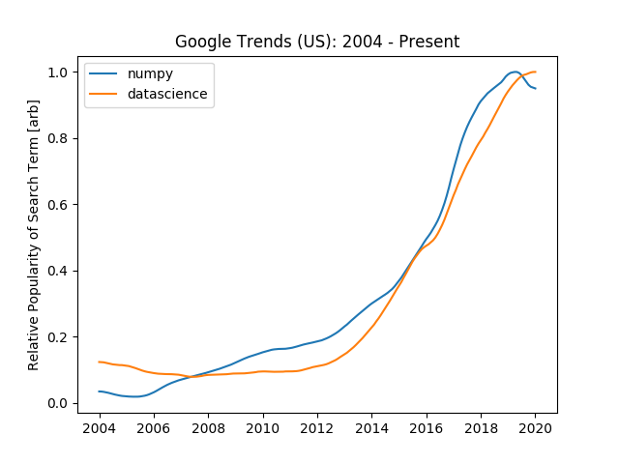

Slide 6
Having limited human and financial resources is a common challenge for open source projects. The NumPy leadership team would like to gain a better understanding of the ever-growing NumPy user community, their experiences, and expectations for the project. This insight will help the team to better guide and prioritize decision-making about the development of NumPy as software and a community.
CUSTOM SLIDE to be added
Starting with
why

Slide 7

LISTEN
Invite all stakeholders to share thoughts about NumPy as software and as a community project
GAIN INSIGHTS
Objectives
Understand their needs and expectations
TAKE ACTION
Develop or refine policies, processes, and practices

Slide 8
TRANSPARENCY
Guiding
Principles
CONFIDENTIALITY
SUSTAINED ACTION

Slide 9
COMMUNITY DEMOGRAPHICS
CONTRIBUTION
MENTORSHIP
PROJECT PRIORITIES
FUTURE OF NUMPY
Topics & Questions

Slide 10

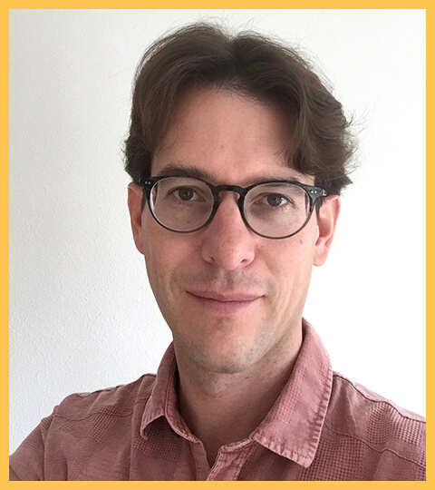
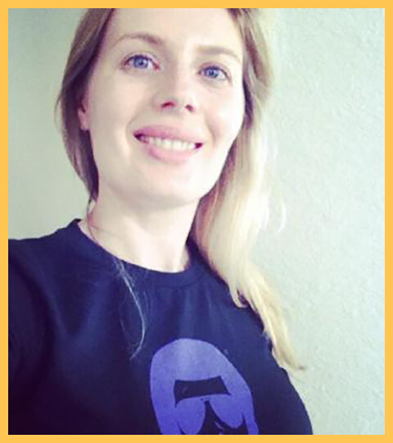
MEET YOUR PROJECT COORDINATORS
Ross Barnowski
Ralf Gommers
Inessa Pawson

