Slide 1
Spring Hadoop Admin Scalability Solution

Slide 2
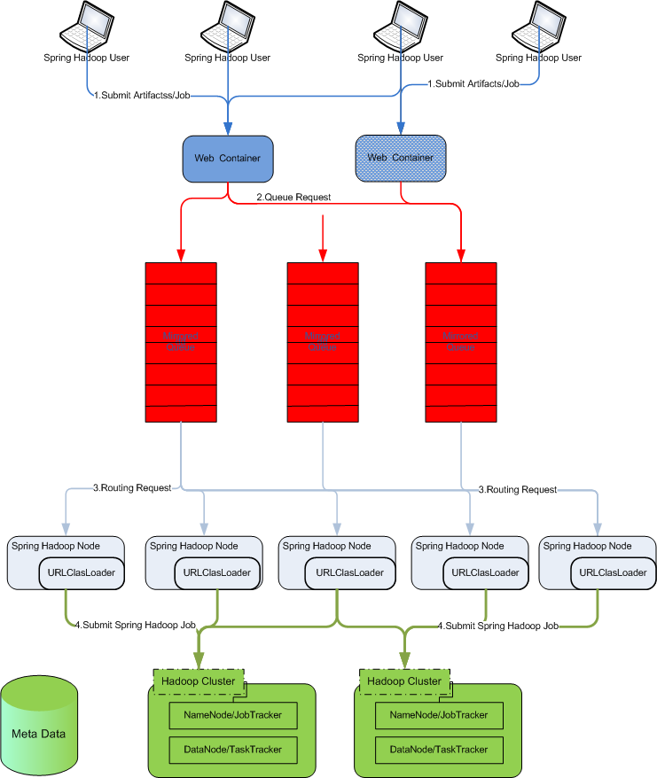
Option 1-1: Share Nothing

Slide 3
Option 1-1: Share Nothing
1.Submit Artifacts: User can upload workflow artifacts to web server(s) with REST. Web server(s) are load balanced
2.Queue Request: Workflow artifacts are put into queues. Queues are mirrored to ensure high availability
3.Routing Request: Spring Hadoop Nodes get request from queue with some routing algorithm to store workflow artifacts
1. Submit Job: User trigger starting job request to web servers
2. Queue Request: Job request are put into queue
3. Routing Request: The nodes where workflow artifacts are stored are picked up to handle the request
4.Submit Spring Hadoop Job: The job is submitted to Hadoop clusters

Slide 4
Option 1-1: Share Nothing
Pros:
Performant
Easy to extend
Cons:
Data(Jar, XML) lost (This may be mitigated by route data to multiple Spring Hadoop Nodes)
Resource usage is difficult to balance

Slide 5
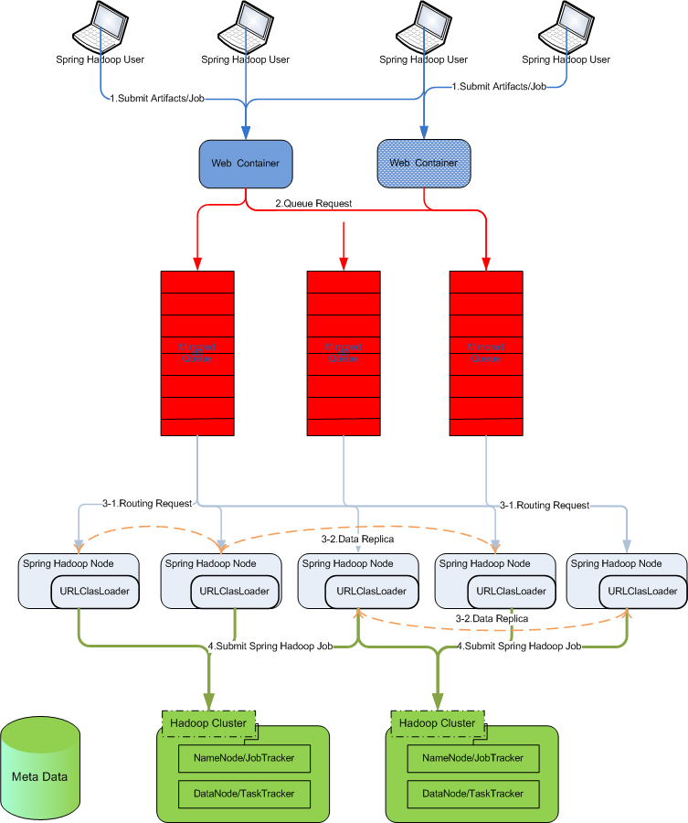
Option 1-2: Share Nothing with Data Replication

Slide 6
Option 1-2: Share Nothing with Data Replication
1.Submit Artifacts: User can upload workflow artifacts to web server(s) with REST. Web server(s) are load balanced
2.Queue Request: Workflow artifacts are put into queues. Queues are mirrored to ensure high availability
3-1.Routing Request: Spring Hadoop Nodes get request from queue with some routing algorithm to store workflow artifacts
3-2.Data Replica: Workflow artifacts are replicated to multiple nodes to minimize data lost and balance resource usage
1. Submit Job: User trigger starting job request to web servers
2. Queue Request: Job request are put into queue
3-1. Routing Request: The nodes where workflow artifacts are stored are picked up to handle the request
4.Submit Spring Hadoop Job: The job is submitted to Hadoop clusters

Slide 7
Option 1-2: Share Nothing with Data Replication
Pros:
Without data lost
Performant
Resource usage balance by dynamic data replication
Cons:
Big development efforts to dynamic replicate data among nodes to minimize data lost
(we may support static data replication to minimize development efforts)
Big development efforts to dynamic balance resource usage

Slide 8
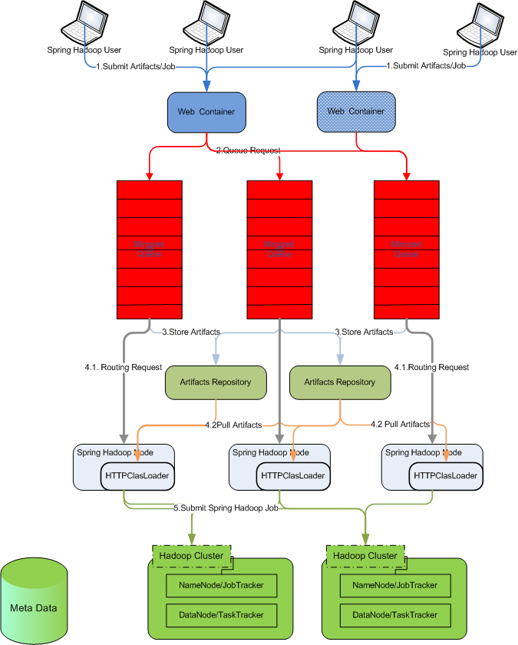
Option 2-1: Share Data with File Server

Slide 9
Option 2-1: Share Data with File Server
1.Submit Artifacts: User can upload workflow artifacts to web server(s) with REST. Web server(s) are load balanced
2.Queue Request: Workflow artifacts are put into queues. Queues are mirrored to ensure high availability
3.Store Artifacts: Artifacts Repository Nodes retrieve artifacts and store workflow artifacts
1. Submit Job: User trigger starting job request to web servers
2. Queue Request: Job request are put into queue
4-1. Routing Request: Spring Hadoop Nodes with more resource capacity handle job request
4-2.Pull Request: Spring Hadoop Node which will handle the job request pull workflow artifacts from repository
5.Submit Spring Hadoop Job: The job is submitted to Hadoop clusters

Slide 10
Option 2-1: Share Data with File Server
Pros:
Without data lost
Easy to balance resource usage
Cons:
Extra nodes to store workflow artifacts (jar, xml etc.)

Slide 11
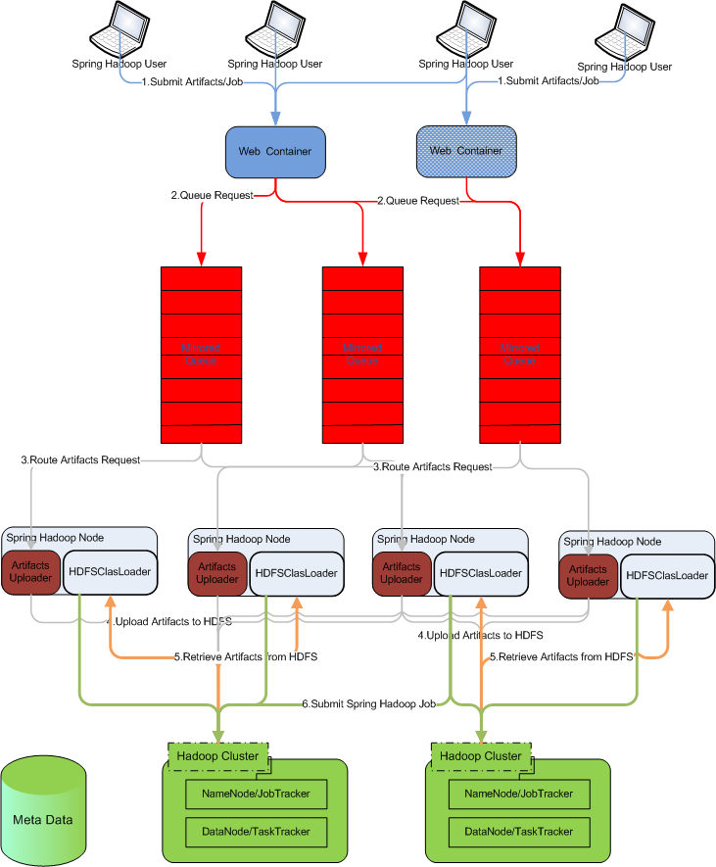
Option 2-2: Share Data with HDFS

Slide 12
Option 2-2: Share Data with HDFS
1.Submit Artifacts: User can upload workflow artifacts to web server(s) with REST. Web server(s) are load balanced
2.Queue Request: Workflow artifacts are put into queues. Queues are mirrored to ensure high availability
3.Route Artifacts Request: Artifacts Repository Nodes retrieve artifacts and store workflow artifacts
4. Upload Artifacts to HDFS: Artifacts Uploader get queued request and upload artifacts to HDFS
1. Submit Job: User trigger starting job request to web servers
2. Queue Request: Job request are put into queue
5.Retrieve Artifacts from HDFS: HDFSClassLoader in Spring Hadoop Node pull workflow artifacts from HDFS
6.Submit Spring Hadoop Job: The job is submitted to Hadoop clusters

Slide 13
Option 2-2: Share Data with HDFS
Pros:
Without data lost – More secure and reliable comparing with Option 2
Cons:
Extra traffic to HDFS cluster

Slide 14
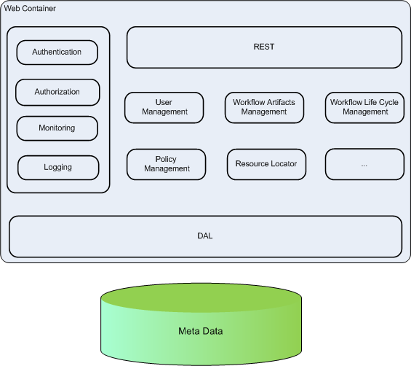
Web Container

Slide 15
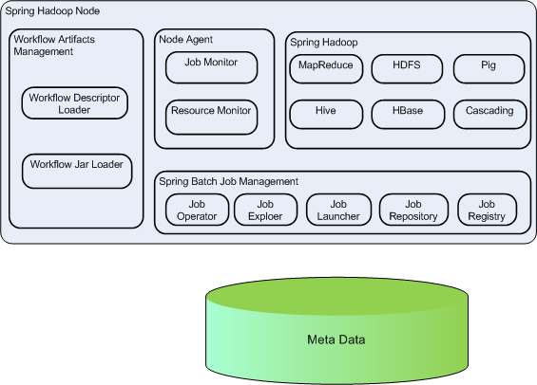
Spring Hadoop Node

