Slide 1






Part of the AgentCon World Tour by the Global AI Community
AI Agents Developer Conference
agentcon.city/rome

Slide 2
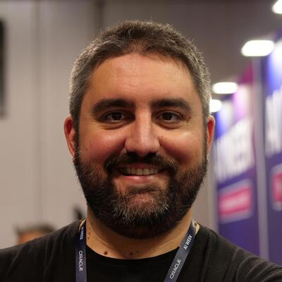
GitHub Agentic Workflows: Continuous AI per la manutenzione del software che non dorme mai
Giulio Sciarappa
Giulio Sciarappa
agentcon.city/rome

Slide 3

Made Possible by

Slide 4
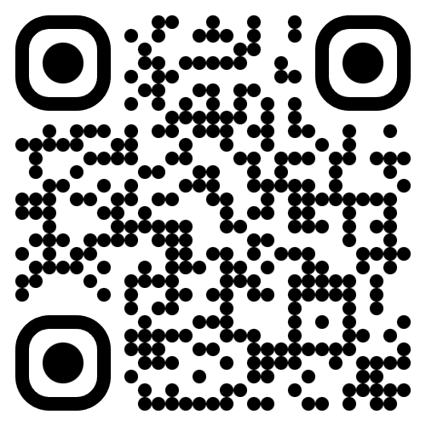
Join the AI Conversation on Discord
gaic.io/discord

