Slide 1






Part of the AgentCon World Tour by the Global AI Community
AI Agents Developer Conference
agentcon.city/rome

Slide 2
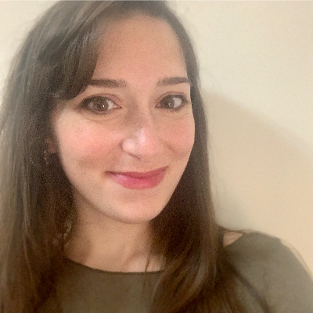
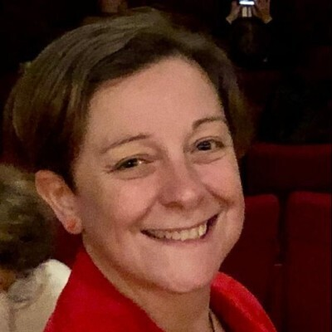
Automatizzare la Compliance di Azure Firewall con gli SRE Agent
Martina Mangione, Elisa Anzelmo
Martina Mangione
Elisa Anzelmo
agentcon.city/rome

Slide 3

Made Possible by

Slide 4

Join the AI Conversation on Discord
gaic.io/discord

