Slide 1






Part of the AgentCon World Tour by the Global AI Community
AI Agents Developer Conference
agentcon.city/rome

Slide 2
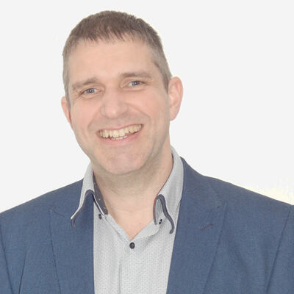
Llamas and Lobsters - Connecting the Agent Internet Without Getting Pinched
Richard Brough
Richard Brough
agentcon.city/rome

Slide 3

Made Possible by

Slide 4

Join the AI Conversation on Discord
gaic.io/discord

