Slide 1






Part of the AgentCon World Tour by the Global AI Community
AI Agents Developer Conference
agentcon.city/rome

Slide 2
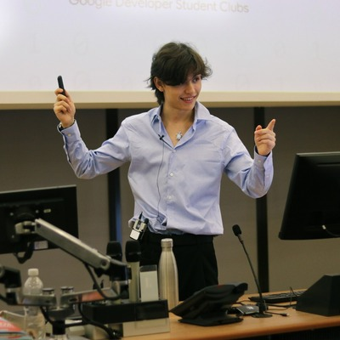
ARC-AGI and the Road to General Intelligence: Levels, Benchmarks, and Approaches
Lorenzo Satta Chiris
Lorenzo Satta Chiris
agentcon.city/rome

Slide 3

Made Possible by

Slide 4

Join the AI Conversation on Discord
gaic.io/discord

