Slide 1
Democratizing & Accelerating AI Through Automated Machine Learning AI Platform Team

Slide 2
Agenda
Welcome Video
Why Automated Machine Learning
Automated ML Capabilities
How to Get Started

Slide 3
Welcome Video

Slide 4
Why Automated Machine Learning

Slide 5
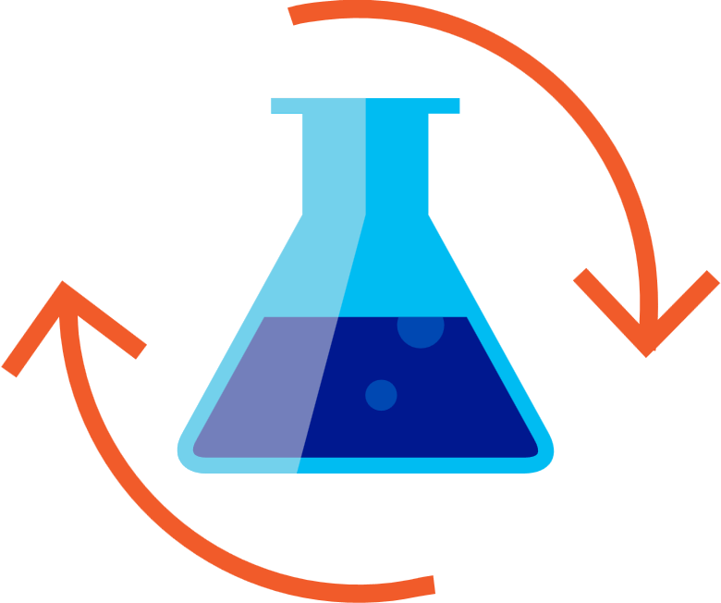

Machine Learning Process
SQL DB
Cosmos DB
Datawarehouse
Data lake
Blob storage
…
Prepare Data
Build & Train
Deploy

Slide 6
Machine Learning Problem Example
How much is this car worth?

Slide 7
Model Creation Is Typically Time-Consuming
Which features?
Which algorithm?
Which parameters?
Mileage
Condition
Car brand
Year of make
Regulations
…
Gradient Boosted
Nearest Neighbors
SVM
Bayesian Regression
LGBM
…
Parameter 1
Parameter 2
Parameter 3
Parameter 4
…
Mileage
Gradient Boosted
Criterion
Loss
Min Samples Split
Min Samples Leaf
Others
Car brand
Year of make
30%
Model

Slide 8
Model Creation Is Typically Time-Consuming
Which features?
Which algorithm?
Which parameters?
Mileage
Condition
Car brand
Year of make
Regulations
…
Gradient Boosted
Nearest Neighbors
SVM
Bayesian Regression
LGBM
…
Criterion
Loss
Min Samples Split
Min Samples Leaf
Others
Mileage
Gradient Boosted
N Neighbors
Weights
Metric
P
Others
Condition
Nearest Neighbors
Car brand
Car brand
50%
Year of make
30%
Year of make
Model
Iterate

Slide 9
Model Creation Is Typically Time-Consuming
Which features?
Which algorithm?
Which parameters?
30%
50%
70%
30%
45%
50%
65%
95%
35%
10%
75%
20%
70%
30%
15%
Iterate

Slide 10
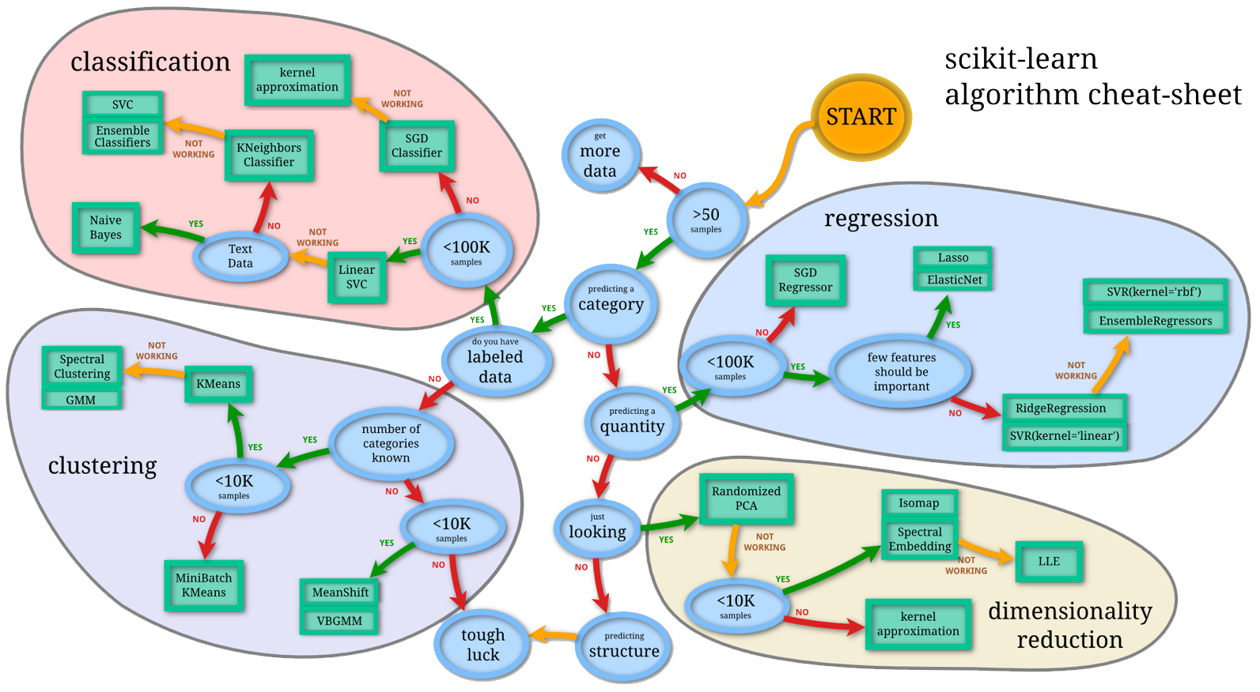
Machine Learning Complexity
Source: http://scikit-learn.org/stable/tutorial/machine_learning_map/index.html

Slide 11

Model Selection & Hyperparameter Tuning
Dataset
Model Training
Infrastructure
Training Algorithm 1
Training Algorithm 2
Model 1
Model 2
Model 3
Model 4
Hyperparameter
Values – config 1
Hyperparameter
Values – config 2
Hyperparameter
Values – config 3
Hyperparameter
Values – config 4
Repetitive & Manual

Slide 12
Introducing Automated Machine Learning
Dataset
Optimization
Metric
Automated ML
ML Model
Constraints
(Time/Cost)
Accessible & Faster

Slide 13
Automated ML Accelerates Model Development
Input
Intelligently test multiple models in parallel
Output
25%
Optimized model
25%
40%
Enter data
70%
25%
40%
70%
95%
95%
Define goals
25%
40%
70%
25%
40%
25%
70%
Apply constraints
40%

Slide 14
Automated ML Customer Testimonials
“I quite like your AutoML function. It gives me good results compared to other libraries I tested before (tpot and auto-sklearn) that I believe was only looking at scores and often gave me models that over-trained my data. And of course the model from your suggested code is better.”
- Big oil company
“I will start with AutoML and use the algorithm that AutoML recommends to further tune the model”
- Data Scientist
“I actually enjoy being able to use AutoML in a Jupyter notebook. The DataRobot interface was nice for non-experts, but for someone like me, it felt a bit basic.”
- Data Scientist
Press-coverage from public preview:
CNET
VentureBeat
PRNewswire

Slide 15
Automated ML Capabilities

Slide 16
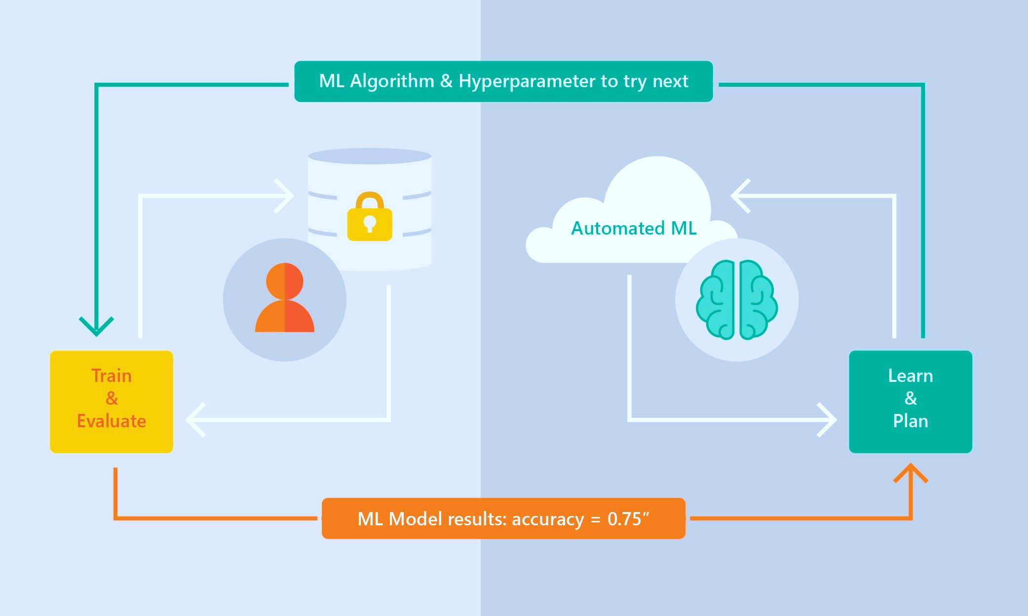
Automated ML Capabilities
Based on Microsoft Research
Brain trained with several million experiments
Collaborative filtering and Bayesian optimization
Privacy preserving: No need to “see” the data

Slide 17
Automated ML Capabilities
ML Scenarios: Classification & Regression, Forecasting
Integration: Azure Machine Learning, Azure Notebooks, Jupyter Notebooks
Data Type: Numeric, Text
Languages: Python SDK for deployment and hosting for inference
Training Compute: Local Machine, Remote Azure DSVM (Linux), Azure Batch AI, Databricks
Transparency: View run history, model metrics
Scale: Faster model training using multiple cores and parallel experiments

Slide 18
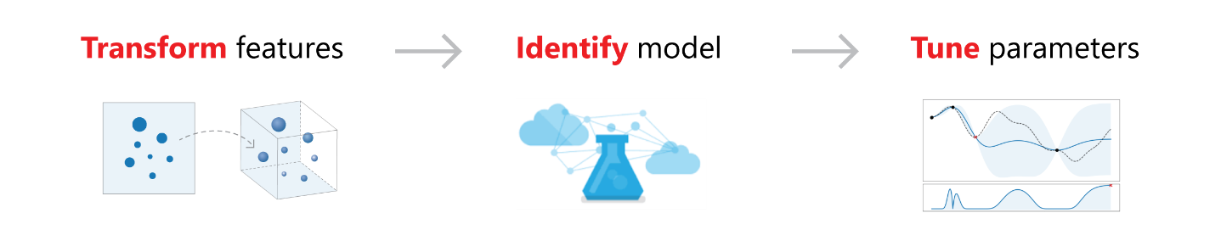
Feature Engineering
Dropping high cardinality or no variance features
Missing value imputation
Generating additional features
Transformations and encodings

Slide 19
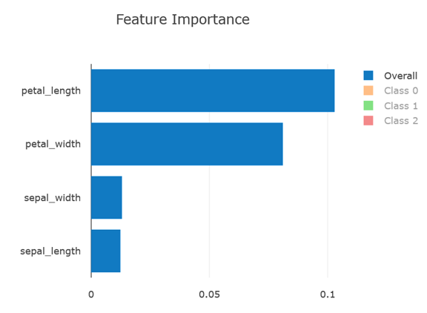
Model Explain-ability
Feature importance as part of training
Local feature importance for a given sample

Slide 20
Workshop

Slide 21
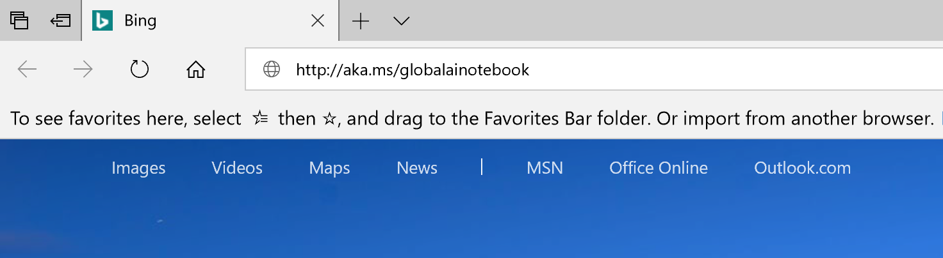
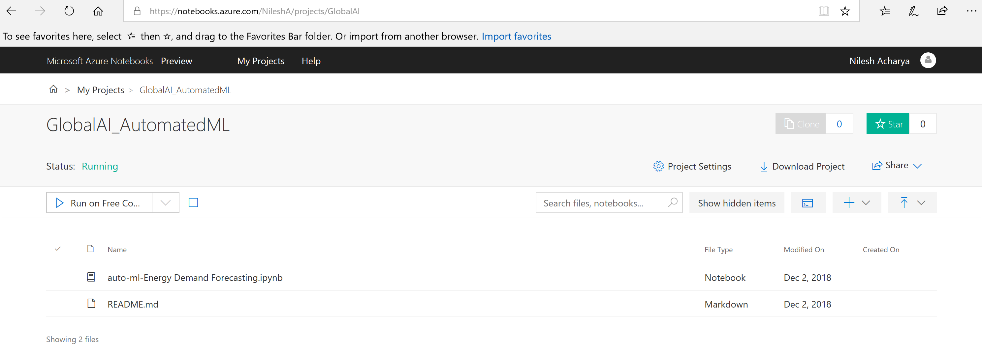
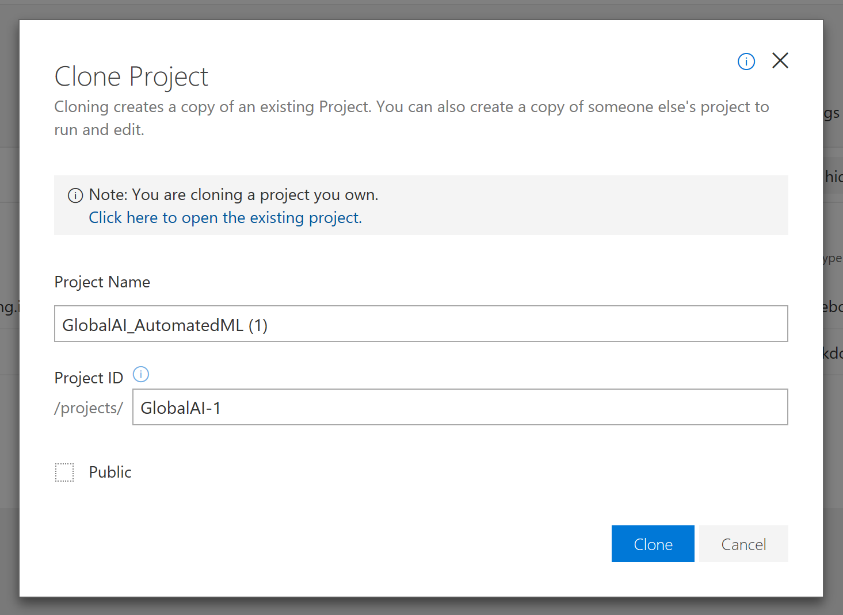
1. Go to aka.ms/GlobalAINotebook
2. Click on Clone
3.Enter Project name, Project ID and uncheck Public tick box
4. Open notebook and follow instructions

Slide 22
Thank You!
AI Platform Team

Slide 23
Resources
AskAutomatedML@microsoft.com
https://aka.ms/AutomatedML
https://aka.ms/AutomatedMLDocs
https://github.com/Azure/MachineLearningNotebooks

